Slide 1
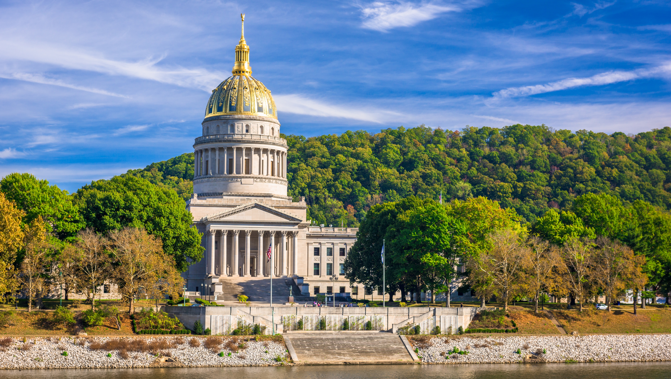

Smart Skills
Week 7
Charts & Graphs 2:
Levels of Government
Venn Diagram
Notes:
See the Smart Skills directions on the Teacher Tech Website for West Virginia: Our Beautiful Home for teaching suggestions.
Teacher notes and answers will display in this space.

Slide 2

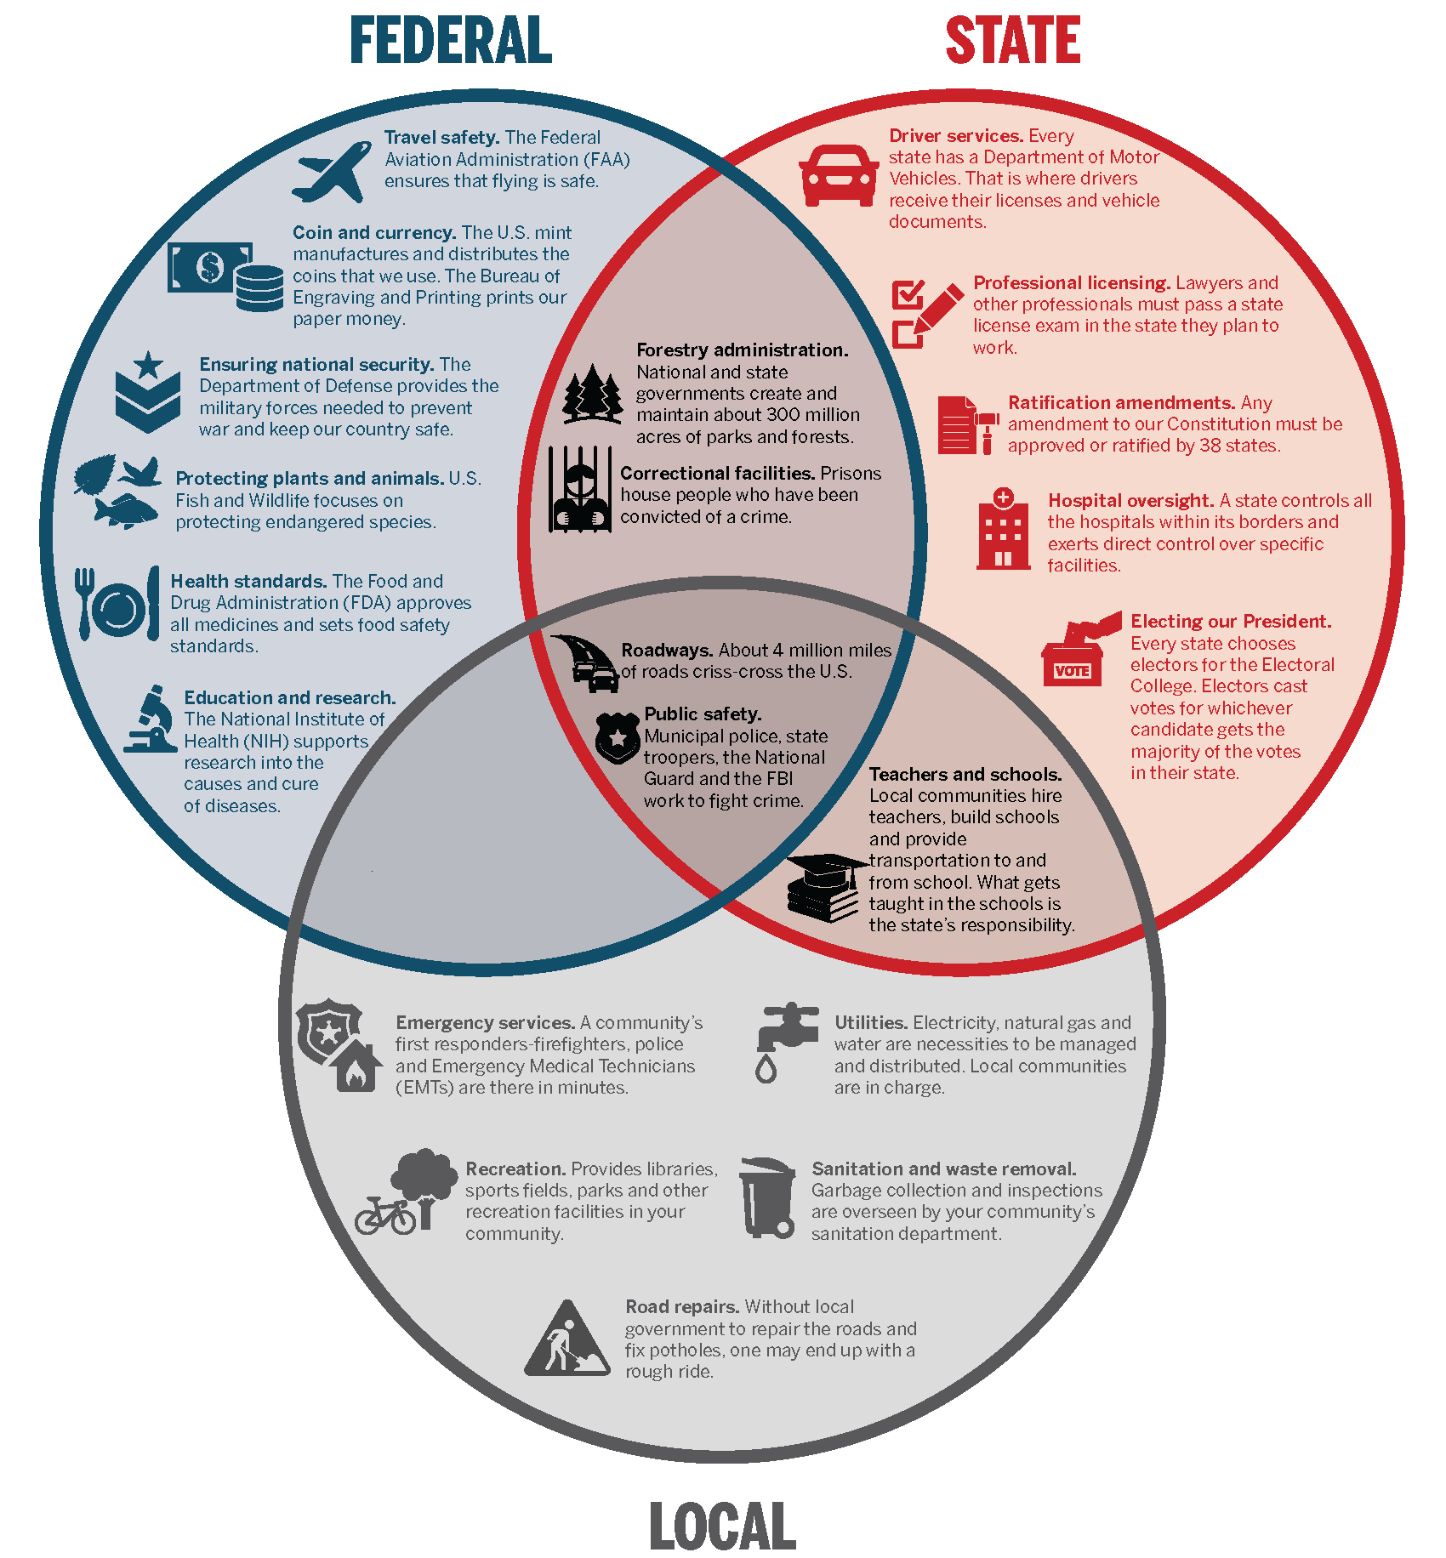
Monday
Study the Venn diagram.
What do you notice?
Notes:
Students should record as many things as they can observe within a one- to two-minute period.

Slide 3
TUESDAY
Each circle represents a level of government in the United States.
What are the three levels shown?
How do the colors aid the reader in understanding the information?
Notes:
Federal, state, local
The colors help illustrate how responsibilities are organized for each level.

Slide 4
WEDNESDAY
What is the purpose of the words in each section of the diagram?
How many sections are there?
Why are some word entries in a section within two or more circles?
Notes:
The words describe the responsibilities of each level of government.
There are 7 sections.
Some of the responsibilities are shared between two or more levels of government.

Slide 5
THURSDAY
A student claims that West Virginia’s schools get some of their funding from the Federal government.
What change would be made to the diagram to respond to the student’s claim?
Why do you think there is nothing in the space for Federal/Local responsibilities?
Notes:
The teachers and schools responsibility would have to be moved to the center region of the diagram.
There may not be any responsibilities that the Federal and Local levels have that the State doesn’t also have.

Slide 6
FRIDAY
What question could be answered using the graph? Explain your thinking.
Notes:
Answers will vary. Students could be allowed to share their questions and check that others can agree on the correct answer.

Slide 7

Image credits: Title slide, West Virginia State Capitol, Charleston, WV, ©Shutterstock; End slide, Williams River Valley Overlook, Black Mountain, Monongahela National Forest, West Virginia, ©Shutterstock.

