Slide 1
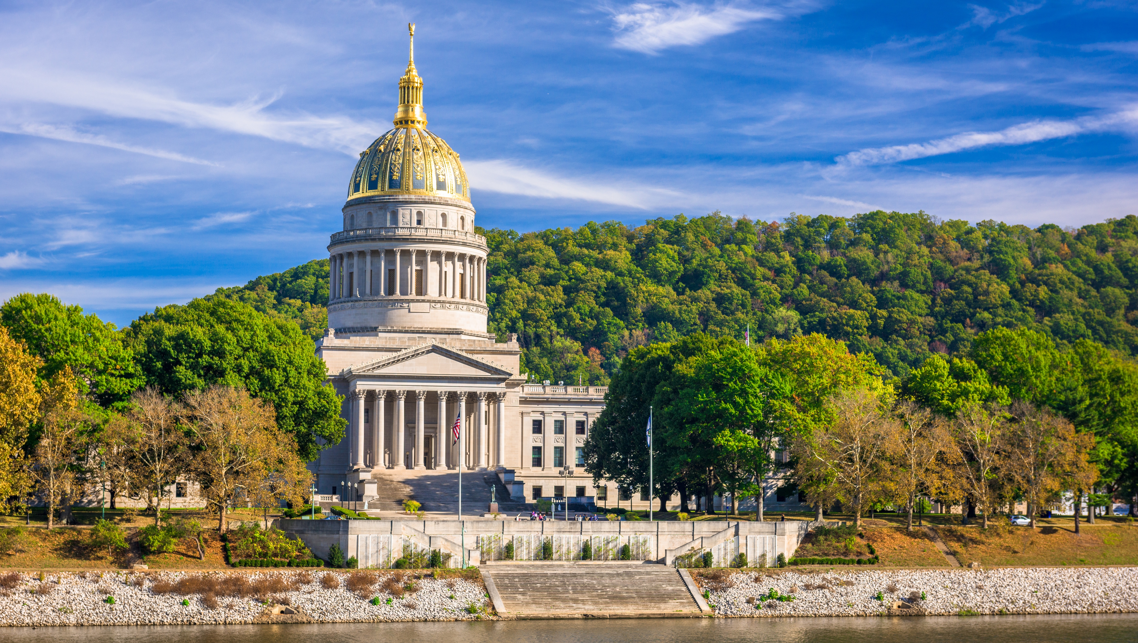

Smart Skills
Week 5
Political Cartoon 1:
Pizza Delivery
Notes:
See the Smart Skills directions on the Teacher Tech Website for West Virginia: Our Beautiful Home for teaching suggestions.
Teacher notes and answers will display in this space.

Slide 2

Monday
As you study the political cartoon, make a jot list of what you observe.
Click this to go to the Political Cartoon link.
Notes:
Answers will vary. Students should list only what they see and refrain from voicing an interpretation of the cartoon.
This opener lets students view the image without a specific question to answer. A one- or two-minute silent study helps students notice details they might miss otherwise. Discuss responses as a group, and let students physically point out their findings on the projection to ensure all students see the details being discussed.
TEACHER NOTE: Depending on your projection system, you may have to view the cartoon link while the PowerPoint presentation is hidden.

Slide 3
TUESDAY
Who is the author of the political cartoon?
What is the date of the political cartoon?
Who or what is the subject of the cartoon?
Click this to go to the Political Cartoon link.
Notes:
Mike Luckovich
September 7, 2014
Wages of low-income workers

Slide 4
WEDNESDAY
What is the cartoon meant to signify: humor, anger, sarcasm, or disgust?
What emotions does the cartoon stir in you?
Click this to go to the Political Cartoon link.
Notes:
Answers may vary, but should be at least humorous. Have students explain their thinking. Political cartoons often feature abstract components that can be difficult for adolescents to understand.

Slide 5
THURSDAY
Does the cartoonist choose a political side in this cartoon?
Is the cartoonist making a fair statement? Explain your thinking with evidence.
Click this to go to the Political Cartoon link.
Notes:
Answers will vary. It will be most important for students to defend their thinking in their responses.

Slide 6
FRIDAY
How can a cartoonist be an influential citizen in society?
Why is it important to analyze the political standpoint of the cartoon?
Click this to go to the Political Cartoon link.
Notes:
Answers may vary.
TEACHER NOTE: Students need to learn to decode and appreciate political cartoons in social studies because they provide insights into historical events, public opinion, and the social and political climate of a particular era. They are visual primary sources that encourage higher-level thinking, interpretation of symbolism, and understanding of persuasive techniques used by cartoonists.

Slide 7

Image credits: Title slide, West Virginia State Capitol, Charleston, WV, ©Shutterstock; End slide, Williams River Valley Overlook, Black Mountain, Monongahela National Forest, West Virginia, ©Shutterstock.

