Slide 1
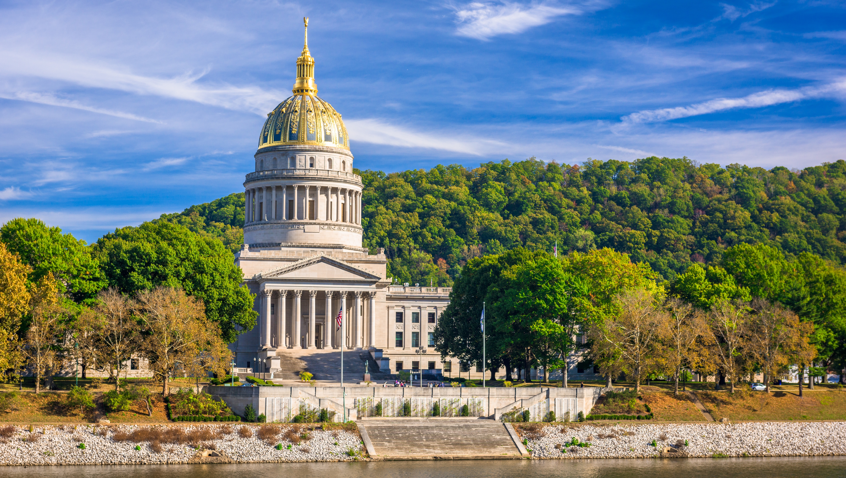

Smart Skills
Week 3
Art and Artifacts 1:
Native American Artifact
Notes:
See the Smart Skills directions on the Teacher Tech Website for West Virginia: Our Beautiful Home for teaching suggestions.
Teacher notes and answers will display in this space.

Slide 2

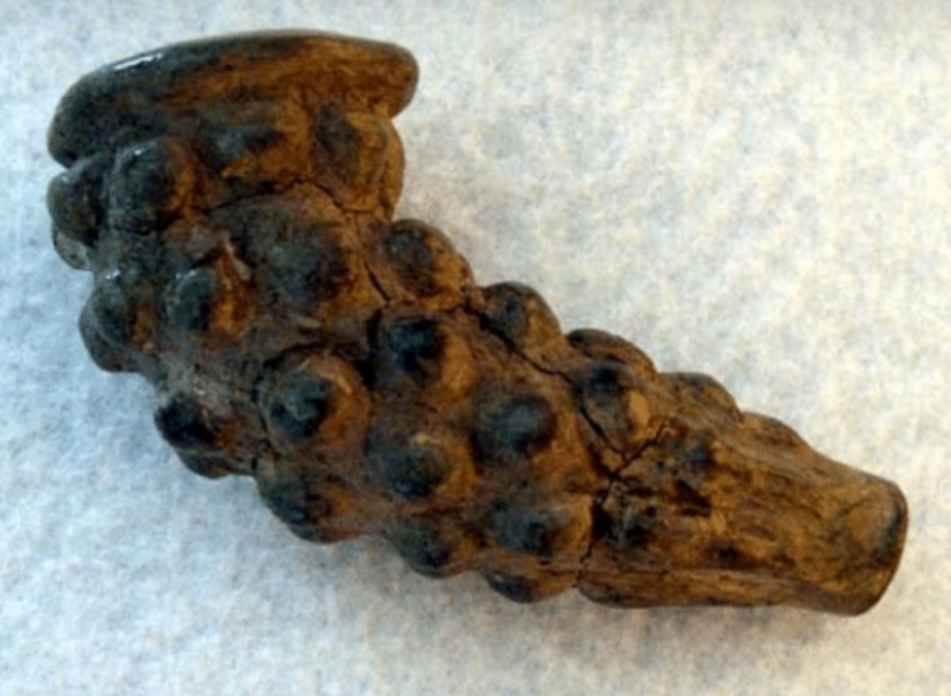
Monday
The object shown is an artifact or item of historical interest made by humans.
What do you notice about the artifact?
What questions would you have about it?
Notes:
This opener allows students to view the map with no specific question to answer.
Allow at least one minute for students to silently study the image and create a jot list before discussing responses as a group.
Students may notice the bumpy texture, the apparent crack, the color, and so on. They may wonder about its size, which is not given. Point out that it would be helpful to have that before determining the purpose of the artifact.

Slide 3
TUESDAY
What evidence is there that this artifact was made for a special purpose?
Notes:
Answers may vary, but should include that there is a decorative pattern in the material. It would take a skilled person to make it, etc.

Slide 4
WEDNESDAY
This artifact is made of clay. What information might be helpful for understanding its purpose?
Notes:
Answers will vary. Students might suggest that knowing its size or three-dimensional shape would be helpful. Also, is it hollow? Are there openings?

Slide 5
THURSDAY
The artifact is open on the ends and hollow, suggesting it is a pipe. Why would people create an object like this?
Notes:
Answers will vary.

Slide 6
FRIDAY
This pipe was found in a Native American archaeological site near Charleston, WV. What does an object like this tell us about the person who created it?
Notes:
Answers will vary.
Sample responses: It may indicate that the people traded with other tribes or had the skills to grow crops like tobacco. The pipe suggests that the person who made it had time to create something artistic.

Slide 7
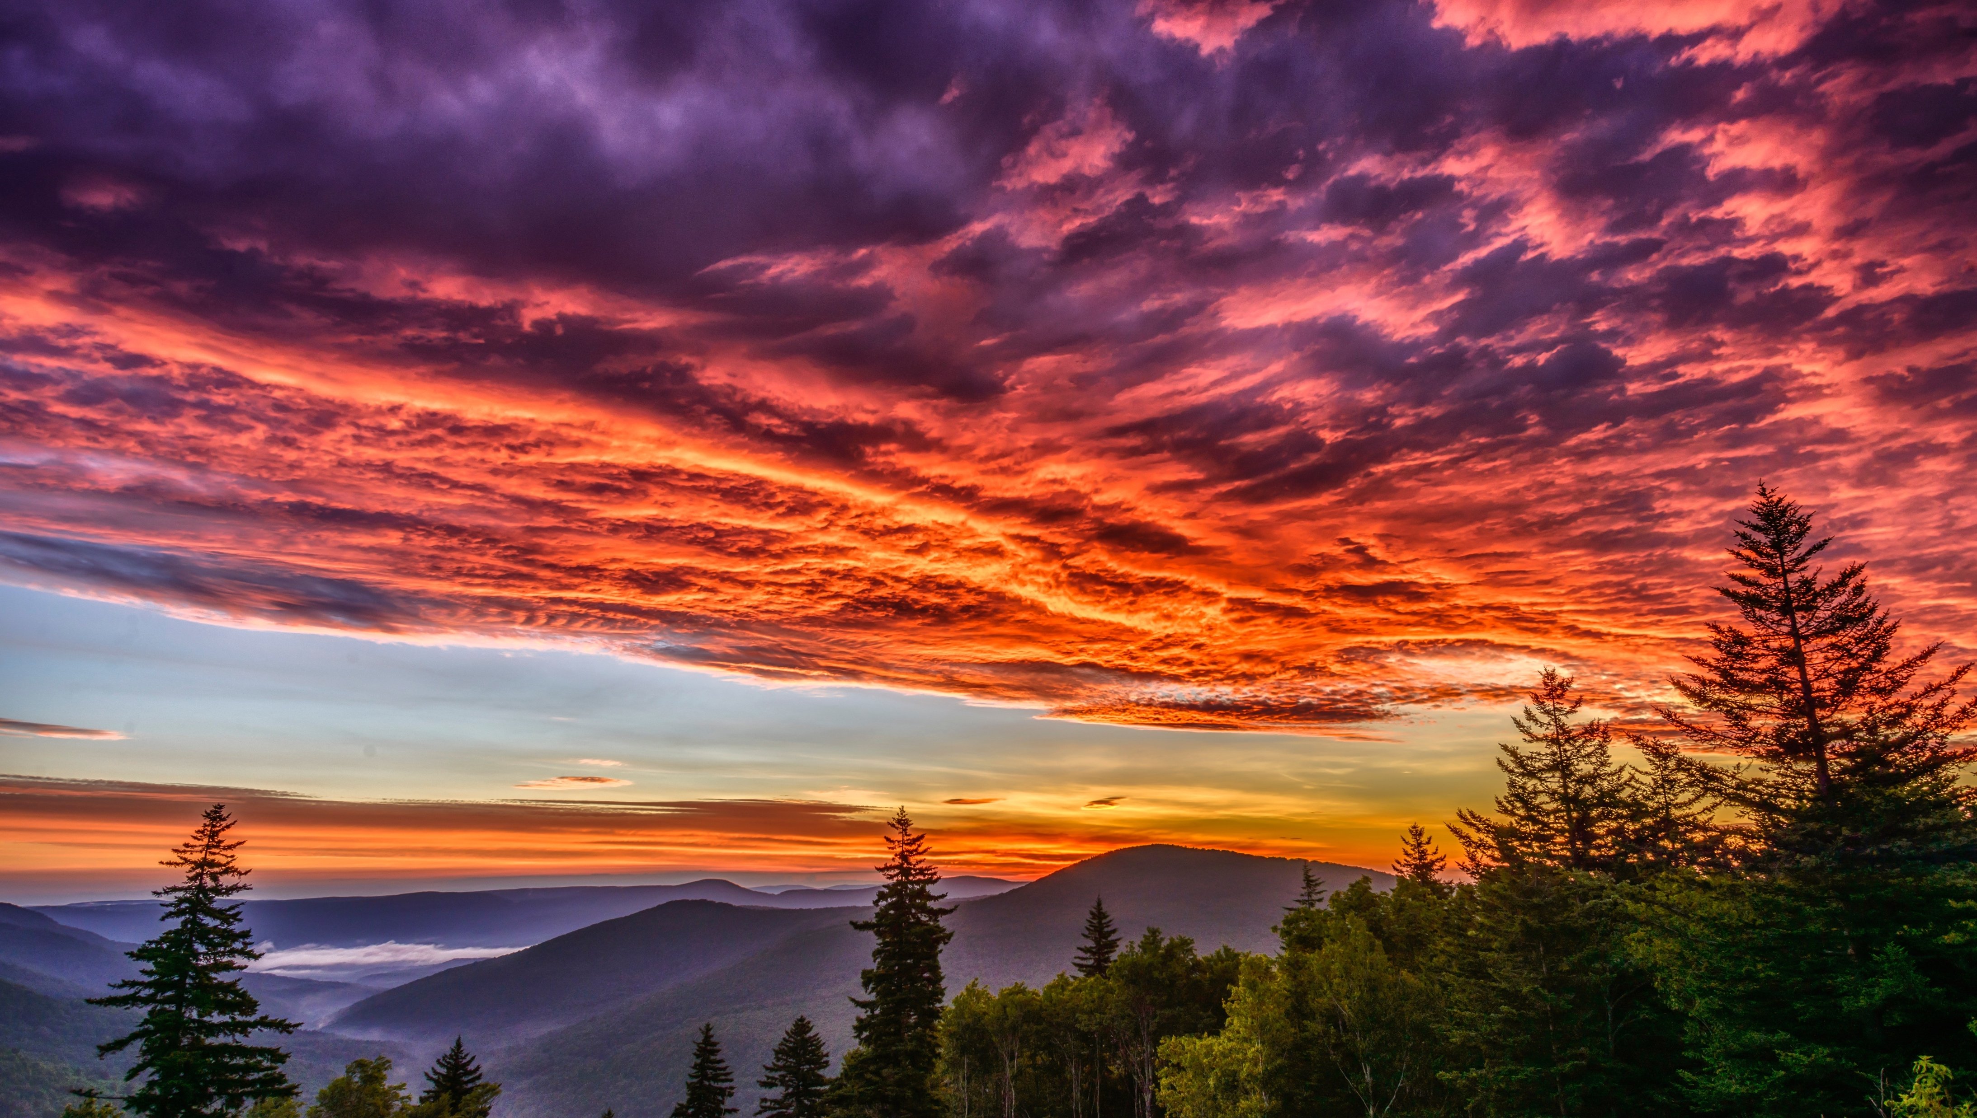
Image credits: Title slide, West Virginia State Capitol, Charleston, WV, ©Shutterstock; End slide, Williams River Valley Overlook, Black Mountain, Monongahela National Forest, West Virginia, ©Shutterstock.

