Slide 1


Smart Skills
Week 34
Timeline 7:
Make Your Own
Notes:
See the Smart Skills directions on the Teacher Tech Website for West Virginia: Our Beautiful Home for teaching suggestions.
Teacher notes and answers will display in this space.

Slide 2

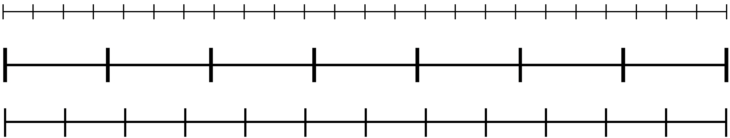
Monday
Study the graphic. Create a jot list of what you notice.
Notes:
Answers will vary. Discuss observations.
TEACHER NOTE: Students will create a personal timeline throughout the week.

Slide 3
TUESDAY
The best timelines help viewers understand the events’ order and how far apart the events are in time.
What units of time would these blank timelines be useful for representing?
Notes:
Top: 24 hours for one day
Middle: 7 days for one week
Bottom: 12 months for one year

Slide 4
WEDNESDAY
These blank timelines can be useful for representing common timeframes. As discussed yesterday, these blanks could be used as follows:
  Top: 24 hours for one day
  Middle: 7 days for one week
  Bottom: 12 months for one year
You will create your timeline in the next few days. Today, choose one of the examples above. Recreate the timeline on paper using a straight edge, such as a ruler. Be sure to include equal distances between each vertical tick mark. Save the blank timeline for tomorrow.
Notes:
TEACHER NOTE: It might be helpful for students to have a ruler for this lesson; however, they can approximate the spaces for their timelines. You can emphasize that for this lesson, they aren’t trying to make a ”perfect” representation for display.

Slide 5
THURSDAY
Yesterday, you created a blank timeline like one of these.
  Top: 24 hours for one day
  Middle: 7 days for one week
  Bottom: 12 months for one year
Today, you will add events and labels to create a personal timeline.
Add labels to the timeline to show the units of time (e.g., days of the week)
Begin a jot list of 5-8 events to add to your personal timeline. Be sure to include the time or date of the event. Save your timeline until the next class.

Slide 6
FRIDAY
Today, you will complete your personal timeline.
Use your jot list of 5-8 events and add them to your personal timeline at the appropriate spots.
Have another student compare your jot list with your timeline to ensure that the events are marked in their correct locations.
Add an appropriate title to the timeline. Examples: “Tawanna’s Typical Day,” “David’s Week at Camp 2024,” or “Gene’s Year at Competitions.”
Notes:
Answers will vary. Be sure to compare the jot list times and dates with the locations on the timeline.

Slide 7
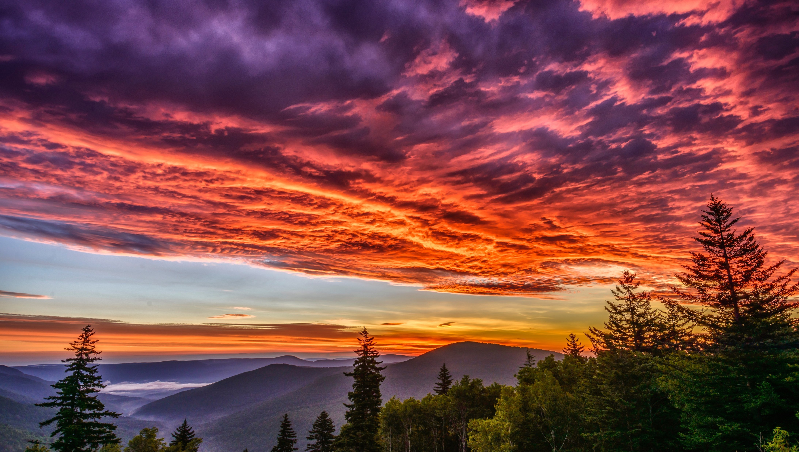
Image credits: Title slide, West Virginia State Capitol, Charleston, WV, ©Shutterstock; End slide, Williams River Valley Overlook, Black Mountain, Monongahela National Forest, West Virginia, ©Shutterstock.

