Slide 1


Smart Skills
Week 33
Art & Artifacts 7:
20th Century Artifact
Notes:
See the Smart Skills directions on the Teacher Tech Website for West Virginia: Our Beautiful Home for teaching suggestions.
Teacher notes and answers will display in this space.

Slide 2

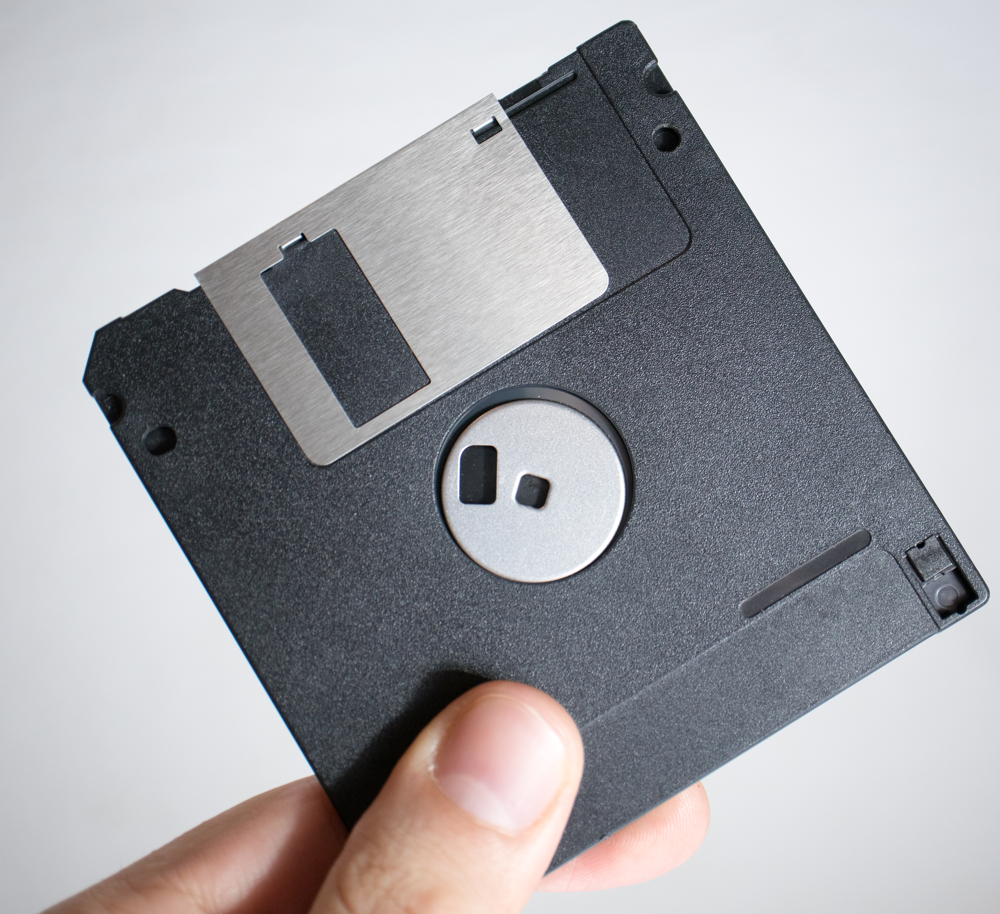
Monday
Study the picture. What do you notice about the artifact? Record observations only.
Notes:
Answers will vary. Discuss only observations.

Slide 3
TUESDAY
How does having the finger and thumb in the image help you understand it?
Notes:
Sample: The finger and thumb help the viewer understand the artifact's relative size.

Slide 4
WEDNESDAY
Are there any indications that the artifact may have moving parts? What evidence do you have to support your thinking?
Notes:
The silver piece appears to be able to slide over because there is space for it in the black plastic. The round part in the middle resembles a wheel that might turn. The bottom right has a piece of plastic that appears to be able to slide back and forth.

Slide 5
THURSDAY
What do you think is the purpose of the artifact? What evidence or experience do you have to support your thinking?
Notes:
Answers will vary. Some students may recognize the artifact as a 3.5-inch floppy disc for computer data storage. The shape of the disc is often drawn today in apps to symbolize the “Save” function.

Slide 6
FRIDAY
The artifact is a 3½-inch disc for saving computer data.
Such discs were used in computers to store and move data. Their use peaked in the mid-1990s.
What technologies allow computers to move data today? How have these technologies changed the demand for 3½-inch discs?
Notes:
Today, data may be transferred to cloud storage systems, on thumb drives, or over the Internet. Data on phones can be transferred wirelessly to another phone.
TEACHER NOTE: Billions of 3.5-inch discs were produced from the 1980s to the early 2000s. They were replaced by CDs, which could hold about 450 times more data. The 3.5-inch disc could only hold the data for about one photo taken on a smartphone. A smartphone with 8 GB of memory holds more data than over 5,700 of these 3.5-inch discs. Demand for the discs declined, and the last disc producer ceased production around 2011, although some vendors continue to sell the remaining discs to individuals using older computers.

Slide 7

Image credits: Title slide, West Virginia State Capitol, Charleston, WV, ©Shutterstock; End slide, Williams River Valley Overlook, Black Mountain, Monongahela National Forest, West Virginia, ©Shutterstock.

