Slide 1
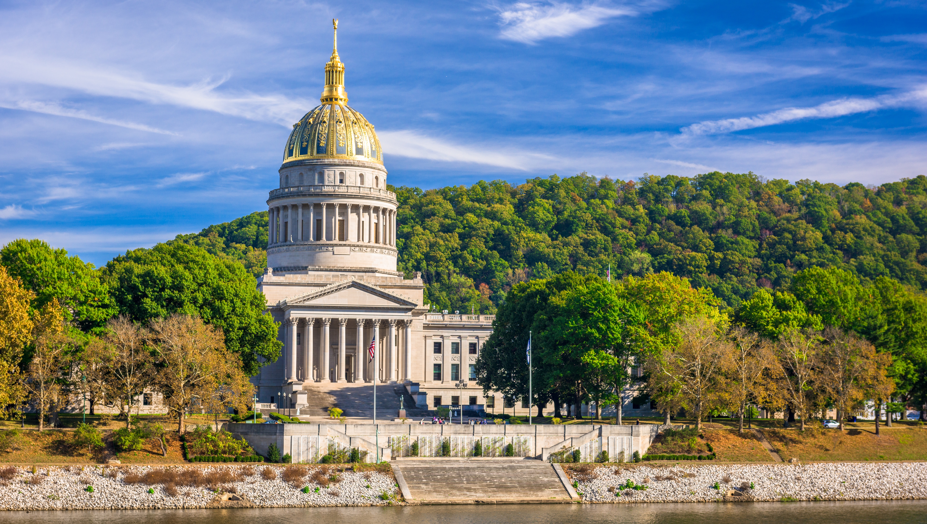

Smart Skills
Week 2
Charts & Graphs 1: Climograph
Notes:
See the Smart Skills directions on the Teacher Tech Website for West Virginia: Our Beautiful Home for teaching suggestions.
Teacher notes and answers will display in this space.

Slide 2

Monday
A climograph is a graphic representation of a location's basic climate data.
Study the two graphs. What do you notice?
Notes:
This opener lets students view the graphs without a specific question to answer.
A one- or two-minute silent study helps students notice details they might miss otherwise. Students should notice that the graphs have identical axis labels but are for two different locations.
Discuss responses as a group, and let students physically point out their findings on the projection to ensure all students see the details being discussed.
Ensure that in the discussion, it is made clear that one of the cities, Sydney, is in Australia, which is in the Southern Hemisphere. Charleston, WV, is located in the Northern Hemisphere. Some students may benefit from locating these cities on a globe.

Slide 3
TUESDAY
What is approximately the highest average temperature that Charleston reaches during the year?
What is the average lowest temperature?
Notes:
85 ºF
26 ºF
In the class discussion, have students physically point out where they found their answers on the graphs.

Slide 4
WEDNESDAY
Which city reaches the highest average temperature?
Which city reaches the average lowest temperature?
In an individual month, which city on average receives the most rainfall?
Notes:
Charleston
Charleston
Sydney
In the class discussion, have students physically point out where they found their answers on the graphs.

Slide 5
THURSDAY
What differences do you notice in the overall pattern of temperature and precipitation when comparing the two cities?
What might explain the differences?
Notes:
Answers may vary. Students may consider the region each is located in (south of the equator has “opposite seasons” to locations to the north). Each gets a similar amount of precipitation, however. Other factors could also affect these data, such as proximity to the ocean and altitude.

Slide 6
FRIDAY
What would be another city you would like to visit? What kind of climate (highs, lows, and rainfall) would you expect in this city throughout the year?
Notes:
Answers will vary. Should include general high, low, and rainfall estimates for each season.
Students may also want to include their climate preferences. For instance, do they prefer one with snow? Would they like one with low humidity?

Slide 7
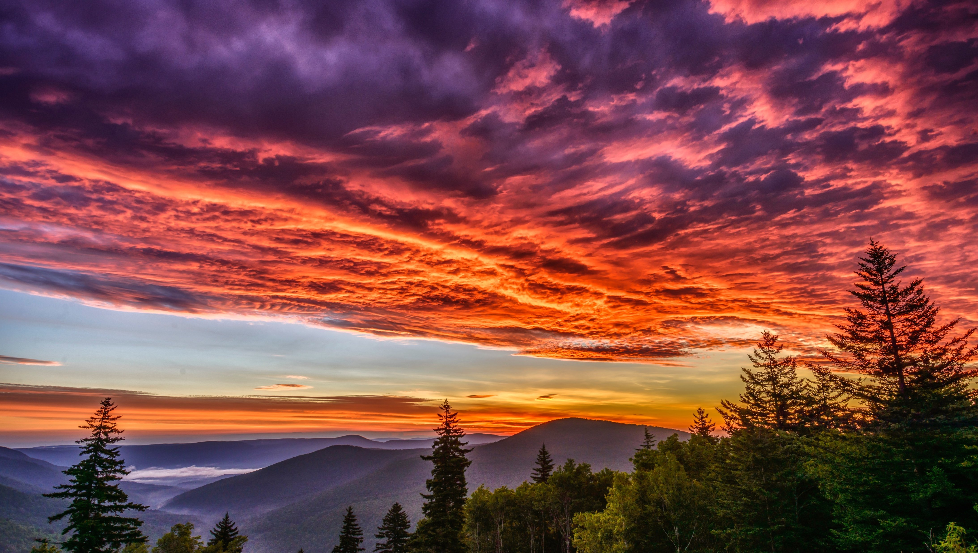
Image credits: Title slide, West Virginia State Capitol, Charleston, WV, ©Shutterstock; End slide, Williams River Valley Overlook, Black Mountain, Monongahela National Forest, West Virginia, ©Shutterstock.

