Slide 1


Smart Skills
Week 27
Charts & Graphs 6:
U.S. Gross Domestic Product
Notes:
See the Smart Skills directions on the Teacher Tech Website for West Virginia: Our Beautiful Home for teaching suggestions.
Teacher notes and answers will display in this space.

Slide 2

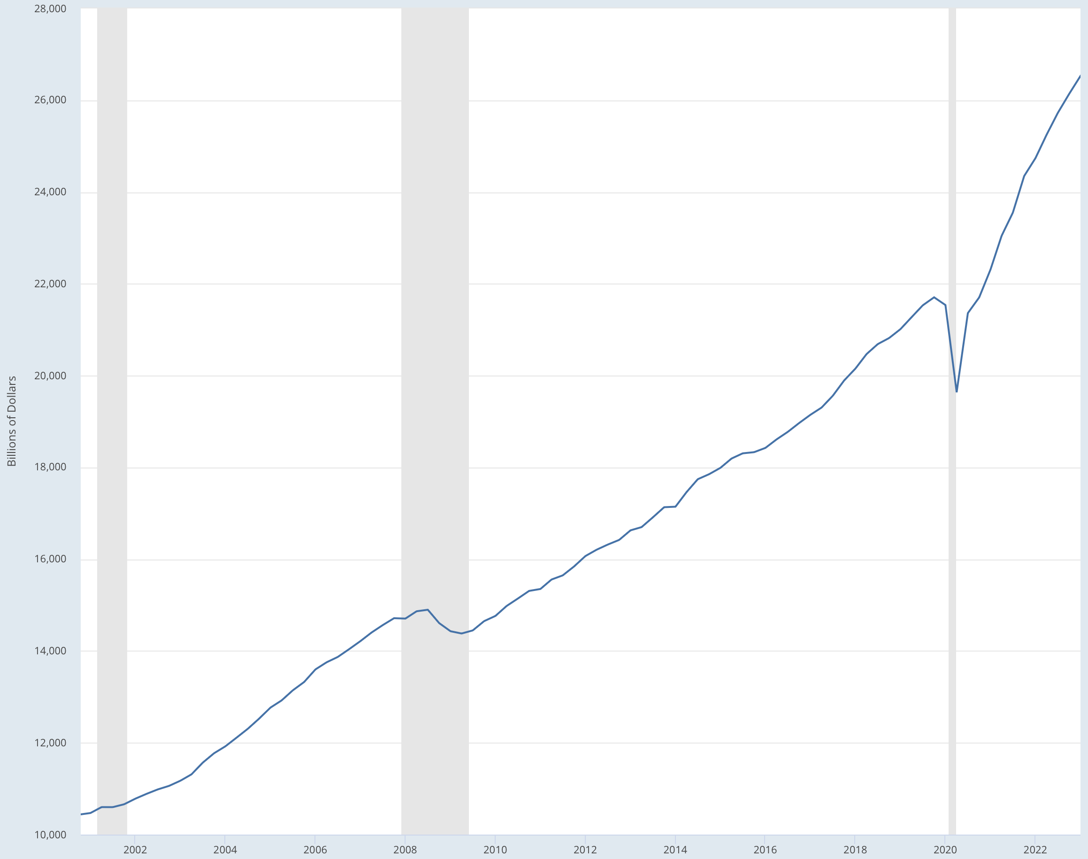
Monday
Gross Domestic Product – United States (2000-2023)
GDP is the value of all goods and services produced within a country’s borders over time.
Study the data graphic. Make a jot list of things you notice.
The gross domestic product (GDP) tracks the health of a country’s economy.
Economists can use GDP to determine whether an economy is growing or experiencing a recession.
Notes:
This opener lets students view the image without a specific question to answer. A one- or two-minute silent study helps students notice details they might miss otherwise. Discuss responses as a group, and let students physically point out their findings on the projection to ensure all students see the details being discussed.
TEACHER NOTE: This graph has text boxes that provide background information for students who may be unfamiliar with the term GDP and its significance.

Slide 3
TUESDAY
Gross Domestic Product – United States (2000-2023)
GDP is the value of all goods and services produced within a country’s borders over time.
What information is given in the title that helps explain the graph?
What values are shown on the y-axis?
What values are shown on the x-axis?
The gross domestic product (GDP) tracks the health of a country’s economy.
Economists can use GDP to determine whether an economy is growing or experiencing a recession.
Notes:
The subject, Gross Domestic Product, the country (U.S.), and the years (2000-2023).
Billions of dollars
Years

Slide 4
WEDNESDAY
Gross Domestic Product – United States (2000-2023)
GDP is the value of all goods and services produced within a country’s borders over time.
The vertical gray bands show periods of recession or negative growth.
When were the recessions on this chart?
What happened to the GDP during these recessions?
The gross domestic product (GDP) tracks the health of a country’s economy.
Economists can use GDP to determine whether an economy is growing or experiencing a recession.
Notes:
2001, 2008-2009; 2020
The GDP declined during the recession. The decline was not as significant in 2001 as it was in 2020.

Slide 5
THURSDAY
Gross Domestic Product – United States (2000-2023)
GDP is the value of all goods and services produced within a country’s borders over time.
In 2008-2009, the GDP declined. By how far did it fall?
How long did it take for the GDP to regain its 2008 level?
The gross domestic product (GDP) tracks the health of a country’s economy.
Economists can use GDP to determine whether an economy is growing or experiencing a recession.
Notes:
About $500,000,000,000.
About 2 years.
Discuss that even though the economy began to improve in 2009, it took two years for the GDP to return to its previous level.

Slide 6
FRIDAY
Gross Domestic Product – United States (2000-2023)
GDP is the value of all goods and services produced within a country’s borders over time.
An event often triggers recessions and declines in the GDP. What event caused the decline shown in 2020?
What evidence is there that the economy recovered after this event?
The gross domestic product (GDP) tracks the health of a country’s economy.
Economists can use GDP to determine whether an economy is growing or experiencing a recession.
Notes:
The COVID-19 pandemic led to a drop in GDP.
By 2021, the GDP had surpassed its previous level and continued to increase by 2023.

Slide 7

Image credits: Title slide, West Virginia State Capitol, Charleston, WV, ©Shutterstock; End slide, Williams River Valley Overlook, Black Mountain, Monongahela National Forest, West Virginia, ©Shutterstock.

