Slide 1


Smart Skills
Week 24
Timeline 5:
Events Leading to World War I
Notes:
See the Smart Skills directions on the Teacher Tech Website for West Virginia: Our Beautiful Home for teaching suggestions.
Teacher notes and answers will display in this space.

Slide 2

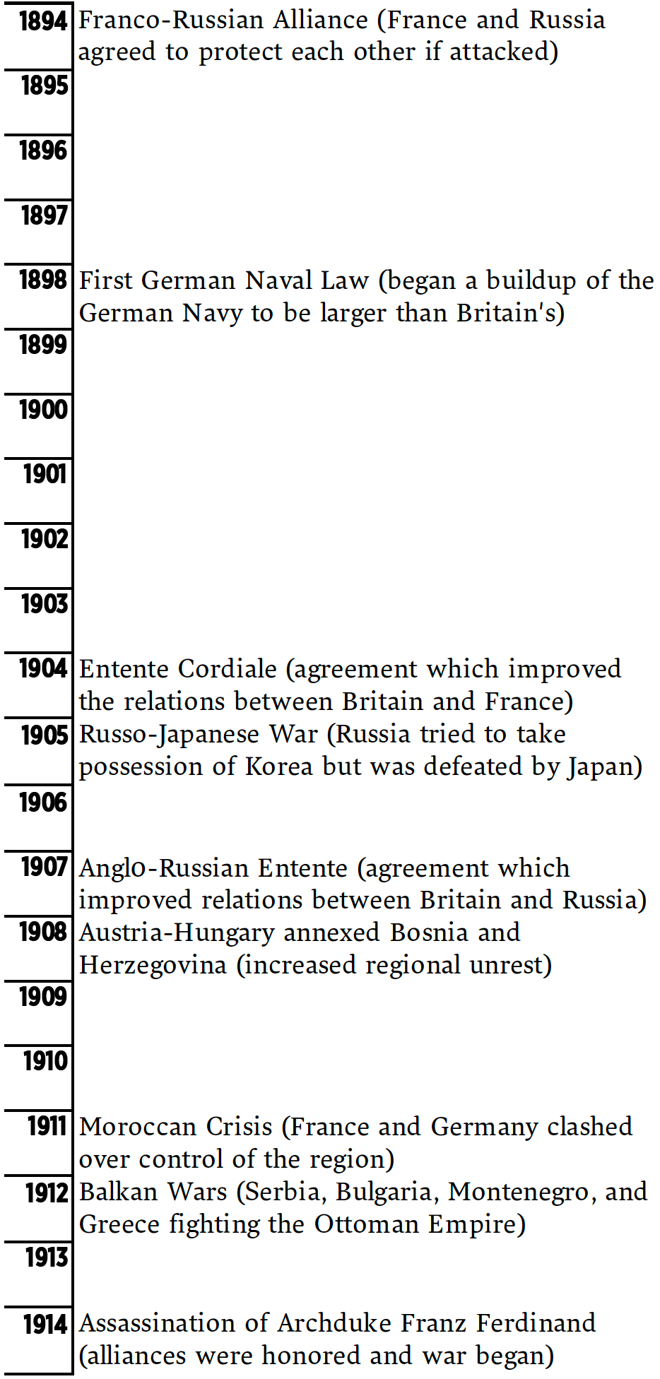
Monday
Study the graphic. Make a jot list of your observations about it.
Notes:
Allow students 1-2 minutes to record observations. Discuss only what students have noticed from the timeline. Discuss possible titles. Example: Important inventions 1894-1914.
NOTE: A suggested title would be ”Events Leading to World War One.”

Slide 3
TUESDAY
What is the range of years on the timeline? What is its topic?
What would you describe as its purpose?
Notes:
1894-1914
The topic is events leading to World War I, but students may not have the background to answer the question yet, depending on where you are in the curriculum.

Slide 4
WEDNESDAY
How many years passed between the Franco-Russian Alliance and the assassination of Archduke Franz Ferdinand?
What event signaled Germany’s plan to expand its navy?
When did this occur?
Notes:
20 years
The First German Naval Law
1898

Slide 5
THURSDAY
What is a question that could be answered using the timeline? Write and share it with a classmate. Agree upon the correct answer.
Notes:
Answers will vary; you may want to use some of the questions and answers for class discussion.

Slide 6
FRIDAY
How would you change this timeline to make it more effective or informative?
Notes:
Answers will vary.
Students may indicate that adding pictures or adding maps would be helpful. Additionally, they may suggest a title, larger text, or a longer timeline with the inclusion of key events.

Slide 7

Image credits: Title slide, West Virginia State Capitol, Charleston, WV, ©Shutterstock; End slide, Williams River Valley Overlook, Black Mountain, Monongahela National Forest, West Virginia, ©Shutterstock.

