Slide 1
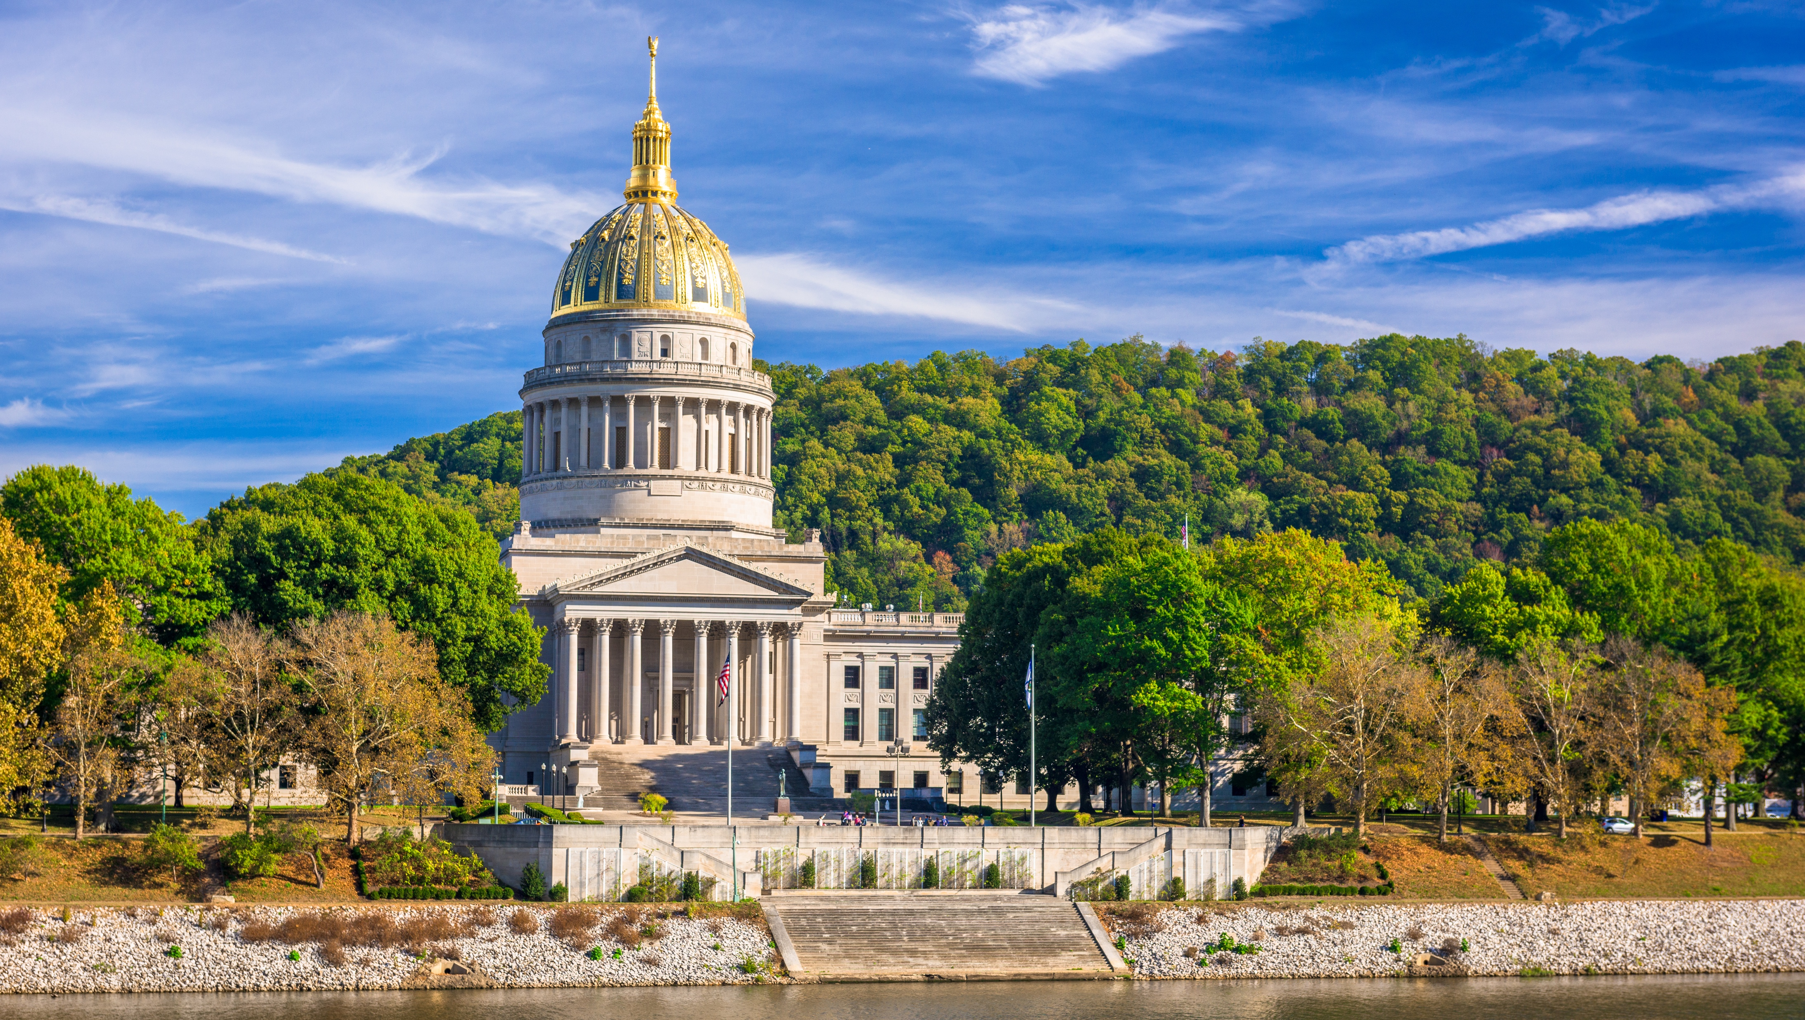

Smart Skills
Week 1
Map 1: West Virginia Counties
Notes:
See the Smart Skills directions on the Teacher Tech Website for West Virginia: Our Beautiful Home for teaching suggestions.
Teacher notes and answers will display in this space.

Slide 2

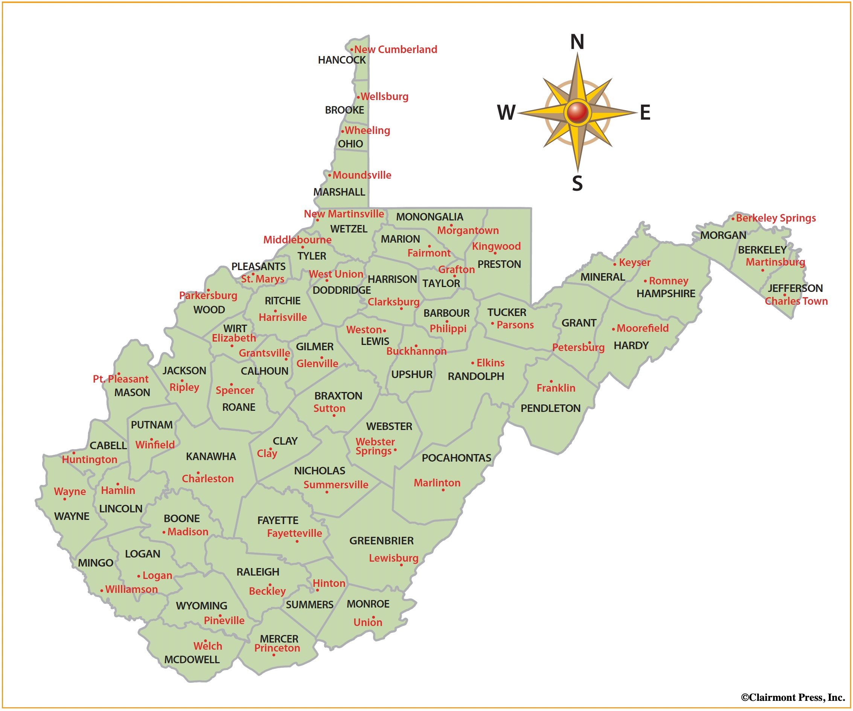
Monday
Study the map. What do you notice about it? In the time given by your teacher, jot down the things that you notice about the map.
Notes:
This opener allows students to view the map with no specific question to answer. Often, it is beneficial to study a map and its components before searching for a specific answer. Allow at least one minute for students to silently study the map and create a jot list before discussing responses as a group. Students may notice that this is a map of West Virginia. Counties are outlined, and county seats are identified. There is a compass rose. The map only has two colors – one to fill the county regions and another to outline them. Students may notice that there are no physical features (such as mountains or rivers). Border states are not shown, etc.

Slide 3
TUESDAY
What is the county seat of Kanawha County?
What is the county seat of your county?
Notes:
Charleston
The answer will depend on your county.
These are basic locate and identify questions.
If you have not done so already, this is an opportunity to discuss the significance of a county seat and gauge what students already know about the county seat as a center of local government. You may want to discuss the types of government functions that are directed from the county seat, where the county courthouse is located.
Have a student physically point out these locations on the map during the discussion rather than assuming that all students have seen them.

Slide 4
WEDNESDAY
Which direction would you travel from Charleston (Kanawha County seat) to get to Union (Monroe County seat)?
Write a similar question to the one above based on your county. Share your question with another student.
Notes:
southeast
Answers will vary
This is a basic directions question. You should ensure that the discussion includes both cardinal and intermediate points on the compass rose. Some students may need direct instruction on using the points of the compass rose in directions.
Classroom management: Provide students with directions on who they should share their questions with (e.g., elbow partners, nearby students, etc.). Allow a few students to share their questions with the class while another student points out the answers to the group using the projected map.

Slide 5
THURSDAY
What counties border Kanawha County?
What counties border your county?
Notes:
Jackson, Roane, Clay, Fayette, Raleigh, Boone, Lincoln, Putnam
Answers will vary according to your school’s location.
This is an opportunity to gauge whether students understand the concept of a border. You may want to discuss how they would know if they were at a border. For example, most county borders are marked by signs on the roadside. You may want to ask why the borders matter. For example, local government services vary by county. Taxes may differ from one county to the next. School districts are often aligned to county borders, etc.

Slide 6
FRIDAY
If a person wanted to travel from Beckley (Raleigh County seat) to Parkersburg (Wood County seat), passing through the fewest counties, which counties would they cross?
Write a question like the one above. Share it with another student and see if you agree upon an answer.
NOTE: Your routes must stay within West Virginia’s boundaries.
Notes:
Kanawha, Jackson
Answers will vary
Classroom management: Provide students with directions on who they should share their questions with (e.g., elbow partners, nearby students, etc.). Allow a few students to share their questions with the class while another student points out the answers to the group using the projected map.
Discuss that this question does not reflect the real-world presence of roads and bridges, which would be necessary to make the trip.

Slide 7
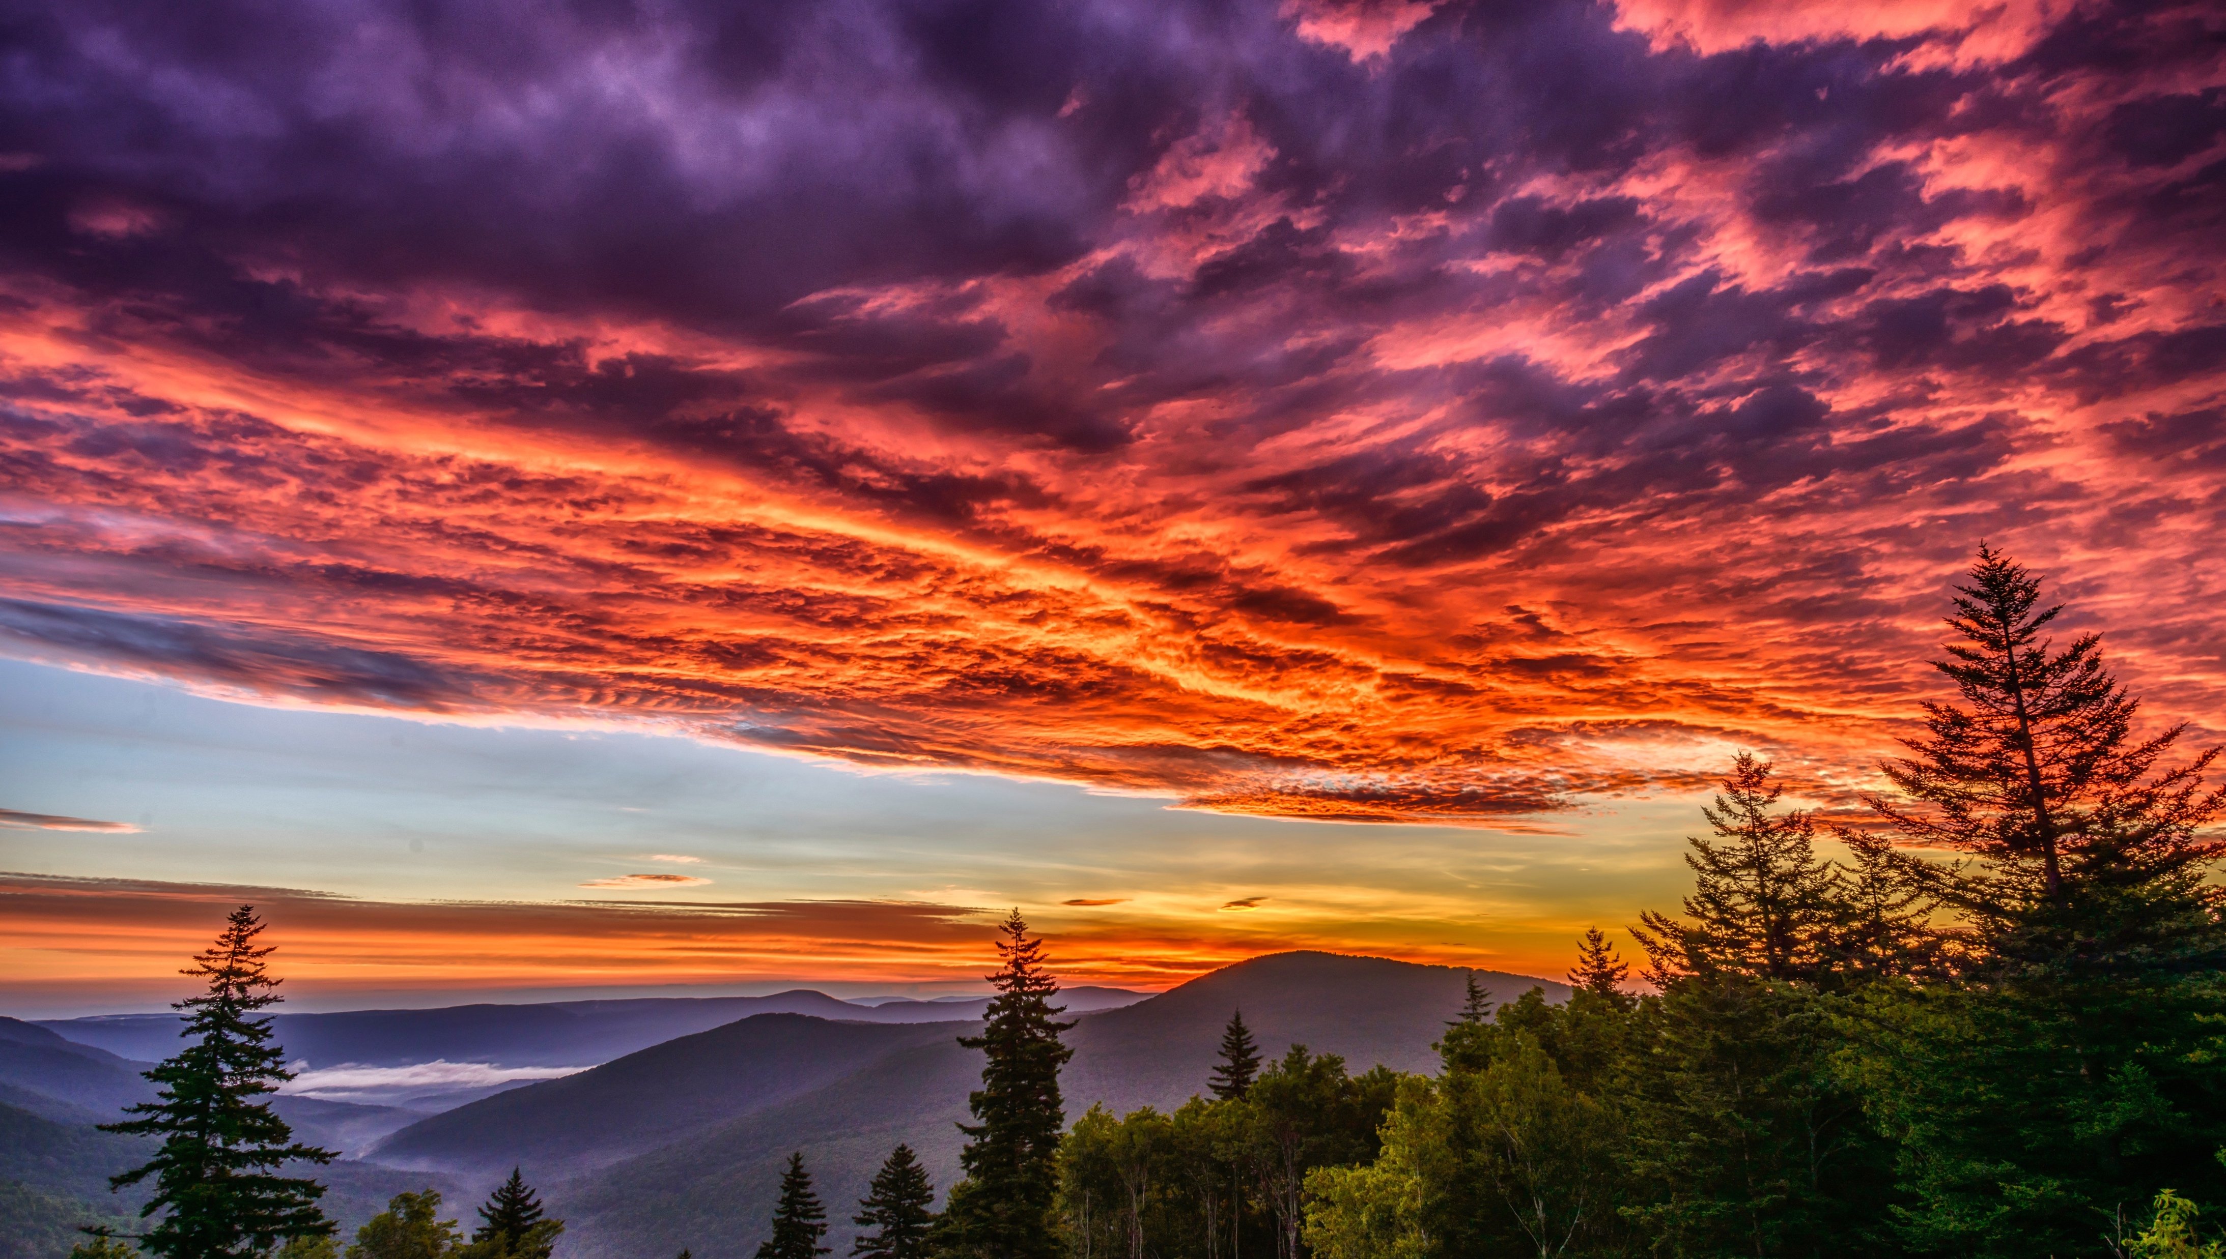
Image credits: Title slide, West Virginia State Capitol, Charleston, WV, ©Shutterstock; End slide, Williams River Valley Overlook, Black Mountain, Monongahela National Forest, West Virginia, ©Shutterstock.

