Slide 1
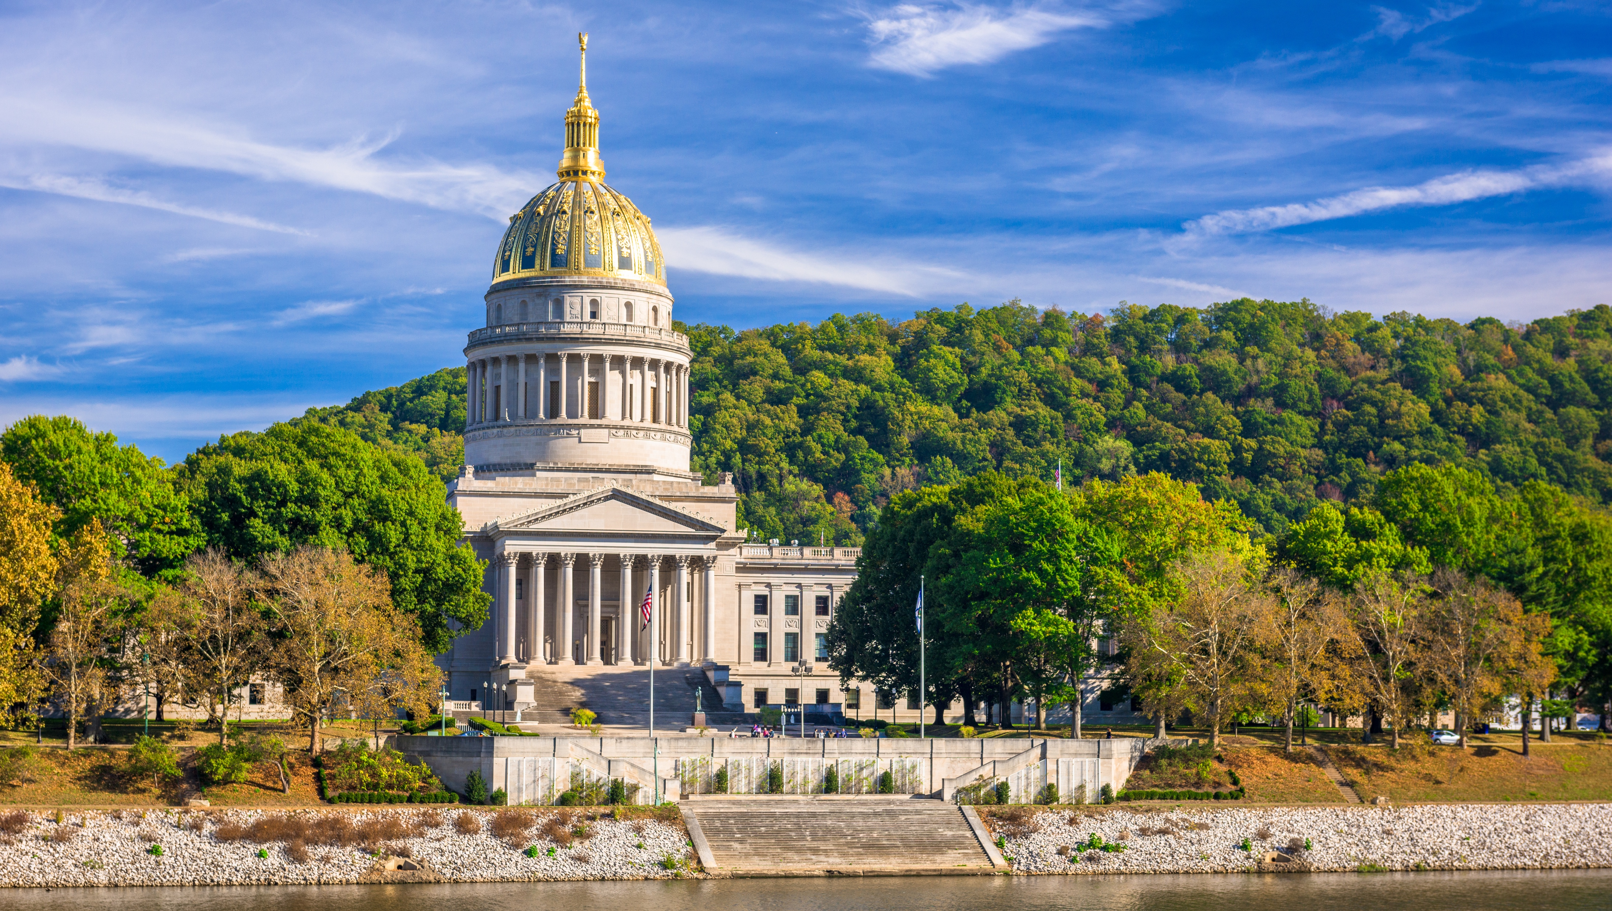

Smart Skills
Week 18
Art & Artifacts 4:
19th Century Painting
Notes:
See the Smart Skills directions on the Teacher Tech Website for West Virginia: Our Beautiful Home for teaching suggestions.
Teacher notes and answers will display in this space.

Slide 2

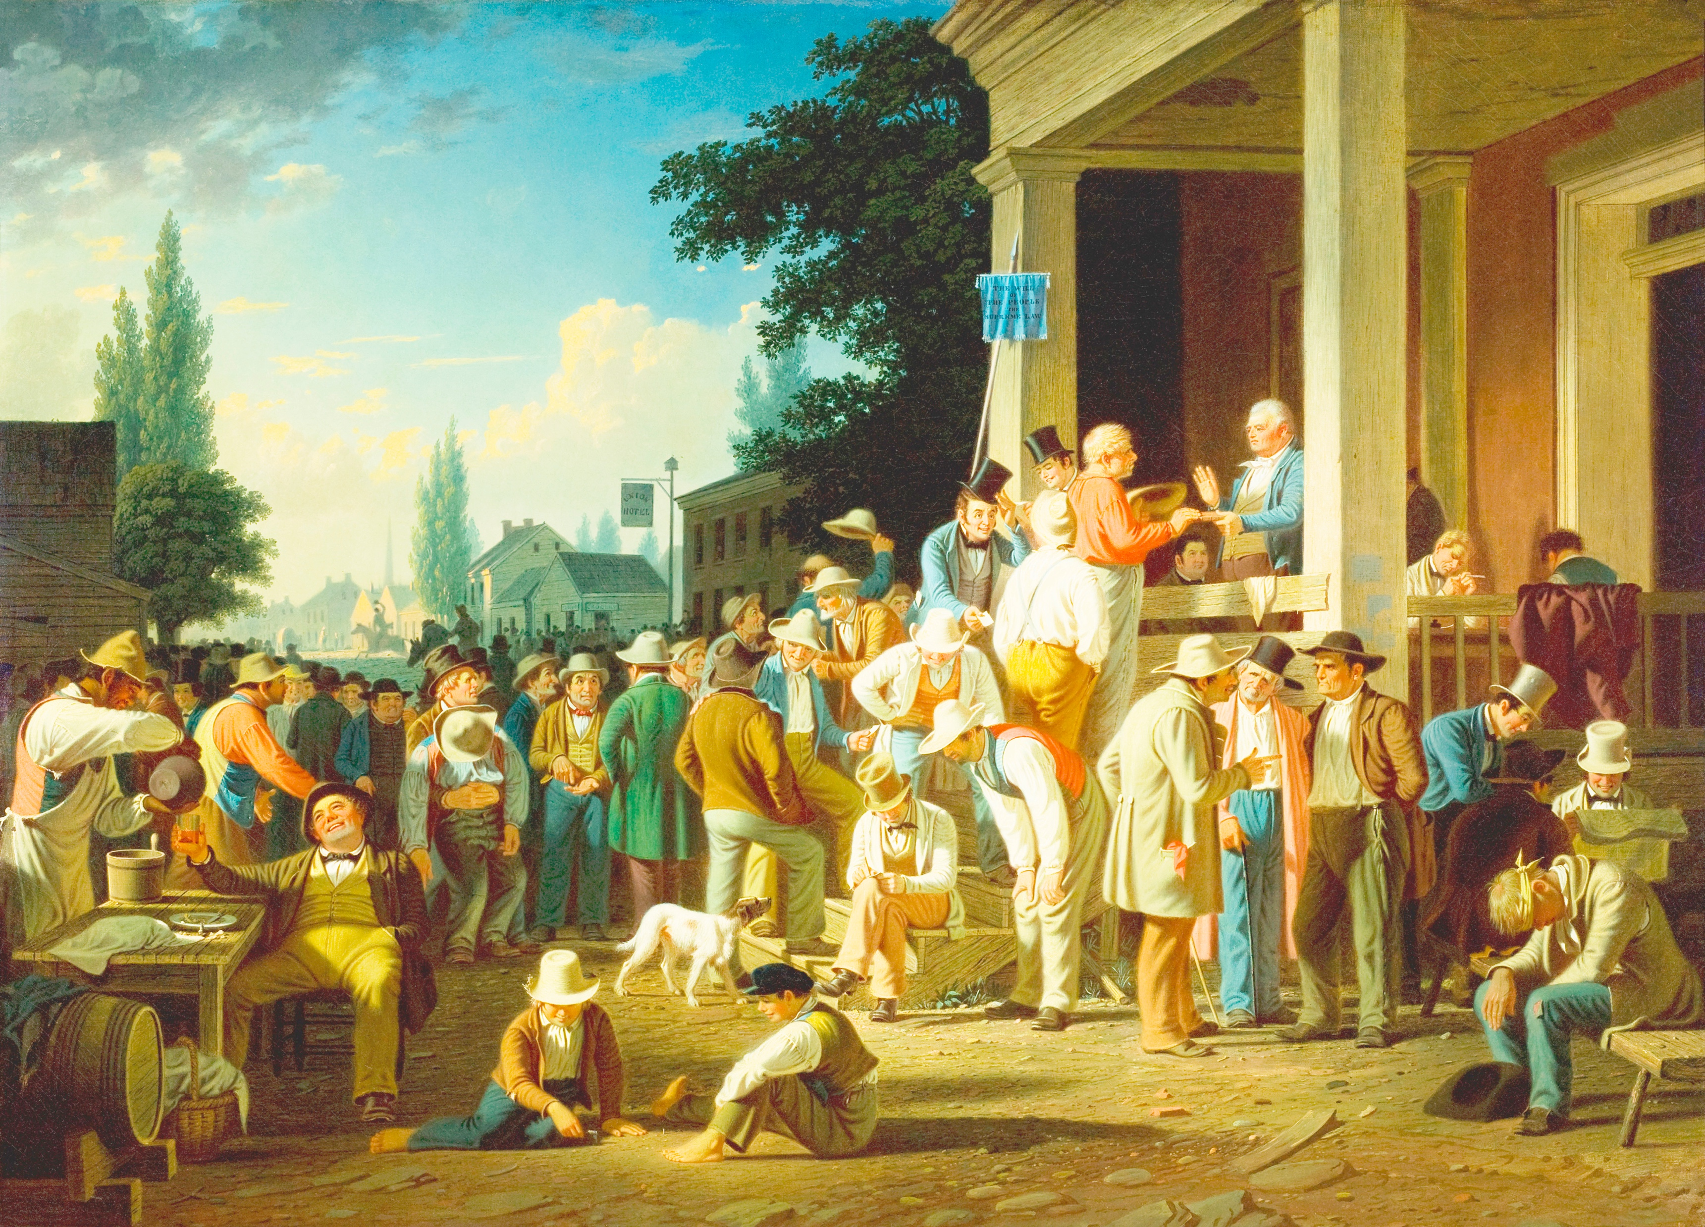
Monday
Study this painting by Missouri artist George Caleb Bingham (1854). What do you notice?
List as many observations as you can in two minutes.
Notes:
Discuss observations as a group without speculating on specifics in the scene.
TEACHER BACKGROUND: Throughout the week, this is a good opportunity to compare voting in the past with the present. Voting booths to protect privacy were not present. No women are seen voting. There seems to be campaigning and perhaps money being paid or drinks offered to voters. We suggest saving this information for later discussion.
NOTE: For more information on the painting, read the article at https://reynoldahouse.emuseum.com/objects/163/the-county-election.

Slide 3
TUESDAY
Based on the observations from the previous day, what do you believe is shown in the image? What is the purpose of the image? Explain your thinking.
Notes:
Answers will vary. Students may get a sense that this is a voting day, but they may also have other ideas. They should support their response with evidence.

Slide 4
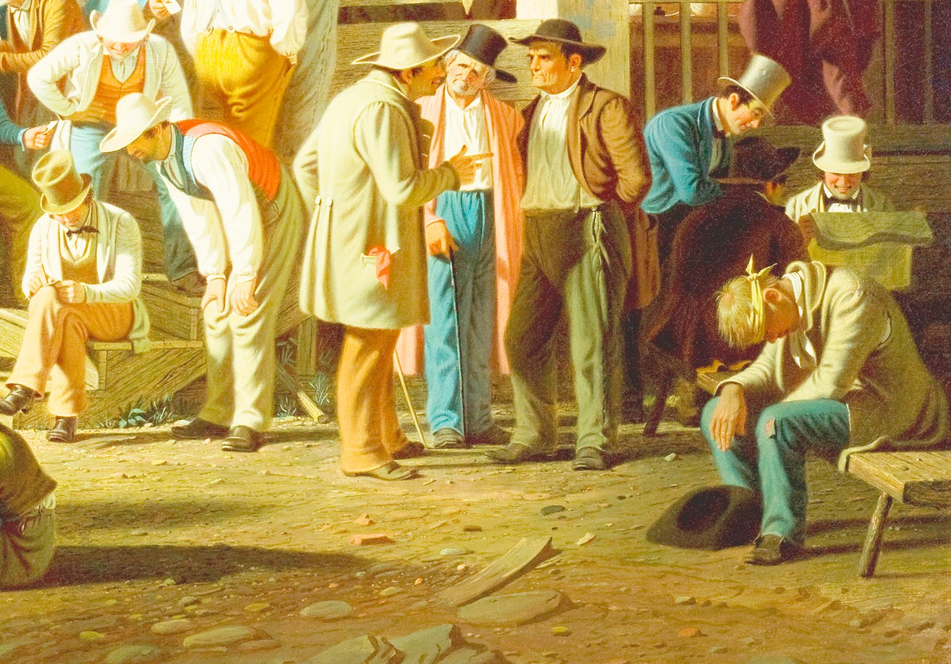
WEDNESDAY
The image was divided into four quadrants. Focus your attention on this one from the bottom right corner. What do you notice that you didn’t see before? What do you see that is happening in the painting?
Notes:
Answers will vary, but students should list details.
TEACHER NOTE: Dividing an image into quadrants for study is a good strategy for learning to pick out details. You may want to apply this to other image studies.

Slide 5
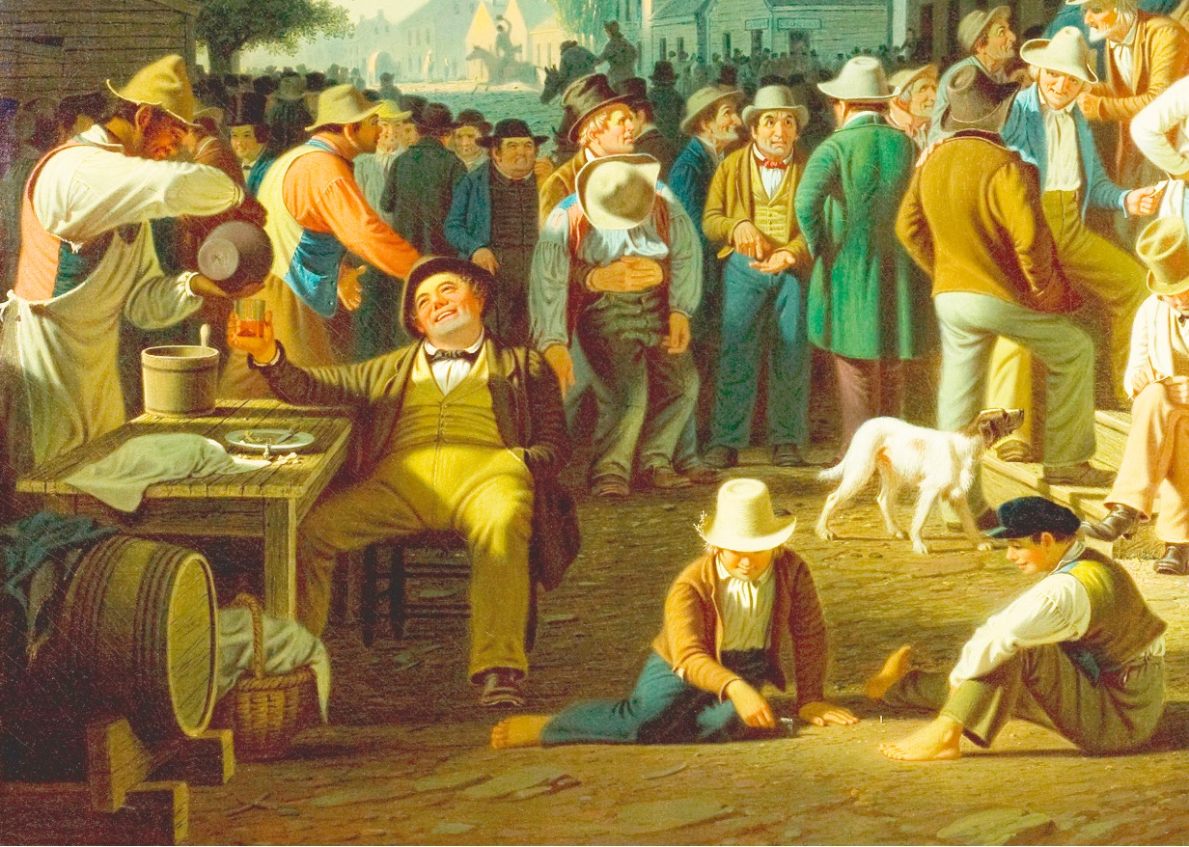
THURSDAY
The image was divided into four quadrants. Focus your attention on this one from the bottom left corner. What do you notice that you didn’t see before? What do you see that is happening in the painting?
Notes:
Answers will vary.

Slide 6
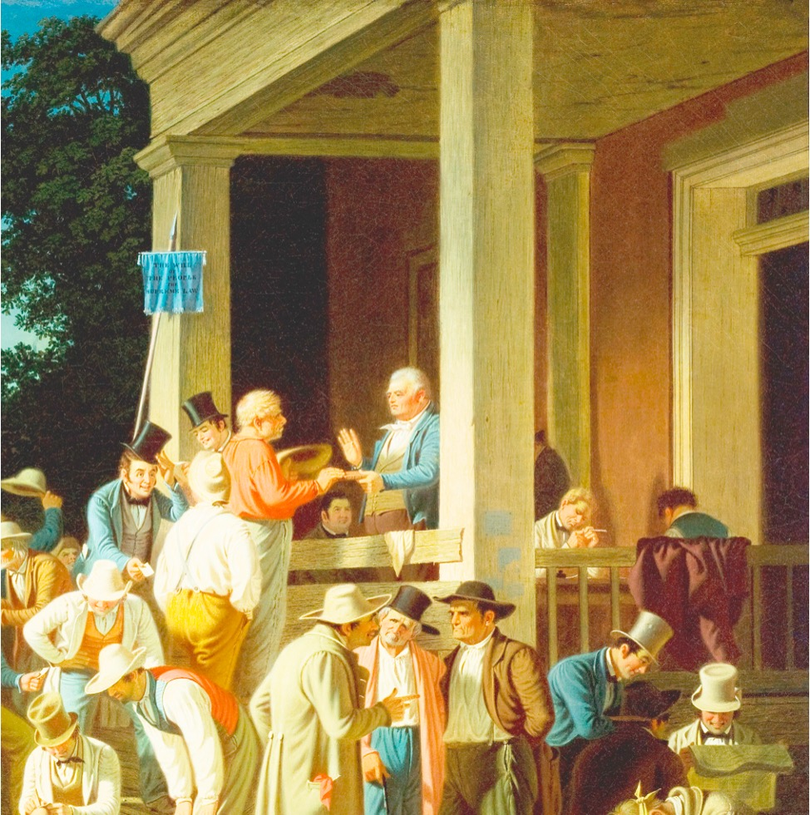
FRIDAY
Part 1
The painting is called “The County Election.” People are voting at a county voting site. What do you notice that is different from voting in modern times?
Notes:
Answers will vary, but should include that the voters are all white men, they are outside, there is a crowd with drinking, and maybe some fighting. Also, there don’t seem to be paper ballots.
TEACHER NOTE: There are two images for Friday, so you can discuss the top-left corner of the painting. The banner reads, “The will of the people the supreme law.” A whole community of men, from rich to poor, comes together to vote. Notice how no one figure is emphasized or made larger than others in this crowd. That suggests that all the votes are equal.

Slide 7
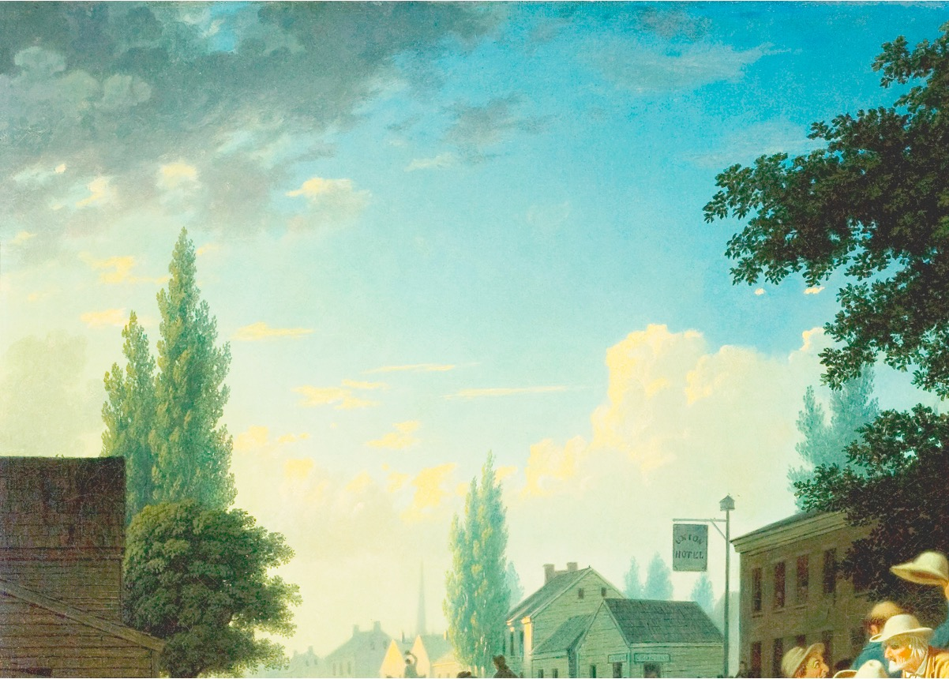
FRIDAY
Part 2
What do you notice in this image that you didn’t see before? What might be the symbolism of the hotel’s name? What might the blue sky symbolize?
Notes:
Answers will vary, but may include the Union Hotel, which may symbolize the artist’s view of the importance of the Union. The blue sky glows beautifully even as there is some disorderliness in the process of democracy.

Slide 8
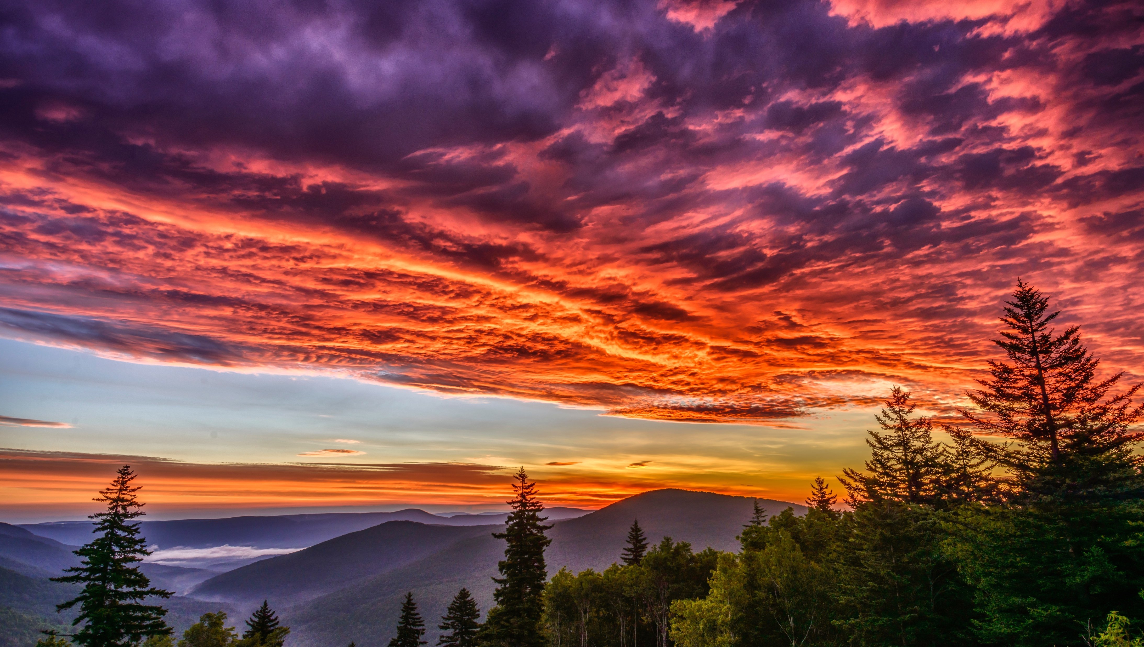
Image credits: Title slide, West Virginia State Capitol, Charleston, WV, ©Shutterstock; End slide, Williams River Valley Overlook, Black Mountain, Monongahela National Forest, West Virginia, ©Shutterstock.

