Slide 1
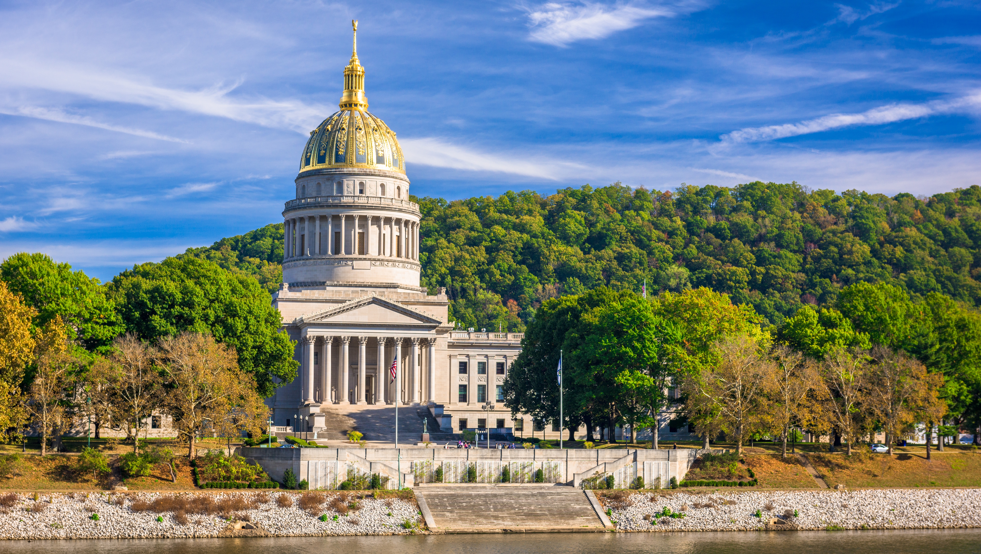

Smart Skills
Week 15
Political Cartoons 3:
Britain and France
Divide the World
Notes:
See the Smart Skills directions on the Teacher Tech Website for West Virginia: Our Beautiful Home for teaching suggestions.
Teacher notes and answers will display in this space.

Slide 2

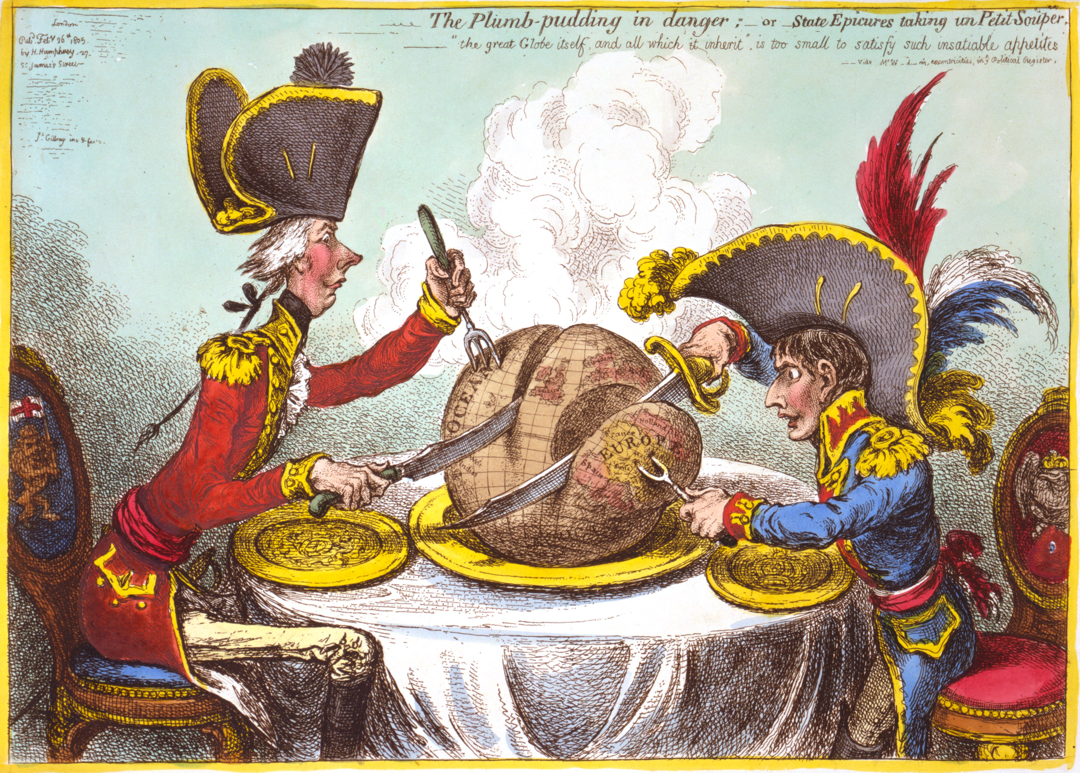
Monday
Study the image. Make a jot list of what you observe.
Notes:
Answers will vary.
TEACHER NOTE: This opener lets students view the image without a specific question to answer. A one- or two-minute silent study helps students notice details they might miss otherwise. Discuss responses as a group, and let students physically point out their findings on the projection to ensure all students see the details being discussed.

Slide 3
TUESDAY
A caricature is an image of a person that exaggerates their features, often in a mockingly humorous manner.
What features of these people are evident in the caricatures?
Notes:
Answers will vary.

Slide 4
WEDNESDAY
The 1805 caricatures depict Great Britain’s Prime Minister Pitt (left) and the French Emperor Napoleon (right).
Is the cartoonist a supporter of one over the other?
What evidence is there in the image to support your thinking?
Notes:
Answers will vary.
Note Prime Minister Pitt is using a knife and fork. He does appear thin, perhaps hungry, but overall shows better manners. Napoleon is depicted as child-sized, and his eyes appear greedy. He is using a sword to cut the pudding rather than a knife.

Slide 5
THURSDAY
Study the caption.
What is the “plumb-pudding?
In what way was it in danger?
What does the cartoonist mean that the men have ”insatiable appetites”?
Notes:
Answers will vary.
Planet Earth is shown as the plum pudding.
The planet was in danger from these two leaders and the imperial power they represented.
Their insatiable appetites describe that no matter how much they have, they want more.
TEACHER NOTE: The state “epicures” are the men having dinner, and a petit souper is a “small dinner.”
Plum pudding is a rich, dense, steamed dessert popular in Britain, particularly during the Christmas season.

Slide 6
FRIDAY
How would Americans have viewed the cartoon?
What opinions might they have had about the ideas in the image? Explain your thinking.
Notes:
Answers will vary. Allow students to explain their thinking as they answer questions during a class discussion.
TEACHER NOTE: Prime Minister Pitt is shown cutting into the Atlantic Ocean. Perhaps this suggests Britain’s focus on naval power. The Americas are not shown on the globe, but they would have landed in Pitt’s portion of the pudding.

Slide 7
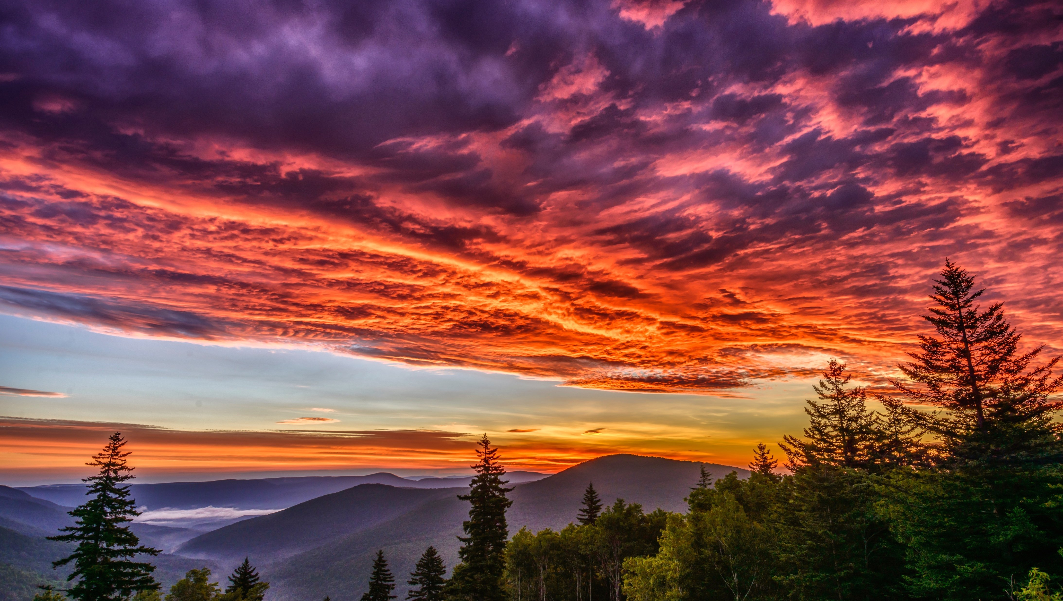
Image credits: Title slide, West Virginia State Capitol, Charleston, WV, ©Shutterstock; End slide, Williams River Valley Overlook, Black Mountain, Monongahela National Forest, West Virginia, ©Shutterstock.

