Slide 1
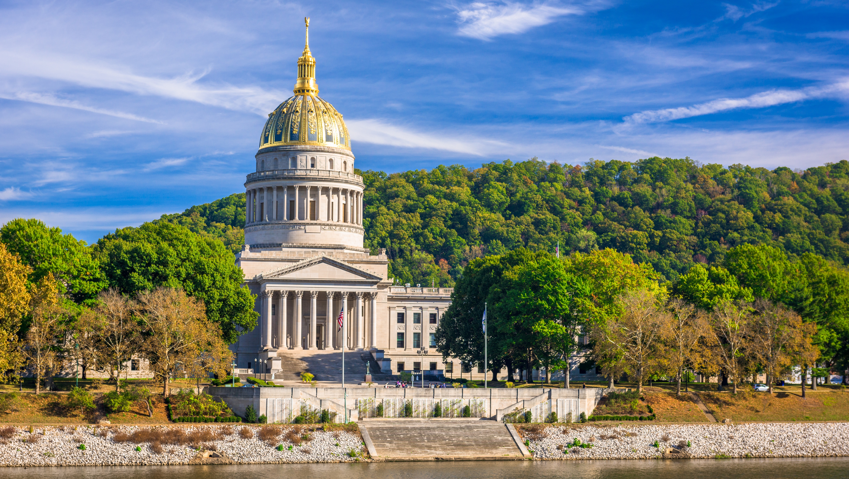

Smart Skills
Week 14
Timeline 3: Circulating Coins
Notes:
See the Smart Skills directions on the Teacher Tech Website for West Virginia: Our Beautiful Home for teaching suggestions.
Teacher notes and answers will display in this space.

Slide 2

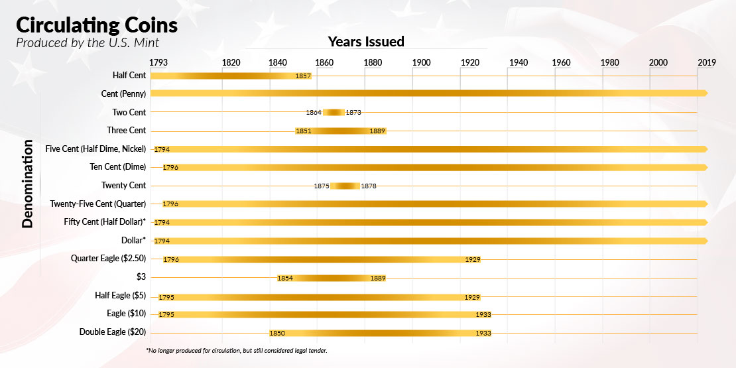
Monday
Study the graphic. Make a jot list of what you notice.
Notes:
Answers will vary. Discuss observations.
TEACHER NOTES: The Treasury Department confirmed in 2025 its plans to stop minting one-cent penny coins. Each penny costs nearly four cents to produce, so that will save $56 million a year. Other countries, such as Canada, New Zealand, and Australia, have also discontinued the production of their one-cent coins. Pennies will remain legal tender.

Slide 3
TUESDAY
Congress established the U.S. Mint in 1792.
According to the timeline, what were the mint’s first coins?
How long were those coins in production?
Notes:
The half cent and penny were the first coins issued by the U.S. Mint.
The half cent was in production 64 years. The penny was in production as of this timeline. The Treasury Department announced plans to stop production in 2025.

Slide 4
WEDNESDAY
How many different denominations has the U.S. Mint produced?
Which coin had the highest denomination?
What was the lowest?
How many years did the Mint produce both coins simultaneously?
Notes:
15
The Double Eagle had the highest value at $20.
The lowest was the half cent.
These were in production from 1850 to 1857, a period of seven years.

Slide 5
THURSDAY
Write a question that could be answered using this timeline. Have another student answer it and check their work. Agree upon the correct answer.
Notes:
Answers will vary. Select some students' questions and answers for class discussion.

Slide 6
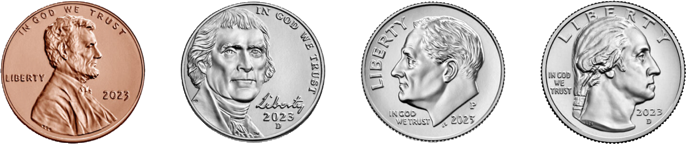
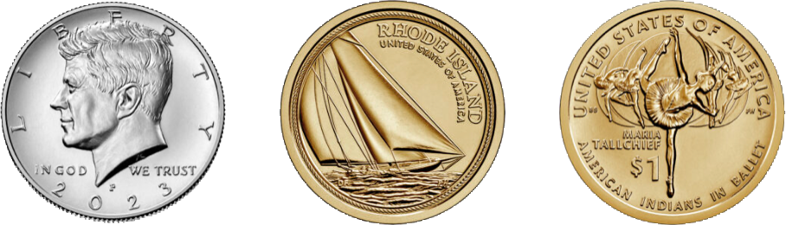
FRIDAY
The pennies, nickels, dimes, and quarters were produced for circulation in 2025. The half-dollar and dollar coins were produced for collectors. What would make a good subject for a dollar honoring West Virginia? Explain your thinking.
Notes:
Answers will vary. Students should support their ideas with explanations.

Slide 7
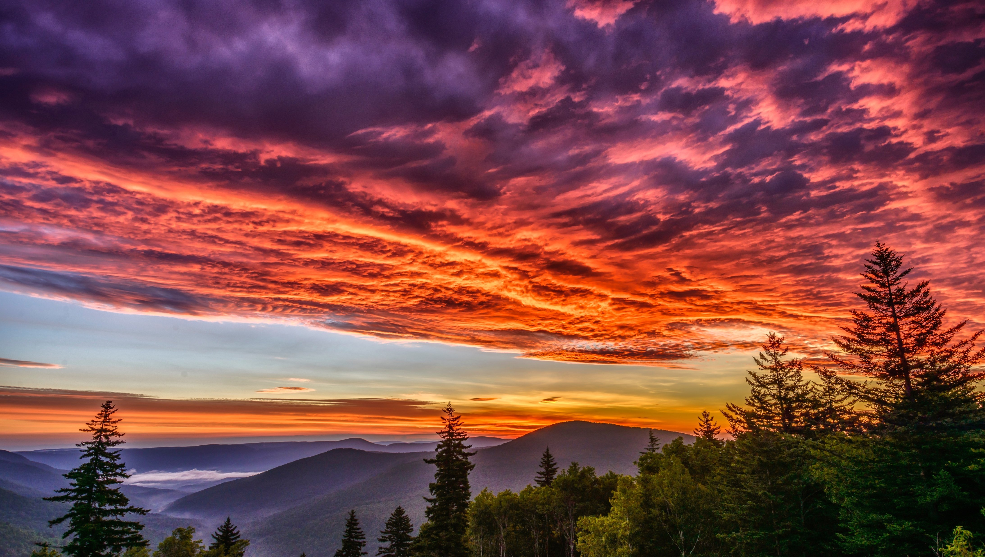
Image credits: Title slide, West Virginia State Capitol, Charleston, WV, ©Shutterstock; End slide, Williams River Valley Overlook, Black Mountain, Monongahela National Forest, West Virginia, ©Shutterstock.

