Slide 1


The Grist Mill in Babcock State Park, West Virginia
Chapter 17: As One Century
Ends, Another Begins
STUDY PRESENTATION
© 2025 Clairmont Press

Slide 2

West Virginia State Capitol building, Charleston
Section 2: Keeping the World Safe

Slide 3
Section 2:
Keeping the World Safe

Slide 4
The End of the Cold War
Communism’s threat ended when people in several countries—Poland, Czechoslovakia, Bulgaria, Romania, and East Germany—overthrew their communist governments.
The end of the Cold War led
to the tearing down of the
Berlin War on November 9,
1989.
In 1991, the biggest threat to the United States during the Cold War—the Soviet Union—collapsed.

Slide 5
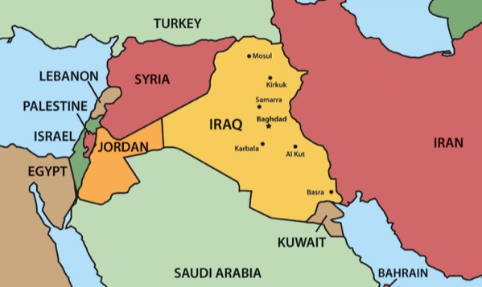
Operation Desert Storm
The first United States military
operation since Vietnam took
place in the Middle East.
On August 2, 1990, Iraq invaded
and occupied Kuwait in an effort
to seize oil and gain a port on
the Persian Gulf.
The United States led a coalition, called Operation Desert Shield, to free Kuwait.
When Iraq refused to leave Kuwait, Operation Desert Shield became Operation Desert Storm.

Slide 6
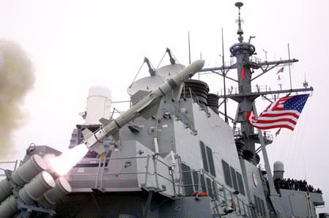
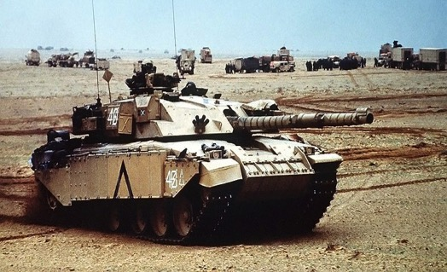
There was an increased use of technology in Operation Desert Storm.
Operation Desert Storm was almost entirely a war of air bombardment.
Iraqi missiles were intercepted and destroyed by American antimissile rockets.
In February 1991, an intensive ground offensive was launched that resulted in a cease fire four days after it began.

Slide 7
West Virginians in the Gulf War
1,222 active National Guard members and 949 reserves served in the Persian Gulf. Five lost their lives.
Admiral Joseph T. Lopez served as an adviser to Secretary of Defense Richard Cheney.
Admiral Lopez was awarded the Navy Distinguished Service Medal and the Bronze Star.

Slide 8
Terrorism Strikes the United States
On September 11, 2001, the United States was attacked by unknown terrorists.
Four airplanes were hijacked. The World Trade Center in New York City was the target of two planes. One of the planes crashed into the North Tower of the World Trade Center and minutes later a second plane flew into the South Tower.
As stunned Americans watched the tragedy unfold on television, the third plane crashed into the Pentagon in Washington, D.C.
On the fourth plane, passengers overtook the terrorists and caused the plane to land in a rural field in Pennsylvania. Their act of heroism possibly saved hundreds of lives.

Slide 9
Operation Enduring Freedom
An extremist group of Islamist terrorists, called al-Qaeda, was found to be responsible for the attacks. Al-Qaeda, based in Afghanistan, was protected by a group called the Taliban.
Immediately after the attacks, President George W. Bush asked Congress to give him war powers.
The United States gave
al-Qaeda an ultimatum:
  close terrorist training camps
  hand over al-Qaeda leaders
  return all foreign nationals who had been unjustly detained in Afghanistan

Slide 10
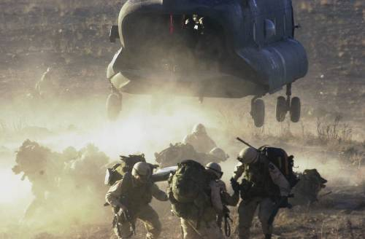
The Taliban refused the ultimatum, resulting in a United States-led coalition attack on al-Qaeda’s leader Osama bin Laden’s camps in Afghanistan. This military operation, called Enduring Freedom, began in October and, by the end of March 2002, had successively removed the Taliban from power in Afghanistan.
US Troops in Afghanistan
Osama bin Laden was ultimately killed in Pakistan on May 2, 2011, by a United States Special Operations Military Unit.

Slide 11
The United States combat mission in Afghanistan continued until December 2014 when most troops returned home.
After 2014, the name of the operation in Afghanistan was changed to Operation Freedom Sentinel.
Between 2017 and 2018 President Donald Trump sent some 6,000 additional troops to Afghanistan and changed the name of US operations there to Resolute Support.

Slide 12
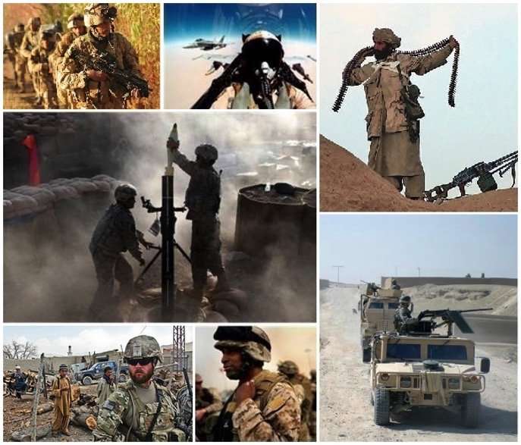
West Virginia Presence In Afghanistan
By February 2002, some 1,100 West Virginians had been deployed, giving the state a ranking of third in the nation in terms per capita active-duty deployment following September 11.
Fifteen West Virginias lost their lives through August 15, 2011.
The Martinsburg-based 167th Airlift Wing flew missions in Afghanistan that included transporting more detainees as well as the bodies of US Servicemen killed in action.

Slide 13
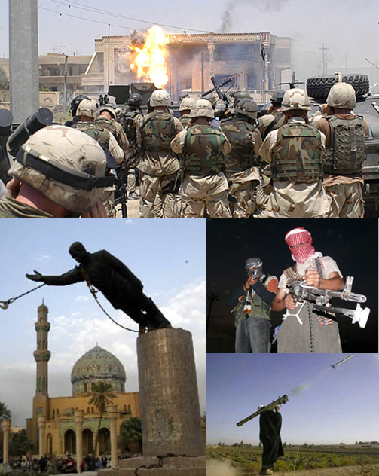
Operation Iraqi Freedom
Following the attacks on September 11, 2001, the
United States became more concerned about
foreign nations having weapons of mass destruction
that could be used by terrorists.
On March 19, 2003, President George W. Bush
announced that the United States was involved in
a military conflict, named Operation Iraqi Freedom.
The combat phase of the operation lasted less than
two months, ending on May 1, 2003.
In December 2003, Iraqi dictator, Saddam Hussein
was captured by U.S. troops and was hanged for
crimes against humanity on December 30, 2006.
Operation Iraqi Freedom became a political issue
during the presidential election of 2008. Barack
Obama, who favored the earliest withdrawal of
troops from Iraq, was elected.
On December 15, 2011, the United States lowered the flag of command over Bagdad, officially ending the country’s military mission in Iraq.

Slide 14
Reevaluating Foreign
Relations Economically
When Donald Trump became president in 2017, he disagreed with the policies of previous presidents regarding foreign relations.
To that end, he supported an “America First” agenda, which called for:
  reducing the amount of money the United States would spend to defend other countries around the world
  increasing the amount of money allied countries would contribute to the defense of others
  withdrawing from agreements that were not “in the best interests” of the United States

Slide 15
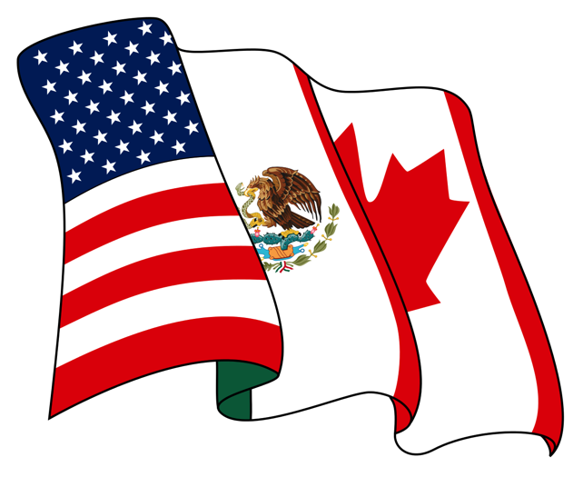
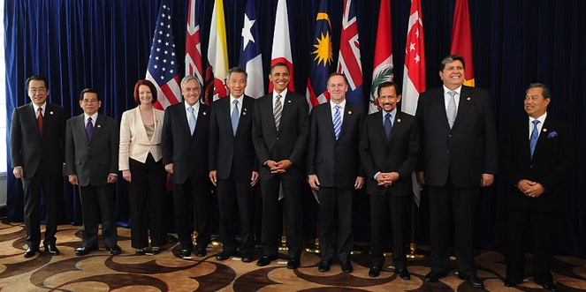
New Trade Agreements
One of President Trump’s first orders as president was to
  withdraw the United States from the TPP (Trans-Pacific Partnership) with provided lower tariffs would be levied on partner nations, including Japan, Canada, and Mexico
  renegotiate NAFTA (North American Free Trade Agreement) with Canada and Mexico
Leaders from 10 of the 12 prospective member states at a TPP summit in 2010

Slide 16
Reevaluating Foreign
Relations Politically
President Trump became more friendly with several nations, including:
  Russia
  China
  North Korea
  Saudi Arabia
  Israel
Meanwhile, he distanced himself from several other nations, including:
  Germany
  Great Britain
  Canada
  Mexico
Return to Main Menu

Slide 17

Woodburn Hall, West Virginia University, Morgantown, West Virginia
Image Credits
Slide 1: ForestWander, https://creativecommons.org/licenses/by/2.0/deed.en, Wikimedia Commons
Slide 2: formulanone, https://creativecommons.org/licenses/by-sa/2.5/deed.en, Wikimedia Commons
Final Slide: Tom Long, https://creativecommons.org/licenses/by-sa/3.0/deed.en, Wikimedia Commons
Return to Main Menu

