Slide 1


The Grist Mill in Babcock State Park, West Virginia
Chapter 17: As One Century
Ends, Another Begins
STUDY PRESENTATION
© 2025 Clairmont Press

Slide 2
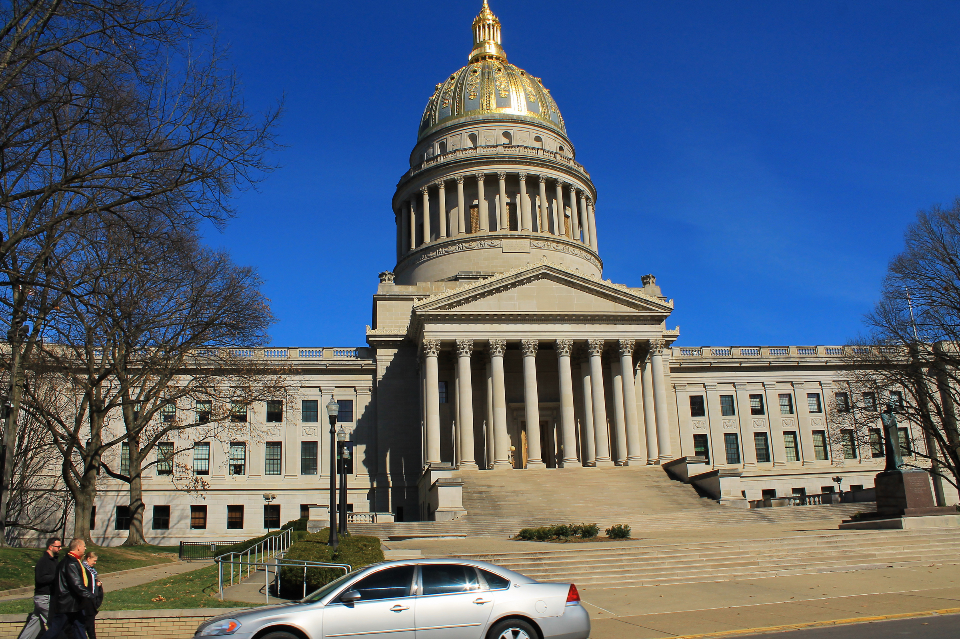
West Virginia State Capitol building, Charleston
Section 1: Changes in Lifestyle

Slide 3
Section 1:
Changes in Lifestyle

Slide 4
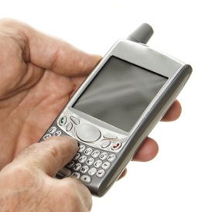
The 1980s
The Impact of the Computer
  Increased communication
  Reduced unemployment in rural areas
  Ushered in the age of electronic games
  Internet
Other Advancements in Computer Technology
  Replaced Cash Registers
  Transformed banking (ATMS)
  Fax machines
  Scanners
  Cellular telephones

Slide 5
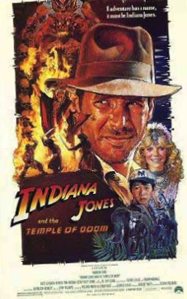

Other Symbols of the 1980s
Movies
Television
Music
Madonna, Michael Jackson, Stevie Wonder, Kenny Rogers

Slide 6

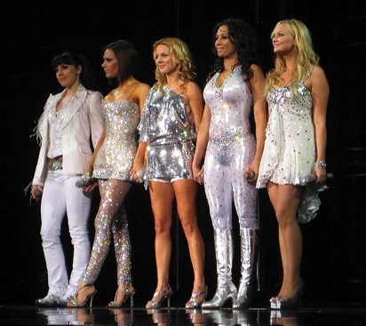
The 1990s
The Impact of Technology
  Introduction of the World Wide Web
  Email
Other Symbols of the 1990s
Grunge clothing
Television/Movies
Music
Everybody Loves Raymond
The Golden Girls
Star Wars
The Spice Girls

Slide 7

The 21st Century
The Impact of Technology
  Digital electronics
  Multi-use mobile phones
  GPS
  High Definition TV
  Blu Ray
Social Networking
  Blogs
  MySpace
  Facebook
  Twitter (X)
  Instagram
  Snapshat
  Discord

Slide 8

Other Symbols of the 21st Century
Television
American Idol
Survivor
The Amazing Race
NCIS
The Good Doctor
Young Sheldon
Game of Thrones
Movies
Toy Story
Hacksaw Ridge
Green Book
Lion King
The Shape of Water
Moonlight
Dress
Music
Maroon Five
Brad Paisley
Beyonce
Return to Main Menu

Slide 9
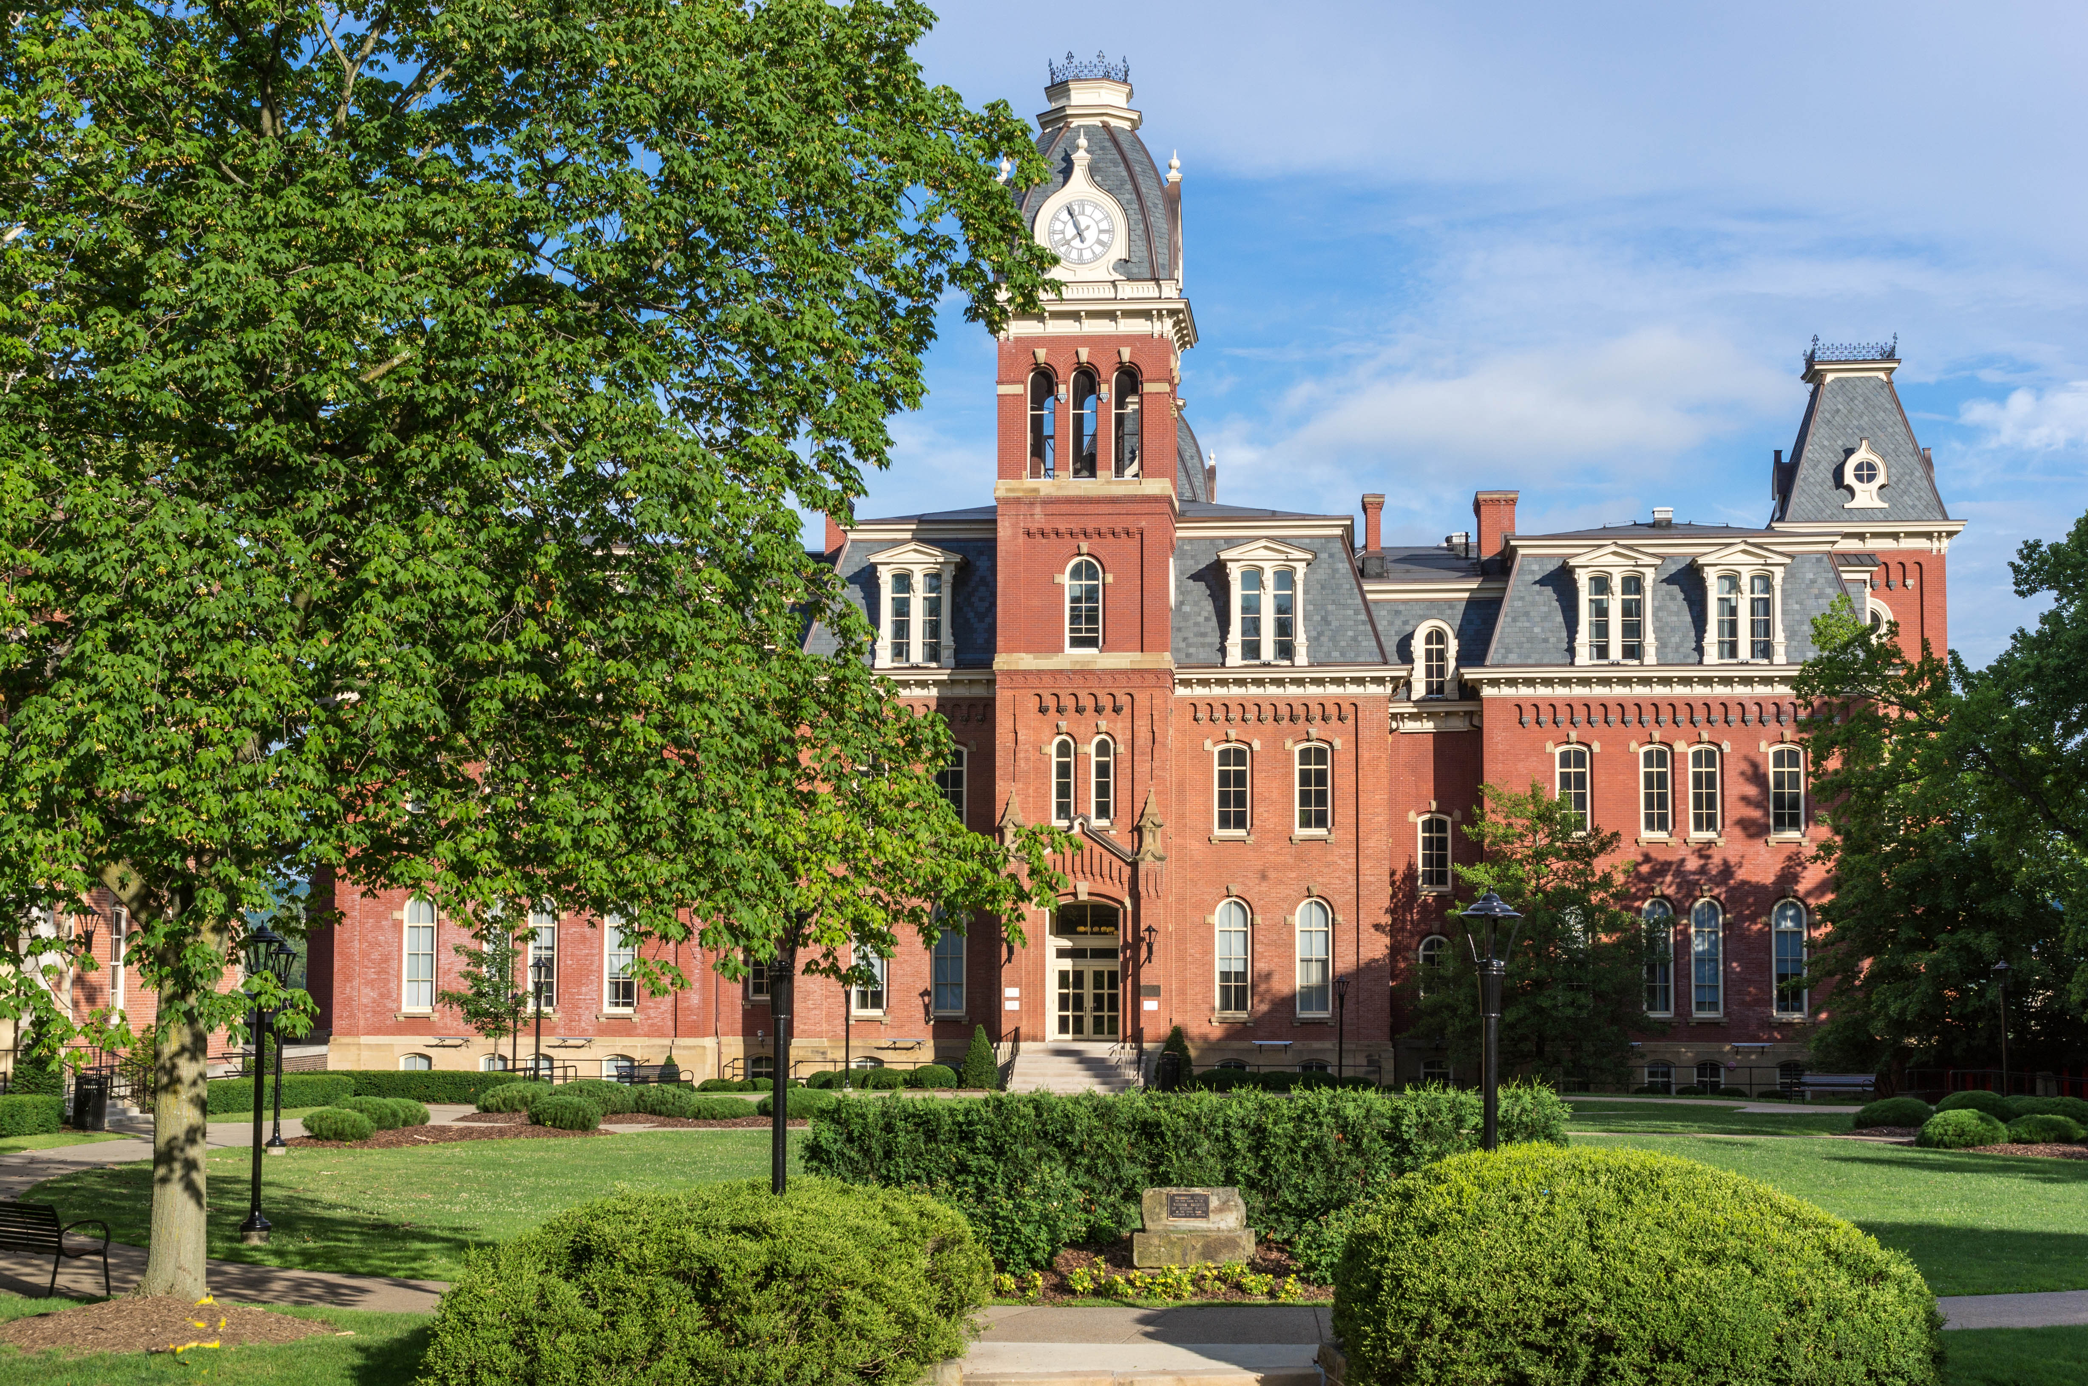
Woodburn Hall, West Virginia University, Morgantown, West Virginia
Image Credits
Slide 1: ForestWander, https://creativecommons.org/licenses/by/2.0/deed.en, Wikimedia Commons
Slide 2: formulanone, https://creativecommons.org/licenses/by-sa/2.5/deed.en, Wikimedia Commons
Final Slide: Tom Long, https://creativecommons.org/licenses/by-sa/3.0/deed.en, Wikimedia Commons
Return to Main Menu

