Slide 1


The Grist Mill in Babcock State Park, West Virginia
Chapter 4: The 21st Century
Global Economy
STUDY PRESENTATION
© 2025 Clairmont Press

Slide 2

West Virginia State Capitol building, Charleston
Section 1: A History of a Global Economy

Slide 3
Section 1:
A History of a Global Economy

Slide 4
What is globalization?
To some
  globalization represents the coming together of all the people in the world to form a single society.
To others
  globalization represents the bringing together of nations throughout the world through international trade, foreign
  investment, migration, and technology

Slide 5
A HISTORY OF TRADE
Early traders used a barter system to obtain things they needed or wanted.
The Silk Road became a major trade route between China and the countries in the Mediterranean Region.
Trade along the Silk Road introduced the concept of middlemen, who drove up the prices on goods like silk, perfume, gold, jewels, and spices.

Slide 6
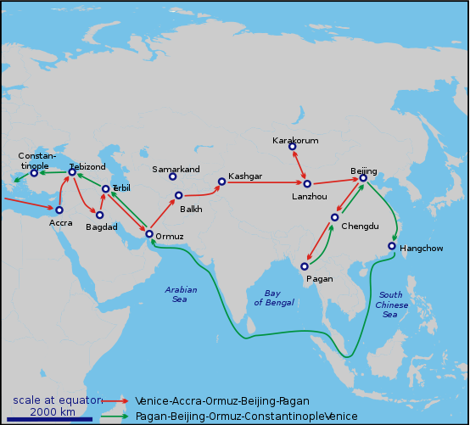
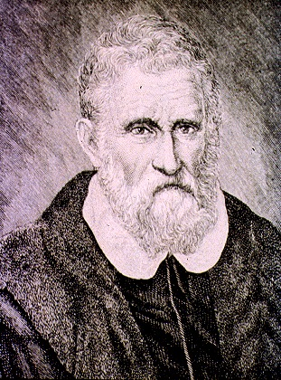
Marco Polo, with his father and uncle, spent many years in China. When they returned home, Marco wrote a book about their travels. This book attracted other travelers to the Far East.

Slide 7
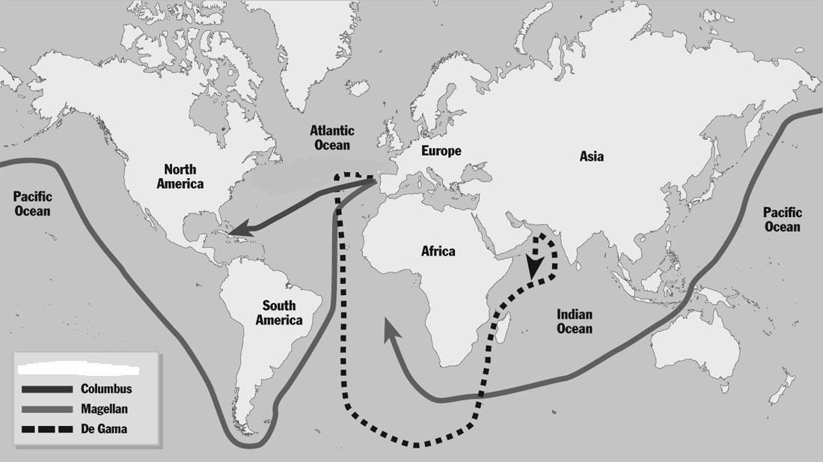
The Age of Exploration and Global Trade
Early explorers, who were sent to find new trade routes to the Far East, often claimed unknown lands for their rulers.

Slide 8
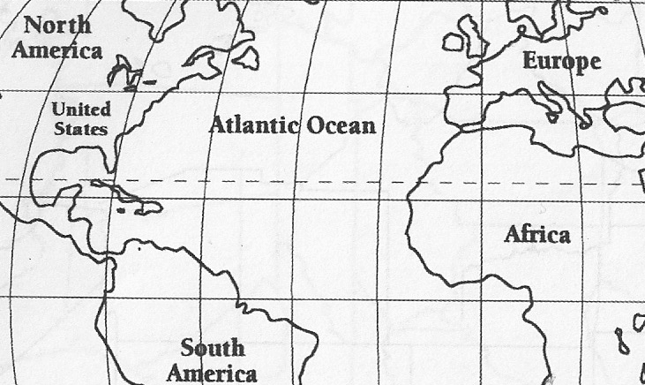
Colonization and Global Trade
In the seventeenth century, Great Britain encouraged its colonies to develop an economy based on agriculture and commerce.
These colonies became part of a triangular trade in which the colonies sent raw materials (sugar, tobacco, cotton) to Great Britain. Great Britain used the raw materials to manufacture goods, e.g. textiles, which it sent to Africa. Africa in turn sent slaves to the American colonies.
Sugar – Tobacco - Cotton
Sugar – Tobacco - Cotton
Colonies
Manufactured Goods
Manufactured Goods
Slaves
Slaves

Slide 9
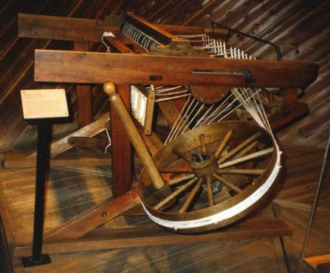
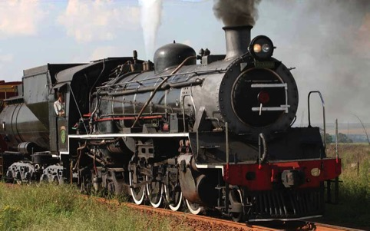
The Growth of Global Trade
After the United States got its independence from Great Britain, it wanted to concentrate on developing its own industries. To this end, it charged high tariffs (taxes on imported goods) to protect American industry.
In the eighteenth century, the Industrial Revolution affected global trade.
New inventions like the Spinning Jenny fueled global trade.
In the nineteenth century, the steam engine revolutionized transportation and made it easier to move products to markets.

Slide 10
Global Trade in the 20th and 21st Centuries
The United States’ participation in global trade declined after World War I, but grew after World War II.
International trade in the 20th Century received a boost from the creation of
  GATT (General Agreement on Tariffs and Trade) which was created to prevent free trade (international trade free of government intervention).
  WTO (World Trade Organization), which replaced GATT. It establishes the rules of trade between nations, polices members, and negotiates new trade agreements.
  NAFTA (North American Free Trade Agreement) which eliminated trade barriers on products traded among the United States, Canada, and Mexico.
    President Donald Trump withdrew The United States from the TPP(Trans – Pacific Partnership). He also imposed high tariffs on Canada which changed the terms of NAFTA.

Slide 11
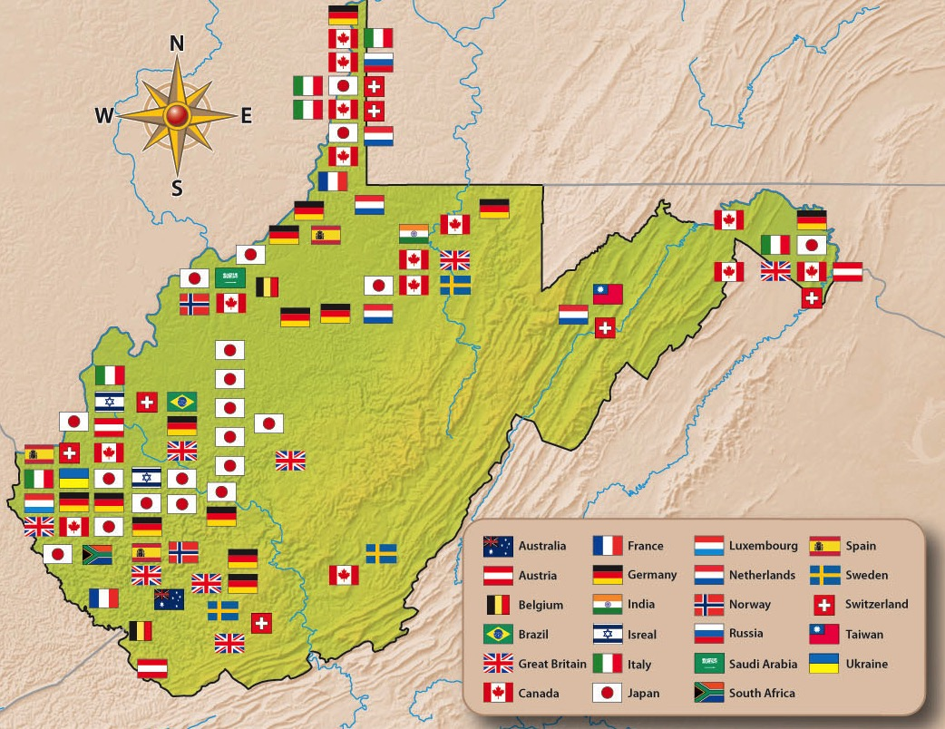
West Virginia’s economy today depends on foreign investment in the state as well as selling its goods in foreign markets.
Investments by foreign countries in West Virginia have grown. By 2018, some thirty foreign nations had invested in the state.
Japanese investment in West Virginia began more than 30 years ago. Today, there are 21 Japanese companies operating in the state.
Return to Main Menu

Slide 12
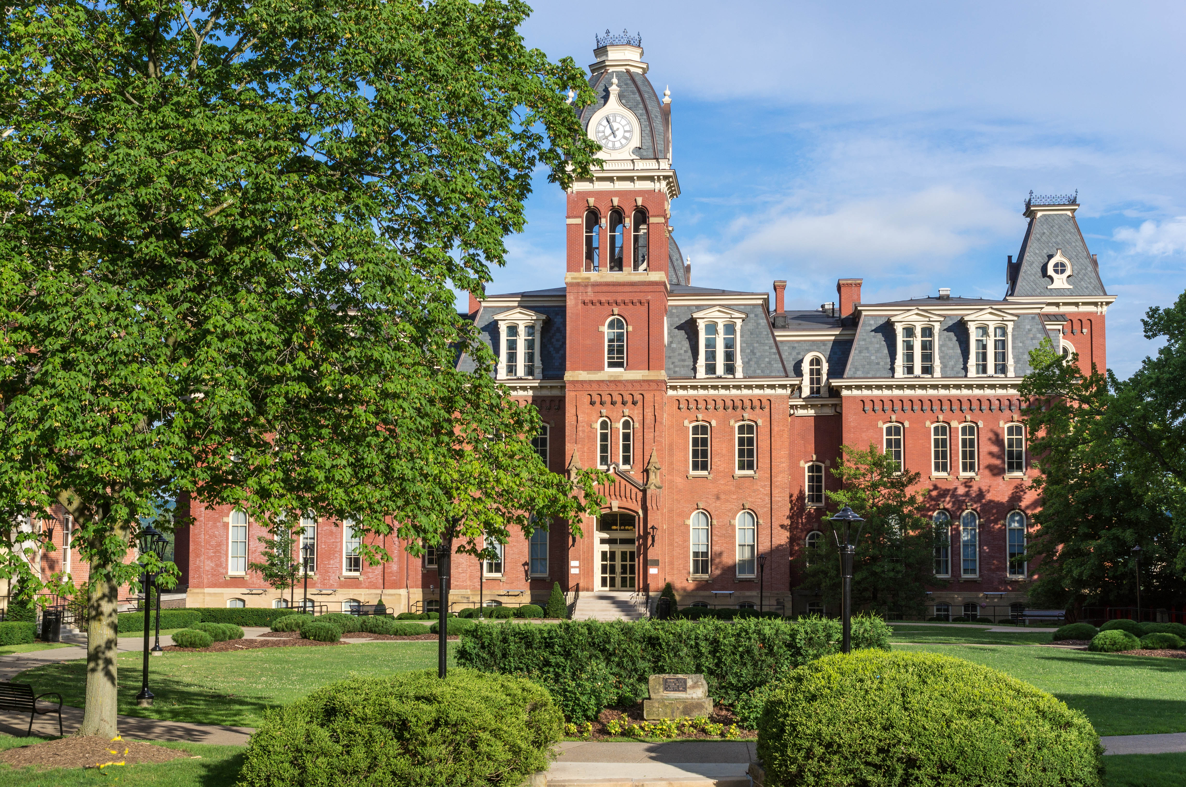
Woodburn Hall, West Virginia University, Morgantown, West Virginia
Image Credits
Slide 1: ForestWander, https://creativecommons.org/licenses/by/2.0/deed.en, Wikimedia Commons
Slide 2: formulanone, https://creativecommons.org/licenses/by-sa/2.5/deed.en, Wikimedia Commons
Final Slide: Tom Long, https://creativecommons.org/licenses/by-sa/3.0/deed.en, Wikimedia Commons
Return to Main Menu

