Slide 1


The Grist Mill in Babcock State Park, West Virginia
Chapter 2: State and Local
Government in West Virginia
STUDY PRESENTATION
© 2025 Clairmont Press

Slide 2
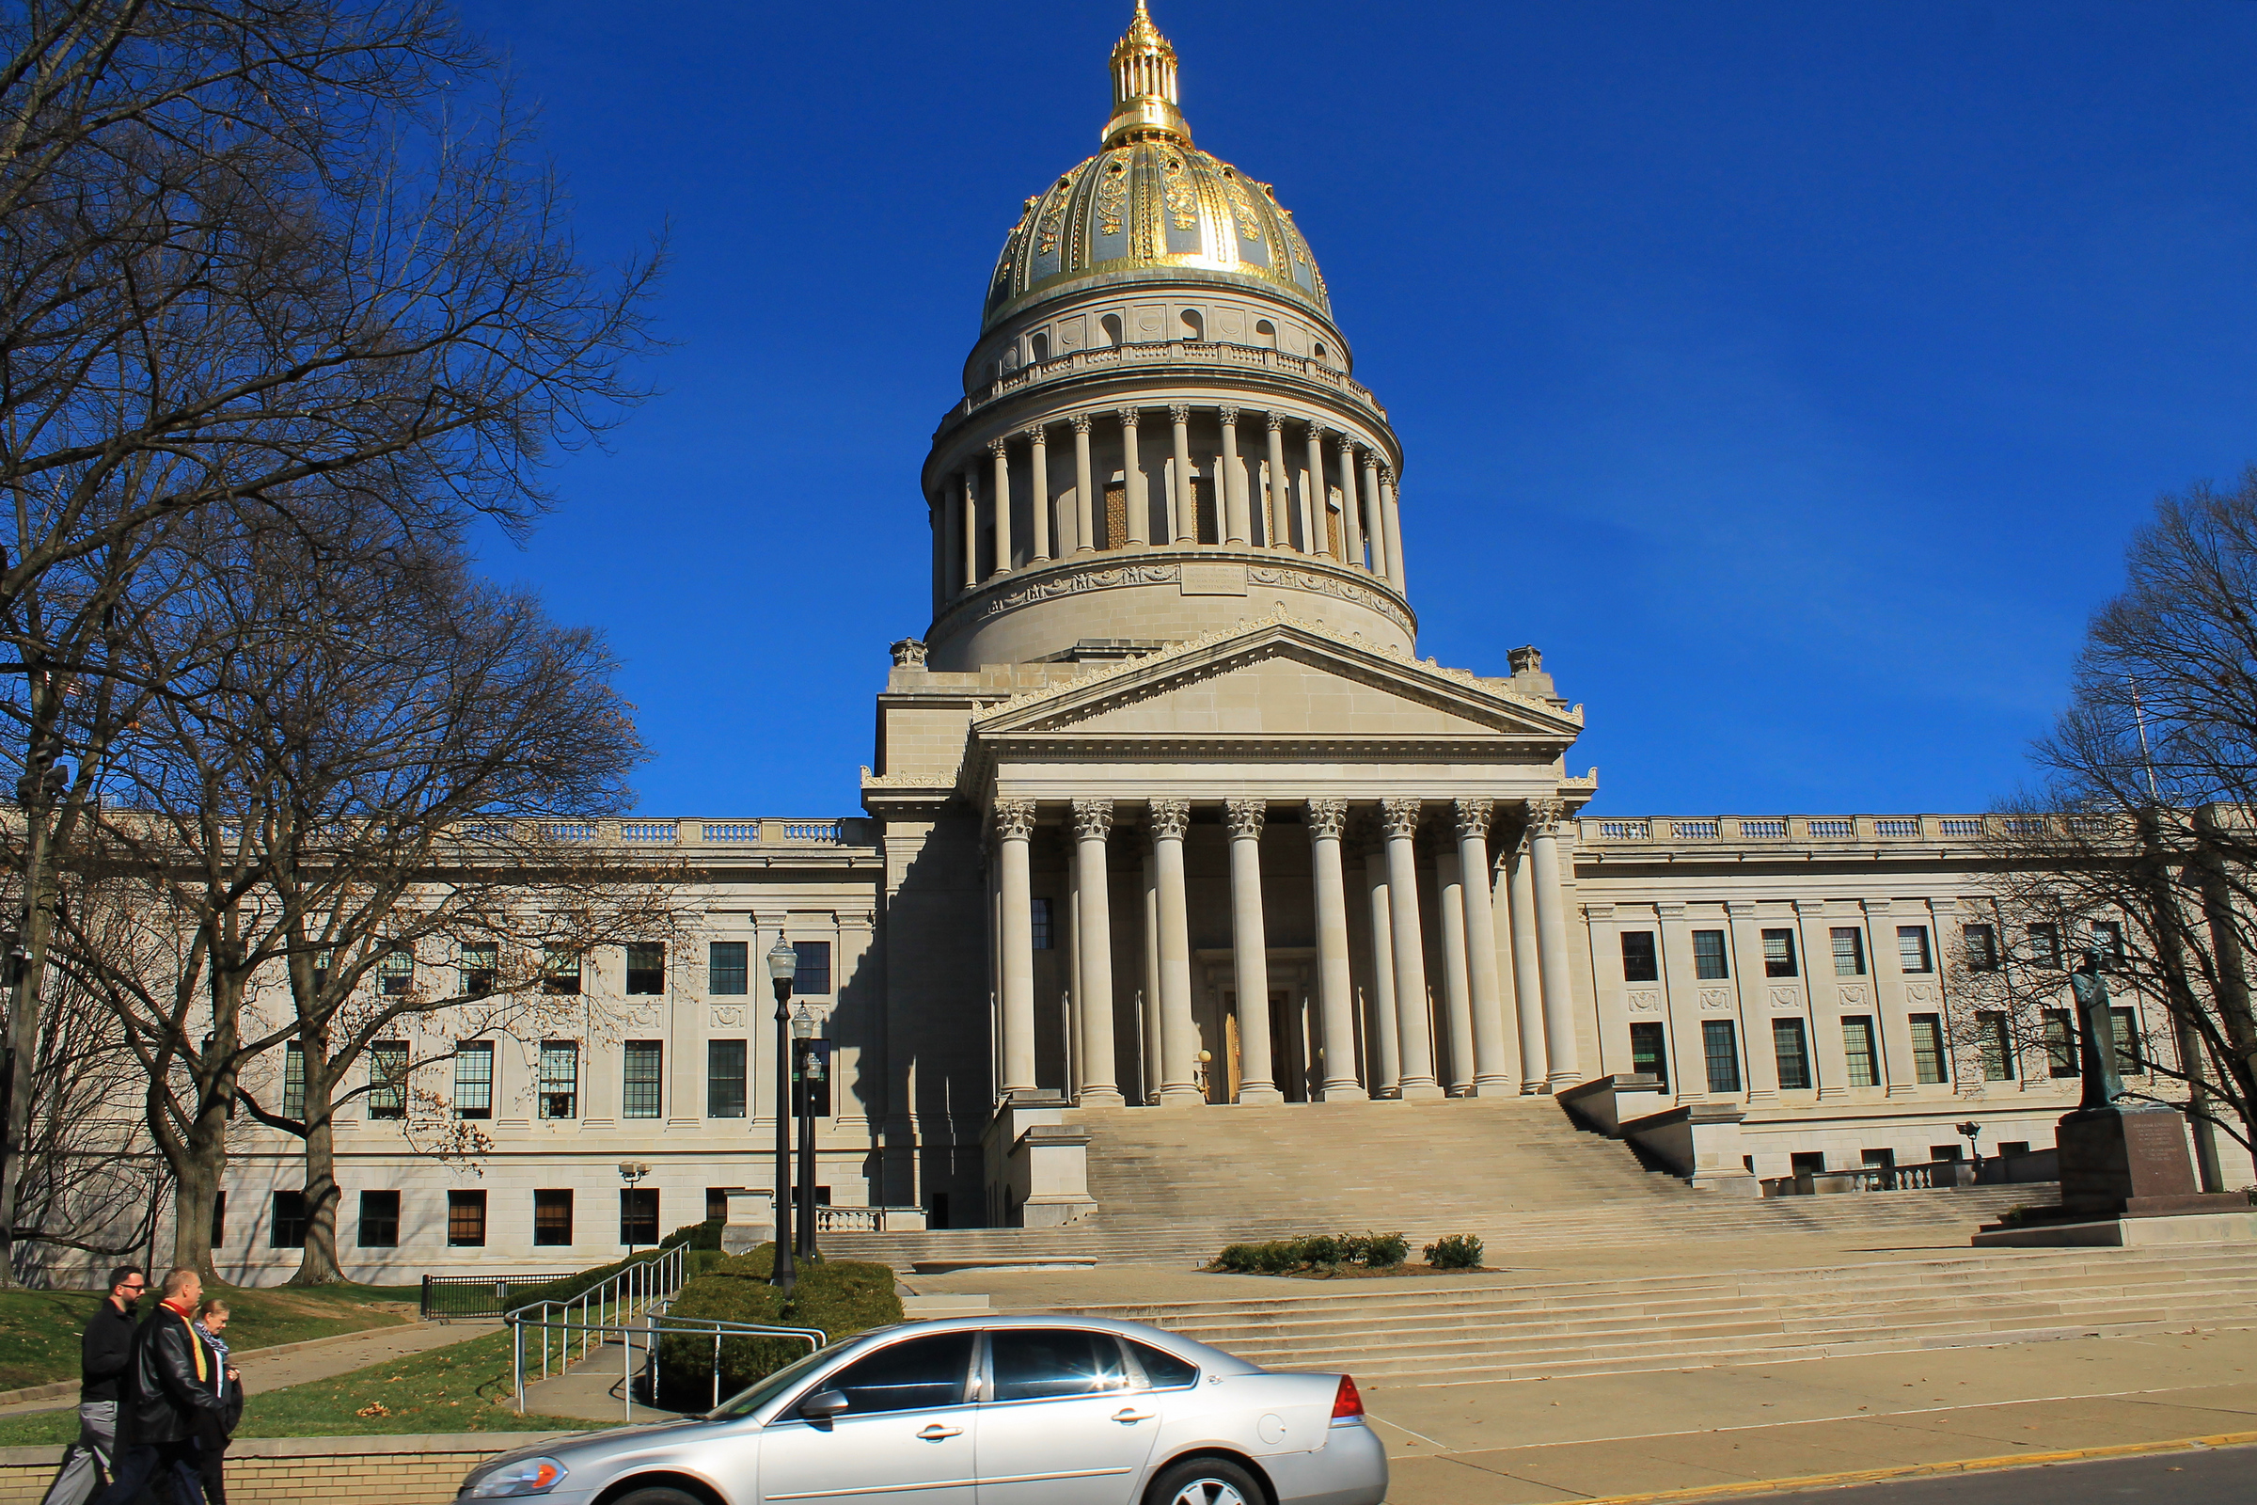
West Virginia State Capitol building, Charleston
Section 3: County and Municipal Government

Slide 3
Section 3:
County and Municipal Government

Slide 4
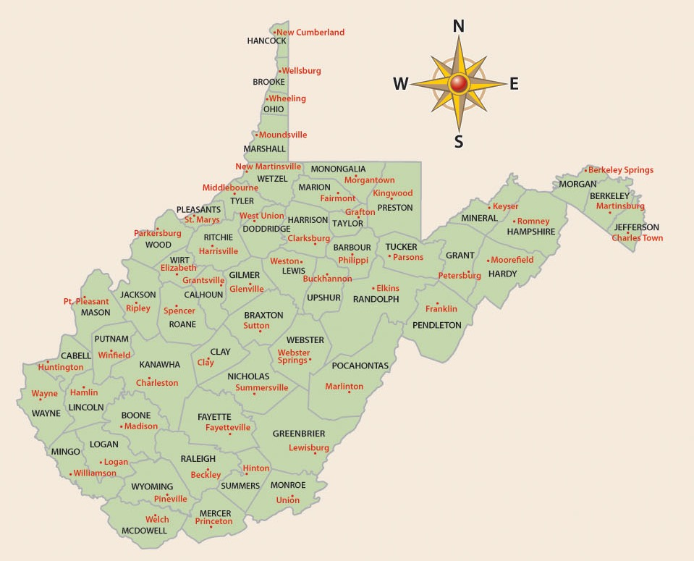
West Virginia’s Constitution provides for the establishment of governments for counties, municipalities, and boards of education.
There are over 3,000 counties in the United States; 55 of those counties are located in West Virginia.

Slide 5
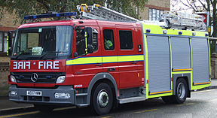
Services Provided by County Governments
Building and maintaining water and sewage systems
Fire Protection
Building and maintaining libraries
Providing emergency services, e.g., law enforcement, fire protection, medical emergencies
Providing recreational opportunities, e.g., swimming pools, parks

Slide 6
A County Commission presides over county government.
  Each county commission must have at least three members.
  Commissioners are elected to six-year terms.
  Commissioners must meet at least four times per year.
Other Elected County Officials
County Clerk: keeps official records of county
Circuit Clerk: keeps records of circuit court
Sheriff: enforces the law and collects taxes
Assessor: determines value of property for tax purposes
Prosecuting Attorney: represents county in court; pursues wrongdoers

Slide 7
Counties have executive, legislative, and judicial duties.
EXECUTIVE
Collect taxes
Enforce county ordinances
Conduct elections
Keep records
LEGISLATIVE
Regulate the use
of property
Levy taxes
Issue bonds
Set requirements for business licenses
Spend money for county purposes
JUDICIAL
Hear appeals on
tax assessments, employee complaints, and zoning decisions
Prosecute cases in circuit courts

Slide 8
MUNICIPAL GOVERNMENT
Depending on its size, a municipality may be classified as a city, town or village.
  CLASS I CITIES have a population of at least 50,000
  CLASS II CITIES have a population between 10,000 and 50,000
  CLASS III CITIES have a population between 2,000 and 10,000
  -Municipalities of less than 2,000 are classified as towns or villages.

Slide 9
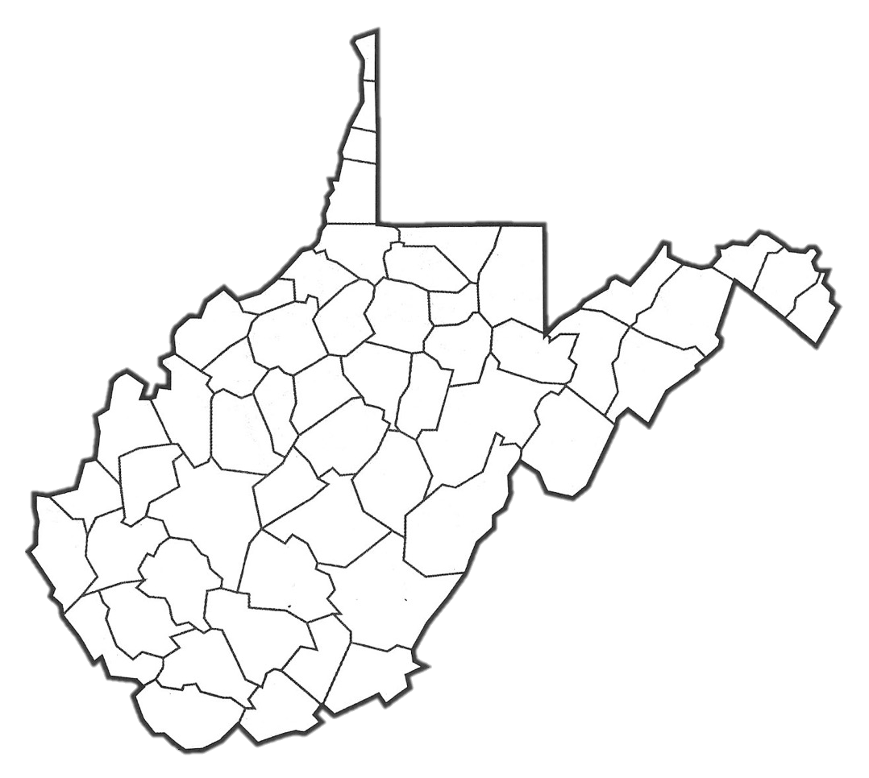
WEST VIRGINIA’S LARGEST CITIES
BY POPULATION
Weirton
Wheeling
Morgantown
Martinsburg
Fairmont
Parkersburg
Charleston
Clarksburg
Huntington
Beckley

Slide 10
Municipalities may choose from
one of three types of government:
Mayor-Council Form
  The people elect both the mayor and the council members.
Commission Form
  Voters elect individuals to specific administrative positions. In West Virginia, there must be either three or five commissioners.
Council-Manager Form
  Elected city council members set policy and pass ordinances. There is a mayor who presides at council meetings. The mayor is either elected to the office or designated by a vote of the council members.
Municipalities of fewer than 2,000 residents must use the Mayor-Council form of government.

Slide 11
BOARDS OF EDUCATION
The third example of local government is the board of education.
Each county has a Board of Education consisting of five members.
Board members are chosen in nonpartisan elections.
Board members set education policy, approve a budget, approve curriculum, and hire employees.
Board members hire the county superintendent to carry out the system’s goals.
County boards of education receive direction from the West Virginia Department of Education.
County boards of education receive funding from county property taxes, state funds, federal funds, and sometimes from special assessments.

Slide 12
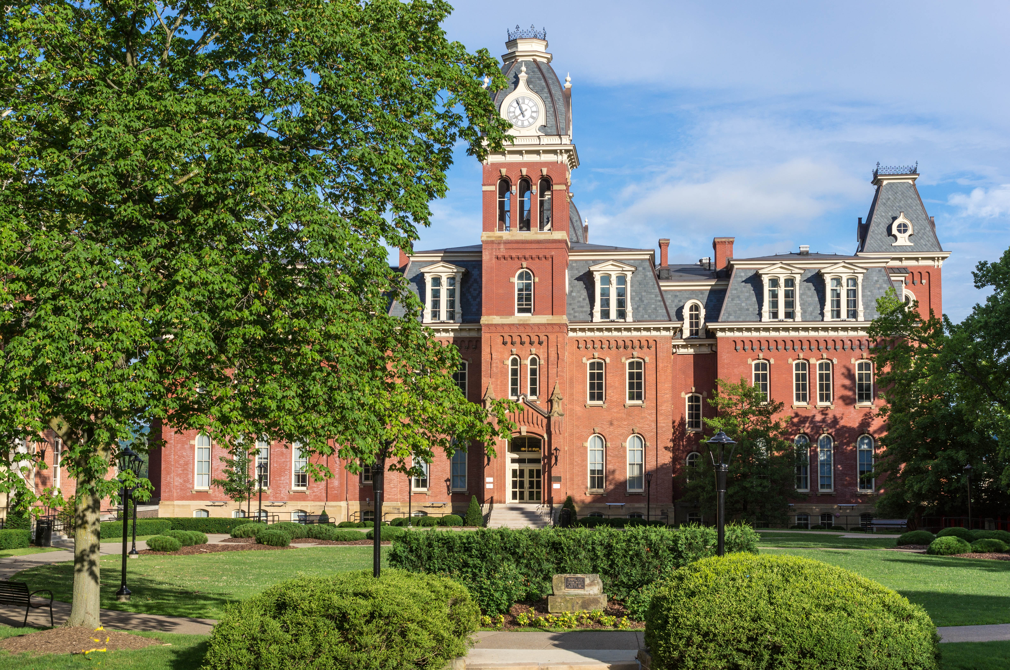
Woodburn Hall, West Virginia University, Morgantown, West Virginia
Image Credits
Slide 1: ForestWander, https://creativecommons.org/licenses/by/2.0/deed.en, Wikimedia Commons
Slide 2: formulanone, https://creativecommons.org/licenses/by-sa/2.5/deed.en, Wikimedia Commons
Final Slide: Tom Long, https://creativecommons.org/licenses/by-sa/3.0/deed.en, Wikimedia Commons
Return to Main Menu

