Slide 1
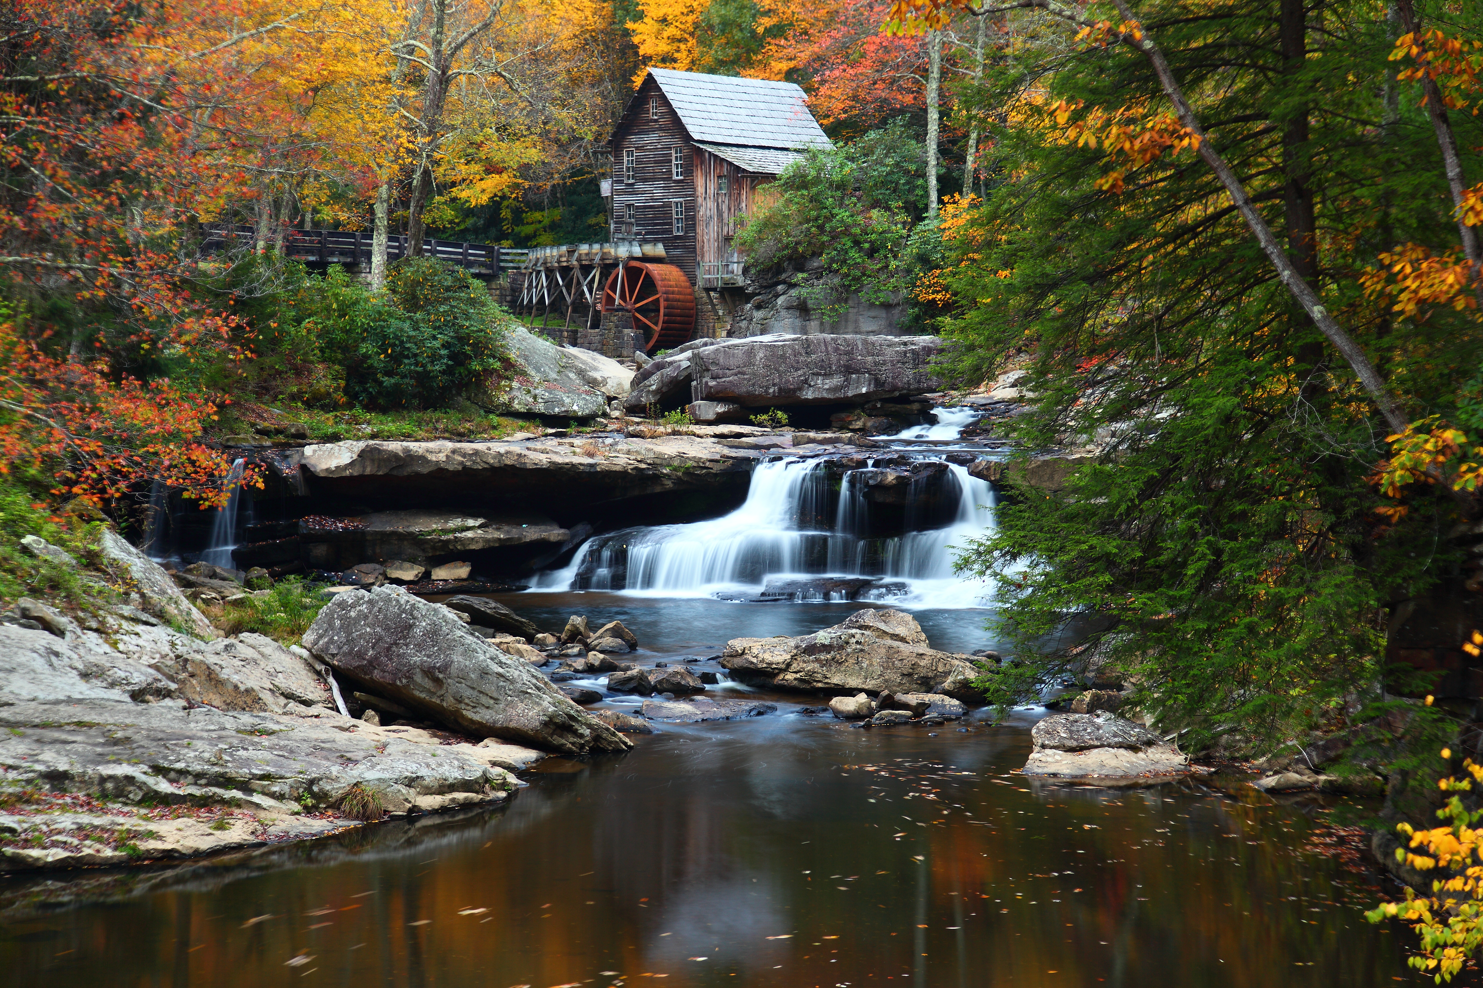

The Grist Mill in Babcock State Park, West Virginia
Chapter 2: State and Local
Government in West Virginia
STUDY PRESENTATION
© 2025 Clairmont Press

Slide 2
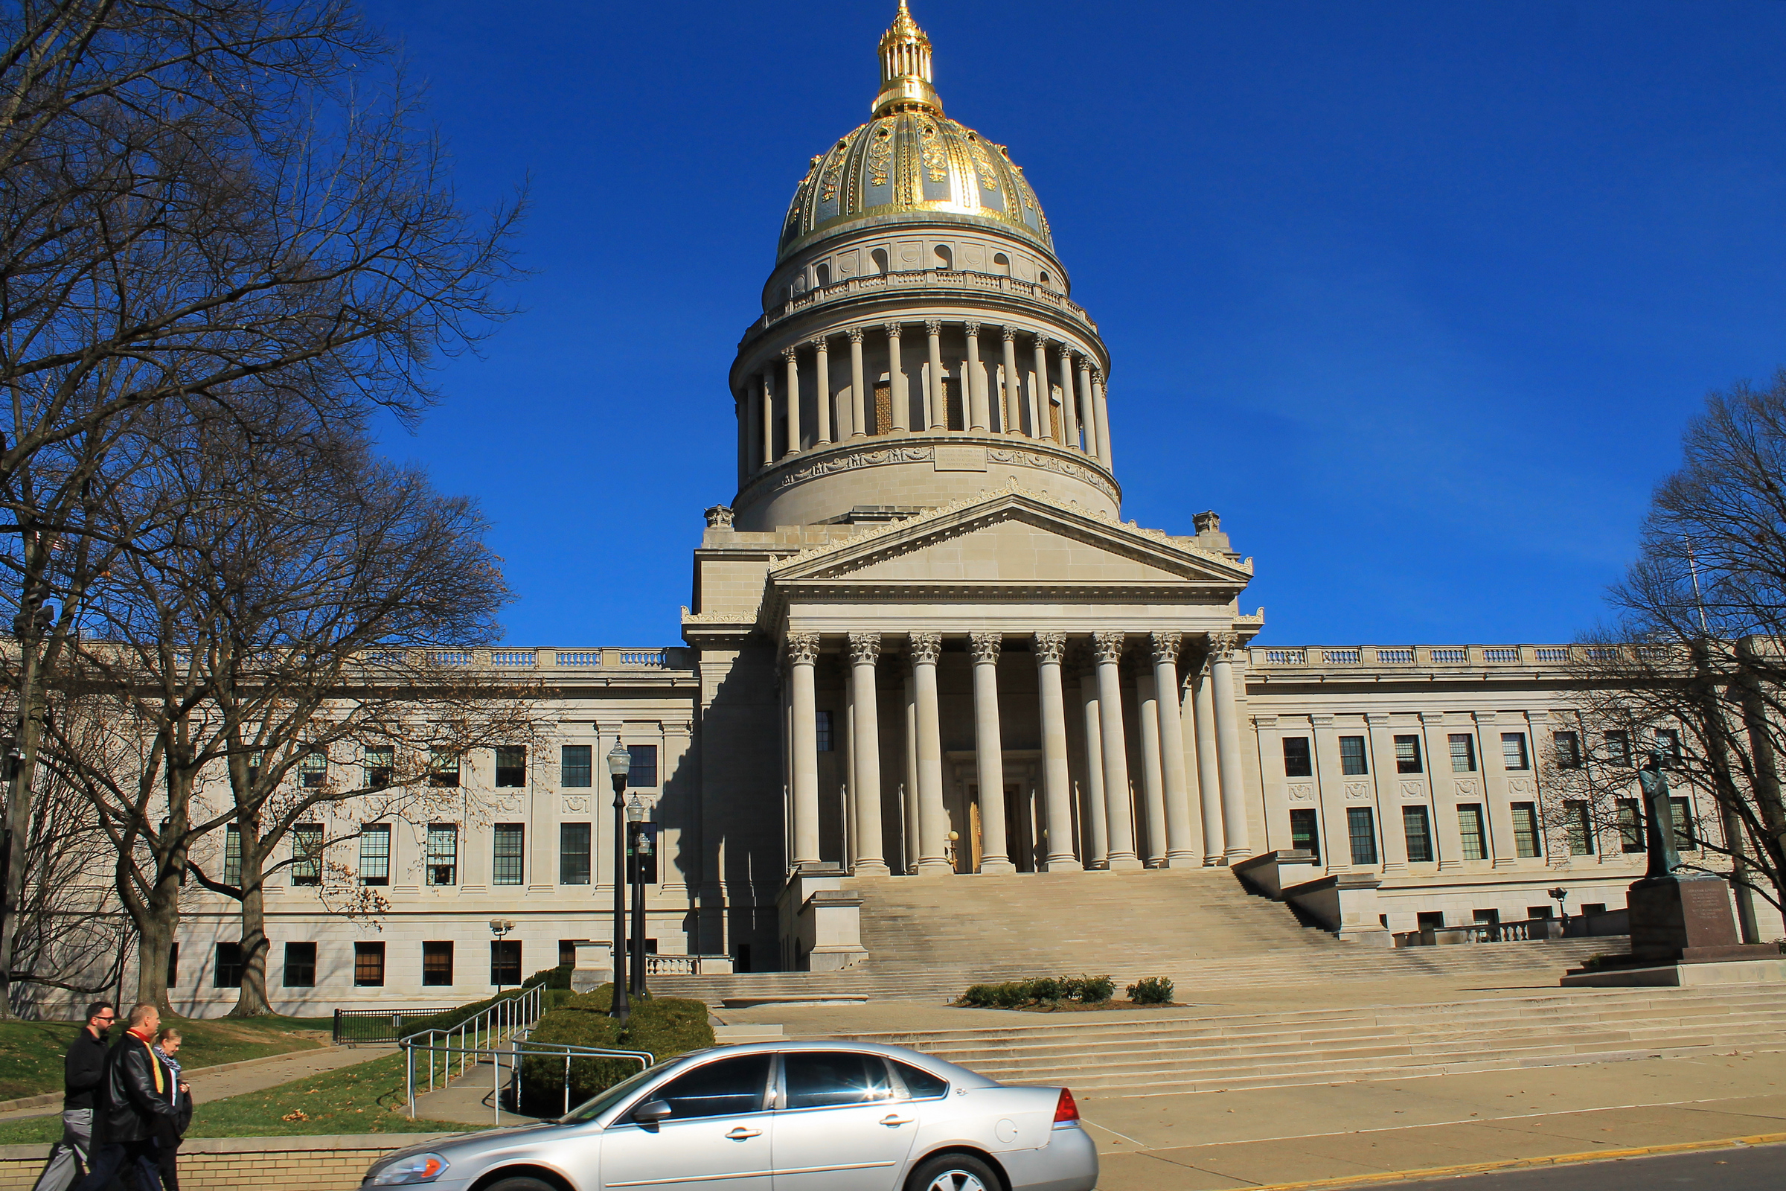
West Virginia State Capitol building, Charleston
Section 2: The Three Branches of State Government

Slide 3
Section 2:
The Three Branches of State Government

Slide 4
The three branches of State Government are:
The Legislative Branch
The Executive Branch
The Judicial Branch

Slide 5
LEGISLATIVE BRANCH
HOUSE OF DELEGATES
  100 members; 58 districts
  Serve two-year terms; unlimited number of terms
  Speaker of the House is the presiding official
SENATE
  34 members; 17 districts
  Serve 4-year terms; unlimited number of terms
  President/Lieutenant Governor is the presiding official

Slide 6
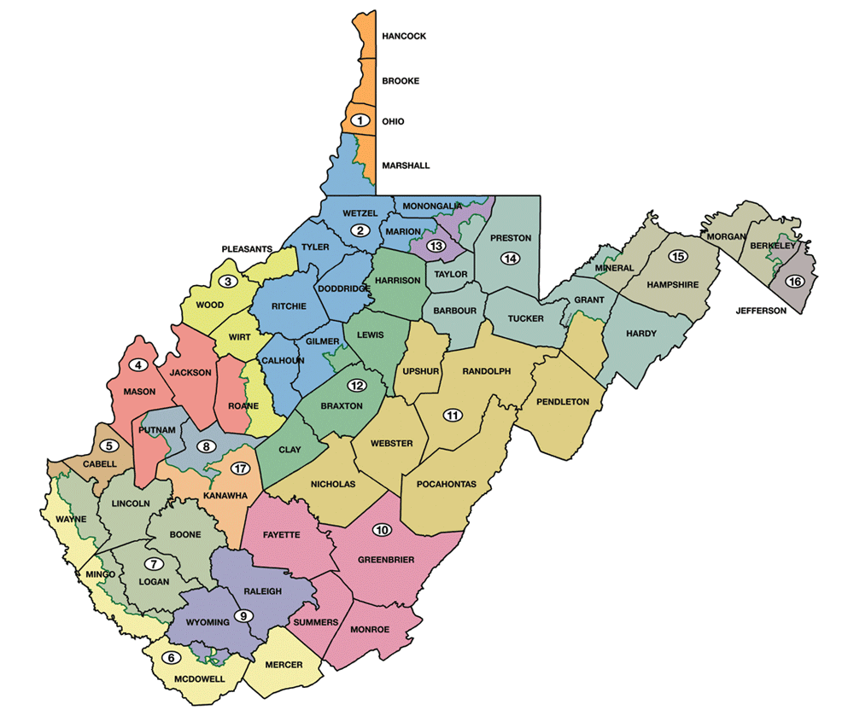
State Senate Districts

Slide 7
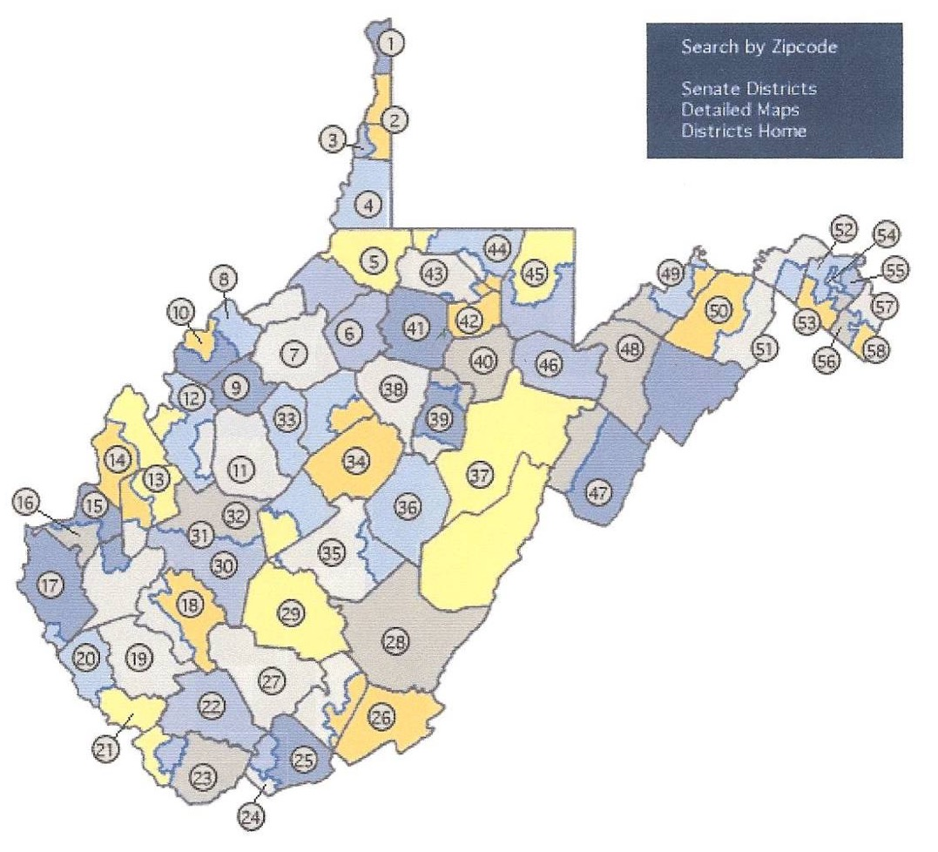
House of Delegates Districts

Slide 8
REQUIREMENTS TO SERVE IN THE LEGISLATURE
House of Delegates | Senate
Eligible to vote Resident of state for one year Resident of district in which they are running At least 18 years of age | Eligible to vote Resident of state for one year Resident of district in which they are running At least 25 years of age

Slide 9
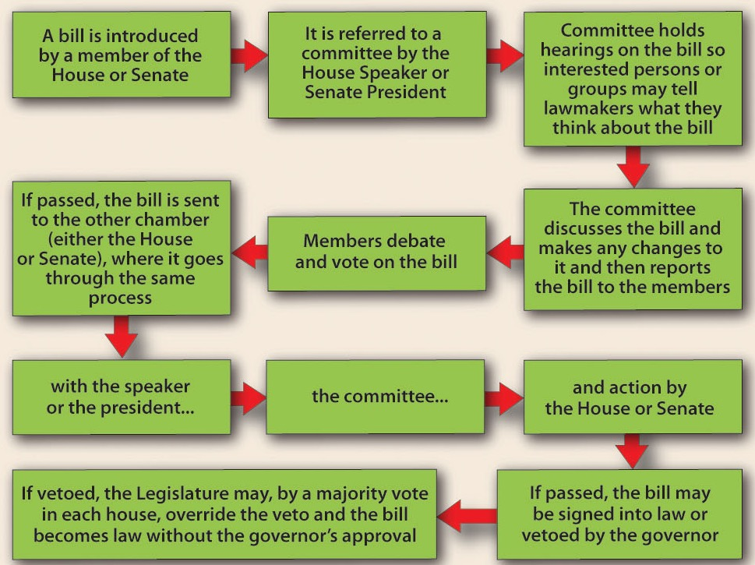
LAW MAKING PROCESS
To become a law, a bill goes through a process like that at the national level.

Slide 10
EXECUTIVE BRANCH
GOVERNOR
BOARD OF PUBLIC WORKS
CABINET
VARIOUS AGENCIES AND OFFICES

Slide 11
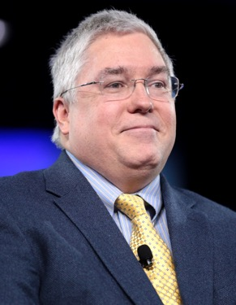
GOVERNOR
Patrick James Morrisey was elected the 37th governor in 2024 and took office January 13, 2025. To be governor, a person must be at least 30 years of age and have lived in the state for five years prior to the election.
DUTIES
Enforces state laws
Prepares annual budget
Commander-in-chief of state’s military
Pardons people accused of crimes
Appoints heads of various agencies
Serves on state boards and commissions
Holds press conferences to keep people informed

Slide 12
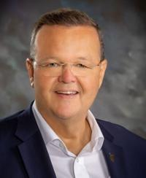
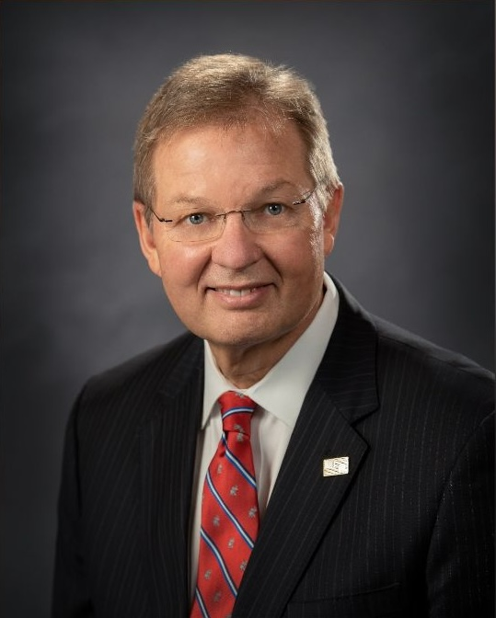
BOARD OF PUBLIC WORKS
Secretary of State: Kris Warner
  Keeper of Great and Less Seal of State
  Chief state election officer
  Maintains all official state papers
State Treasurer: Larry Pack
  Receives state revenues
  Pays the state’s bills
Kris Warner
Larry Pack

Slide 13
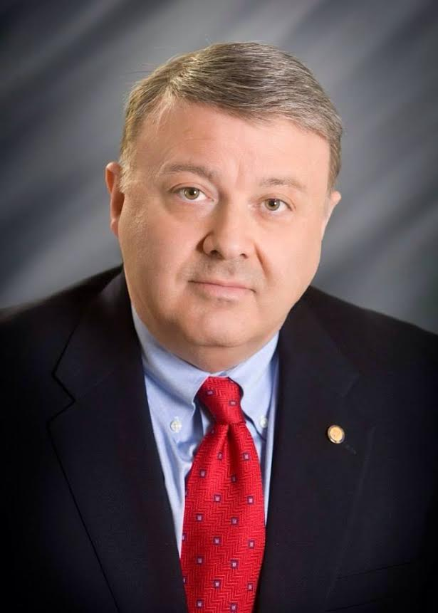
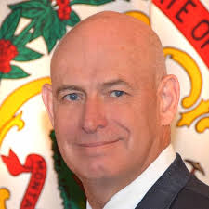
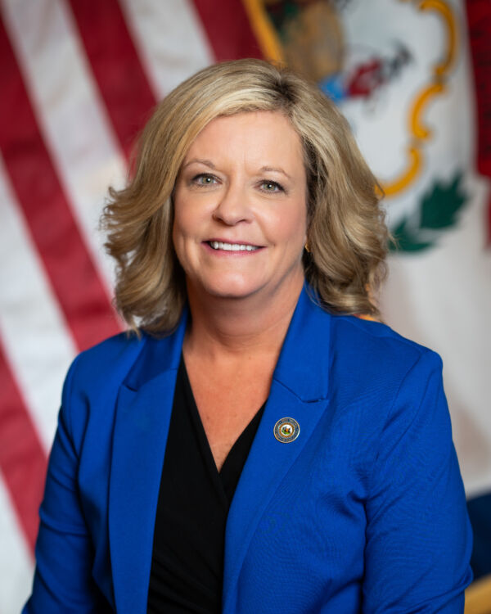
Attorney General: John McCuskey
  Heads state legal department
  Serves as the state’s lawyer
State Auditor: Mark Hunt
  State’s official bookkeeper
Commissioner of Agriculture:
Kent Leonhardt
  Sets standards
  Grades all farm products
  Identifies markets for farm products
State Superintendent of Schools: Michele L. Blatt
  Oversees state’s public school system, including teacher certification, curriculum, and textbook adoptions
Mark Hunt
John McCuskey
Kent Leonhardt
Michele L. Blatt

Slide 14
Other Executive Departments
Department of Administration
Department of Commerce
Department of Arts, Culture and History
Department of Environmental Protection
Department of Health and Human Resources
Department of Military Affairs and Public Safety
Department of Revenue
Department of Transportation
Department of Veterans’ Assistance
Each of these departments is headed by a secretary.

Slide 15
This chart provides a look at the organization of the executive branch of West Virginia’s government.

Slide 16
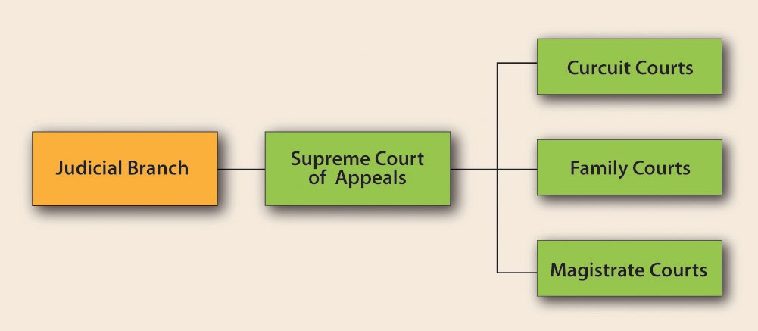
JUDICIAL BRANCH

Slide 17
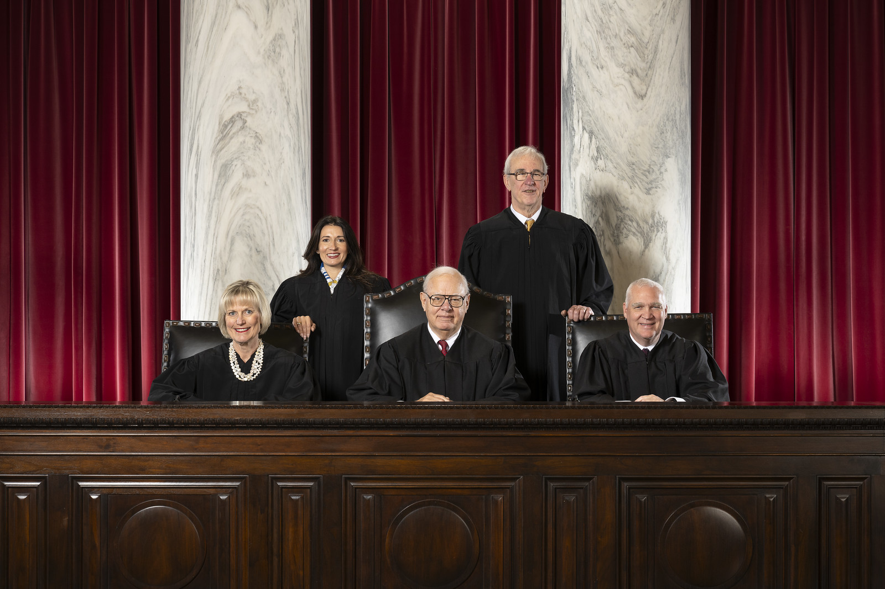
WEST VIRGINIA SUPREME COURT
The Court has five justices, one of whom serves as the chief justice.
A chief justice may serve from one to four years.
Justices are elected for twelve-year terms.
The Court has two terms each year: January to July and September into December.

Slide 18
THE SUPREME COURT
  has appellate and original jurisdiction. Most of the court’s cases are appealed from circuit or magistrate courts.
  has no witnesses, testimony, or juries. The justices hear oral arguments and review printed materials.
  has the power of judicial review.
  Most of the decisions of the Supreme Court are final.

Slide 19
OTHER STATE COURTS
CIRCUIT COURTS
  Trial Court
  31 circuits; 74 judges
  Judges elected to eight-year terms
  Hear all felony and some misdemeanor cases
MAGISTRATE COURTS
  158 magistrates
  At least 2 in every county
  Magistrates elected to four-year terms

Slide 20
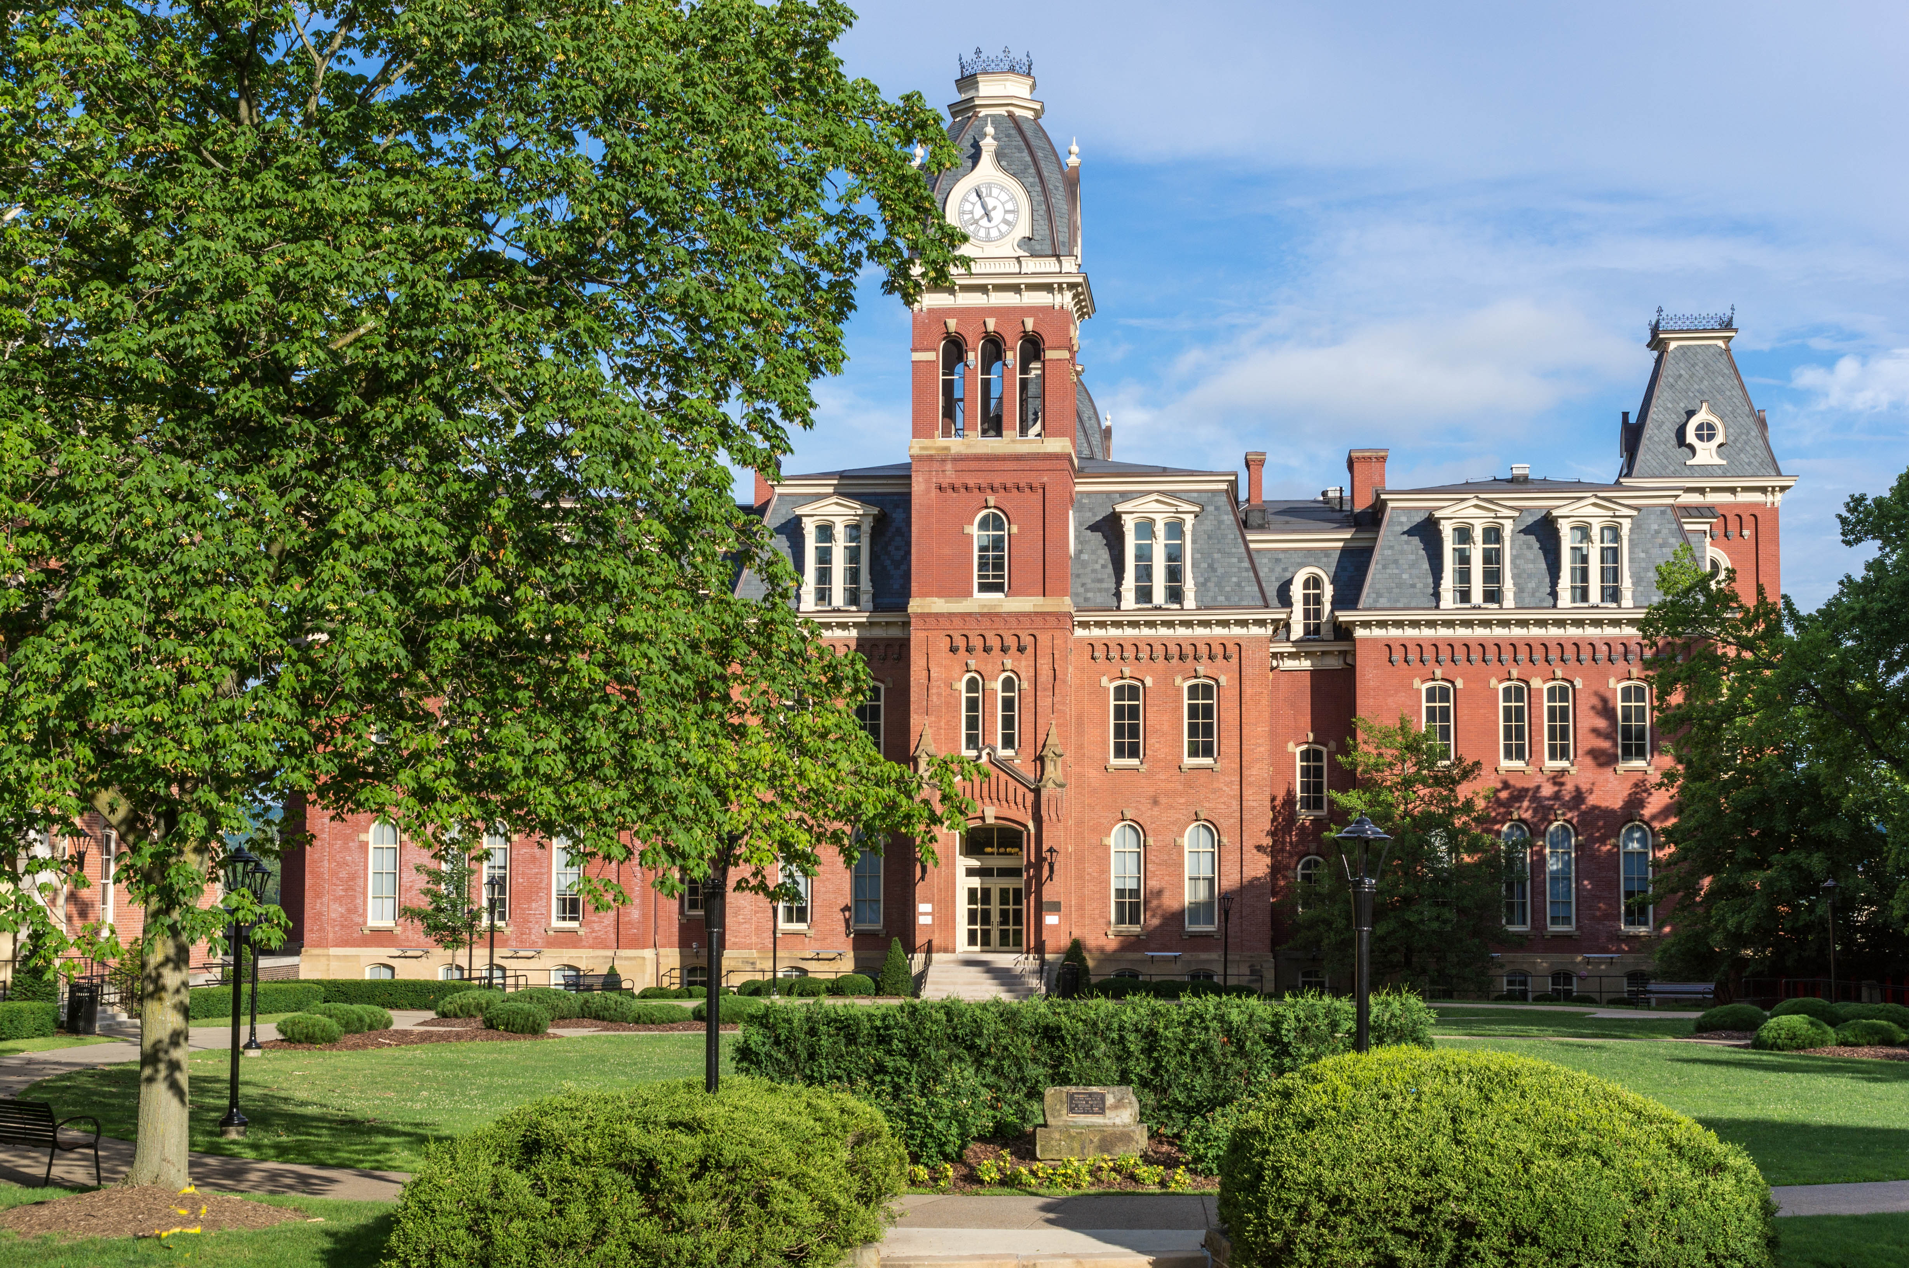
Woodburn Hall, West Virginia University, Morgantown, West Virginia
Image Credits
Slide 1: ForestWander, https://creativecommons.org/licenses/by/2.0/deed.en, Wikimedia Commons
Slide 2: formulanone, https://creativecommons.org/licenses/by-sa/2.5/deed.en, Wikimedia Commons
Final Slide: Tom Long, https://creativecommons.org/licenses/by-sa/3.0/deed.en, Wikimedia Commons
Return to Main Menu

