Slide 1


The Grist Mill in Babcock State Park, West Virginia
Chapter 2: State and Local
Government in West Virginia
STUDY PRESENTATION
© 2025 Clairmont Press

Slide 2
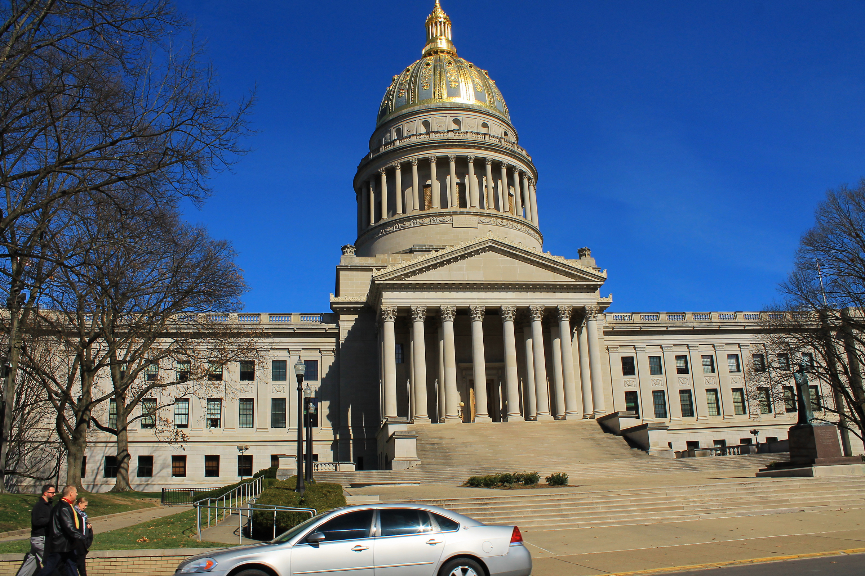
West Virginia State Capitol building, Charleston
Section 1: A History of West Virginia Government

Slide 3
Section 1:
A History of West Virginia Government

Slide 4
West Virginia’s government is based on the same five principles as the federal government:
  Sovereignty
  Limited Government
  Separation of Powers
  Checks and Balances
  Federalism

Slide 5
West Virginia has had two constitutions in its nearly 150 years of statehood. The present constitution, written in 1872, begins with a preamble stating its purpose.
Preamble to the West Virginia Constitution
Since through Divine Providence we enjoy the blessings of civil, political and religious liberty, we, the people of West Virginia, in and through the provisions of this Constitution, reaffirm our faith in and constant reliance upon God and seek diligently to promote, preserve and perpetuate good government in the State of West Virginia for the common welfare, freedom and security of ourselves and our posterity.

Slide 6
Since the people who wrote the West Virginia Constitution in 1872 could not anticipate what life would be like in the future, the amendment process provided the flexibility to make needed changes.
West Virginia Constitution Amendment Process
Proposed by constitutional convention and approved by a majority of both houses of the Legislature and a majority of the voters
Proposed by two-thirds of members of both houses of the Legislature and approved by a majority of the voters in the state
OR

Slide 7
Amendments include:
  Adding a preamble
  Establishing a family court system
  Allowing the governor to serve two consecutive terms
  Providing better highways
  Providing bonuses for veterans
Return to Main Menu

Slide 8
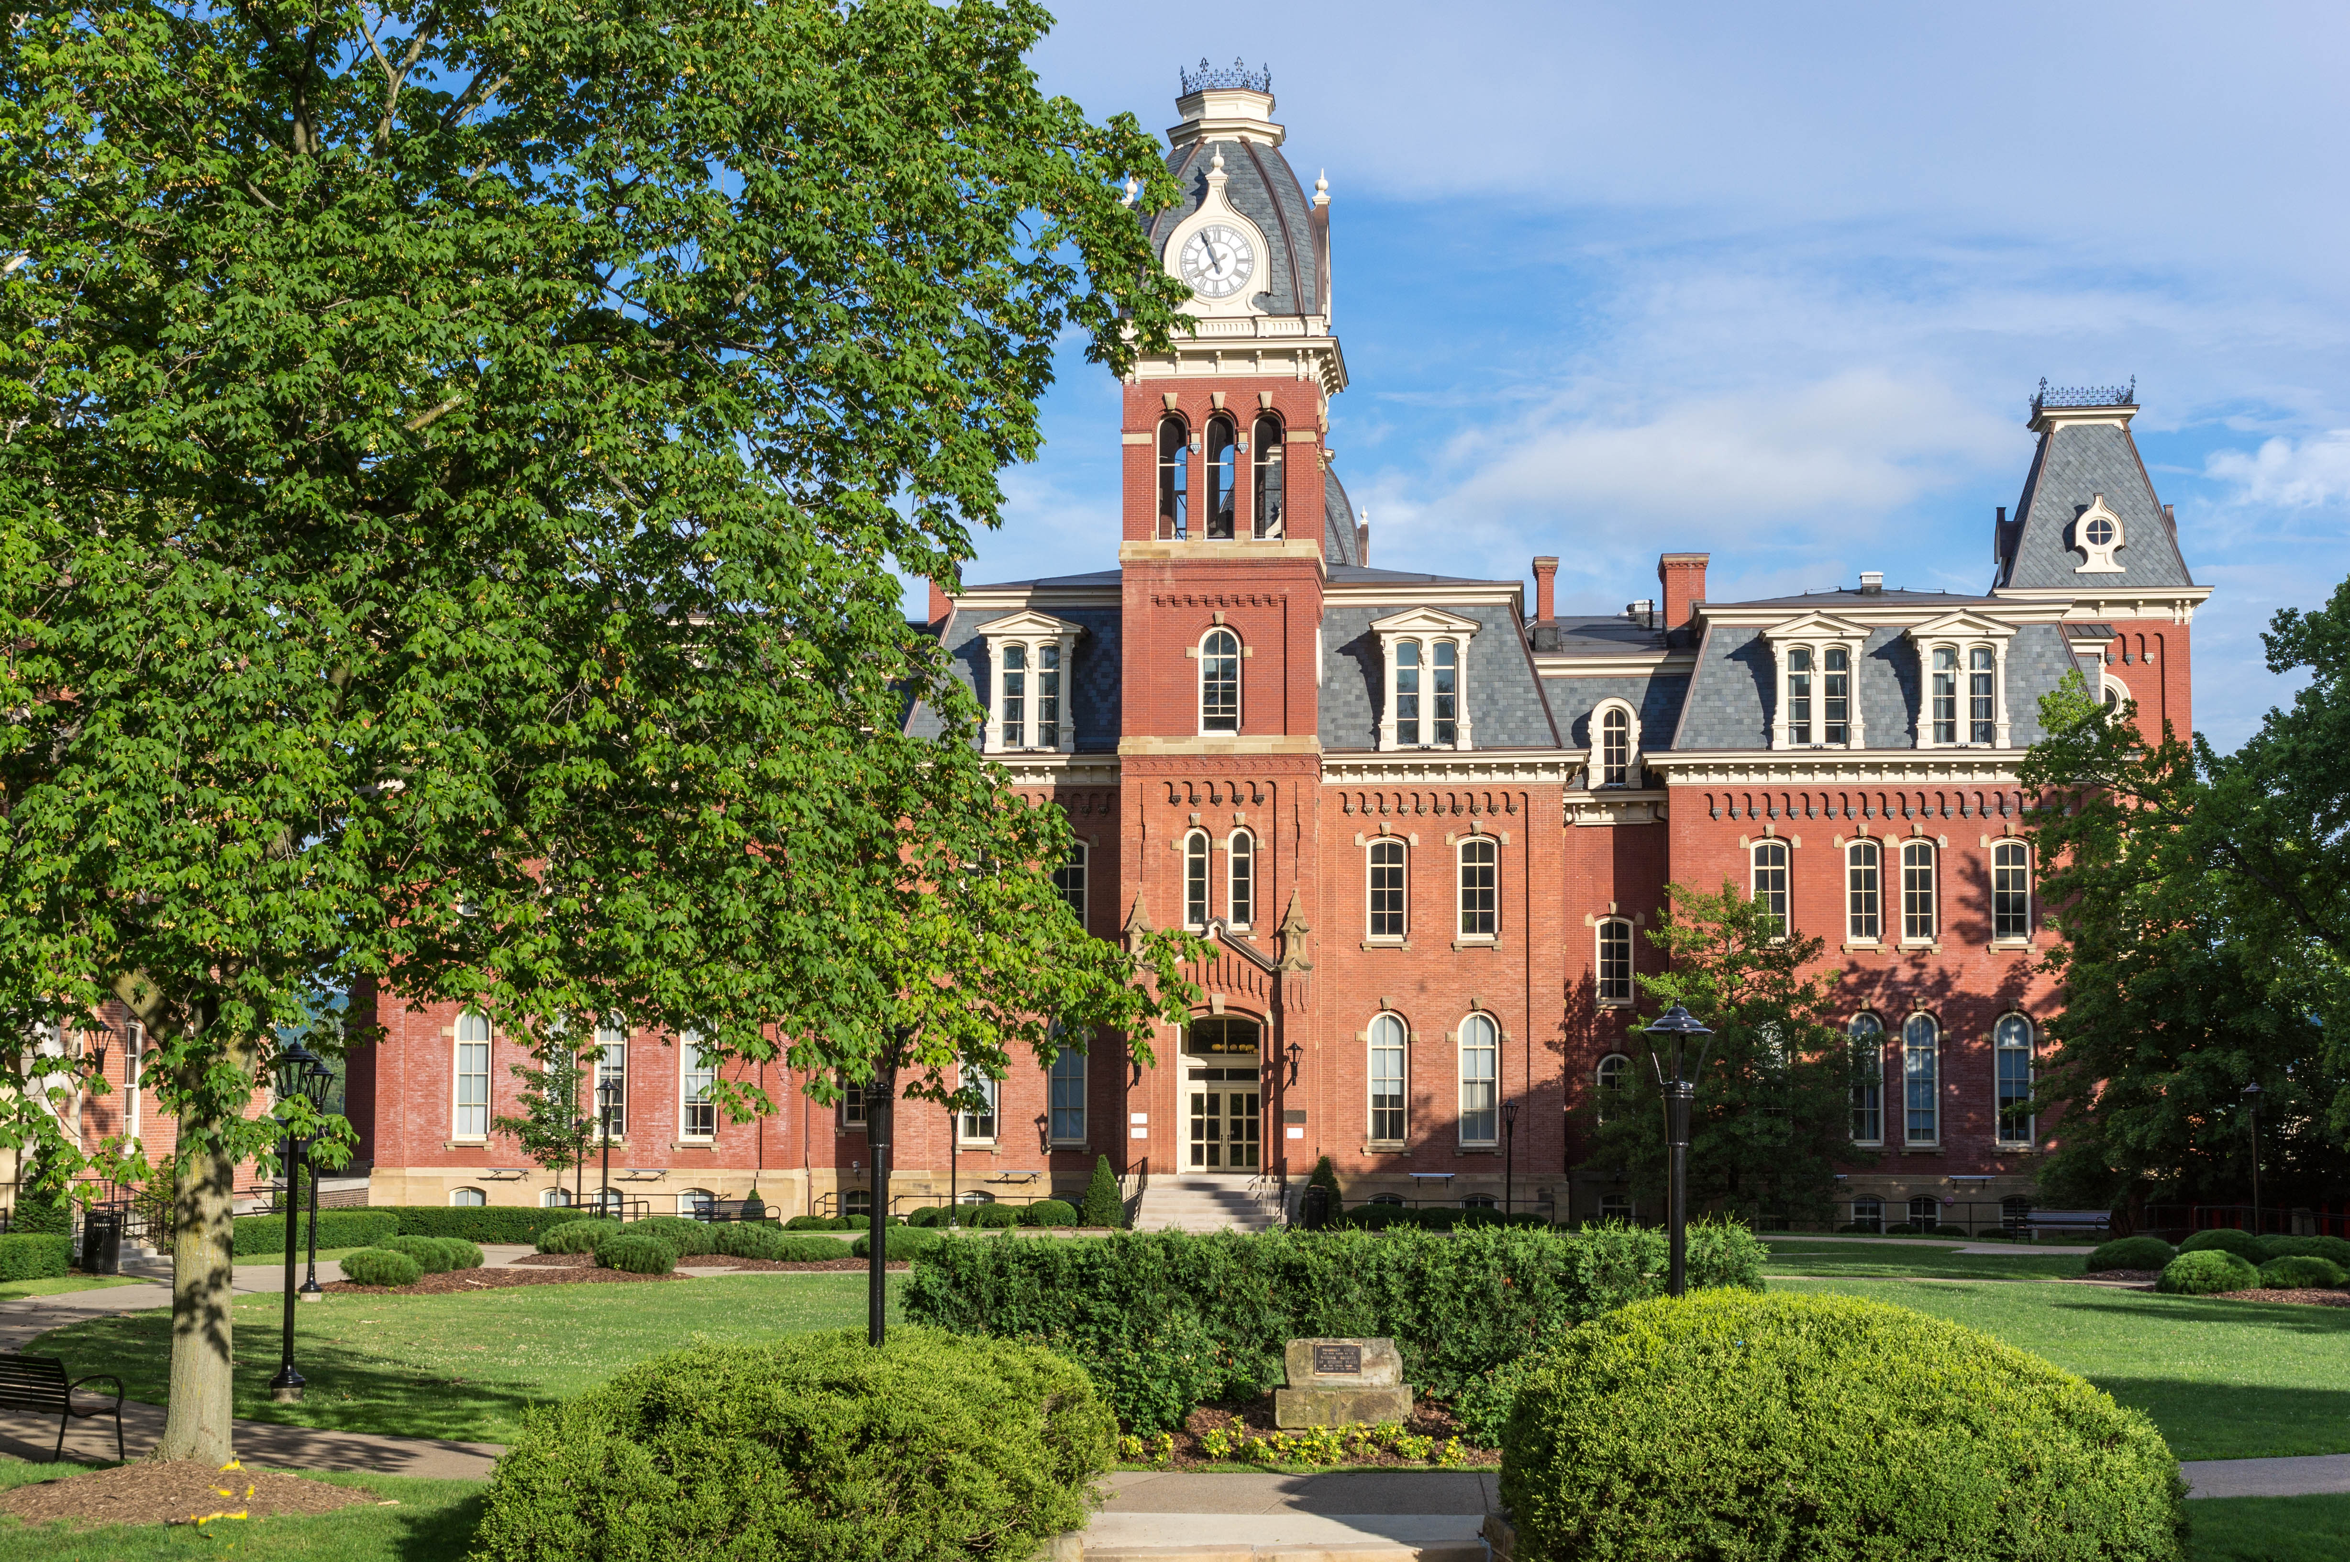
Woodburn Hall, West Virginia University, Morgantown, West Virginia
Image Credits
Slide 1: ForestWander, https://creativecommons.org/licenses/by/2.0/deed.en, Wikimedia Commons
Slide 2: formulanone, https://creativecommons.org/licenses/by-sa/2.5/deed.en, Wikimedia Commons
Final Slide: Tom Long, https://creativecommons.org/licenses/by-sa/3.0/deed.en, Wikimedia Commons
Return to Main Menu

