Slide 1
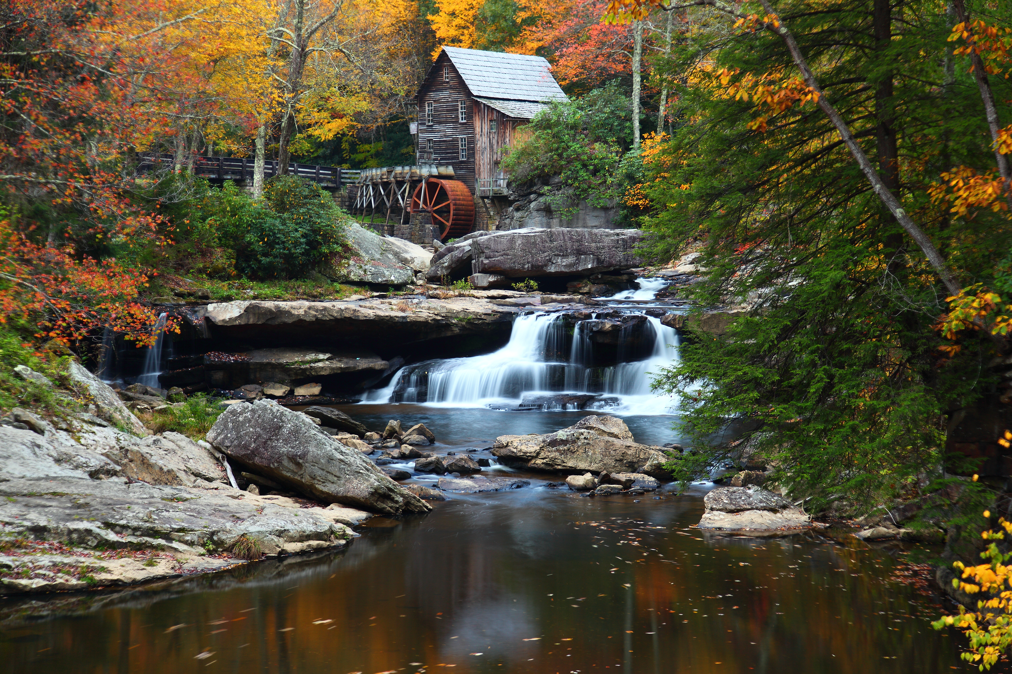

The Grist Mill in Babcock State Park, West Virginia
Chapter 17: As One Century
Ends, Another Begins
STUDY PRESENTATION
© 2025 Clairmont Press

Slide 2
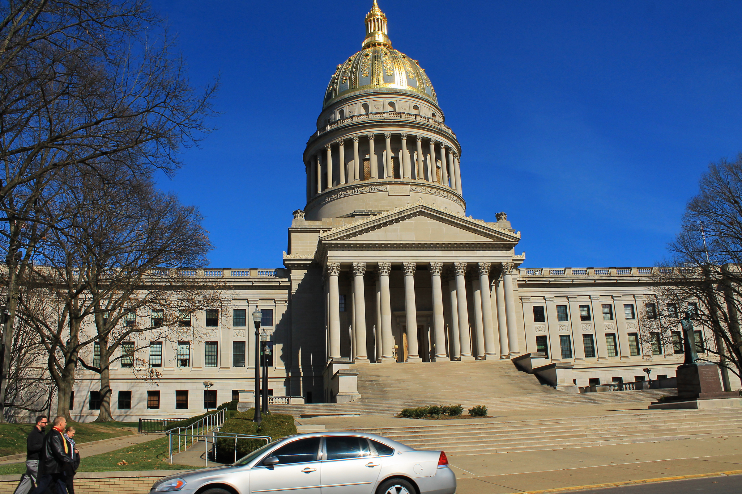
West Virginia State Capitol building, Charleston
Section 1: Twenty-first-Century Lifestyles
Section 2: The Rise of Terrorism
Section 3: West Virginia Emerges from a Worldwide Pandemic to Find a Bright Future

Slide 3
Section 1:
Twenty-first-Century Lifestyles

Slide 4





TECHNOLOGY
The turn of the century marked major advancements in technology.
  Cell phones gained the ability to
  take pictures, watch movies and
  live TV, access the internet, and
  even collect medical information.
  Televised entertainment moved
  from analog and cable to digital
  and online.
  Social media websites like Twitter, Facebook, and Instagram revolutionized worldwide communication and connectivity with friends and followers.

Slide 5
ENTERTAINMENT
The entertainment industry continued to thrive in the new century.
  Music of the 20th century started to fuse and change, becoming new genres like nu-disco and post-punk.
  Many top music artists of the 80s and 90s continued their fame into the 2000s, but new artists like Taylor Swift, Bruno Mars, and Kendrick Lamar also rose to stardom over the next two decades.
  Movies continued to be a favorite type of entertainment, especially with new advancements in filmmaking, and reality shows, mocumentary sitcoms, and period dramas became popular on TV.

Slide 6

FASHION
Fashion has been one of the faster-changing aspects of the new century, even bringing back elements of the past.
  The 2000s saw tracksuits, dresses over
  jeans, wide belts, and Ugg boots as
  some of the top fashion picks.
  The 2010s saw merch shirts, skinny
  jeans, leggings, fanny packs, and ankle
  boots became all-the-rage.
  COVID changed fashion for the 2020’s,
  with people choosing comfy clothing
  like sweat clothes, tie-dye, Crocs, and
  athleisure wear.

Slide 7

LITERATURE
Major literary genres of the 21st century include poetry, drama, blogs, and graphic novels.
  Early works of the 21st century include
  books like The Da Vinci Code (2003),
  Percy Jackson: The Lightning Thief
  (2005), and The Hunger Games (2008).
  The 2010s saw successes like The
  Martian (2011), Ready Player One
  (2011), and The Fault in Our Stars (2012).
  While the top pieces of literature of the
  2020’s are still to be decided, some standout hits are Project Hail Mary (2021) and Babel (2022).
Return to Main Menu

Slide 8
Section 2:
The Rise of Terrorism

Slide 9
TERRORISM STRIKES
THE UNITED STATES
On September 11, 2001, the United States was attacked by unknown terrorists.
Four airplanes were hijacked. The World Trade Center in New York City was the target of two planes. One of the planes crashed into the North Tower of the World Trade Center and minutes later a second plane flew into the South Tower.
As stunned Americans watched the tragedy unfold on television, the third plane crashed into the Pentagon in Washington, D.C.
On the fourth plane, passengers overtook the terrorists and caused the plane to land in a rural field in Pennsylvania. Their act of heroism possibly saved hundreds of lives.

Slide 10
OPERATION ENDURING FREEDOM
An extremist group of Islamist terrorists, called al-Qaeda, was found to be responsible for the attacks. Al-Qaeda, based in Afghanistan, was protected by a group called the Taliban.
Immediately after the attacks, President George W. Bush asked Congress to give him war powers.
The United States gave
al-Qaeda an ultimatum:
  close terrorist training camps
  hand over al-Qaeda leaders
  return all foreign nationals who had been unjustly detained in Afghanistan

Slide 11
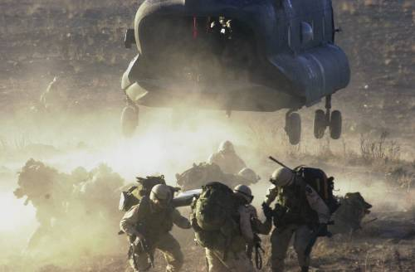
The Taliban refused the ultimatum, resulting in a United States-led coalition attack on al-Qaeda’s leader Osama bin Laden’s camps in Afghanistan.
This military operation, called “Enduring Freedom”, began in October 2001, and, by the end of March 2002, had successively removed the Taliban from power in Afghanistan.
US Troops in Afghanistan
Osama bin Laden was killed in Pakistan on May 2, 2011, by
a United States Special
Operations Military Unit.

Slide 12
The United States combat mission in Afghanistan continued until December 2014, when most troops returned home.
After 2014, the name of the operation in Afghanistan was changed to “Operation Freedom Sentinel”.
Unlike President Obama’s prediction that all US troops would be removed by 2017, President Trump sent more troops there.
After the total withdraw of troops from Afghanistan by President Biden in 2021, the Taliban quickly returned to power.

Slide 13
Several counter-terrorism training centers were created before and after 9/11, with Camp Dawson of Preston County being one of these.
The Memorial Tunnel on the West Virginia Turnpike is another training center, which trains emergency workers for handling various urban scenarios.
The Department of Homeland Security was created in 2002 to maintain border security and protect critical installations at home and abroad.

Slide 14
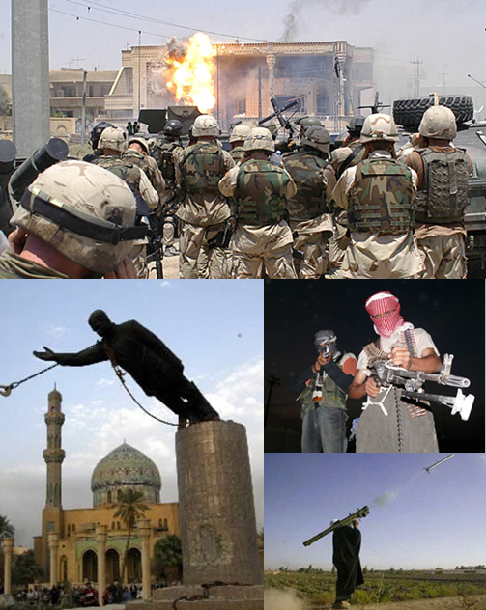
OPERATION IRAQI FREEDOM
Following the attacks on September
11, 2001, the United States became
more concerned about foreign
nations, like Iraq, having weapons of
mass destruction that could be used
by terrorists.
On March 19, 2003, President
George W. Bush announced that
the United States was involved in a
military conflict, named Operation
Iraqi Freedom.
The combat phase of the operation
lasted less than two months, ending on May 1, 2003, but troops remained to help with stability.

Slide 15
In December 2003, Iraqi dictator Saddam Hussein was captured by U.S. troops and was hanged for crimes against humanity on December 30, 2006.
Operation Iraqi Freedom became a political issue during the presidential election of 2008, resulting in Barack Obama, who favored the earliest withdrawal of troops from Iraq, was elected.
On December 15, 2011, the United States lowered the flag of command over Bagdad, officially ending the country’s military mission in Iraq.

Slide 16
REEVALUATING FOREIGN RELATIONS
When Donald Trump became president in 2017, he disagreed with the policies of previous presidents regarding foreign relations.
To that end, he supported an “America First” agenda, which called for:
  reducing the amount of money the United States would spend to defend other countries around the world
  increasing the amount of money allied countries would contribute to the defense of others
  withdrawing from agreements that were not “in the best interests” of the United States

Slide 17
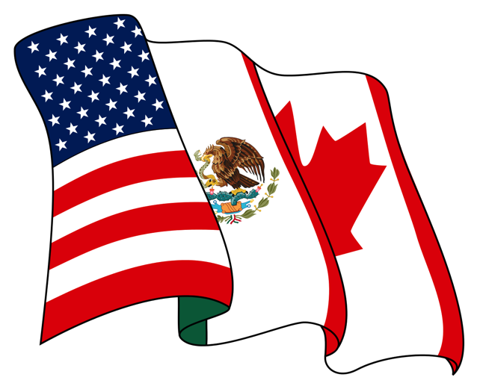
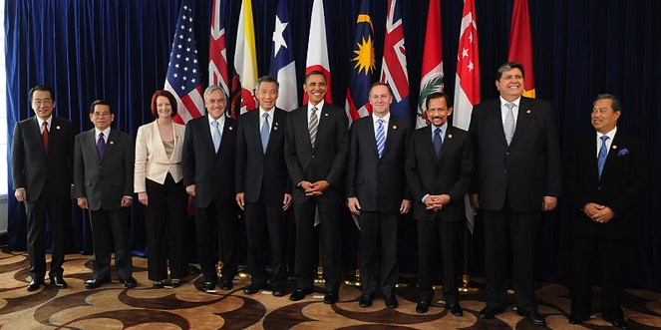
NEW TRADE AGREEMENTS
One of President Trump’s first orders was to:
  withdraw the United States from the TPP (Trans-Pacific Partnership), which saw lower tariffs levied on partner nations, including Japan, Canada, and Mexico
  renegotiate NAFTA (North American Free Trade Agreement) with Canada and Mexico
Leaders from 10 of the 12 prospective member states at a TPP summit in 2010

Slide 18
REEVALUATING FOREIGN
RELATIONS POLITICALLY
President Trump became more friendly with several nations, including:
  Russia
  China
  North Korea
  Saudi Arabia
  Israel
Meanwhile, he distanced himself from several other nations, including:
  Germany
  Great Britain
  Canada
  Mexico
Return to Main Menu

Slide 19
Section 3:
West Virginia Emerges from a Worldwide Pandemic to
Find a Bright Future

Slide 20
In late 2019, a coronavirus (COVID-19) from China resulted in the first worldwide pandemic in about 100 years.
The US began seeing cases in January of 2020 and reached West Virginia by March.
The virus was extremely deadly and very contagious, resulting in several lifestyle changes to keep people safe.
  Many people limited going out in public by choice, but some places had curfews or mandates restricting them.
The pandemic officially ended in May 2023.

Slide 21
THE BEGINNING OF THE
COVID-19 PANDEMIC
China announced the discovery of several pneumonia cases linked to a lab in Wuhan in December 2019.
A public health emergency was declared after the first case appeared in the US in January 2020, and travel from China was restricted.
The US was slow to respond further and downplayed of the severity of the virus.
After declaring a national emergency in March 2020, the CDC recommended people social distance and wear masks, though many chose not to.

Slide 22
WEST VIRGINIA’S RESPONSE
TO COVID-19
States had to take measures into their own hands to deal with the virus, and throughout 2020, West Virginia took steps to lessen COVID-19’s spread.
All schools, casinos, bars, courthouses, retail stores, manufacturing, and restaurant dining rooms were shut down in March, and Governor Justice urged citizens to stay home as much as possible.
The state also worked hard to process over 150,000 unemployment claims due to the closures.
By April, West Virginia was ranked #1 for its response to the pandemic.

Slide 23
In the fall, the state used a special map to determine which schools would be opened or closed on a weekly basis, which was based on new daily cases per county.
The White House commended Governor Justice and West Virginia’s planning for the Fall 2020 school year.
Vaccine deployment in the state began in December 2020, with a priority on deploying it to hospitals and long-term-care facilities first.
By January 2021, all public and private pre-K, elementary, and middle schools in the state resumed full-time, in person or hybrid instruction.

Slide 24
High schools were still required to close if cases were high, but all grades and schools resumed in-person instruction in late March, regardless of case numbers.
There was a focus in 2021 to vaccinate citizens of West Virginia to prevent/lessen symptoms of COVID-19, and 2022 saw less severe/deadly variants of the virus because of:
  vaccine updates that allowed for rapid responses to new strains
  the development of better treatment methods
  a growing herd immunity to the virus

Slide 25
REBUILDING THE NATION AFTER COVID
President Joe Biden, who was sworn into office in 2021, declared the end of the COVID-19 health emergency on May 11, 2023.
President Biden’s “Build Back Better” agenda brought billions of federal dollars, created jobs, and updated infrastructure in our state.
The American Rescue Plan was a relief bill that gave the state $4 billion of assistance to rebuild after the health and economic crises.
The Infrastructure Investment and Jobs Act granted our state $9.5 billion to work on roads and bridges, water infrastructure, Internet access, public transit, clean buses, electric-vehicle charging, and clean energy and power.

Slide 26
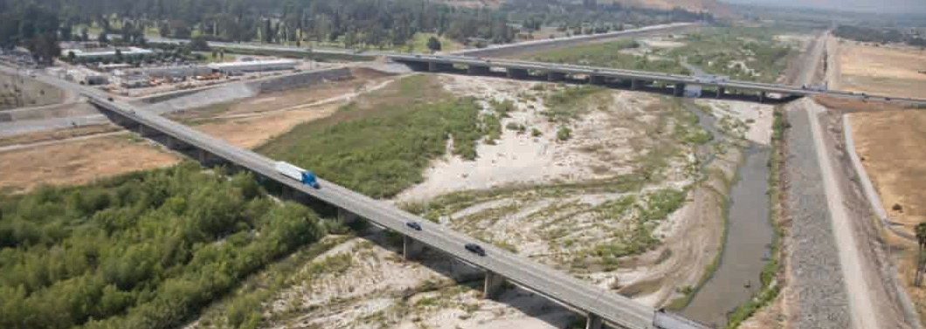
Roads and Bridges
West Virginia received $2.4 billion for its roads, bridges, roadway safety, and other major projects from the Infrastructure Investment and Jobs Act.
The US Department of Transportation (DOT) also awarded the West Virginia DOT $16.2 million to expand transportation options and access in downtown Wheeling.
The West Virginia DOT was also awarded $88 million for the Market Street Bridge Replacement Project.

Slide 27
Water Infrastructure
Lead pipes and dangerous PFAS chemicals have been a major concern for the state.
The state was granted $267 million to put towards this project.
  $57 million is going toward lead pipe and service line replacement
  $62 million is for safe drinking water investments

Slide 28
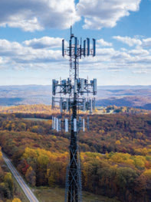
Internet Access
High-speed Internet is required
for people to do their jobs, do
schoolwork, access healthcare,
and stay connected, but many
just don’t have access to it.
West Virginia was granted $65
billion to provide affordable,
high-speed Internet throughout
the state.

Slide 29
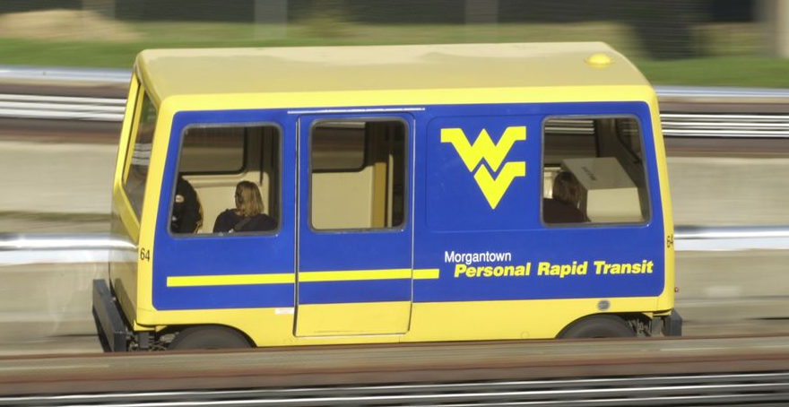
Public Transit
West Virginia is set to receive approximately $195 million over the next 5 years to expand transportation options and attract more commuters.
As of now, 34% of transit vehicles in the state are past their useful life.

Slide 30
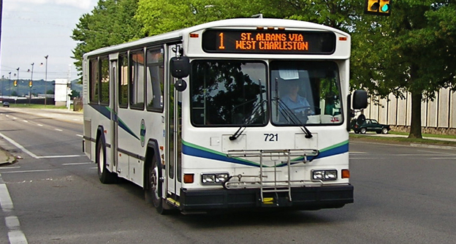
Clean Buses
The state was given $10 billion for low- or zero-emission public transit and school buses, which would promote cleaner air, reduce health risks, and reduce greenhouse emissions.
The state has been awarded $20.5 million through the EPA’s Clean School Bus Program.

Slide 31
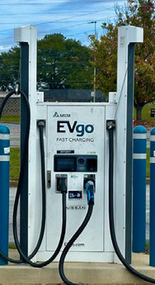
Electric Vehicle Charging
$7.5 billion was invested to build a national network of electric vehicle (EV) chargers in the US.
West Virginia is expected to receive about $46 million from the National Electric Vehicle Infrastructure Program to expand electric vehicle charging.

Slide 32
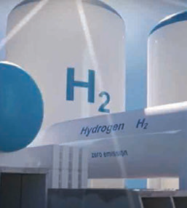
Clean Energy and Power
There are plans to upgrade the power infrastructure by making the grid more resilient to outages and building thousands of miles of transmission lines to deliver clean, affordable electricity.
There are also plans to invest in clean energy technologies like nuclear and clean hydrogen weatherization.
So far, West Virginia has been allocated $123.2 million for these projects.

Slide 33
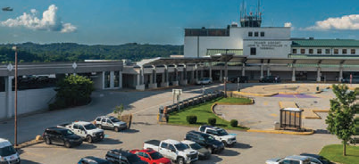
Airports
Currently, no US airports are listed in the top 25 airports worldwide, so $26 billion has been allocated to replace and modernize the country’s airport infrastructure.
This will help the US become more economically competitive, create good jobs, and revitalize traveling experiences.
West Virginia has received about $42.6 million for airports.

Slide 34
Ports and Waterways
$17 billion has been invested to strengthen our supply chains, address maintenance backlogs, and reduce congestion and emissions near ports.
This will help our country move goods faster and at lower costs.
West Virginia has received about $7.2 million for this project.

Slide 35
A FINAL NOTE
Throughout West Virginia’s history, its natural beauty and the beauty of its people have played a major role in shaping the state.
The state’s natural environment has been mostly preserved, while some of it has been sacrificed to industrial development.
West Virginians have been shown to lay down their lives for their freedom and way of life, but they are also friendly and quick to help others in need.

Slide 36
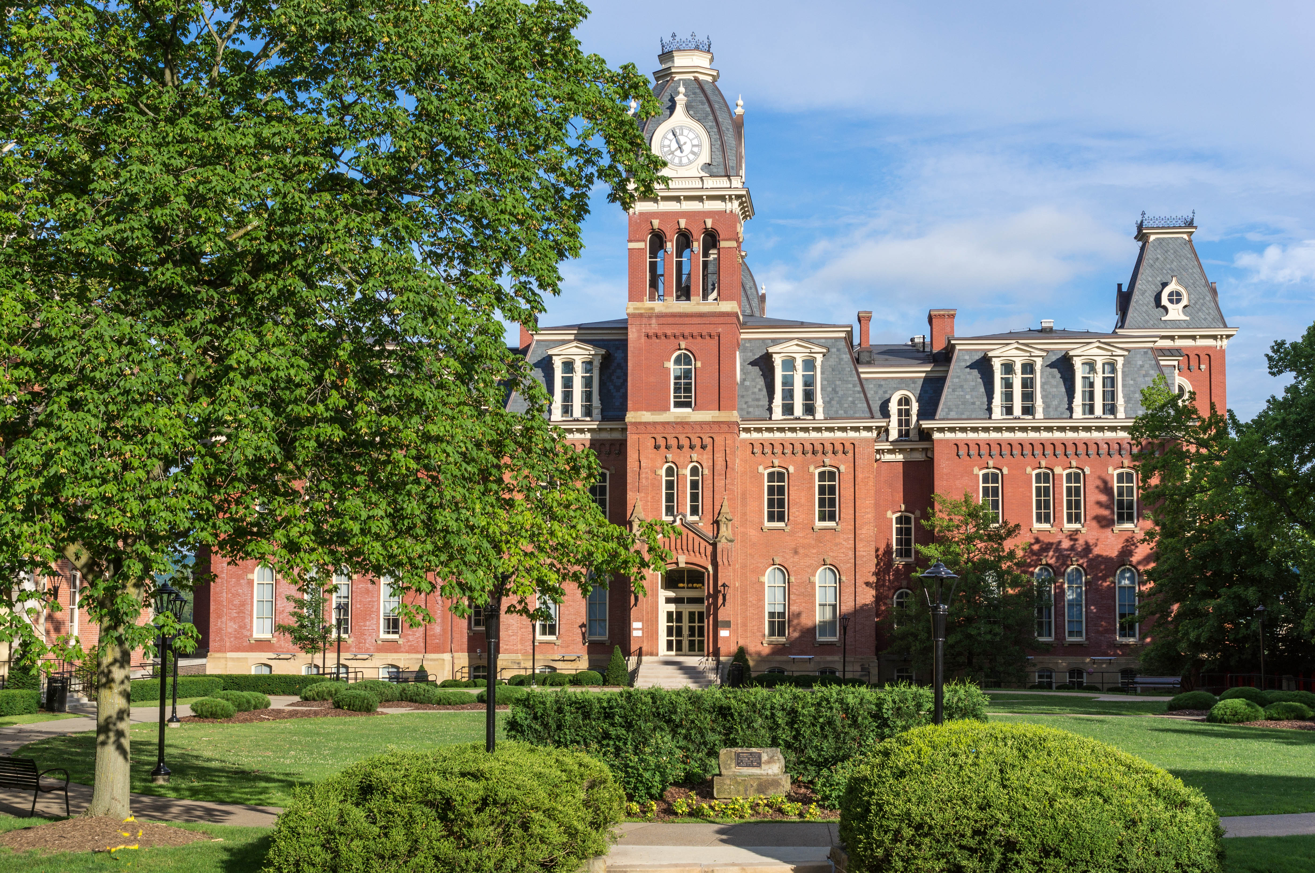
Woodburn Hall, West Virginia University, Morgantown, West Virginia
Image Credits
Slide 1: ForestWander, https://creativecommons.org/licenses/by/2.0/deed.en, Wikimedia Commons
Slide 2: formulanone, https://creativecommons.org/licenses/by-sa/2.5/deed.en, Wikimedia Commons
Final Slide: Tom Long, https://creativecommons.org/licenses/by-sa/3.0/deed.en, Wikimedia Commons
Return to Main Menu

