Slide 1


The Grist Mill in Babcock State Park, West Virginia
Chapter 4: The 21st Century
Global Economy
STUDY PRESENTATION
© 2025 Clairmont Press

Slide 2
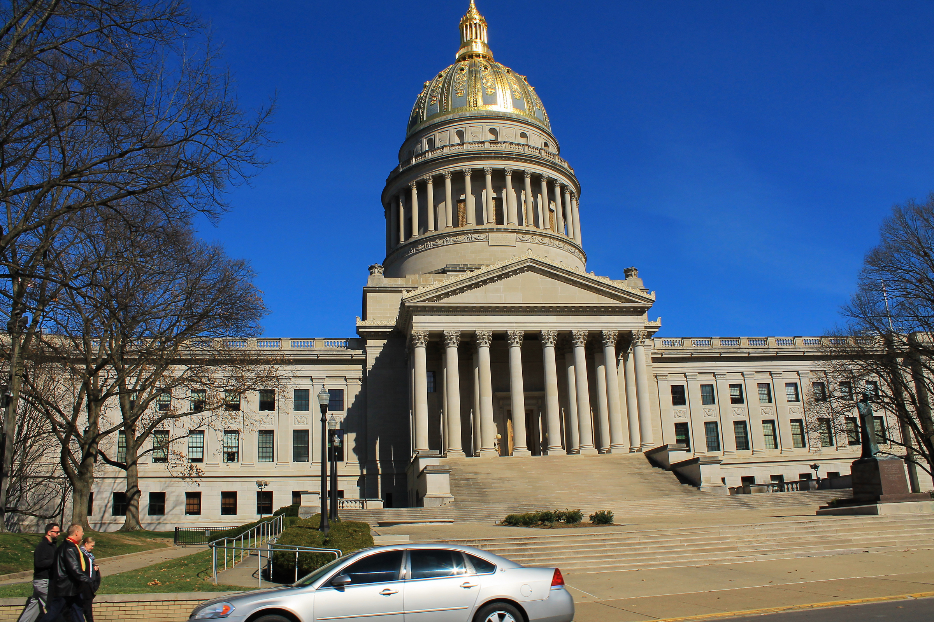
West Virginia State Capitol building, Charleston
Section 1: A History of a Global Economy
Section 2: West Virginia’s Demographic Profile
Section 3: The Role of Individuals in a Global Economy

Slide 3
Section 1:
A History of a Global Economy

Slide 4
WHAT IS GLOBALIZATION?
To some
  globalization represents the coming together of all the people in the world to form a single society.
To others
  globalization represents the bringing together of nations throughout the world through international trade, foreign
  investment, migration, and technology

Slide 5
A HISTORY OF TRADE
Early traders used a barter system to obtain things they needed or wanted.
The Silk Road became a major trade route between China and the countries in the Mediterranean Region.
Trade along the Silk Road introduced the concept of middlemen, who drove up the prices on goods like silk, perfume, gold, jewels, and spices.

Slide 6
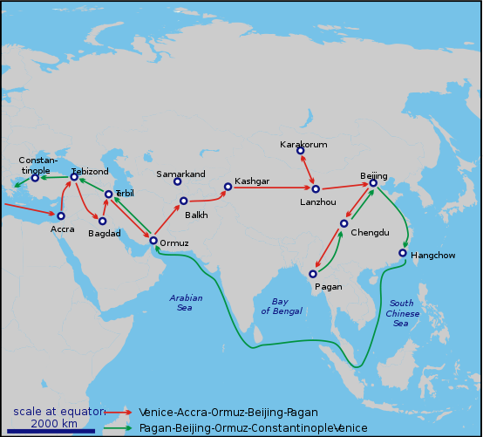
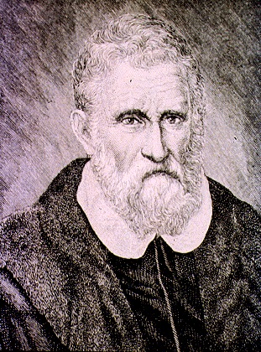
Marco Polo, with his father and uncle, spent many years in China. When they returned home, Marco wrote a book about their travels. This book attracted other travelers to the Far East.

Slide 7
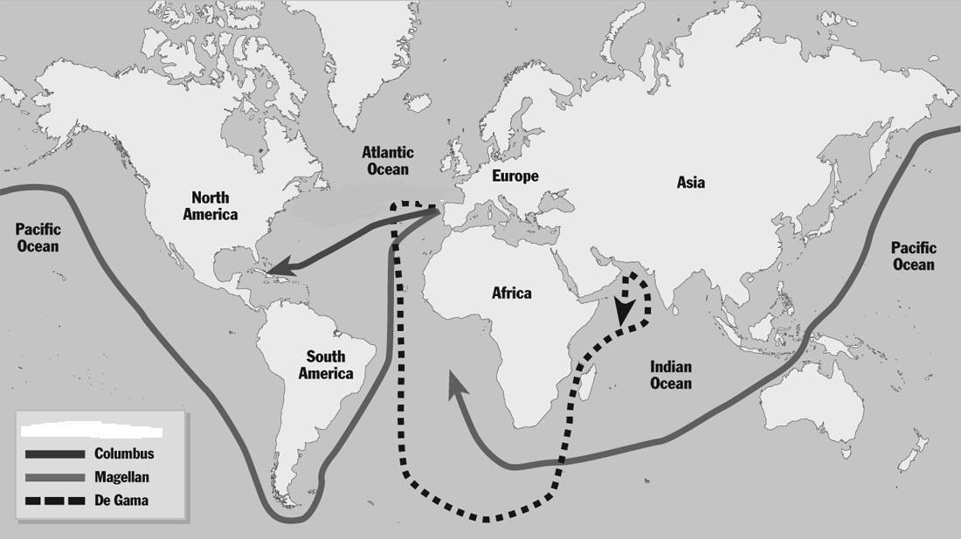
AGE OF EXPLORATION AND GLOBAL TRADE
Early explorers, who were sent to find new trade routes to the Far East, often claimed unknown lands for their rulers.

Slide 8
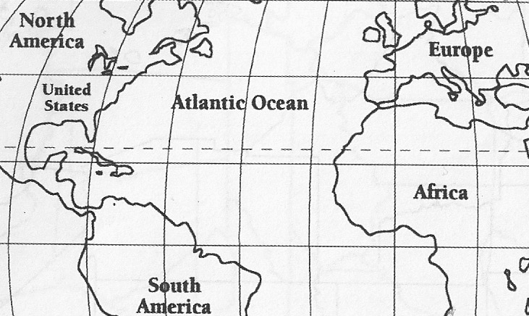
COLONIZATION AND GLOBAL TRADE
In the seventeenth century, Great Britain encouraged its colonies to develop an economy based on agriculture and commerce.
These colonies became part of a triangular trade in which the colonies sent raw materials (sugar, tobacco, cotton) to Great Britain. Great Britain used the raw materials to manufacture goods, e.g. textiles, which it sent to Africa. Africa in turn sent slaves to the American colonies.
Sugar – Tobacco - Cotton
Sugar – Tobacco - Cotton
Colonies
Manufactured Goods
Manufactured Goods
Slaves
Slaves

Slide 9
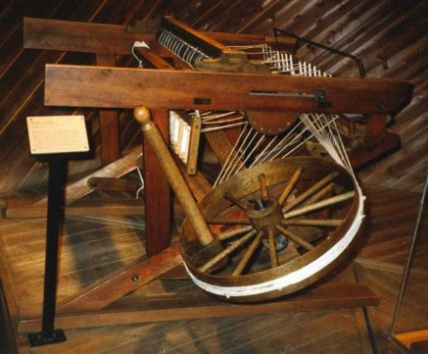
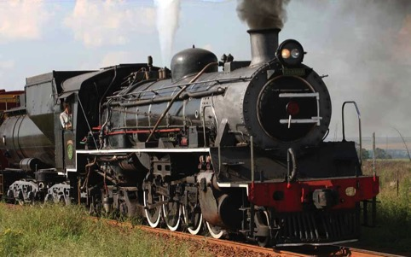
GROWTH OF GLOBAL TRADE
After the United States got its independence from Great Britain, it wanted to concentrate on developing its own industries. To this end, it charged high tariffs (taxes on imported goods) to protect American industry.
In the eighteenth century, the Industrial Revolution affected global trade.
New inventions like the Spinning Jenny fueled global trade.
In the nineteenth century, the steam engine revolutionized transportation and made it easier to move products to markets.

Slide 10
GLOBAL TRADE IN THE 20th AND 21st CENTURIES
The United States’ participation in global trade declined after World War I, but grew after World War II.
International trade in the 20th Century received a boost from the creation of
  GATT (General Agreement on Tariffs and Trade) which was created to prevent free trade (international trade free of government intervention).
  WTO (World Trade Organization), which replaced GATT. It establishes the rules of trade between nations, polices members, and negotiates new trade agreements.
  NAFTA (North American Free Trade Agreement) which eliminated trade barriers on products traded among the United States, Canada, and Mexico.
    President Donald Trump withdrew The United States from the TPP(Trans – Pacific Partnership). He also imposed high tariffs on Canada which changed the terms of NAFTA.

Slide 11
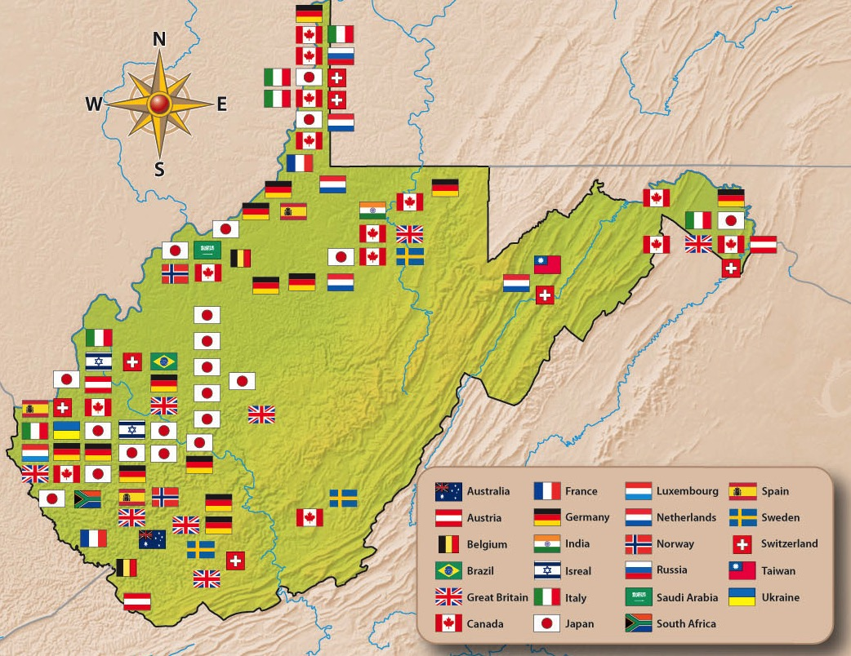
West Virginia’s economy today depends on foreign investment in the state as well as selling its goods in foreign markets.
Investments by foreign countries in West Virginia have grown. By 2018, some thirty foreign nations had invested in the state.
Japanese investment in West Virginia began more than 30 years ago. Today, there are 21 Japanese companies operating in the state.
Return to Main Menu

Slide 12
Section 2:
West Virginia’s Demographic Profile

Slide 13


FACTORS AFFECTING WEST VIRGINIA’S WORKFORCE
Loss of Population
  largest loss in southern West Virginia and among college-aged and young workers
Older Population
  largest percentage of population over 60 years of age
Health
  second highest death rate in United States
  high rate of heart disease, cancer, and diabetes
  60% of state’s population have limited access to health care

Slide 14
WEST VIRGINIA’S ECONOMIC PLAN
2017 - 2022
Economic Sectors
  Energy
    Natural resources and mining sectors will show some increase.
    There will be more growth in natural gas.
  Construction / Manufacturing
    Energy products will drive growth in construction, e. g. pipeline projects
    Infrastructure projects will also impact construction.
    Other areas of growth include wood products(furniture), machinery, fabricated metals, and chemicals.
  Service
    Service industries will have greater job opportunities.

Slide 15
WORKFORCE
Problem
  West Virginia’s population is not expected to grow substantially.
Solution
  Productivity must increase to offset the small number of available workers. Increasing access to technology can result in increased productivity.

Slide 16
WEST VIRGINIA’S FASTEST GROWING JOBS 2017

Slide 17
In 2017, West Virginia’s top ten private employers included:
  WV Medicine (WV United Health System)
  Walmart
  Charleston Area Medical Center
  Kroger
  Mylan Pharmaceuticals
  Lowe’s Home Center
  St Mary’s Medical Center
  Cabell Huntington Hospital
  Wheeling Hospital
  Res-Care, Inc.
Return to Main Menu

Slide 18
Section 3:
The Role of Individuals in a Global Economy

Slide 19

Individuals, just like states and nations, must watch their income and spending to achieve economic security.
What would happen if
our country or our state managed money poorly?
your parents or you managed money poorly?

Slide 20
A knowledge of personal finance will enable you to be better prepared for economic success.
The four major areas of personal finance include
  Budgeting
  Credit
  Saving
  Investing

Slide 21
BUDGETING
Steps in developing a budget
  Find the total income for the month from all sources.
  Total up all the expenses for the month.
  Make the totals match.
  Provide for adjustments.

Slide 22
SAVING
A savings plan requires you to set aside so much money each month to help you achieve long- and short-term goals.
Common ways to save include opening up a savings account, purchasing a certificate of deposit, or putting money in a money market account.
Banks use the money from investors’ savings to make loans, and reward investors for allowing them to use their money for this purpose. The rewards are paid as interest.

Slide 23
INVESTING
If you have money that you don’t immediately need, you may want to invest it. Some investments are riskier than others. Choices include:
  U.S. Treasury Bonds
  Precious Metals
  Real Estate
  Stock Market

Slide 24

CREDIT
Your access to credit depends on
  your income.
  how much you borrow.
  how much you owe.
Most people use credit for large purchases.

Slide 25

BEWARE OF CREDIT
Credit cards are no magic carpet to the future.
  Money spent is always money owed.
  Always check for high interest rates.
You can always do this!

Slide 26

Woodburn Hall, West Virginia University, Morgantown, West Virginia
Image Credits
Slide 1: ForestWander, https://creativecommons.org/licenses/by/2.0/deed.en, Wikimedia Commons
Slide 2: formulanone, https://creativecommons.org/licenses/by-sa/2.5/deed.en, Wikimedia Commons
Final Slide: Tom Long, https://creativecommons.org/licenses/by-sa/3.0/deed.en, Wikimedia Commons
Return to Main Menu

