Slide 1


The Grist Mill in Babcock State Park, West Virginia
Chapter 2: State and Local
Government in West Virginia
STUDY PRESENTATION
© 2025 Clairmont Press

Slide 2
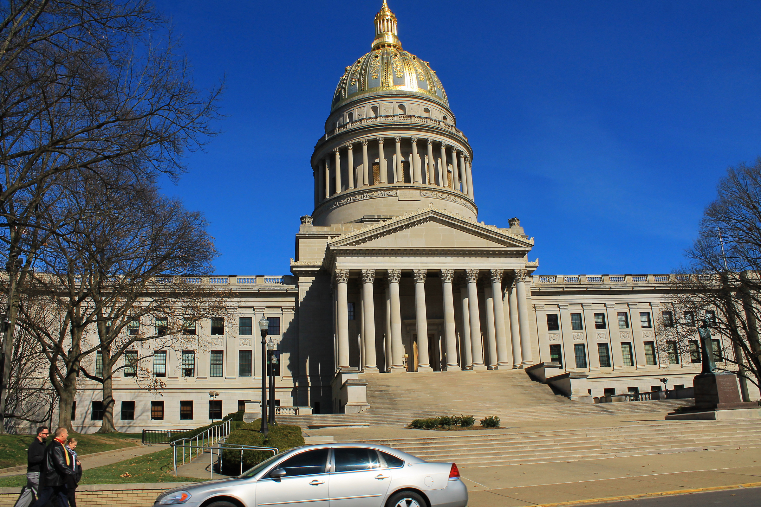
West Virginia State Capitol building, Charleston
Section 1: A History of West Virginia Government
Section 2: The Three Branches of State Government
Section 3: County and Municipal Government

Slide 3
Section 1:
A History of West Virginia Government

Slide 4
West Virginia’s government is based on the same five principles as the federal government:
  Sovereignty
  Limited Government
  Separation of Powers
  Checks and Balances
  Federalism

Slide 5
West Virginia has had two constitutions in its nearly 150 years of statehood. The present constitution, written in 1872, begins with a preamble stating its purpose.
Preamble to the West Virginia Constitution
Since through Divine Providence we enjoy the blessings of civil, political and religious liberty, we, the people of West Virginia, in and through the provisions of this Constitution, reaffirm our faith in and constant reliance upon God and seek diligently to promote, preserve and perpetuate good government in the State of West Virginia for the common welfare, freedom and security of ourselves and our posterity.

Slide 6
Since the people who wrote the West Virginia Constitution in 1872 could not anticipate what life would be like in the future, the amendment process provided the flexibility to make needed changes.
West Virginia Constitution Amendment Process
Proposed by constitutional convention and approved by a majority of both houses of the Legislature and a majority of the voters
Proposed by two-thirds of members of both houses of the Legislature and approved by a majority of the voters in the state
OR

Slide 7
Amendments include:
  Adding a preamble
  Establishing a family court system
  Allowing the governor to serve two consecutive terms
  Providing better highways
  Providing bonuses for veterans
Return to Main Menu

Slide 8
Section 2:
The Three Branches of State Government

Slide 9
THE THREE BRANCHES OF
STATE GOVERNMENT
The Legislative Branch
The Executive Branch
The Judicial Branch

Slide 10
LEGISLATIVE BRANCH
HOUSE OF DELEGATES
  100 members; 58 districts
  Serve two-year terms; unlimited number of terms
  Speaker of the House is the presiding official
SENATE
  34 members; 17 districts
  Serve 4-year terms; unlimited number of terms
  President/Lieutenant Governor is the presiding official

Slide 11
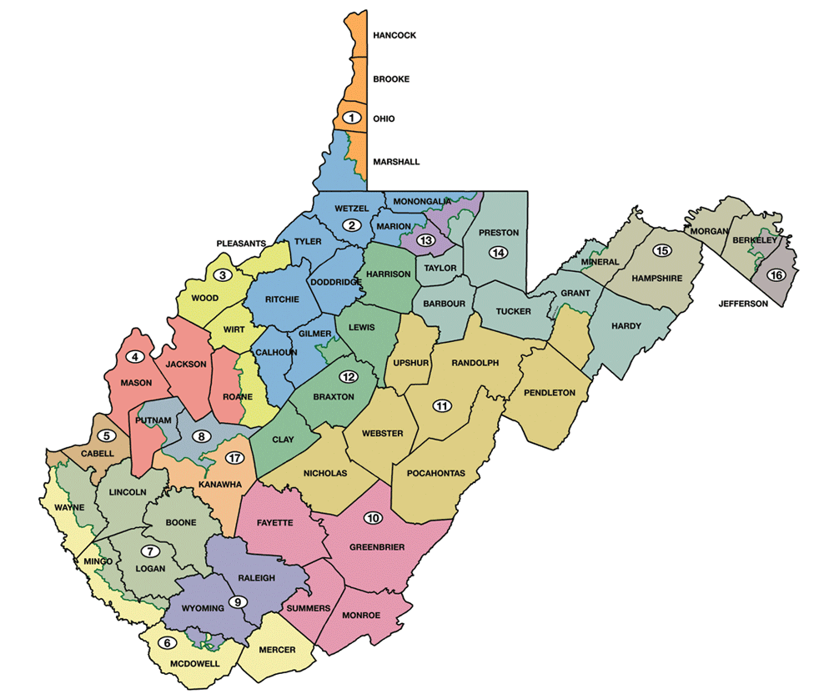
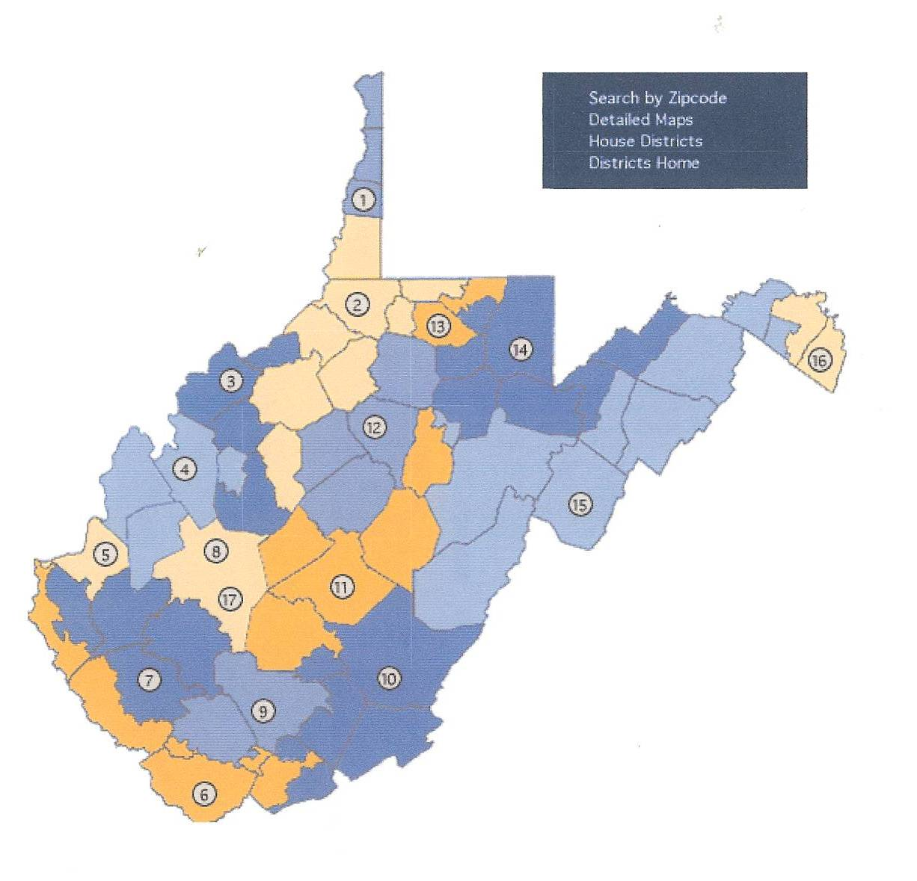
State Senate Districts

Slide 12
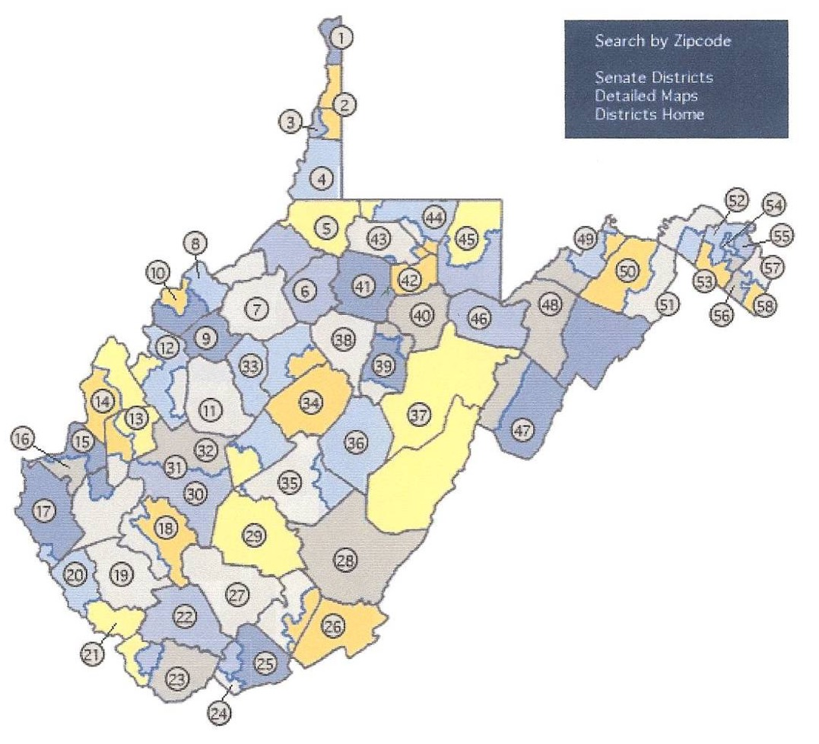
House of Delegates Districts

Slide 13
REQUIREMENTS TO SERVE IN THE LEGISLATURE
House of Delegates | Senate
Eligible to vote Resident of state for one year Resident of district in which they are running At least 18 years of age | Eligible to vote Resident of state for one year Resident of district in which they are running At least 25 years of age

Slide 14
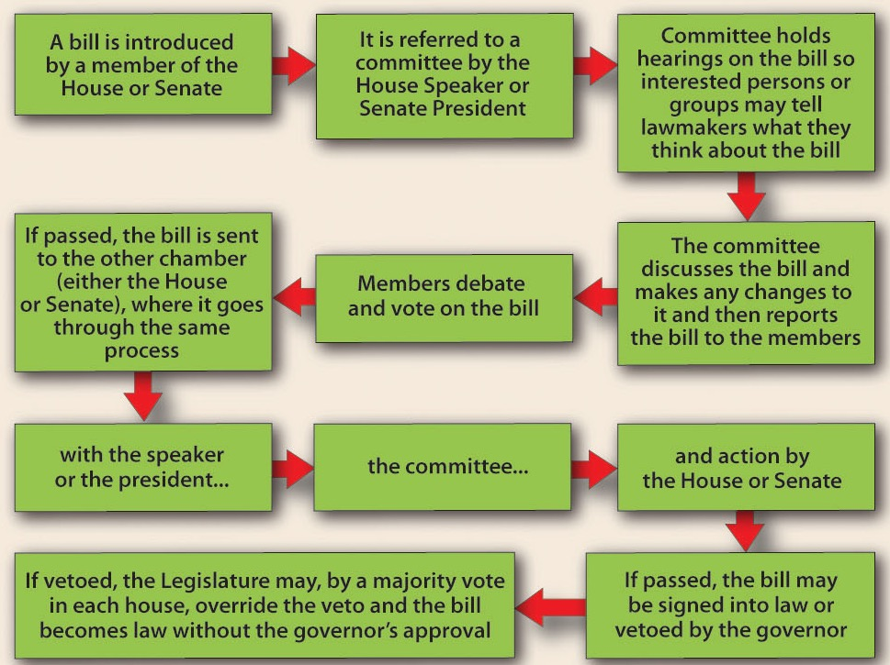
LAW MAKING PROCESS
To become a law, a bill goes through a process like that at the national level.

Slide 15
EXECUTIVE BRANCH
GOVERNOR
BOARD OF PUBLIC WORKS
CABINET
VARIOUS AGENCIES AND OFFICES

Slide 16
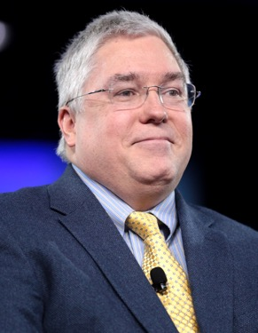
GOVERNOR
Patrick James Morrisey was elected the 37th governor in 2024 and took office January 13, 2025. To be governor, a person must be at least 30 years of age and have lived in the state for five years prior to the election.
DUTIES
Enforces state laws
Prepares annual budget
Commander-in-chief of state’s military
Pardons people accused of crimes
Appoints heads of various agencies
Serves on state boards and commissions
Holds press conferences to keep people informed

Slide 17
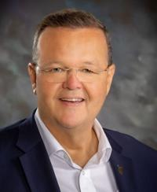
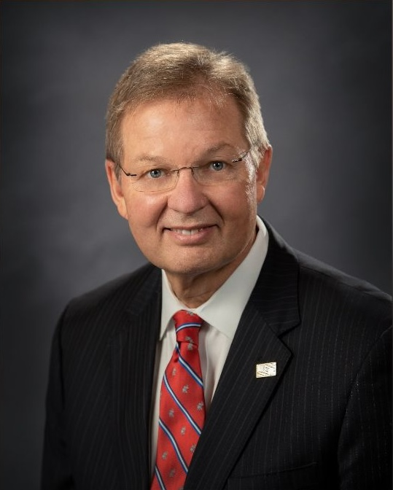
BOARD OF PUBLIC WORKS
Secretary of State: Kris Warner
  Keeper of Great and Less Seal of State
  Chief state election officer
  Maintains all official state papers
State Treasurer: Larry Pack
  Receives state revenues
  Pays the state’s bills
Kris Warner
Larry Pack

Slide 18
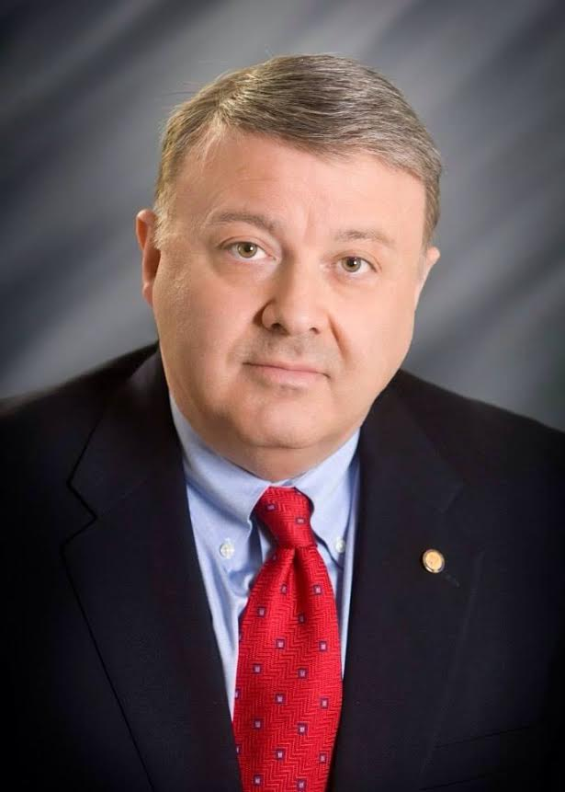
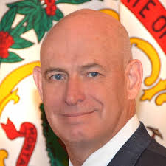
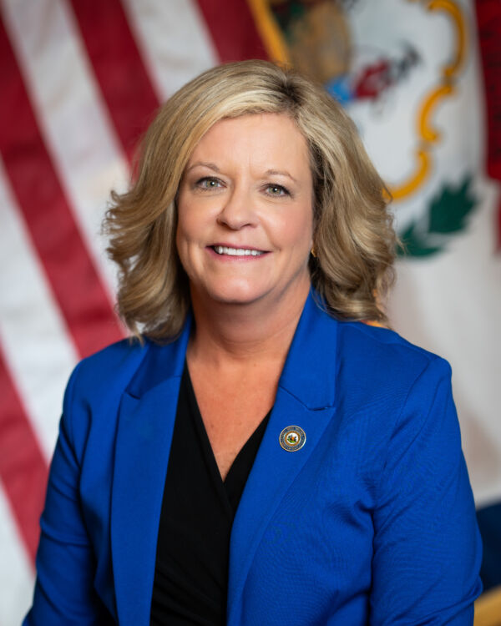
Attorney General: John McCuskey
  Heads state legal department
  Serves as the state’s lawyer
State Auditor: Mark Hunt
  State’s official bookkeeper
Commissioner of Agriculture:
Kent Leonhardt
  Sets standards
  Grades all farm products
  Identifies markets for farm products
State Superintendent of Schools: Michele L. Blatt
  Oversees state’s public school system, including teacher certification, curriculum, and textbook adoptions
Mark Hunt
John McCuskey
Kent Leonhardt
Michele L. Blatt

Slide 19
OTHER EXECUTIVE DEPARTMENT
Department of Administration
Department of Commerce
Department of Arts, Culture and History
Department of Environmental Protection
Department of Health and Human Resources
Department of Military Affairs and Public Safety
Department of Revenue
Department of Transportation
Department of Veterans’ Assistance
Each of these departments is headed by a secretary.

Slide 20
This chart provides a look at the organization of the executive branch of West Virginia’s government.

Slide 21
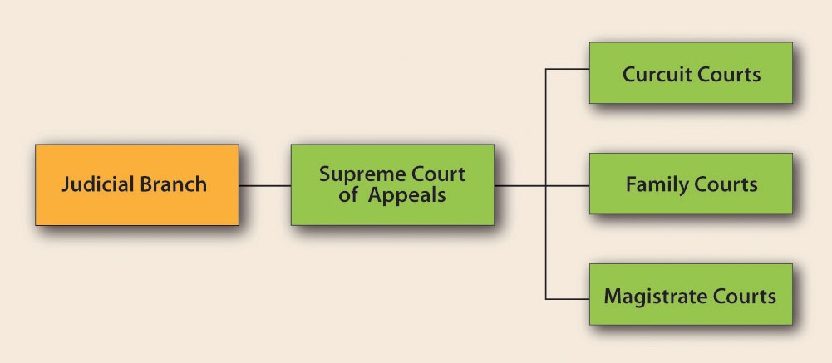
JUDICIAL BRANCH

Slide 22
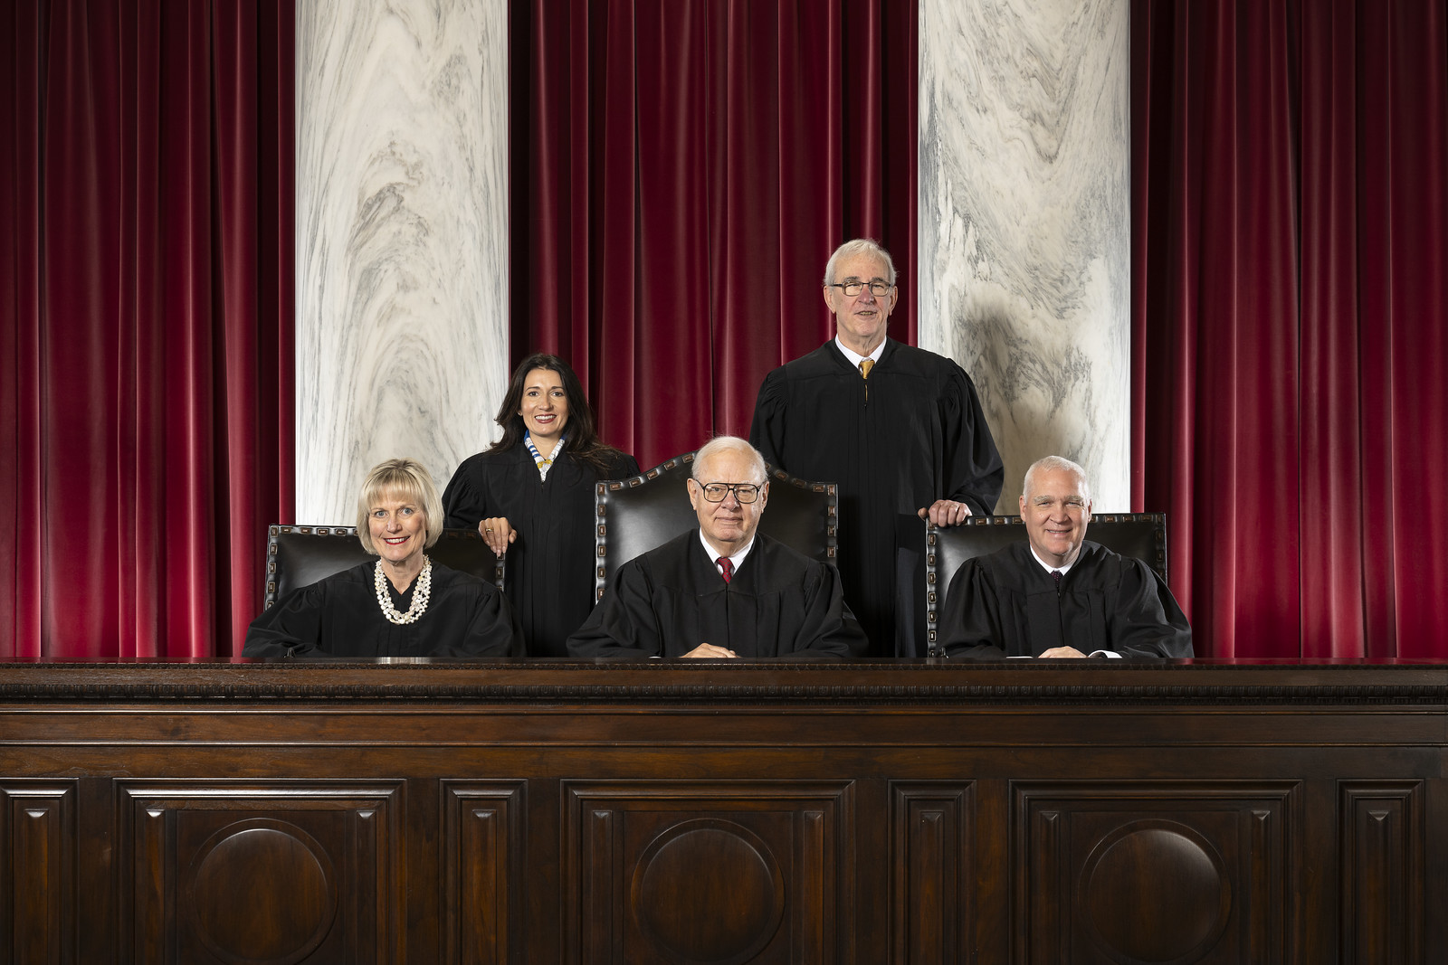
WEST VIRGINIA SUPREME COURT
The Court has five justices, one of whom serves as the chief justice.
A chief justice may serve from one to four years.
Justices are elected for twelve-year terms.
The Court has two terms each year: January to July and September into December.

Slide 23
THE SUPREME COURT
  has appellate and original jurisdiction. Most of the court’s cases are appealed from circuit or magistrate courts.
  has no witnesses, testimony, or juries. The justices hear oral arguments and review printed materials.
  has the power of judicial review.
  Most of the decisions of the Supreme Court are final.

Slide 24
OTHER STATE COURTS
CIRCUIT COURTS
  Trial Court
  31 circuits; 74 judges
  Judges elected to eight-year terms
  Hear all felony and some misdemeanor cases
MAGISTRATE COURTS
  158 magistrates
  At least 2 in every county
  Magistrates elected to four-year terms
Return to Main Menu

Slide 25
Section 3:
County and Municipal Government

Slide 26
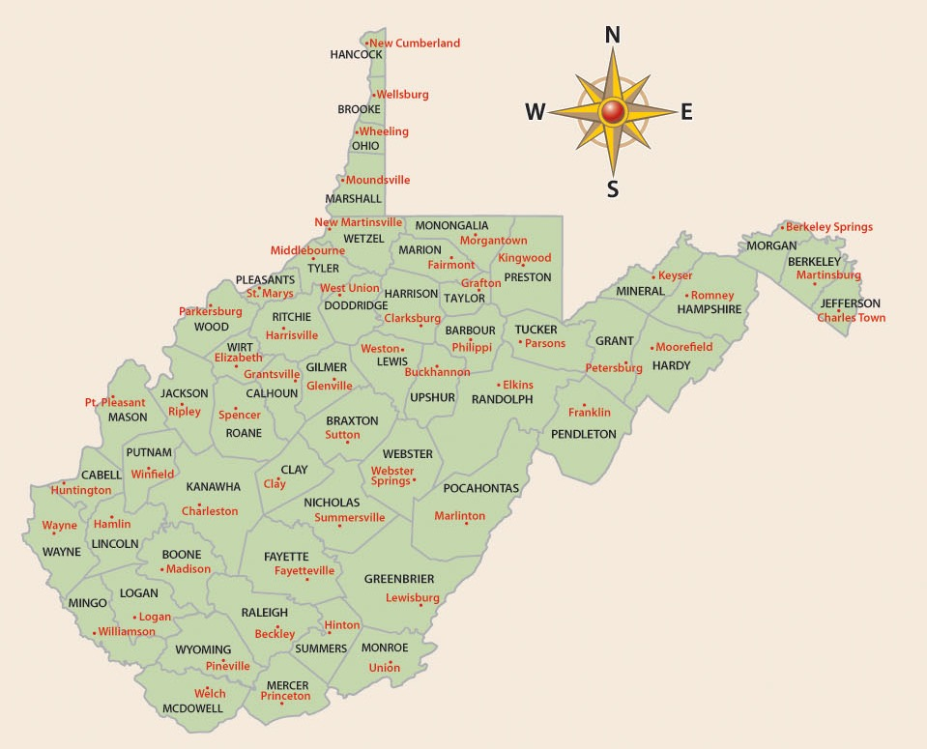
West Virginia’s Constitution provides for the establishment of governments for counties, municipalities, and boards of education.
There are over 3,000 counties in the United States; 55 of those counties are located in West Virginia.

Slide 27
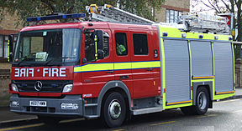
SERVICES PROVIDED BY
COUNTY GOVERNMENTS
Building and maintaining water and sewage systems
Fire Protection
Building and maintaining libraries
Providing emergency services, e.g., law enforcement, fire protection, medical emergencies
Providing recreational opportunities, e.g., swimming pools, parks

Slide 28
A County Commission presides over county government.
  Each county commission must have at least three members.
  Commissioners are elected to six-year terms.
  Commissioners must meet at least four times per year.
Other Elected County Officials
County Clerk: keeps official records of county
Circuit Clerk: keeps records of circuit court
Sheriff: enforces the law and collects taxes
Assessor: determines value of property for tax purposes
Prosecuting Attorney: represents county in court; pursues wrongdoers

Slide 29
Counties have executive, legislative, and judicial duties.
EXECUTIVE
Collect taxes
Enforce county ordinances
Conduct elections
Keep records
LEGISLATIVE
Regulate the use
of property
Levy taxes
Issue bonds
Set requirements for business licenses
Spend money for county purposes
JUDICIAL
Hear appeals on
tax assessments, employee complaints, and zoning decisions
Prosecute cases in circuit courts

Slide 30
MUNICIPAL GOVERNMENT
Depending on its size, a municipality may be classified as a city, town or village.
  CLASS I CITIES have a population of at least 50,000
  CLASS II CITIES have a population between 10,000 and 50,000
  CLASS III CITIES have a population between 2,000 and 10,000
  -Municipalities of less than 2,000 are classified as towns or villages.

Slide 31
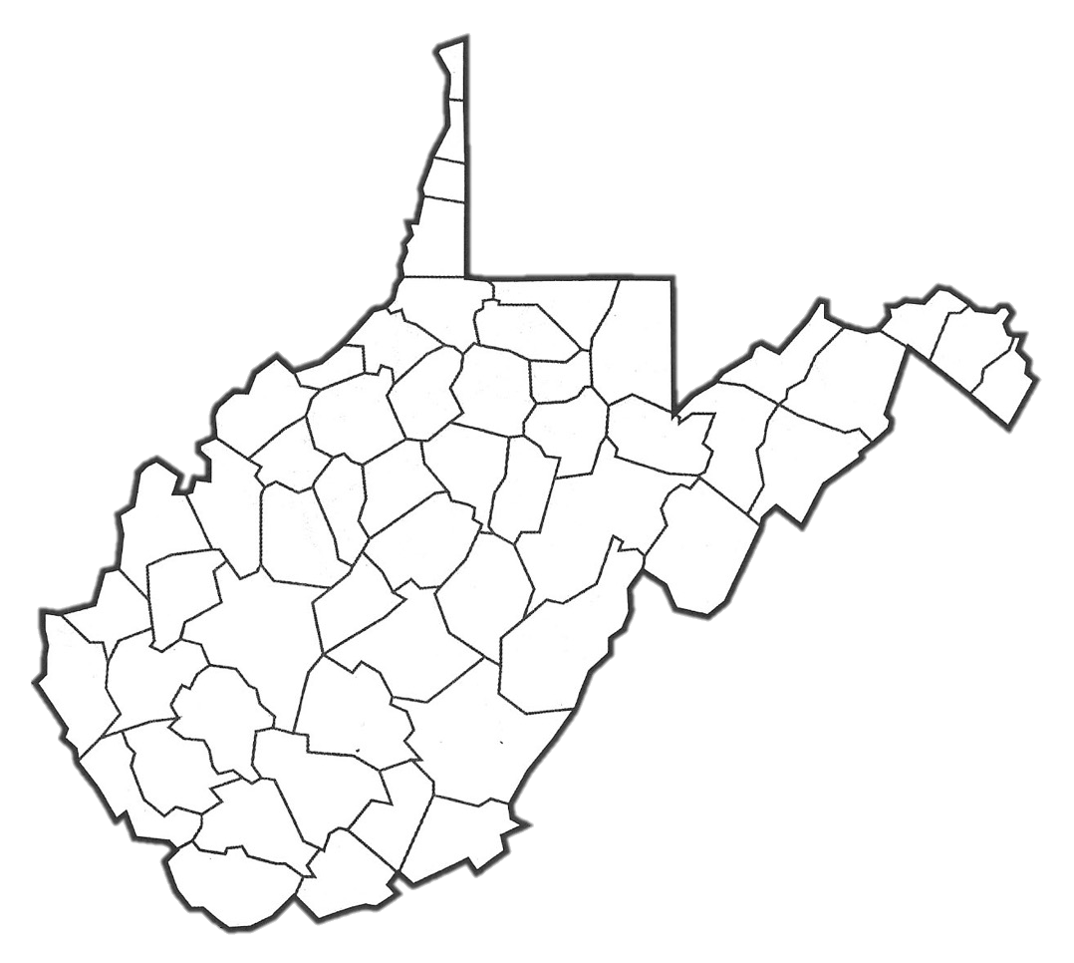
WEST VIRGINIA’S LARGEST CITIES
BY POPULATION
Weirton
Wheeling
Morgantown
Martinsburg
Fairmont
Parkersburg
Charleston
Clarksburg
Huntington
Beckley

Slide 32
THREE TYPES OF
MUNICIPAL GOVERNMENT
Mayor-Council Form
  The people elect both the mayor and the council members.
Commission Form
  Voters elect individuals to specific administrative positions. In West Virginia, there must be either three or five commissioners.
Council-Manager Form
  Elected city council members set policy and pass ordinances. There is a mayor who presides at council meetings. The mayor is either elected to the office or designated by a vote of the council members.
Municipalities of fewer than 2,000 residents must use the Mayor-Council form of government.

Slide 33
BOARDS OF EDUCATION
The third example of local government is the board of education.
Each county has a Board of Education consisting of five members.
Board members are chosen in nonpartisan elections.
Board members set education policy, approve a budget, approve curriculum, and hire employees.
Board members hire the county superintendent to carry out the system’s goals.
County boards of education receive direction from the West Virginia Department of Education.
County boards of education receive funding from county property taxes, state funds, federal funds, and sometimes from special assessments.

Slide 34
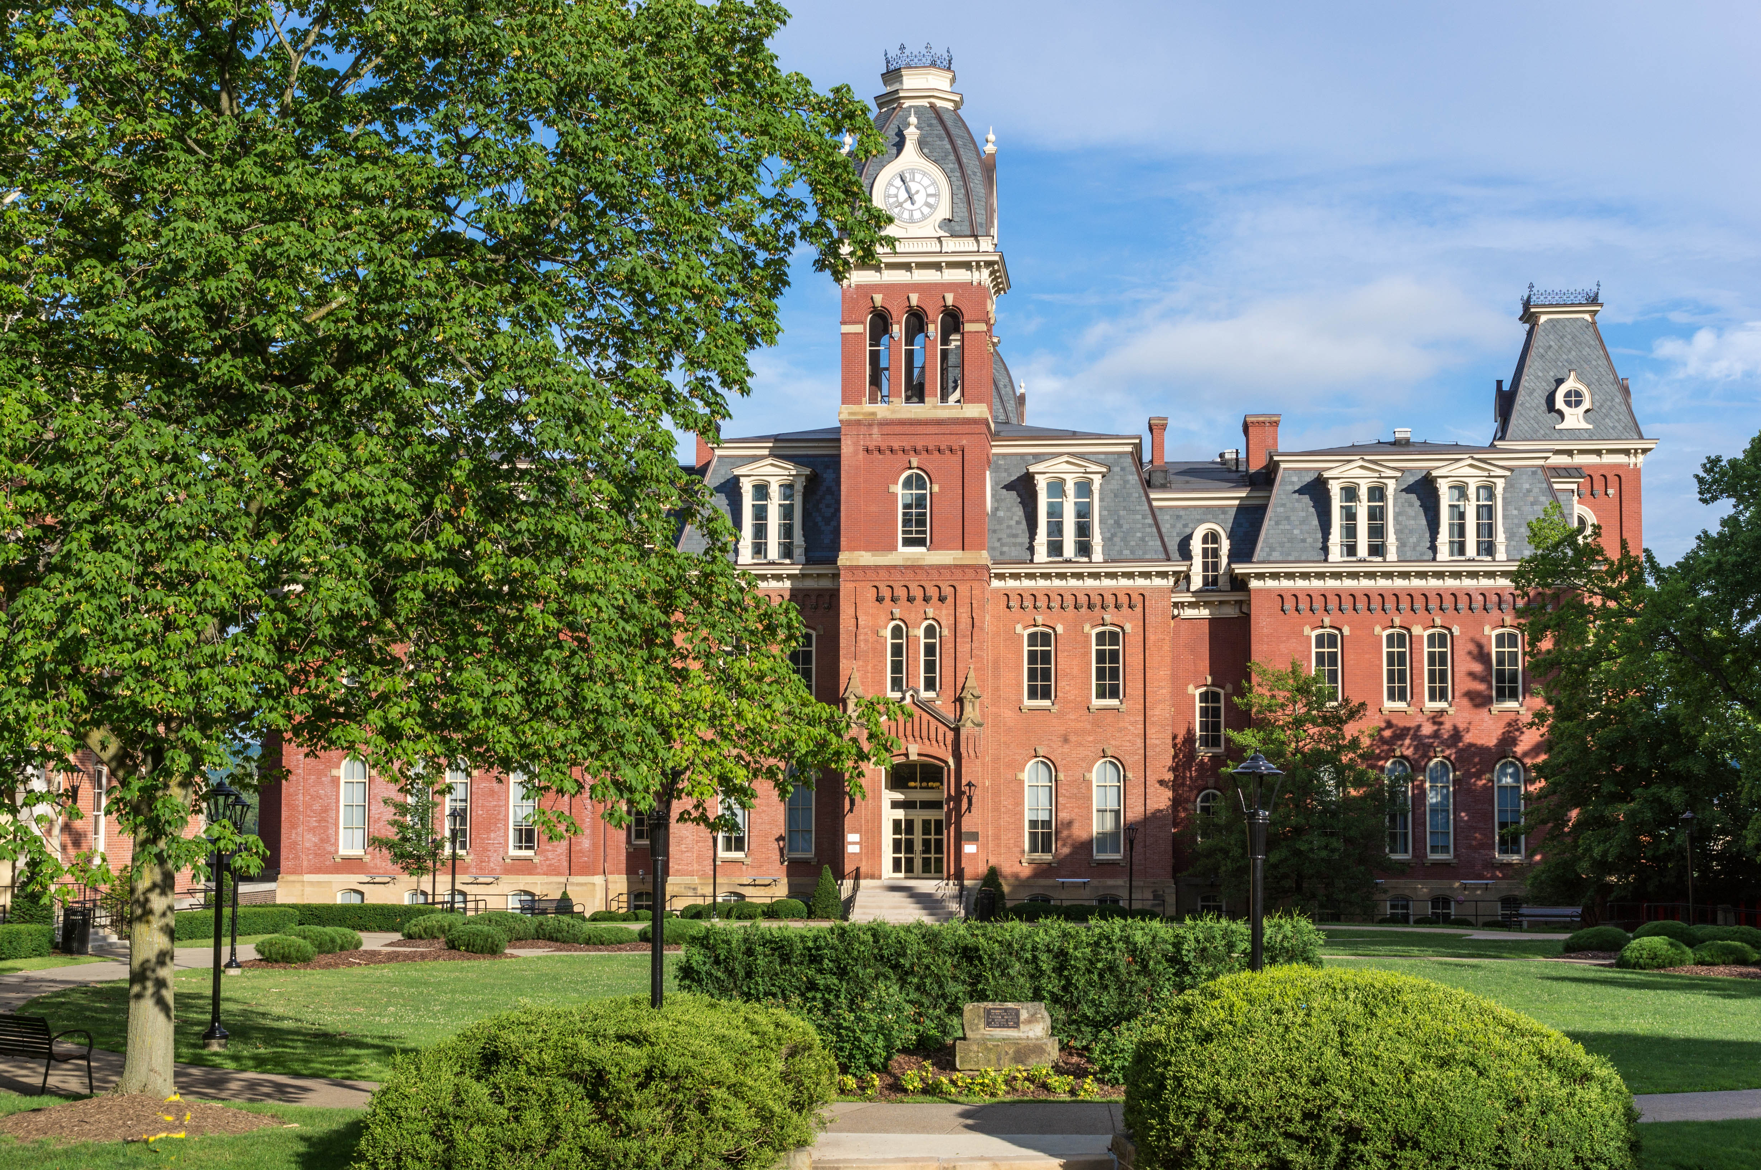
Woodburn Hall, West Virginia University, Morgantown, West Virginia
Image Credits
Slide 1: ForestWander, https://creativecommons.org/licenses/by/2.0/deed.en, Wikimedia Commons
Slide 2: formulanone, https://creativecommons.org/licenses/by-sa/2.5/deed.en, Wikimedia Commons
Final Slide: Tom Long, https://creativecommons.org/licenses/by-sa/3.0/deed.en, Wikimedia Commons
Return to Main Menu

