Slide 1
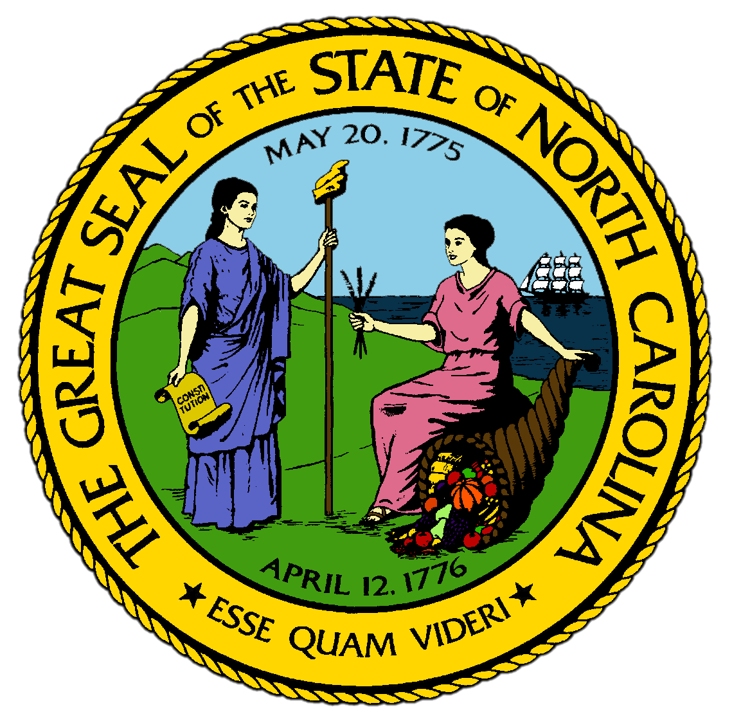
Chapter 14:
Stars on the National Stage
STUDY PRESENTATION
© 2017 Clairmont Press

Slide 2
Section 1: The Republicans Restore Political Balance
Section 2: The First Truly Urban Places Develop
Section 3: New Technologies Alter the Industrial Economy
Section 4: North Carolina Acts to Preserve Its Resources

Slide 3
Section 1: The Republicans Restore Political Balance
Essential Question:
What impact did the growth of the Republican Party have on the politics of North Carolina and the development of the two-party system?

Slide 4
Section 1: The Republicans Restore Political Balance
What terms do I need to know?
Equal Rights Amendment (ERA)
subsidy

Slide 5
Introduction
North Carolina had its first Republican governor in 72 years in 1972.
The 1972 election was a turning point for North Carolina in the 20th century.
In the 1970s, North Carolina helped the national Republican Party change the course of the federal government.
In the 1980s, North Carolina again had a two-party system as it had in the 1800s.

Slide 6
The Basis for the Rebound
No Republican had won a statewide election since the early 1900s when white supremacist Democrats eliminated the black vote.
Republicans made a comeback in the 1940s when post-war prosperity spread across the state.
The civil rights movement of the 1960s led to even more Republican votes.
Governor Jim Holshouser built up the Republican Party in the Mountains counties, but he ended up winning because of statewide support for President Nixon.
Many North Carolinians supported turning back the liberal laws of the federal government in the 1960s, and the state refused to ratify the Equal Rights Amendment (ERA) to the U.S. Constitution.

Slide 7
“Senator No”
The Republican most benefitted by the change was Senator Jesse Helms.
Helms was a commentator for a TV station in Raleigh, hinting that liberal changes, like the civil rights movement, might have communist involvement.
He supported limited government and gained the nickname “Senator No” since he voted against anything liberal.
He became one of the most influential senators of the 20th century.
Helms defended subsidies, or grants of money, paid to North Carolinian tobacco farmers.
Helms also helped make the national Republican Party more conservative and was an early supporter of Ronald Reagan.

Slide 8
A Balance of Power in Raleigh
Governor Holshouser moved North Carolina in a more conservative direction despite the Democratic majority in the legislature.
He reorganized the state government based on amendments passed in 1971.
The governor could now name the head of a department, which allowed better direction.
The office of the governor was built up over these years and the governor was now allowed to serve more than one term.
State leaders tried many ways to provide better education to students and take care of disadvantaged citizens during this period.

Slide 9
Changing Patterns of Representation
In 1988, the Republican Party elected enough representatives to influence legislation.
In 1991, Dan Blue became the first African American speaker of the House in state history.
The number of women in the General Assembly increased from 1 in 1971 to 18 in 1990.
Most U.S. representatives from western North Carolina were Republicans, and eastern countries continued to elect more Democrats.
The state was required to create new Congressional districts where the majority of residents were minorities, which created a balance of political parties in Congress.
Return to Main Menu

Slide 10
Section 2: The First Truly Urban Places Develop
Essential Question:
What were some of the effects of urbanization in North Carolina?

Slide 11
Section 2: The First Truly Urban Places Develop
What terms do I need to know?
metropolitan
urban sprawl
urban renewal
franchise

Slide 12
Introduction
Some North Carolina towns had become small cities by the end of the 1800s.
Until the late 1900s, North Carolina had not become metropolitan.
A metropolitan area has a large concentration of people, jobs, services, and entertainment.
After 1970, more North Carolinians lived in metropolitan areas than anywhere else in the state.

Slide 13
Metropolitan Areas in the State
Charlotte was the first city to gain more than 100,000 residents.
Many cities grew very little, but the areas around them more than tripled in size.
A new urban awareness had developed, and millions lived in the main urban centers of the state.
Cities spread outward from downtowns into farmland, building subdivisions and shopping centers, leading to an urban sprawl, which is unplanned, uncoordinated development.
Federal projects attempted urban renewal, or a replacement of run-down city buildings.
New and improved interstates contributed to urban sprawl.
Fast food franchises appeared in the 1960s.

Slide 14
Effects on Small Towns
Very small towns lost most of their businesses in less than 10 years.
Small-town grocery stores were replaced with supermarket chains.
In the country, crossroads stores closed when convenience stores opened nearby.
As cars became available and paved roads were built all over the state, doctors stopped making house calls.
Small town commerce also decreased because of the loss of so many farms.
Return to Main Menu

Slide 15
Section 3: New Technologies Alter the Industrial Economy
Essential Question:
How did new technologies and companies come to North Carolina and how did they impact the state’s economy?

Slide 16
Section 3: New Technologies Alter the Industrial Economy
What terms do I need to know?
interstate banking

Slide 17
Introduction
The stability of the big three industries gave way steadily at the end of the 1900s.
As old forms of industry declines, new economic opportunities came to the state.
While the number of farmers decreased dramatically, farms were larger and more productive because of better technology.

Slide 18
Stop Signs Along Tobacco Road
North Carolina continued to make more cigarettes than any other state and grow most of the tobacco used to make them.
As fewer Americans smoked, the tobacco industry shrank.
Profits decreased significantly.
Many small farmers left the business and leased their allotments, or used new technology to increase their production.

Slide 19
Transitions in Textiles and Furniture
Textiles also declined during this period.
As textiles declined, more workers were willing to join labor unions.
Furniture continued to do well into the 1990s when a new convention center for furniture opened in Las Vegas, Nevada.
Factories laid off workers and eventually closed as cheaper furniture from China was imported into the U.S.

Slide 20
New Types of Products and Services
Newer companies were successful in the 1980s and 1990s.
The Statistical Analysis System (SAS) was developed by two NC State students in the 1970s and became part of the great economic success of Research Triangle Park (RTP).
Many technological innovations were developed in RTP that were used worldwide.
After WWII, Krispy Kreme stores spread across the South and then the nation.

Slide 21
The Rise of Interstate Banking
Banks in North Carolina have always been allowed to open branches in multiple towns, unlike many other states.
North Carolina National Bank (NCNB) opened in the 1960s.
When the federal government loosened restrictions on interstate banking, which is allowing banks to have branches in other states, NCNB bought banks in South Carolina, Georgia, Florida, and Virginia.
In 1991, NCNB changed its name to Nations Bank, then merged with the giant Bank of America, and then Bank of America’s headquarters moved to Charlotte.
By the 1990s, Charlotte was the second-largest center of banking in the U.S. after New York City.

Slide 22
The Business of NASCAR
The industry with the most unexpected growth was stock car racing.
NASCAR, which stands for the National Association of Stock Car Auto Racing, formed after WWII.
By the 1960s, some of the best-known drivers were from North Carolina.
NASCAR transitioned in the 1980s to a sport with a national following and developed its own “research triangle” in the area around Charlotte.
Return to Main Menu

Slide 23
Section 4: North Carolina Acts to Preserve Its Resources
Essential question:
How has North Carolina acted to protect its history and culture and what impact have those actions had on the state?

Slide 24
Section 4: North Carolina Acts to Preserve Its Resources
What terms do I need to know?
historic preservation
cultural renewal
ridge law
global warming

Slide 25
Introduction
Changes and innovations after WWII put a great strain on the resources of the state.
Natural and man-made resources became scarce or disappeared.
Citizens worked to preserve, repair, and put to use many of the state’s treasures through the preservation movement during the 1970s and 1980s.

Slide 26
Tourism and Attractions
As Americans gained more money after WWII, they were able to travel more .
In North Carolina, visitors frequented the Great Smoky Mountains National Park.
In 1961, the USS North Carolina, a WWII battleship, was salvaged and moored across from Wilmington for visitors.
In the 1960s, the Biltmore Estate was opened to the public.
The Cherokee Reservation opened The Museum of the Cherokee Indian in the 1960s.
An unusual North Carolina attraction is the outdoor drama, which began in 1937.

Slide 27
Historic Preservation and Cultural Renewal
Urban renewal tore down whole neighborhoods and much of the state’s heritage was nearly lost.
In the 1960s, the state supported the creation of the Cape Hatteras National Seashore to preserve beaches.
In the 1970s, North Carolina pushed for federal laws protecting scenic rivers.
Old colonial communities worked to save landmark buildings and local history, which became known as historic preservation.
Preservation North Carolina helped communities by buying and repairing structures with privately raised funds.
North Carolina also became known for collecting and saving the smaller objects of the state’s history, like magazines, books, letters, photographs, and quilts.
Cultural renewal means people finding out things about their past and continue to use them, as well as expanding awareness of music and art forms popular in different regions in the past.

Slide 28
Environmental Concerns
Real estate developers crowding into the mountains led to the ridge law, where no building could mar the basic shape of the top of a mountain.
In the Piedmont, the main concern was the rising level of ozone in the lower atmosphere, called global warming.
Water pollution was a lesser-known concern in the cities of the Piedmont.
Erosion became a problem where trees had been cut down and there was nothing to hold the soil, leading to more water pollution.
In the 1990s, water quality in the coastal sounds became a concern as the sounds filled with silt and pollutants, threatening the wildlife of the wetlands.
Another issue was loss of sand along the Outer Banks, resulting in beach erosion.

Slide 29
The Impact of Recent Hurricanes
Until the 1980s, there were not enough people living on the coast for hurricanes to have a widespread impact.
In 1989, Hurricane Hugo hit Charleston, South Carolina and then moved to Charlotte.
In 1996, Hurricane Fran hit Cape Fear and the Tidewater.
The year 1999 was the worst year for weather.
A drought damaged crops on the Coastal Plain.
After that, three hurricanes hit the state, the worst of which was Hurricane Floyd, causing the worst flooding in state history.
Princeville, a town settled in 1865 by freedmen, was worst hit, with every house either destroyed or severely damaged.
Return to Main Menu

Slide 30
Image Credits
Title Slide: Public Doman, Wikimedia Commons; Contents slide: Reginald Lankford, Clairmont Press; End Slide: Reginald Lankford, Clairmont Press;
Shown here: Kitty Hawk Bay, NC
Return to Main Menu

