Slide 1
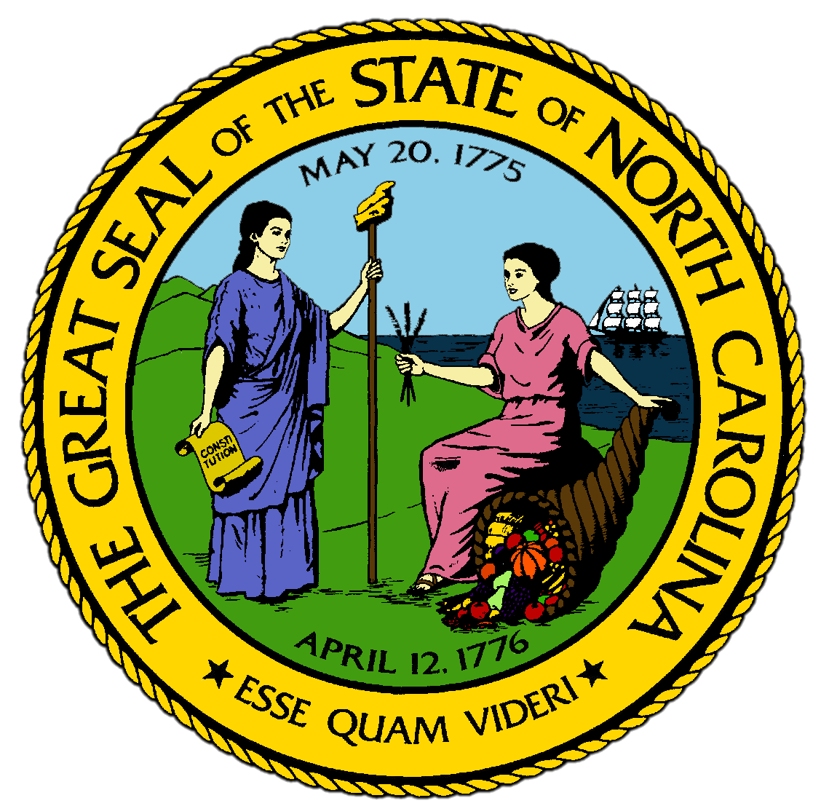
Chapter 13:
World War II and Cold War
STUDY PRESENTATION
© 2017 Clairmont Press

Slide 2
Section 1: The Politics of Reform and Reaction
Section 2: Postwar Prosperity Spreads Across the State
Section 3: New Choices in Daily Life
Section 4: The Civil Rights Movement Comes to North Carolina

Slide 3
Section 1: The Politics of Reform and Reaction
Essential Question:
How did the civil rights movement begin in North Carolina?

Slide 4
Section 1: The Politics of Reform and Reaction
What terms do I need to know?
civil rights
separate-but-equal concept
integration
North Carolina Fund
community college system

Slide 5
Introduction
Frank Porter Graham was known across the state for helping the disadvantaged.
He worked to improve university educations, criticized segregation, supported labor unions, helped found the United Nations, and temporarily filled a U.S. Senate position.
North Carolina was as divided by sectionalism in 1960 as it was before the Civil War.

Slide 6
Kerr Scott and Rural Roads
Kerr Scott, a dairy farmer, became governor in 1948.
He encouraged leaders to spend more money on education and paving rural roads.
The state passed a referendum to raise taxes to pave rural roads.
Governor Scott appointed the first female superior court judge and first black member of the board of education.

Slide 7
From Segregation to Integration
After Governor Scott’s term, the state became more cautious about change.
A national movement for civil rights was developing, and the federal government was pressured to end segregation in the South.
In 1896 the Supreme Court had upheld segregation with the separate-but-equal concept in Plessy v. Ferguson.
In 1954, the Court reversed its decision in Brown v. Board of Education & required integration of all southern schools to give black children equal opportunities.
North Carolina approved a plan for “freedom of choice” that allowed parents to apply for their child to go to any school, but this only slowed integration.

Slide 8
Sanford, Civil Rights, and Education
Terry Sanford became governor in 1960 after losing the 1956 election.
He wanted to advance the interests of black and white citizens.
In 1963, he created the North Carolina Fund, which helped rural black farm families and residents of the mountain coves.
During his term, the General Assembly also created the community college system to bring education to all parts of the state.
He also expanded higher education and kept tuition low, allowing more North Carolinians to obtain a college education for their children.
To address the civil rights movement, he created “Good Neighbor Councils” in every major town.
To fund these efforts, the sales tax was expanded to food for the first time.
Return to Main Menu

Slide 9
Section 2: Postwar Prosperity Spreads Across the State
Essential Question:
What impact did World War II leave on North Carolina’s economy after the end of the war?

Slide 10
Section 2: Postwar Prosperity Spreads Across the State
What terms do I need to know?
service industry
shopping center
Cold War

Slide 11
Introduction
In 1949, a rural family in North Carolina became the millionth rural family to have a telephone installed since the end of WWII.
Almost half of the state’s rural roads were now paved.
The Duke Power Company gained 144,000 new rural customers in the 5 years after the war.

Slide 12
The Postwar Economy
North Carolinians made more wooden and upholstered furniture than any other state.
The state continued to make more than half the cigarettes produced in the U.S.
For a few years after the war, the state produced more sweet potatoes and peanuts than any other state.

Slide 13
The “Big Three”
Most factory workers had jobs in one of the big three: tobacco, textiles, and furniture.
The biggest moneymaker continued to be in tobacco manufacturing.
The federal government began to warn of health risks related to smoking, and filter-tipped cigarettes were introduced.
Burlington Mills and Cannon Mills remained the largest textile manufacturers.
More than half the western counties had a furniture factory after the war.

Slide 14
Attracting New Industry
The state’s population increased after the war, so state leaders worked to recruit northern companies to the state to provide the needed jobs.
The migration of northern companies helped the eastern part of the state by diversifying its tobacco-dominated economy.
Trucking companies made it easier to move goods in and out of the state.
North Carolina also moved into the service industry during this period.

Slide 15
Innovations
In 1948, Piedmont Airlines was founded and flew routes to and from major cities across the state.
As flying grew more convenient in the 1960s, Piedmont added connections to Atlanta and New York, encouraging more people to fly.
Research Triangle Park was developed between Raleigh and Durham to take advantage of the facilities of UNC, State, and Duke, to attract large companies like IBM for research and development.

Slide 16
Labor Union Failures
Despite growth in industry and industrial training schools, North Carolinians had the lowest wages in the country.
Unions from the North worked to enlist workers in the state, but workers were suspicious and rising wages kept most from joining.
North Carolina’s low wage rank was matched by their low unionization rank.
Almost half the workers in northern states were in unions during this time.

Slide 17
Commerce and Trade
Downtown areas were at their peak after WWII.
Many stores moved to the edges of town where they could have paved parking lots, creating “supermarkets” focused on groceries.
By the 1950s, shopping centers were being built, with multiple stores lined up in one parking lot.
In 1961, the Charlottetown Mall became the first enclosed shopping center.
Banks spread throughout the state and had multiple offices in different regions.

Slide 18
The Cold War and the State’s Economy
At this time, the U.S. was the richest nation on earth.
To counter the opposition of the Soviet Union, the U.S. kept its military strong after WWII.
North Carolina became one of the most important training grounds for the Cold War, which were the hostilities between the U.S. and the Soviet Union after WWII.
The growth of military bases continued to create jobs for North Carolinians in the 1960s and helped grow businesses in the regions around the bases.

Slide 19
Farming after World War II
Almost half of the state still farmed in some way, with more citizens farming in North Carolina than any other state besides Texas.
Farms were smaller and incomes were much higher after WWII.
More Mountains families grew burley tobacco to flavor cigarettes.
Cotton production declined as larger farms in Texas and Mississippi produced more.
Many farmers switched to dairying and used mechanical devices to milk their cows.
Return to Main Menu

Slide 20
Section 3: New Choices in Daily Life
Essential Question:
What kinds of social changes did North Carolina undergo during the postwar period?

Slide 21
Section 3: New Choices in Daily Life
What terms do I need to know?
commute
consolidated high school
interstate highway system
bypass

Slide 22
Introduction
“Rural non-farm” described families who still lived in the country but did not spend all their time farming or gain most of their income from the land.
North Carolina had the greatest number of these families after WWII.
By the 1940s, thousands lived in rural neighborhoods and commuted to nearby towns to work.
Rising incomes and broadening employment allowed this new situation, allowing residents a choice in where to live for the first time.
Even mill village residents had more choices as mill owners began to sell them the houses they lived in.

Slide 23
Widening Educational Opportunities
There was greater freedom of choice in education and career.
There were twice as many high schools in the 1950s as in the 1920s.
The schools of the 1920s were replaced by fewer and larger consolidated high schools that were centrally located.
The new high schools had more teachers and courses, as well as more sports to choose from.
More students from farm and factory families could go to college when they graduated from high school, and students who wanted to work in industry could attend the new community colleges.

Slide 24
Entertainment Changes
An increase in leisure time gave people new social outlets.
North Carolina had more minor league baseball teams than any other state.
Movie theaters multiplied, then television put many of them out of business.
The state’s first television show broadcasted in 1949.
Television gave North Carolinians a new love: college basketball.
Before WWII, only the wealthiest attended college games rather than local high school tournaments.
The Dixie Classic Tournament allowed local teams to compete against the best of the nation, and in 1953 the universities of the state helped establish the Atlantic Coast Conference.
From the beginning, the games were televised.

Slide 25
Going Places, on New Roads
Since industrial workers had more time off, they could go more places.
The Mountains region became a favorite place to visit.
The Biltmore Estate opened to the public in 1956, so citizens could visit the largest and richest house in the country.
North Carolina imitated northern states by investing in multilane highways.
The interstate highway system was created by the federal government in 1956 to connect the entire nation.
New types of roads called bypasses went around cities to avoid congestion.

Slide 26
For Some, Few Choices
Despite widening prosperity, segregation was still the law and the custom everywhere in the state.
Though African Americans had begun to make more money and in some cases, to live in better environments, many still lived in shotgun houses, went to schools with no gyms, and lived in neighborhoods without sewers.
Greater education increased the number of black voters.
After WWII, black citizens protested the treatment they received and became important parts of the civil rights movement of the 1950s and 1960s.
Return to Main Menu

Slide 27
Section 4: The Civil Rights Movement Comes to North Carolina
Essential question:
What were the Greensboro sit-ins and what impact did they have on the Civil Rights Movement in North Carolina?

Slide 28
Section 4: The Civil Rights Movement Comes to North Carolina
What terms do I need to know?
discrimination
sit-in
freedom riders
Civil Rights Act of 1964
Voting Rights Act of 1965
busing

Slide 29
Introduction
In 1945, Phairlever Pearson was made principal of the black high school in Newton.
The windows were patched, bare bulbs hung from ceilings, one coal stove heated the whole school, there was no refrigerator, and the basketball team practiced outside on a dirt court.
Pearson asked the all-white school board to come see the terrible conditions, but none came.
The school board built a gym, cafeteria, and a shop after the war.
The civil rights movement was moving slowly into North Carolina.

Slide 30
The Greensboro Sit-Ins
By the late 1950s, Greensboro’s African American residents had protested discrimination in stores, restaurants, and other public places.
On February 1, 1960, four university students sat down at the lunch counter at Woolworth’s store.
When they were refused, they came back the next day with more students.
These “sit-ins” quickly gained national attention and spread to 54 other southern cities.
It took nearly 2 years for Greensboro to integrate public places.
Thousands of high school and college students marched on business for days, and when most were arrested, nearly every black adult in Greensboro came to protest the next day.
Change came slowly, but there was positive progress.

Slide 31
The Civil Rights Acts of 1964 and 1965
The U.S. Congress passed the Civil Rights Act of 1964, making it illegal for any public place to practice segregation.
The following year, Congress passed the Voting Rights Act of 1965, identifying counties in the South known to have kept blacks from registering to vote.
Black residents of North Carolina quickly came out to register to vote, mostly as Democrats, as the Democratic Party in the North had led the effort to pass the laws.
The laws also sped up integrating the schools, and more black children applied to and were accepted by previously white schools.
Black and white families began to interact more closely in public places.
By 1968, more black leaders sought public offices and made up a significant portion of the electorate.

Slide 32
Conservative White Reactions
Many white North Carolinians did not easily accept the ideas of integration.
After the civil rights acts were passed by Congress, thousands of Democrats switched to the Republican party.
In the 1968 presidential election, they voted for the segregationist candidate, though North Carolina gave Republican Richard Nixon the state’s majority.
The most extreme conservatives joined a revived Ku Klux Klan, which increased its demonstrations in the 1960s.

Slide 33
The Swann Case
In 1969, the Justice Department in Washington, D.C. used the authority of the Civil Rights Act to order the closing of all black schools in the South.
All schools had to be fully integrated.
Because of segregation, most black families lived in all-black neighborhoods, so school districts were primarily black even when integrated.
In 1965, Darius Swann sued to have his son admitted to a neighboring white school, and in 1969 a federal judge ruled that civil rights laws called for equality.
To achieve this, many school districts used busing to achieve a racial balance in the schools, angering many residents.
Busing was done in many cities without violence, but in some northern cities, violence erupted when busing was ordered and it became a national controversy.
Return to Main Menu

Slide 34
Image Credits
Title Slide: Public Doman, Wikimedia Commons; Contents slide: Reginald Lankford, Clairmont Press; End Slide: Reginald Lankford, Clairmont Press;
Shown here: Kitty Hawk Bay, NC
Return to Main Menu

