Slide 1
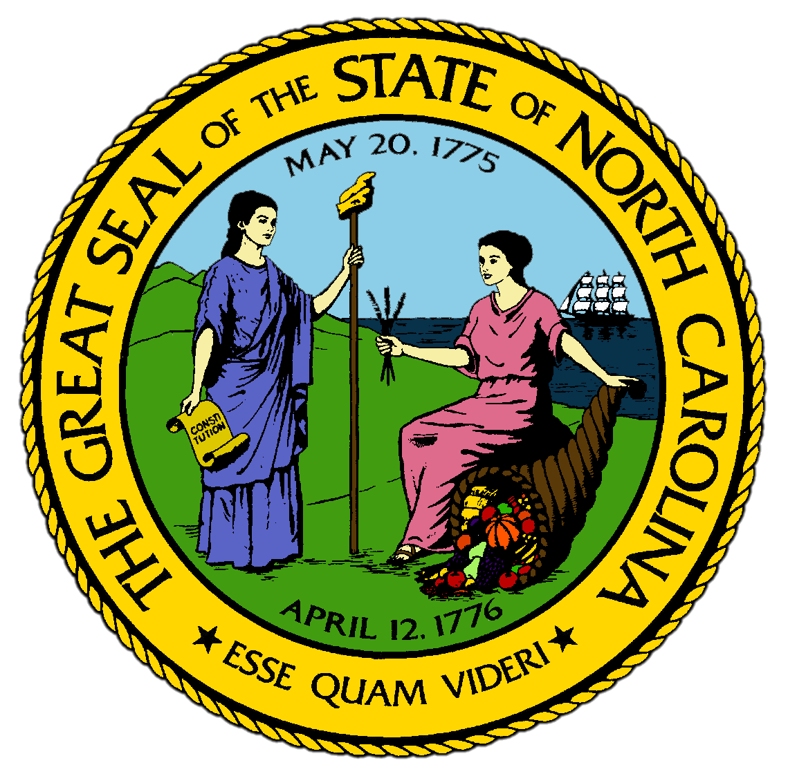
Chapter 11:
Patterns of Progress
STUDY PRESENTATION
© 2017 Clairmont Press

Slide 2
Section 1: "Progress,” Democrats, and Education
Section 2: Black Responses to Segregation
Section 3: Main Streets and Mill Villages
Section 4: Progress in the Countryside
Section 5: The Impact of the First World War

Slide 3
Section 1: “Progress,” Democrats, and Education
Essential Question:
What steps were taken by the state that led to segregation and disfranchisement of African Americans, and why were they considered “progress”?

Slide 4
Section 1: “Progress,” Democrats, and Education
What terms do I need to know?
hydroelectricity
disfranchisement
grandfather clause
universal education
equalization
referendum
prohibition
compulsory education
Jim Crow laws

Slide 5
Introduction
North Carolina’s economy grew rapidly after the 1890s and became the lead manufacturing state in the South.
One reason North Carolina was able to expand its wealth was that it took advantage of the western rivers of the state.

Slide 6
Industrial Progress
In 1904, dams were built across the Catawba River to generate electricity, which was sold to nearby textile mills.
Eventually all of the Piedmont benefitted from hydroelectricity, or water-powered electricity, from the Duke Power Company.
Towns continued to grow rapidly and became the centers of progress.
North Carolina had to become more organized to handle its industrial growth.

Slide 7
Disfranchisement and the Election of 1900
The white supremacists in charge of the legislature were the ones to reorganize North Carolina based on two main ideas:
First, all voters should be literate.
They had a racial motivation in promoting literacy, as most black men would be disfranchised, or not allowed to vote, if literacy was a voting requirement.
A grandfather clause provided exceptions, meaning any man whose father or grandfather had voted before 1867 could vote anyway, which eliminated the black vote further.
Second, the state would create a public education system that responded to the new demands of industry.
Universal education: every child should have access to better schools, and the state should provide this through equalization, which is the funding schools in poorer areas at a greater rate than those in richer areas.

Slide 8
The Aycock Education Plan
Disfranchisement eliminated the black vote from state politics and turned Republicans into minority.
Governor Aycock pushed a “progressive” agenda of laws to set up North Carolina for industrial success.
He wanted more money spent on graded education by legislature and counties, and more normal schools established to train teachers for the graded schools.
Thousands of schools were built between 1902-1914, and many rural areas had graded schools for the first time.

Slide 9
Legislating Behavior
The legislatures of the early 1900s passed laws that altered the traditional behavior of North Carolinians.
Manufacturers argued that drinking alcohol wasn’t compatible with factory work, and in 1908, a referendum passed approving prohibition, which made it illegal to make, possess, or consume alcohol.
In 1903, the state passed a child labor law, forbidding parents from allowing children under 12 to work in the mills.
In 1913, compulsory education was approved, requiring all children to attend school until a certain age.
The legislature also supported segregation laws for public places and schools, called Jim Crow laws.
By 1910, North Carolina was strictly segregated, which was seen as part of the "progressive advancement" of the state.
Return to Main Menu

Slide 10
Section 2: Black Responses to Segregation
Essential Question:
How did segregation in North Carolina impact the education and culture of African Americans?

Slide 11
Section 2: Black Responses to Segregation
What terms do I need to know?
paradox
shotgun house

Slide 12
Introduction
“Progress” put severe limits on North Carolina’s black citizens.
Neighborhoods became segregated in 1900s, often split by railroad tracks through the towns.
As towns grew, so did their levels of segregation.
Businesses owned by blacks moved to separate areas of towns, or blacks did menial, meaning lowly, work for white business owners or families.

Slide 13
Black Neighborhoods
Durham was segregated like the rest of the state, but there were more opportunities for blacks than other towns.
Rather than textiles, Durham was home to tobacco manufacturing.
Tobacco manufacturers hired black men as well as whites for major positions, and blacks earned higher wages in Durham than anywhere else in the state.

Slide 14
Durham’s “Black Wall Street”
Hayti was the black neighborhood of Durham, south of the cigarette factories.
This area soon gained influence over the rest of the state.
“The Mutual” was founded here, and it provided insurance policies to help cover burial costs.
It soon became the largest black-owned business in the region.
Stores, churches, and businesses all grew around the bank and insurance building, earning the area the nickname “Black Wall Street”.

Slide 15
Shotgun Houses
Most blacks were sold or leased shotgun houses by both black and white businessmen.
The houses were narrow with no hallways and two or three rooms.
This earned them their nickname, since if all the doors were open, a shotgun blast could go through the house without touching anything .
These houses had few comforts, though North Carolina towns got paving, electricity, running water, and sewers in the early 1900s.

Slide 16
Limited Schooling
Despite intentions of the legislature, black education lagged behind white education in the 1900s.
There was one black school built for every ten white schools.
Graded schools were part of the new century, but few black children had access to high schools.
Blacks were expected to continue doing menial work and service jobs.
Blacks often turned to northerners for help building their own schools and colleges, and teachers got the best training possible to give their students a true education.
Return to Main Menu

Slide 17
Section 3: Main Streets and Mill Villages
Essential Question:
What were the differences between the ways middle-class families and mill village families lived and worked during this period?

Slide 18
Section 3: Main Streets and Mill Villages
What terms do I need to know?
suburb

Slide 19
Introduction
Economic status separated whites from each other.
Urban whites lived either in privileged, comfortable towns or mill villages on the edge of towns .
There were not formal restrictions on interactions between whites like segregation forced on blacks, but their interactions tended to be limited.

Slide 20
The Middle Class and the Spirit of Progress
North Carolina’s middle class emerged in the early 1900s.
Main Street was paved and had streetlights, and houses had indoor plumbing, furnaces, and telephones.
Women of successful families rarely worked outside the home.
They joined clubs to read and talk about how to bring progress to their communities.
Churches in every town grew rapidly and built larger buildings.
The variety of entertainment in towns increased.
Some people moved to fashionable neighborhoods at the edge of their communities called suburbs.

Slide 21
The Confines of the Mill Village
Life in the mill village was far different than the suburbs.
Most cotton mills workers could not afford housing, so mill owners provided housing in mill villages.
Houses had 3-4 rooms with no running water, electricity, or indoor plumbing.
Most mill workers worked more than 10 hours a day, 6 days a week.
For many, the mill village would be their home for life.
Families kept some country traditions.
They dug vegetable gardens and some kept cows and pigs.
Families were active in churches and children went to school after the compulsory education law in 1913.
Mill village life was isolated, so many never went into the town outside the mill village.
Return to Main Menu

Slide 22
Section 4: Progress in the Countryside
Essential Question:
How did progressive ideas improve the lives of rural families?

Slide 23
Section 4: Progress in the Countryside
What terms do I need to know?
rural free delivery
auction

Slide 24
Introduction
The largest towns in North Carolina grew into cities in 1900s, but only a tenth of the population lived in them.
By 1905, many farms received mail through rural free delivery, which brought farmers closer to urban society.
More shopped for manufactured goods at crossroads stores and earned money by growing raw materials needed by the factories, mainly cotton and tobacco.

Slide 25
“Tobacco Road”
North Carolinians became famous worldwide in the early 1900s because they made the bulk of the world’s cigarettes.
Tobacco took over the economies of the Coastal Plain.
Famers sold their leaf at warehouses in town, where it was then shipped to Durham or other cities.
The area between Wilson and Durham became known as “Tobacco Road” because so much leaf was shipped to the factories.
A new culture developed in the Coastal Plain around the planting, cropping, harvesting, and marketing of bright leaf tobacco.
Farmers went into debt each year to buy fertilizer and supplies to raise as much tobacco as possible.
Tobacco was sold at an auction in the fall, where it was sold in a matter of seconds to the highest bidder.

Slide 26
Cotton Pickers and Mountaineers
More farmers began to grow cotton as textile manufacturing grew, but large amounts of fertilizer were required to farm the red clay soil.
Most mountaineer families were no longer prosperous in the 1900s, as they had grown too large for the amount of farmable land.
Many found work cutting down trees on mountain slopes, but that further reduced the health of their farms as the soil eroded where there were no longer trees to hold it.
Thousands of mountain families moved as far as the timber regions of Washington state.
Return to Main Menu

Slide 27
Section 5: The Impact of the First World War
Essential question:
How did North Carolina contribute to the First World War, and how did their part in the war affect the state’s economy?

Slide 28
Section 5: The Impact of the First World War
What terms do I need to know?
armistice
strike
Great Migration

Slide 29
Introduction
In 1914, the continent of Europe was involved in all-out war.
This conflict included almost all European nations and lasted 5 years.
The principal combatants were Great Britain and France, who fought against Germany and Austria.
The United States took a decisive role in the outcome of the war near the end of the conflict, and North Carolina had significant influence on the U.S. presence in the First World War.

Slide 30
North Carolinians and the World War
For the first time, North Carolina exerted influence over the United States.
President Woodrow Wilson grew up in Wilmington and had a North Carolinian in his cabinet for the first time since the Civil War.
After the U.S. entered the war in 1917, the government drafted, or conscripted, all able-bodied single young men into service, and North Carolina provided 86,000 soldiers.
The government set up three enlistment camps across the state to train the soldiers from North Carolina.
Few North Carolinians were opposed to the war.

Slide 31
The Economics of War
The tobacco industry profited greatly from the war, since smoking increased as people worked longer hours.
More factories were needed to make weapons and other materials for the war.
The U.S. provided weapons to British and French troops as well as American soldiers.

Slide 32
The Home Front during the World War
Factory workers were most enthusiastic about the war and the most likely to invest in war bonds, or long-term IOUs issued to raise money for the war, than people who lived in the countryside.
African Americans were drafted alongside whites for the first time, though they were still segregated in the Army.
The state’s worst suffering of the war was the worldwide epidemic of Spanish influenza in 1918, the largest health crisis in North Carolina’s history.
Thousands died across the state during one of the coldest winters in a decade.

Slide 33
The Effects of the War
The Germans surrendered and signed an armistice in November 1918.
North Carolina was richer because of the war.
Farmers got good prices for tobacco and cotton, and wages increased in factories since many workers were gone.
The whole nation experienced an economic slump in 1920-1921 as soldiers came back and wanted to return to their jobs, workers' wages were cut, and a demand for goods decreased.
This led to some of the first labor strikes, which is when workers refuse to work.
Congress passed the 19th Amendment, giving women the right to vote, but North Carolina’s state legislature failed to ratify the amendment.
The war created opportunities for African Americans to leave North Carolina for the North, where segregation was less significant.
So many blacks across the South moved to the North that it was called the Great Migration.
Return to Main Menu

Slide 34
Image Credits
Title Slide: Public Doman, Wikimedia Commons; Contents slide: Reginald Lankford, Clairmont Press; End Slide: Reginald Lankford, Clairmont Press;
Shown here: Kitty Hawk Bay, NC
Return to Main Menu

