Slide 1
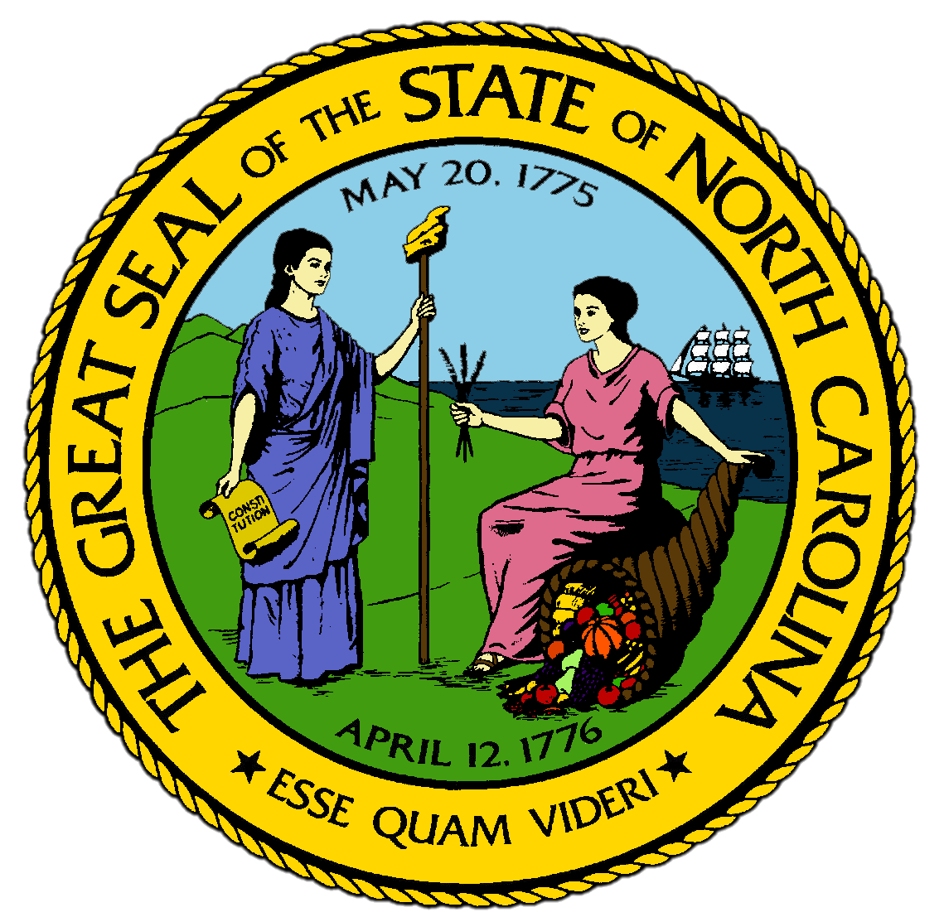
Chapter 10:
The Industrial Transition
STUDY PRESENTATION
© 2017 Clairmont Press

Slide 2
Section 1: Railroads Lead to Town Growth
Section 2: Tobacco and Textiles Spur the Transition
Section 3: Transition in the Towns
Section 4: Transitions in the Countryside
Section 5: A Troubled End to the Century

Slide 3
Section 1: Railroads Lead to Town Growth
Essential Question:
What impact did North Carolina’s transition to an industrial state have on the residents of different parts of the state?

Slide 4
Section 1: Railroads Lead to Town Growth
What terms do I need to know?
transition

Slide 5
Introduction
North Carolina’s towns grew quickly after Reconstruction.
Wilmington remained the state’s largest town and seaport, but was no longer the only large town in the state.
Charlotte, Winston, and Asheville were all growing similar in size to Wilmington.
North Carolina was in a time of transition.

Slide 6
Reasons for the Transition
The first reason for the transition was the restoration of the railroads during Reconstruction, which finally connected the state with the rest of the country.
North Carolinians could trade easily and cheaply with the rest of the country for the first time.
Trade encouraged the growth of towns along the railroads.
The second reason for the transition was that the state began to process their raw materials they produced, like tobacco, cotton, and so on, to receive a higher profit.
This led to the construction of factories and greater industrialization in the state.
By 1900, North Carolina was becoming the most industrial state in the South.

Slide 7
Concord, an Industrial Town
During the Civil War, Concord had fewer than 1,000 residents and only 1 factory.
Once the railroads were revived, they began to grow more cotton and revived the cotton factory, and by the 1890s they had half a dozen cotton mills.
By 1900, more than 4,000 people lived in Concord, with most involved in the new industrial work.
Many of Concord’s residents lived in the mill village, where factory workers lived in houses rented from the factory owners.

Slide 8
New Towns on the Railroads
Many new towns were built during this period along the railroads.
Many of the towns had been hamlets, or small settlements, before becoming thriving industrial towns within 30 years.
The development of new towns hurt the older towns that weren’t connected to the railroads, stopping the less-connected towns’ growth.

Slide 9
The Rise of Charlotte
The biggest change in the western side of the state was the importance of Charlotte and Salisbury.
The towns were roughly the same before the Civil War, but afterwards, Salisbury was less connected to the railroads.
By 1900, Charlotte was the intersection of railroads from 6 directions and had nearly 18,000 residents.
In every growing town, the factories were as important as the railroads in the process of development.
Return to Main Menu

Slide 10
Section 2: Tobacco and Textiles Spur the Transition
Essential Question:
What factors led to the development of the tobacco and textile industries in North Carolina?

Slide 11
Section 2: Tobacco and Textiles Spur the Transition
What terms do I need to know?
bright leaf tobacco
monopoly

Slide 12
Introduction
North Carolinians did their best to take advantage of the opportunities made available by the railroads.
Their two main products were tobacco and cotton.
To maximize their profit, North Carolinians constructed their own factories to process the raw materials and sell their goods for a higher price.

Slide 13
Bright Leaf Tobacco
In 1852, a slave on a plantation discovered that controlled heat improved the curing of tobacco, which lead farmers to start “flue-curing” their tobacco.
This improved product was called bright leaf tobacco, due to the heat that dried the leaves and turned them bright yellow.
The railroads made North Carolina’s bright leaf tobacco known worldwide.
Businessmen began competing to sell the cured tobacco all over the United States.

Slide 14
Buck Duke’s Monopoly
In the 1880s, James Buchanan Duke decided to start selling pre-rolled cigarettes, which were rolled by a machine, rather than just the loose tobacco.
Bright leaf tobacco had made Americans more likely to use cigarettes than a pipe.
“Buck” Duke gained the rights to a machine that could roll cigarettes 40 times faster than a human roller.
Duke became one of the richest Americans and was known throughout the country for his tobacco monopoly, meaning he personally controlled most tobacco production in the country.
The men of the tobacco industry put some of their wealth into North Carolina’s other important industry-cotton textiles.

Slide 15
Cotton Mills along the Railroads
North Carolinians had built cotton mills along streams before the railroads, but shipping was a problem.
After the Civil War, manufacturers moved their mills along the railroads to make shipping easier and cheaper.
By the 1890s, cotton mills were operating in nearly every town along the railroad.
One reason for Charlotte’s growth was its development of machine shops and warehouses to supply parts to factories.

Slide 16
Steam Power Aids Manufacturing
Most of the factories in North Carolina were run with steam engines, just like the trains, so they didn’t depend on water power from streams.
Factories in the state produced many different types of products, like brooms, drainpipes, mattresses, and candy.
The Wallace brothers of Statesville bought various plants from merchants in the mountains and shipped them to drug companies in the North.
Return to Main Menu

Slide 17
Section 3: Transition in the Towns
Essential Question:
How did the growth of towns impact the growth of other institutions, such as schools and churches?

Slide 18
Section 3: Transition in the Towns
What terms do I need to know?
graded school
normal school

Slide 19
Introduction
Life in North Carolina became more urban after Reconstruction.
More people began to go to church as towns grew, and the amount of churches in towns multiplied.
Downtown churches started chapels in the mill villages.
In all these churches, Sunday schools were started.

Slide 20
New Schools and Colleges
Towns introduced a new form of education—the graded school.
Graded schools required students to pass certain tests before proceeding on to the next grade.
In most cases, a graded school for white children led to the construction of a separate graded school for black children.
Higher education became part of town life, and the state expanded its public education to include industrial education.
More women were teaching in the graded schools, so normal schools, or teacher-training institutions, were started.
Many churches also started colleges during this period throughout the state.
African American colleges grew after Reconstruction as well, including normal schools.

Slide 21
New Technologies and Ideas
The new schools introduced not only the new ways of industry but also new technologies.
Telephones, electric streetlights, electric streetcars, and other new technologies spread throughout the state during this period.
North Carolina also adopted a new type of bank called the Commercial Nation Bank, as part of the new national banking system introduced by Congress.
Daily newspapers became common in towns, allowing the new stores to advertise while also encouraging new industry and investments.
The increasing need for workers in factories had led to problems for farmers.
Many were as poor and disadvantaged as their ancestors had been before the railroads were built.
Return to Main Menu

Slide 22
Section 4: Transitions in the Countryside
Essential Question:
What problems did farmers in North Carolina face during this period of transition?

Slide 23
Section 4: Transitions in the Countryside
What terms do I need to know?
furnishing merchant
Farmers’ Alliance
farmer cooperative store
money supply
collateral
Populist Party

Slide 24
Introduction
While the urban population increased, the majority of North Carolina’s residents continued to live in the country.
Many farming communities were growing as fast as the towns during this period.
By 1890, there were so many farm families that there was not enough good land fertile enough to raise crops.

Slide 25
More Farms, Same Amount of Land
Most farming families stayed on their land for generations.
More and more land was being planted, but much of it wasn’t good land, and farmers had a harder time making things grow.
To compensate, farmers borrowed money from furnishing merchants, who were storekeepers that let them buy fertilizer, seeds, tools, and other supplies.
The farmers would owe interest to the storekeeper, and some required the farmer to sell their crops to the storekeeper they borrowed from.

Slide 26
Falling Crop Prices
Farmers increased the size of their crops to help pay back their loans, which lowered the price of crops.
The more they grew, the less they got back.
Thousands of farmers throughout the state went bankrupt in the 1890s and couldn’t pay back the loans to merchants.
Meanwhile, their debts continued to increase.

Slide 27
A Growing Number of Sharecroppers
Many white farmers ended up in sharecropping agreements as their debts increased.
The landowner usually required the farmer to plant only one crop, which was usually cotton or tobacco, to ensure its sale.
Thousands of farmers were so discouraged that they moved into towns to take industrial jobs.
The North Carolina College of Agricultural and Mechanical Arts was opened to help farmers learn more efficient methods of farming, but most farmers couldn’t afford college.
By the 1890s, the state’s farmers had organized into angry political protest groups.

Slide 28
Farmers’ Organizations
Leonidas L. Polk became the first commissioner of agriculture in the state, then editor of a farming newspaper to help farmers.
The Farmers’ Alliance, which started in Texas, reached North Carolina in 1887 with Polk as its leader.
The Alliance opened farmer cooperative stores, which bought fertilizer and other supplies in bulk to lower the cost to farmers, but most farmers were already too far in debt to be helped.
The U.S. was rapidly building cities in the North, and the money supply throughout the country was decreasing each year.
The Alliance asked Congress to print new money to loan to farmers, who would use their crops as collateral, which is something pledged against the repayment of a loan.
Return to Main Menu

Slide 29
Section 5: A Troubled End to the Century
Essential Question:
What significant events led up to the 1898 election and how did its results impact North Carolina?

Slide 30
Section 5: A Troubled End to the Century
What terms do I need to know?
Fusionists
white supremacy

Slide 31
Introduction
North Carolina and the United States were involved in conflict at the end of the 19th century.
Democrats returned to power in North Carolina in the election of 1898, leading to an outbreak of violence in Wilmington.
The United States entered into a war against Spain in 1898, which ended quickly.

Slide 32
The Fusion Movement
The Populists in North Carolina ran for the state legislature and Congress in the 1890s.
When Populists didn’t win in 1892, Republicans offered to help them win in 1894 in return for restoring some of the Holden reforms.
The Fusionists, which were a combination of the Republicans and Populist Parties, controlled North Carolina from 1895-1898.
They restored many Holden reforms and attempted to improve schools in rural areas.
These reforms restored the fortunes of Republicans in the states, and the reformers tried to help the poor of both races in the state.

Slide 33
The 1898 Election
The Fusionist ideas alarmed the Democrats.
Eastern Democrats decided to repeat the same racial slurs they used during Reconstruction to regain white voters.
Democrats took back control of North Carolina with their white supremacy campaign, which preached the belief that the white race is superior to any other race.
Racial tensions and violence worsened throughout the state, and the Democrats won a narrow victory and took back the legislature.
Violence swept through Wilmington after election day as white mobs took vengeance on African American Republicans who had been in charge of the city.
At least 60 residents were murdered.

Slide 34
The Spanish-American War
The United States went to war with Spain in 1898 over conditions in Cuba.
During the Spanish-American War, America quickly won victories in Cuba and the Philippine Islands in the Pacific.
The U.S. eventually annexed, or took control of, the Philippines and helped Cuba become independent.
North Carolina raised three military regiments for the war, though none of them came under fire during the war.
Several state residents were later killed serving with the Philippine occupation forces.
Return to Main Menu

Slide 35
Image Credits
Title Slide: Public Doman, Wikimedia Commons; Contents slide: Reginald Lankford, Clairmont Press; End Slide: Reginald Lankford, Clairmont Press;
Shown here: Kitty Hawk Bay, NC
Return to Main Menu

