Slide 1
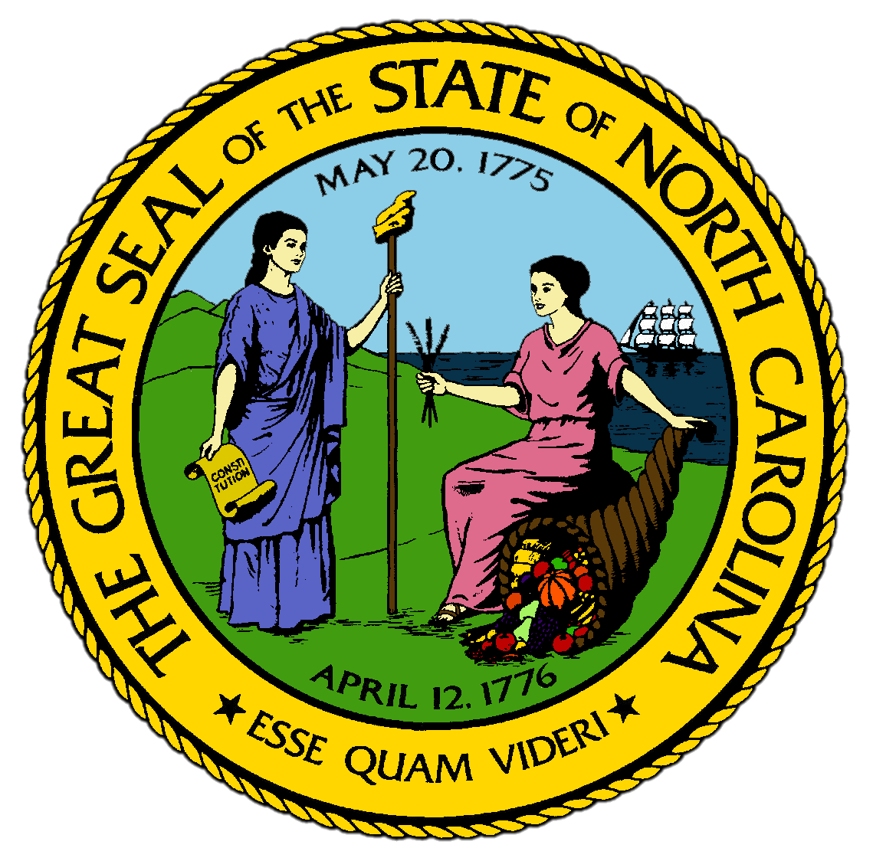
Chapter 7:
The Antebellum Era
STUDY PRESENTATION
© 2017 Clairmont Press

Slide 2
Section 1: The State That Moved Like a Turtle
Section 2: The Rip Van Winkle State
Section 3: North Carolina Awakens
Section 4: Whigs Support Development
Section 5: Racial Issues in the Time of Reform

Slide 3
Section 1: The State That Moved Like a Turtle
Essential Question:
What were North Carolina’s beliefs in states’ rights and how did those beliefs cause their turn to Jeffersonian ideals?

Slide 4
Section 1: The State That Moved Like a Turtle
What terms do I need to know?
states’ rights
republican simplicity
War of 1812

Slide 5
Introduction
North Carolina had been a backwater colony before the Revolution and little changed after the Constitution was written.
North Carolina’s tradition of distrusting political power was the common governing approach of the nation after 1800, and North Carolina began to contribute significantly to national leadership.

Slide 6
North Carolina and Federalism
North Carolina refused to take an oath of allegiance to the federal government in 1790 because Congress had passed a law that disputes between states would be settled in federal court, not state courts.
The Tenth Amendment granted to states all power not delegated to the the federal government in the Constitution.
North Carolina believed in states’ rights, which means states should assert independence when the federal government was doing something wrong.
The Eleventh Amendment restrained the Supreme Court from taking cases brought by a citizen of one state against another.
In the 1794 election, North Carolinians voted for the Antifederalists, led by Thomas Jefferson.

Slide 7
North Carolinians Become Jeffersonians
Americans who distrusted the Federalists rallied to Thomas Jefferson.
Antifederalists soon controlled the state government in North Carolina, with the most important being Nathaniel Macon, a Congressman.
Macon was a leading spokesman for republican simplicity, which is the idea that citizens in a republic should live as independently and simply as possible.
He wanted Americans to be self-sustaining farmers.
Antifederalists believed the government should stay out of the way, except to provide defense and other matters for the nation’s survival.
The best government, in their eyes, was the local government.

Slide 8
North Carolina in the War of 1812
The War of 1812 was fought between the Americans and the British to ensure Americans’ rights to settle in the West and be safe from British interference on the sea.
The War of 1812 had a very small impact on North Carolina itself, but many North Carolinians served in the American army.
Two former residents became national heroes:
First Lady Dolley Madison refused to leave the Executive Mansion to protect the important documents there, and when she left she took an important portrait of George Washington.
Andrew Jackson became the leading military figure of the war.
Return to Main Menu

Slide 9
Section 2: The Rip Van Winkle State
Essential Question:
What factors became obstacles preventing the improvement of transportation and education in North Carolina?

Slide 10
Section 2: The Rip Van Winkle State
What terms do I need to know?
Rip Van Winkle state
subsistence farming
clubbing
recession
internal improvements
canal
common school
Literary Fund

Slide 11
Introduction
Rip Van Winkle was a character in a fictional story set in New York who fell asleep for 20 years and awoke amazed at the changes around him.
At a time when the nation was growing and changing, North Carolina seemed to be asleep to improvements, leading to the state being called the 'Rip Van Winkle state'.

Slide 12
Subsistence Farming
Most families had to practice subsistence farming, growing what they needed to feed themselves and their livestock, then selling the surplus, often to neighbors.
Bartering, or trading one item for another, was very important in North Carolina since most residents had little cash.
Neighborhoods practiced clubbing, which means combining their surplus crops into one large load and trusting friends to go to market for them.

Slide 13
The State Struggles
The state did little to help the situation of its residents, believing that problems could be solved without government interference.
Most years, the state’s taxes barely covered the salaries of state officials.
The state did start building roads in the western mountains, connecting travelers to roads leading to Charleston and making North Carolina more prosperous.
A national recession, or economic slowdown, in 1819 put many farmers in debt, and frustrated residents left the state for newer areas across the Mississippi River.

Slide 14
Murphey’s Proposals
After the War of 1812, Archibald Murphey tried to improve North Carolina by presenting ideas to the legislature for internal improvements and public education.
Internal improvements referred mostly to transportation, as residents of the backcountry were still isolated by rivers.
Murphey wanted to deepen channels and create canals, or man-made water channels that allowed horses or mules to pull flatboats with less effort than on roads.
Despite Murphey’s efforts, North Carolina had fewer canals than almost any other state.
He also urged the state to fund at least one common school in each county, where every white family could send their children to be educated.
The state was slow to fund the proposals due to lack of money, but a Literary Fund was set up in 1825 to help build schools.
Return to Main Menu

Slide 15
Section 3: North Carolina Awakens
Essential Question:
How was a more balanced representation between the eastern and western parts of the state gained and how did this change the government of North Carolina?

Slide 16
Section 3: North Carolina Awakens
What terms do I need to know?
suffrage
Democratic Party
Whig Party

Slide 17
Introduction
In 1831, the capitol building in Raleigh burned down, destroying nearly all of its contents.
Fayetteville was considered again to be the capitol, but then most of Fayetteville burned down as well.
The state laid a cornerstone for a new capitol in Raleigh in 1833.
The granite building with its copper dome is still the North Carolina State Capitol today.

Slide 18
East Versus West
Citizens were leaving because of a lack of opportunity within the state and disgust with the state’s leadership.
The east continued to hold power even after 1830 census showed that the east had fewer people than the west, but the east had more representatives in the legislature.
Sectionalism still mattered more than the state to many leaders in North Carolina.
The west rebelled after attempts to get the legislature to call for a constitutional change.

Slide 19
The Constitutional Convention of 1835
In 1835, almost every voter in the west voted for a constitutional convention, and almost every voter in the east voted against it.
The west had more people, however, so the convention was held.
Their greatest need was to make representation fair across the state.
Each county would still have at least one representative in the House, but more populous counties would have multiple.
The state Senate would be apportioned by wealth; the wealthier a county was, the more Senators it got.
This created a balance of power between the two sections of the state for the first time.
The governor was now elected by the people rather than the legislature for a 2-year term.
Also, black men and Native Americans were no longer granted suffrage, or the right to vote.
With the election of 1836, North Carolina was governed in a new way.

Slide 20
Reform and the Nation
North Carolina’s reforms were part of a broader national movement to change how the government worked.
Andrew Jackson built up the Democratic Party during his terms as president from 1829-1837.
Those who disliked him and his assertiveness formed the Whig Party to oppose him.
Andrew Jackson made it easier to buy federal land, worked to lower federal tax rates, and established banks with federal money in the western states.
Jackson believed that the states, not the nation, should decide where there should be banks, so he vetoed the Bank of the United States.
Return to Main Menu

Slide 21
Section 4: Whigs Support Development
Essential Question:
What improvements were brought to North Carolina under Whig leadership and how did those improvements change the state?

Slide 22
Section 4: Whigs Support Development
What terms do I need to know?
curriculum
literate
plank road

Slide 23
Introduction
The Whigs wanted to use government money to build up the state.
They soon formed a party out of Murphey’s supporters and controlled the state in the 1830s and 1840s.
The first Whig leader was John Motley Morehead, who pushed both parts of Murphey’s plan: public education and internal improvements.

Slide 24
Improvements in Education and Literacy
In 1839, the Whigs created the state’s first public school system, and the first school opened in Rockingham County in 1840.
By the 1850s, every county had common schools and the state had developed a school system.
In 1852, Calvin H. Wiley became the first superintendent of public instruction and introduced standards for the teachers, even publishing a magazine to help teachers improve their skills.
North Carolina had the most extensive school system of the South during the Antebellum era.
The University in Chapel Hill also grew and expanded its curriculum, which means courses offered, to include law and agricultural chemistry.
By the 1850s, more North Carolinians were literate, meaning able to read and write, than ever before.

Slide 25
The Coming of the Railroads
In the 1830s, the invention of railroads became one of the most important things to happen to the state, as railroads could be built almost anywhere.
Both Whigs and Democrats voted to use public money to invest in railroads.
The first railroads in North Carolina were the longest railroads in the world at the time.
Railroads impacted the farmers of the state, with some planters tripling the amount of cotton they grew and tobacco farms multiplying.
Railroads impacted the development of towns, which grew up around railroad stops.
Fayettevillle built plank roads, made out of planks laid like a deck across the roadbed to help farmers keep their wagons above the mud and ruts.

Slide 26
Social Improvements
The spirit of development across North Carolina impacted most residents.
Governor Morehead had the legislature set up a school for the deaf and blind.
In 1894, the state established the Hospital for the Insane in west Raleigh.
The Whig legislature encouraged the chartering of private academies and colleges, which were primarily established by Christian denominations.
As the railroads brought prosperity, support for educating women grew.
The Moravians had already established the Salem Female Academy in 1802.

Slide 27
Industrial Beginnings
The Whigs chartered cotton mills, setting the stage for the later growth of that industry in North Carolina.
A dozen more factories were built in the 1840s, most along the Cape Fear River.
Edwin M. Holt ran the Alamance Factory near the site of the Alamance Battlefield, producing the first dyed cloth in the state in 1852 called “Alamance Plaid”.
The first telegraph in the state was installed in 1848, and between 1835 and 1850, the number of newspapers published in the state more than doubled.
The number of people living in towns also doubled during this period.

Slide 28
Mining
North Carolina had been known as a gold-producing state since the John Reed family opened the nation’s first significant gold mine in the early 1800s.
So much gold was found in the central part of the state that the federal government set up a branch of the United States Mint there in 1837.
The most famous mining site was Gold Hill, which started in 1842 at the edge of the Uwharries with more than 3,000 people working the mine in shifts.
North Carolinians also mined iron ore.
North Carolina’s first coal mine opened in 1855 at Cumnock in Lee County and operated through the Civil War.
Return to Main Menu

Slide 29
Section 5: Racial Issues in the Time of Reform
Essential Question:
How were racial issues in North Carolina impacted by the policy of Indian removal and the Trail of Tears?

Slide 30
Section 5: Racial Issues in the Time of Reform
What terms do I need to know?
Trail of Tears
plantation
staple crop
yeoman farmer
artisan
emancipation
slave code
quarters
free black

Slide 31
Introduction
During the Antebellum era, the rights of minority groups were restricted by the actions of the white majority in North Carolina.
New laws made it easier to control the lives of slaves and put restrictions on privileges of free people of color.
Native Americans were evicted from their homes by the efforts of whites.

Slide 32
The Cherokee in the Southeast
In the early 1800s, North Carolina included part of the Cherokee Nation, considered to be most civilized of the Five Civilized Tribes.
Most of the Cherokee lived in Georgia, but about 4,000 still lived in North Carolina and remained the largest Native American group in the state.
They lived in the deepest parts of the mountains and kept many of the old traditions of hunting, gathering, and village life, and they considered themselves citizens of North Carolina.

Slide 33
Cherokee Removal and the Trail of Tears
In the 1820s, southern whites began to harass the Cherokee and other Native Americans to give up their land.
In the 1830s, President Andrew Jackson convinced the Cherokee to sign a treaty calling for their removal to the west, but many were able to elude the soldiers that were coming to round them up.
During 1838 and 1839, more than 15,000 Cherokee were forced to moved to Indian Territory, later called Oklahoma, in a brutal journey later called the Trail of Tears.
About 1,000 Cherokee were allowed to remain in North Carolina with the help of a white man adopted into the Cherokee nation, who held the land in his name since the Cherokee couldn’t own land.
This became the basis for the establishment of the Eastern Cherokee nation later in the 1800s.

Slide 34
Masters and Slaves
Slavery was not quite as dominant in North Carolina as other states in the South, about 1/4 families owned slaves
The greatest concentration of slaves was along the Tidewater and Coastal Plain, which had some of the best soil in the state and was close enough to ports to sell crops
A significant number of slaves lived on plantations, which were farms large enough to produce both food for subsistence and a large amount of surplus staple crops to earn money.
Staple crops were primarily tobacco and cotton, but sometimes included grains.
Plantations used slave labor to clear and cultivate huge areas of land and to graze livestock, taught some slaves to be skilled craftspeople called artisans, and used large groups of slaves to cultivate and harvest fields.

Slide 35
The Conditions of African Americans
Two conditions made a person a slave:
He or she had to be at least partially African American.
His or her mother had to have been a slave.
Without an act of emancipation, or a master legally freeing a slave, a slave was a slave for life.
The slave code defined the social, economic, and physical place of slaves in North Carolina.
They lacked freedom of movement, were denied most forms of advancement such as reading or writing, and could not legally marry.
Slaves generally lived in slave quarters, which was where their housing was located, and their living conditions depended on the attitude of the master.
All slaves faced the horrors of the possibilities of being beaten or sold, or having their family members sold and sent away.

Slide 36
Free People of Color
A few blacks in North Carolina were free, but they suffered from prejudice and poor treatment.
In Fayetteville, free blacks wore a label on their sleeve identifying them.
Ralf Freeman, a freed slave, became one of the most notable preachers in the Uwharries during the 1820s.
Almost 200 free blacks owned slaves, which in many cases were their own relatives who were bought to keep them from being owned by whites.
Return to Main Menu

Slide 37
Image Credits
Title Slide: Public Doman, Wikimedia Commons; Contents slide: Reginald Lankford, Clairmont Press; End Slide: Reginald Lankford, Clairmont Press;
Shown here: Kitty Hawk Bay, NC
Return to Main Menu

