Slide 1
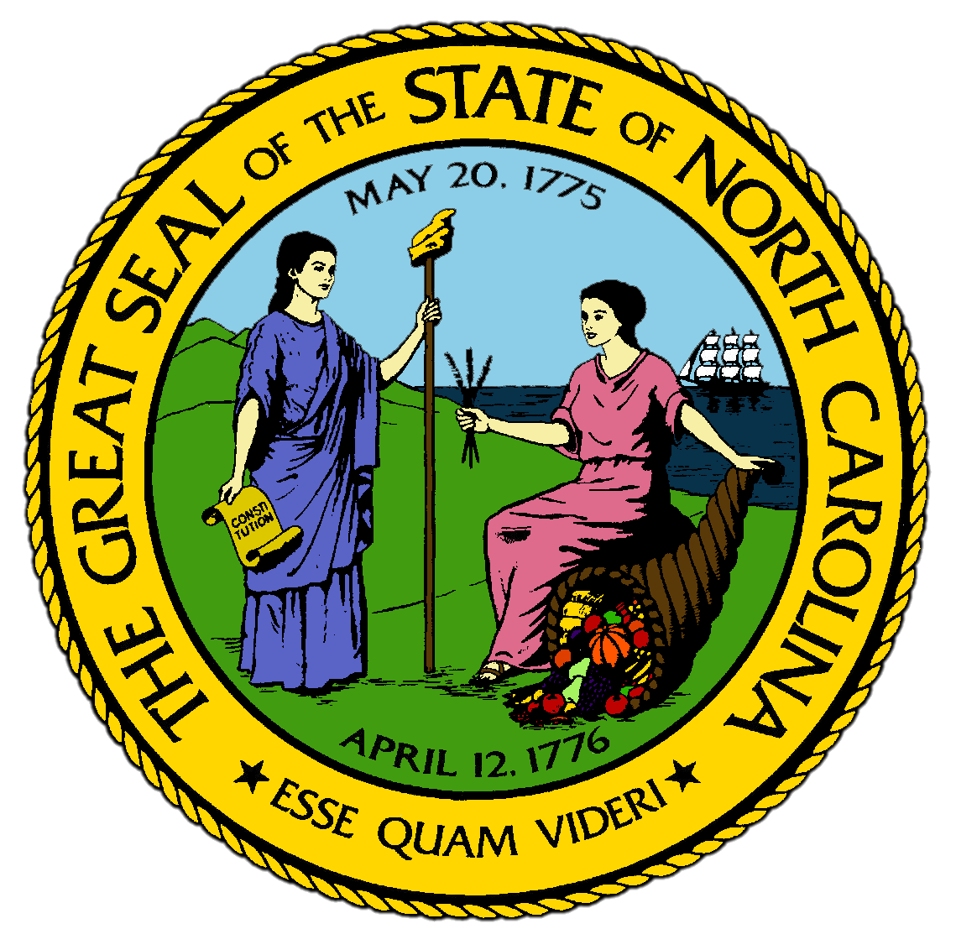
Chapter 6:
A Revolutionary Generation
STUDY PRESENTATION
© 2017 Clairmont Press

Slide 2
Section 1: The Long Road to Independence
Section 2: North Carolina in the War for Independence
Section 3: The British Invade the Carolinas
Section 4: North Carolina from Confederation to Constitution

Slide 3
Section 1: The Long Road to Independence
Essential Question:
What events and issues led to the eventual outbreak of the American War for Independence?

Slide 4
Section 1: The Long Road to Independence
What terms do I need to know?
Proclamation of 1763
Stamp Act
Edenton Tea Party

Slide 5
Introduction
The British Parliament changed the ways the colonies were governed to make the Americans pay heavier taxes and be under more British control.
The colonists were angry that the British passed these laws without any representatives from the colonies participating in the process.
The result was the War for Independence and the American Revolution.

Slide 6
The Proclamation of 1763
The Proclamation of 1763 declared that there could be no settlement on the western side of the Appalachian Mountains.
The king wanted to stop fighting between the Indians and colonists.
Some North Carolinians ignored the king, believing that they could become wealthier by claiming “free” land in the west.
After the Battle of Alamance, many Regulator families moved into the valleys of the Tennessee River, an Indian reserve.

Slide 7
The Stamp Act
The Stamp Act was passed by the British in 1765 to provide the British with more money to pay for the French and Indian War and to pay their troops.
This was done by increasing the colonists’ taxes.
The Stamp Act required all ships to have their records stamped with an official seal, which could only be bought from a customs official.
There had never been a tax like this before, and colonists worried that the tax would only increase, especially since it had been created without their approval.
Mobs protested the Stamp Act in every colonial port, almost leading to open rebellion in Cape Fear before the British cancelled the Stamp Act.

Slide 8
Continuing Disagreements and Protests
In 1769, Governor Tryon again sent the Assembly home because it was too critical to the British.
Even though the colonists knew the British would use force, many continued to disobey.
In 1770, British troops fired on a group of protesters in Boston, later known as the Boston Massacre.
In 1773, Bostonians disguised as Iroquois dumped hundreds of boxes of tea in their harbor, later known as the Boston Tea Party.

Slide 9
The Edenton Tea Party
The British closed the port of Boston for the loss of the tea, and other colonies agreed to not trade with England.
North Carolina leaders sent a ship to Boston with supplies and food to help the citizens.
In October 1774, women from around the Albemarle Sound met on the village green at Edenton and promised to drink no more British tea or use other imported materials.
North Carolinians remember this as the Edenton Tea Party.
By 1775 tensions were even higher, and shots fired in Lexington led to a battle at Concord that started the American War for Independence.
Return to Main Menu

Slide 10
Section 2: North Carolina in the War for Independence
Essential Question:
How did the War for Independence impact the development of the state government in North Carolina?

Slide 11
Section 2: North Carolina in the War for Independence
What terms do I need to know?
Provincial Congress
Committees of Safety
Tories
Whigs
Mecklenburg Resolves
Halifax Resolves
Declaration of Rights
Confiscation Act

Slide 12
Introduction
Even before the battles at Lexington and Concord, North Carolinians were separating themselves from the British.
In 1774, when the governor refused to call the Assembly, the people set up the Provincial Congress to choose delegates for the Continental Congress.
They also created the Committees of Safety in each county to keep order and provide government.
Most wanted supporters of the British, called Tories, to have to sign an oath of loyalty.
The Committee of Safety in Mecklenburg county created the Mecklenburg Resolves, stating that the king’s officers had no power since the British were being so aggressive.
Locals elected new leaders to replace them.

Slide 13
The Battle of Moore’s Creek Bridge
The Provincial Congress set up defenses, made everyone sign a loyalty oath, authorized enlistment of soldiers to fight in the war, and printed money .
The North Carolina militiamen were sent into South Carolina and Virginia to fight the Tories.
By 1776, North Carolinians were fighting amongst themselves about the war.
The Highland Scots marched toward Wilmington and were cut off by the militia, who dismantled the bridge and shot at the Highlanders that tried to cross.
The Battle of Moore’s Creek Bridge was celebrated as an American victory.

Slide 14
Halifax Resolves
North Carolinians were convinced that their conflict with the British couldn’t be settled peacefully.
In 1776, the Provincial Congress passed the Halifax Resolves, authorizing the colony’s delegates in Philadelphia to join the other colonies in seeking independence.

Slide 15
State Constitution
Once independence was declared and the United States was created by an act of the Continental Congress, North Carolina went from a colony to a state.
Each of the thirteen states wrote a state constitution.
North Carolinians agreed that the legislature of representatives of the people should be the strongest part of the government.
They continued the General Assembly, but created two houses: the House of Commons and the Senate.
They were cautious in creation of the office of governor.
He would be chosen by legislature each year and have little power.
North Carolina included a Declaration of Rights in their constitution.

Slide 16
Governing the New State
Under the first governor, Richard Caswell, the state had to find ways to protect its citizens and raise revenue to pay for the war.
In 1777, the Assembly passed the Confiscation Act, saying that residents who wouldn’t take oath of allegiance to the state could have their property taken.
Additionally, strictly religious people like the Quakers and Moravians who would not take oaths or fight had to pay more taxes than other citizens.
North Carolina sent several regiments to fight with General George Washington in 1777.
By the end of the war, more than 7,000 North Carolinians had fought in the Continental Army.

Slide 17
Divided Loyalties
None of the original 13 states was more divided in its loyalties than North Carolina.
Many coastal residents sided with the Whigs, as they were most affected by restrictions on trade.
Tories were concentrated in the central area of the state in areas that supported the Regulators.
They didn’t love the king; they just hated the leaders of the coastal area.
State officers put down a Tory plot in 1777 to steal guns and ammunition and kidnap the governor.
Some Native Americans saw the war as a chance to regain their lands, and the Cherokee attacked the frontier.
Dozens of Cherokee towns were destroyed and the Cherokee were left hungry and homeless.
Return to Main Menu

Slide 18
Section 3: The British Invade the Carolinas
Essential Question:
How did the British invasion of the Carolinas impact the new state and its divided loyalties?

Slide 19
Section 3: The British Invade the Carolinas
What terms do I need to know?
Overmountain Men
pardon

Slide 20
Introduction
In 1779, the American army was trapped in Charles Town and surrendered in 1780.
Most of the North Carolina Continentals were imprisoned for the rest of the war.
They raised a second southern army quickly to march into South Carolina, but they were defeated in 1780, leaving the British in control of South Carolina and North Carolina open to invasion.

Slide 21
North Carolinians Defend Their Homeland
In June 1780, more than 1,000 Tories were defeated as Ramsour’s Mill .
The British split their army, sending half into the North Carolina mountains to force settlers to join the British and sending the rest to Charlotte.
Both lead to disaster for the British.
The Whigs made as much trouble for the invaders as possible.
The Tories sent into the mountains were wiped out.
The Overmountain Men crossed the Blue Ridge and trapped the Tories in October 1780 at the Battle of Kings Mountain, forcing the British to retreat into South Carolina.

Slide 22
The British Chase the American Army
The American army went to Charlotte, where they were split into two groups to help find supplies for the nearly-starving men.
The British went after the group that General Morgan led, but he had militia reinforcements, and he ended up fighting and defeating the British at Hannah’s Cowpens.
When General Greene returned to North Carolina, his army outnumbered the British 2 to 1.
The armies met in March 1781 at Guilford Courthouse, with some of the fiercest fighting in the War for Independence.
The British went to Virginia, but were trapped in October 1781 in Yorktown by Washington, effectively ending the war when the British surrendered.
By the end of 1782, the British had left Wilmington and Charles Town, ending the war in the South.
The final treaty was signed in 1784, 2 years after the British surrender at Yorktown.

Slide 23
A Civil War
Whig control of the state was nearly eliminated when the British swept through in 1781.
Another Tory regiment was formed, led by David Fanning, but didn’t join the British army.
Fanning and his men terrorized the backcountry areas that had sent men to fight for North Carolina.
They ran the Assembly out of town, stole supplies, and kidnapped the governor.
This was typical of the terrible times that Whigs experienced during the British invasion, but the Whigs could be just as cruel as the Tories .

Slide 24
The War Ends in North Carolina
The Tory-Whig war in North Carolina ended after the British withdrew from Wilmington in 1782.
Fanning and his men resettled in Nova Scotia, Canada.
The Whigs attempted to calm the state.
Tories were tried by courts and those who had simply fought for the king were generally allowed to return home, while those charged with crimes lost their property.
In 1784, the state legislature issued a pardon, which is an act forgiving participants for their actions during war, to the Tories.
Return to Main Menu

Slide 25
Section 4: North Carolina from Confederation to Constitution
Essential Question:
What were the main issues with the Articles of Confederation and how did they lead to the development of a new government and Constitution?

Slide 26
Section 4: North Carolina from Confederation to Constitution
What terms do I need to know?
Articles of Confederation
compromise
Federalists
Antifederalists

Slide 27
Introduction
North Carolina slowly recovered from the hate and destruction of the war.
To raise money, the state continued to sell the confiscated lands of the Tories, even though the Treaty of Paris in 1783 made it illegal.
In 1784 the state decided to cede its lands west of the Appalachians, but then reversed the decision.

Slide 28
The State of Franklin
Residents west of the Blue Ridge wanted more control of their own rights and didn’t like the leaders from the Coastal Plain.
When the Assembly ceded its western lands, the leaders of the Watauga area petitioned Congress to create a new state, which would be called Franklin.
When North Carolina took back the land, the leaders of the State of Franklin went ahead anyway.
They met in 1784, wrote a constitution, and elected a governor.
The Confederate Congress and the General Assembly refused to recognize the new state, and Franklin ceased to exist by 1787.
The fight over Franklin helped create the state of Tennessee.

Slide 29
North Carolina Under the Articles of Confederation
During the War for Independence, the Continental Congress created the first constitution, called the Articles of Confederation, which created a one-house legislature called Congress.
The Confederation was ineffective as it lacked money and resources.
Americans were suffering because the British didn’t abide by the terms of the 1783 peace treaty and wouldn’t leave military bases west of Appalachians while encouraging Indians to attack white settlers in those areas.
The issues throughout the United States convinced American leaders that a stronger government was needed in every state.

Slide 30
North Carolina and the Federal Constitution
Leaders met in Maryland in 1786 to call for reform of the Confederation.
All 13 states sent representatives to the Philadelphia Constitutional Convention in 1787 to write a new Constitution.
Virginians proposed a more powerful national government and a Congress with two houses and representation based on population.
Smaller states countered with a plan that gave each state an equal vote.
The Great Compromise set up the government Americans have today— a House of Representatives based on population and a Senate that gives each state an equal vote.
The second significant compromise was the Three-Fifths Compromise, determining that slaves would be counted as 3/5 of a person when it came to representation.

Slide 31
North Carolina Hesitates to Ratify
The writers of the Constitution asked each state to ratify, or approve, the new form of government.
By 1788, enough states had joined the Union that the US held its first elections.
General George Washington was elected president.
North Carolina was divided between Federalists, those in favor of the new government, and Antifederalists, those who distrusted the ideas of the new government.
Most Federalists lived along the coast and would benefit from the government’s new powers over business and money.
Antifederalists were often from the backcountry and worried about how powerful the new government would become.
Because there were so many in the backcountry, the antifederalists were able to stop the first attempt to ratify.

Slide 32
The Hillsborough Convention
The delegates met in 1788 at Hillsborough and voted to delay ratifying the Constitution.
The agreed that they would accept the Union with some changes to the Constitution, particularly a Bill of Rights.
To encourage North Carolina to ratify, Congress delayed any special taxes on North Carolina goods until 1790 and worked to have a Bill of Rights approved by the other states.

Slide 33
The Fayetteville Convention
In November 1788, North Carolina called for a second vote on the Constitution and met a year later in Fayetteville.
The vote was overwhelmingly for the Union.
Growing national support for a Bill of Rights pleased supporters of ratification.
North Carolina sent its first representatives and senators, mostly Federalists, to the new government in 1790.

Slide 34
The State Establishes a New Capital
The 1788, the Hillsborough Convention had agreed to a site for a permanent state capital to be called Raleigh.
It was about equal distance for people in the backcountry, Cape Fear, and Albemarle.
The legislature moved to Raleigh in 1794.
Fayetteville, which was the combining of Cross Creek and Campbelltown, tried to become the capital.
Even after the decision, Fayetteville built a “new state house” to hold the 1789 convention, but it didn’t get enough votes for a reversal.

Slide 35
The First State University
The legislature that met in Fayetteville in 1789 established a State University.
Soon after the University opened in 1795, school officials also established the village of Chapel Hill.
Officials tried to make the University a symbol of a united state, but sectional divisions continued in some ways and would continue to cause trouble for North Carolina in the years to come.
Return to Main Menu

Slide 36
Image Credits
Title Slide: Public Doman, Wikimedia Commons; Contents slide: Reginald Lankford, Clairmont Press; End Slide: Reginald Lankford, Clairmont Press;
Shown here: Kitty Hawk Bay, NC
Return to Main Menu

