Slide 1
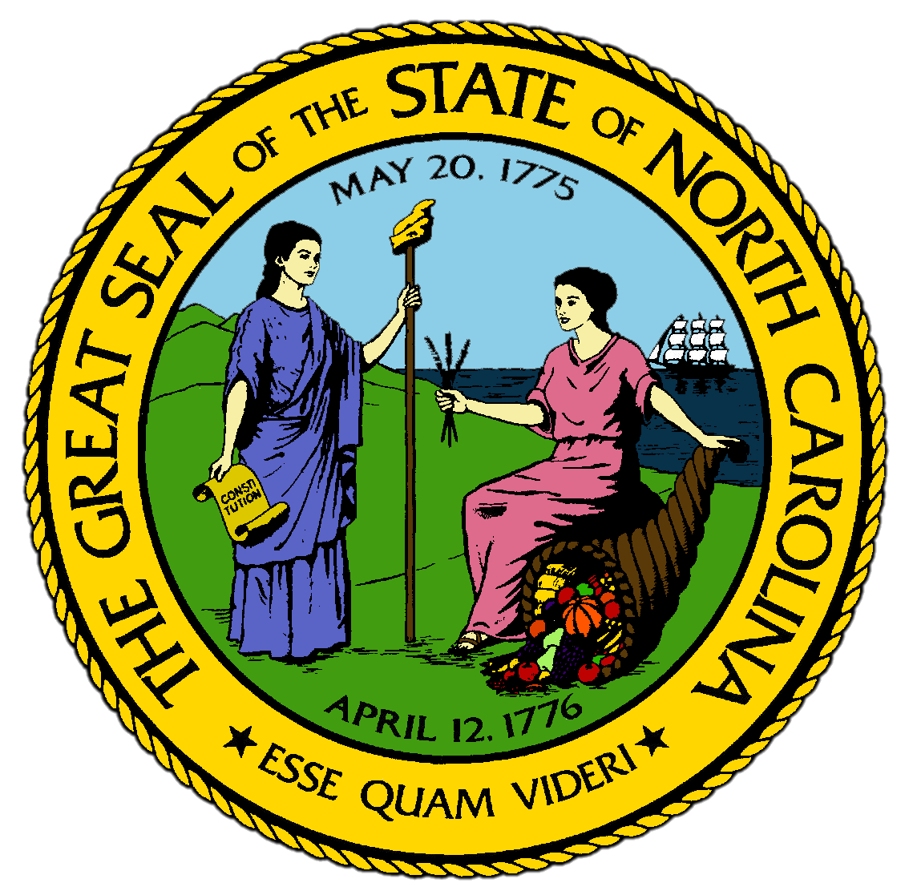
Chapter 5:
The Early Settlement of North Carolina
STUDY PRESENTATION
© 2017 Clairmont Press

Slide 2
Section 1: Early Settlement and Proprietorship
Section 2: Settling the Pamlico Sound and the Cape Fear
Section 3: A Royal Colony Struggles
Section 4: Life in the Backcountry
Section 5: William Tryon and the Regulation

Slide 3
Section 1: Early Settlement and Proprietorship
Essential Question:
How did conflict and rebellion impact the lifestyles of the early settlers in the Carolina colony?

Slide 4
Section 1: Early Settlement and Proprietorship
What terms do I need to know?
neck
Lord Proprietor
customs duty
charter
quit-rent
General Assembly
Navigation Acts
Culpeper’s Rebellion

Slide 5
Introduction
The origins of the colony of Carolina were on the necks, or peninsulas located only in the northeastern corner of the state, on the shore of the Albermarle Sound.
By 1663, the Carolina colony was owned by English aristocrats called the Lords Proprietors, who seldom got along with the colonists.

Slide 6
Settlers from the North
Profits from tobacco eventually convinced English settlers to move south from Jamestown into Carolina.
Tobacco pulled the nutrients out of the soil so severely that a field had to be abandoned after seven years
In 1629, King Charles I gave a patent for a large area of the Carolina colony, but it went unused.
By the early 1660s, a few farmers were moving into the Carolina area to plant and sell land.

Slide 7
Carolina “Rogues”
England was supporting its New World colonies through an expensive tax on tobacco that was collected as customs duties, which were fees paid when a good was shipped out of a port.
The first settlers of Albermarle were called “rogues” because they often shipped their tobacco through back channels without paying the tax.

Slide 8
The Carolina Charter
All of Great Britain’s American colonies were eventually organized by a charter, a contract granted by the king to individuals or groups who were to be in charge of settlement and govern the settlers.
In 1663, King Charles II created the new Carolina colony, giving the charter to the Lords Proprietors.
The king expanded the charter to include all of what is today North and South Carolina, Georgia, and part of Florida.

Slide 9
The Lords Proprietors
The Lords Proprietors were some of the most powerful men in England.
To encourage settlement, Proprietors sold land cheaply, mostly charging for surveying , or measuring, the property and filing the deed.
Settlers would have to pay the Proprietors a quit-rent, which was an old form of payment from Europe, in the form of an annual land tax.
Because the Proprietors made profits from the quit-rents, they were expected to fairly govern the colony.
The Proprietors established a complicated form of government, but the settlers did not comply.
The Albemarle region turned out to be the least profitable and governable part of Carolina.

Slide 10
Social and Economic Conditions
Most of the Albemarle settlers were less wealthy than their Virginian counterparts.
They planted by hand and sold their tobacco, corn, and other crops for small profits each summer to New England ship captains.
There were no churches or schools in the first neighborhoods.
The Quakers, also known as The Society of Friends, did not require ministers and worshipped in their homes.

Slide 11
Unrest in the Colony
The Albemarle settlers fought any effort by the Proprietors to impose order on them.
The Proprietors enforced the Navigation Acts, or laws that listed which colonial goods would be subject to customs duties, but most Albemarle residents would not pay.
Two settlers who sided with the Proprietors, Thomas Miller and Thomas Eastchurch, caused Culpeper’s Rebellion in 1676.
They went to England to complain about the horrible conditions in the colony, but George Durant went as well to claim that limited access to the sea made the settlers too poor to pay the tax.
Both sides returned to Carolina and sent complaints to the Proprietors in England.
Proprietors continued to name new governors, but chaos continued.

Slide 12
The Colony is Split
In 1691, the Lords Proprietors split their colony in two.
The governor was to live in Charles Town, where there were substantial customs duties on rice.
A deputy governor of “north” Carolina would be sent to Albemarle.

Slide 13
Section 2: Settling the Pamlico Sound and the Cape Fear
Essential Question:
What led settlers to the Pamlico and the Cape Fear areas, and how did the tensions and conflicts they encountered impact the settlements?

Slide 14
Section 2: Settling the Pamlico Sound and the Cape Fear
What terms do I need to know?
refugee
naval stores
royal colony

Slide 15
Introduction
In 1696, a group of Huguenots, French Protestants, settled on the Pamlico Sound.
The governor convinced the General Assembly to divide Albemarle into two counties: Albemarle and Bath.
Other settlers hoped to raise cattle on the rich grass in nearby forests.
So many Virginians moved to the Pamlico that Virginia tried to pass laws to prevent them from leaving.

Slide 16
Settlement of the Pamlico
Newcomers to the Pamlico started the first town, Bath, in 1705.
A second town, New Bern, was approved by the Proprietors in 1711.
New Bern was home to German and Swiss refugees,those fleeing danger or persecution, from Switzerland.
Settlers still resisted attempts from the Lords Proprietors to instill order.

Slide 17
Cary’s Rebellion
The Proprietors believed that introducing the Church of England would make Carolinians better citizens and taxpayers.
The establishment of the Anglican church meant that all colonists officially belonged to the Anglican faith and were expected to pay church taxes to build Anglican churches and pay Anglican clergymen.
The Test Act, which required anyone in public office to put his hand on a Bible and swear to uphold the Anglican church, was used to keep Quakers from holding office.
Governor Cary sided with the Quakers and was governor for 3 years without making the Quakers take the test.
When the Proprietors sent a new governor, Cary gathered a crowd and attacked the Anglicans, but they were forced to flee the colony when English soldiers arrived.

Slide 18
The Tuscarora War
The Tuscarora Indians attempted to destroy the Pamlico settlements in 1711, killing several hundred colonists.
The Tuscarora were angry about white settlers taking their land, and their need to hunt conflicted with the farmers’ need to plant fields. White traders also cheated the natives and kidnapped them to sell them as slaves in the Caribbean.
There were few men in the colony prepared to fight. South Carolina sent troops to help and defeated the Tuscarora in a series of battles on the Neuse River.
The commander of the South Carolinians took Tuscarora hostages to sell as slaves, angering the Indians again.
The Tuscarora attacked the Pamlico again in 1712, and were again defeated by troops from South Carolina.
Native Americans who were not forced into slavery decided to leave the region.

Slide 19
Settlement of the Cape Fear
The defeat of the Tuscarora opened up new land to settlement, most significantly the Cape Fear region, which became the most prosperous area of the colony for the production of naval stores.
The British received tar, pitch, and turpentine from the longleaf pines
The Lords Proprietors considered Cape Fear to be part of South Carolina and restricted who could live there.
The North Carolina governor granted land to those who paid quit-rents in advance in spite of the Proprietors' instructions.

Slide 20
Blank Patents
Governor Burrington took land deed forms, which were called blank patents in that day, and sold them, letting the buyers fill in the blanks as to the location of the land afterwards.
The Proprietors dismissed Burrington, and a group of South Carolinians moved to Cape Fear, using blank patents to gain more than 80,000 acres.

Slide 21
End of the Proprietorship
Everyone was angry about the real estate scandal of Cape Fear.
The Proprietors were fed up with the unending troubles that their investment in the Carolina colony had brought them, and decided to sell out.
England bought back its interest in the lands that had become North and South Carolina.
In 1729, North Carolina went from being a proprietary colony to being a royal colony, and now belonged directly to the king.
The transfer did not go smoothly, and there were more conflicts and rebellions in the colonies.

Slide 22
Section 3: A Royal Colony Struggles
Essential Question:
What were the conflicts North Carolina faced after becoming a royal colony, and what impact did the French and Indian War have on the colony?

Slide 23
Section 3: A Royal Colony Struggles
What terms do I need to know?
boycott
Granville District
French and Indian War

Slide 24
Introduction
Even under a royal governor, the handicaps of geography continued to cause problems for North Carolina.
Because it was so difficult to navigate the Outer Banks, goods cost 50% more to ship from North Carolina than from ports like Philadelphia or Charles Town.

Slide 25
Sectional Conflicts
The settlement of Cape Fear continued to cause conflicts.
When Cape Fear demanded equal representation in the General Assembly, the Albemarle boycotted, or refused to participate in, the Assembly from 1746-1754.
The king granted Granville the northern half of the colony to sell land and collect quit-rents while the colony was responsible for governing the Granville District.

Slide 26
Governor Arthur Dobbs and the French and Indian War
Arthur Dobbs was made governor in 1754 of a colony in a dire situation.
Public expenses were high, little money went into the treasury, and settlement moved closer to Cherokee lands.
The French and Indian War, which fought over European control in North America, made matters even worse in North Carolina.
The French controlled land west of the Appalachians and the Cherokee sided with the French.
North Carolina built Fort Dobbs to defend the backcountry.
The Treaty of Paris ended the war in 1763, and the French lost all of their land in America.
Governor Dobbs attempted to make improvements, but colonists didn’t agree with his decisions.

Slide 27
Section 4: Life in the Backcountry
Essential question:
What different cultural groups settled in the North Carolina Backcountry and how did they pass their cultures on?

Slide 28
Section 4: Life in the Backcountry
What terms do I need to know?
backcountry
prairie
girdling
gristmill
toll

Slide 29
Introduction
Until 1730, almost all residents of North Carolina lived east of the Fall Line.
By the 1750s, backcountry towns were being created to serve as market and government centers.

Slide 30
Newcomers to the Backcountry
Most newcomers traveled from the northern colonies, drawn by the low cost of land in North Carolina.
The backcountry was named for the land at the “back” of the settled “country”, or the land near the coast.
The first settlers were Scots-Irish, who had left Ireland for religious freedom of the colonies.
A few Scots-Irish brought slaves with them.
The Germans from Pennsylvania were next, having fled German conflicts in the 1690s to the colonies.
There were English settlers in the backcountry, but most were Quakers.
The most distinctive people group were the Moravians, a German-speaking group from Europe.
The final ethnic group to the backcountry were the Highland Scots, forced out of Scotland after a failed rebellion.
There were still a few Native American groups remaining in the 1760s.

Slide 31
Carving Out Farms on the Frontier
The earliest settlers to the backcountry came for land.
The area near the Great Wagon Road had long stretches of prairie, which had more grassland than woods.
The settlers cut enough trees for houses and fences, then used girdling on the rest, which involved stripping the bark for about 2-3 feet around the tree, causing the trees to die and fall.
The area had dark black soil rather than red clay.
Early settlers grazed cattle and grew grain, and everyone planted corn.
First wealthy settlers were those who built gristmills, which was a place to grind grain into flour, and took a toll, or portion of the grain, in payment.

Slide 32
The Home Front
Settlers worked to improve their land by building fences, double-pen barns, and log houses.
All families in the backcountry had kitchen gardens close to the door where they grew vegetables, herbs, and flowers.

Slide 33
Building Communities
All backcountry settlers brought their own cultures with them, and villages soon began to teach their values.
Most valued religion and settlers quickly began to build churches.
The most active religious community was Wachovia, the Moravian town.
The Moravians were more structured and organized than any other settlers, and therefore Wachovia became the most prosperous place in the backcountry.
Other settlers became jealous of the Moravians’ wealth and religion.

Slide 34
Section 5: William Tryon and the Regulation
Essential question:
What were William Tryon’s reforms and how did they cause the Regulation movement?

Slide 35
Section 5: William Tryon and the Regulation
What terms do I need to know?
appropriate
Regulator
extortion
militia

Slide 36
Introduction
William Tryon made governor in 1765, and he was ambitious to improve North Carolina.
Tryon wanted the colony to be better organized to take advantage of its economic resources.
He also wanted the colonists to be more respectful of authority, especially government officials in charge of the colony.

Slide 37
Tryon’s Reforms
Tryon convinced the General Assembly to have a permanent seat in New Bern and appropriate, or set aside, a large amount of money for construction for the royal government and the governor.
Second, Tryon had the General Assembly reorganize the Church of England in North Carolina by building and repairing churches.
Third, he increased customs collections in the ports despite protests.
Finally, Tryon gained more control over the colony by having his friends appointed to local offices in the backcountry.

Slide 38
The Regulator Movement
While Tryon’s reforms improved organization in North Carolina, they had a large cost to the taxpayers.
Few backcountry residents were Anglican and didn’t want to support the church with their taxes, but most were angry that Tryon hadn’t done anything to stop bad government.
Hundreds signed petitions calling for regulation, eventually calling themselves Regulators.
In 1770, the Regulators took over the Hillsborough courtroom and attacked public officials.
Tryon passed laws for strict punishment of public acts of disorder and called out the militia, which were citizen soldiers.
In 1771, Regulators fought the Battle of Alamance against Tryon and the militia, which the Regulators lost.
The end of the Regulation didn’t solve any of the problems of North Carolina in the 1770s.

Slide 39
Image Credits
Title Slide: Public Doman, Wikimedia Commons; Contents slide: Reginald Lankford, Clairmont Press; End Slide: Reginald Lankford, Clairmont Press;
Shown here: Kitty Hawk Bay, NC
Return to Main Menu

