Slide 1
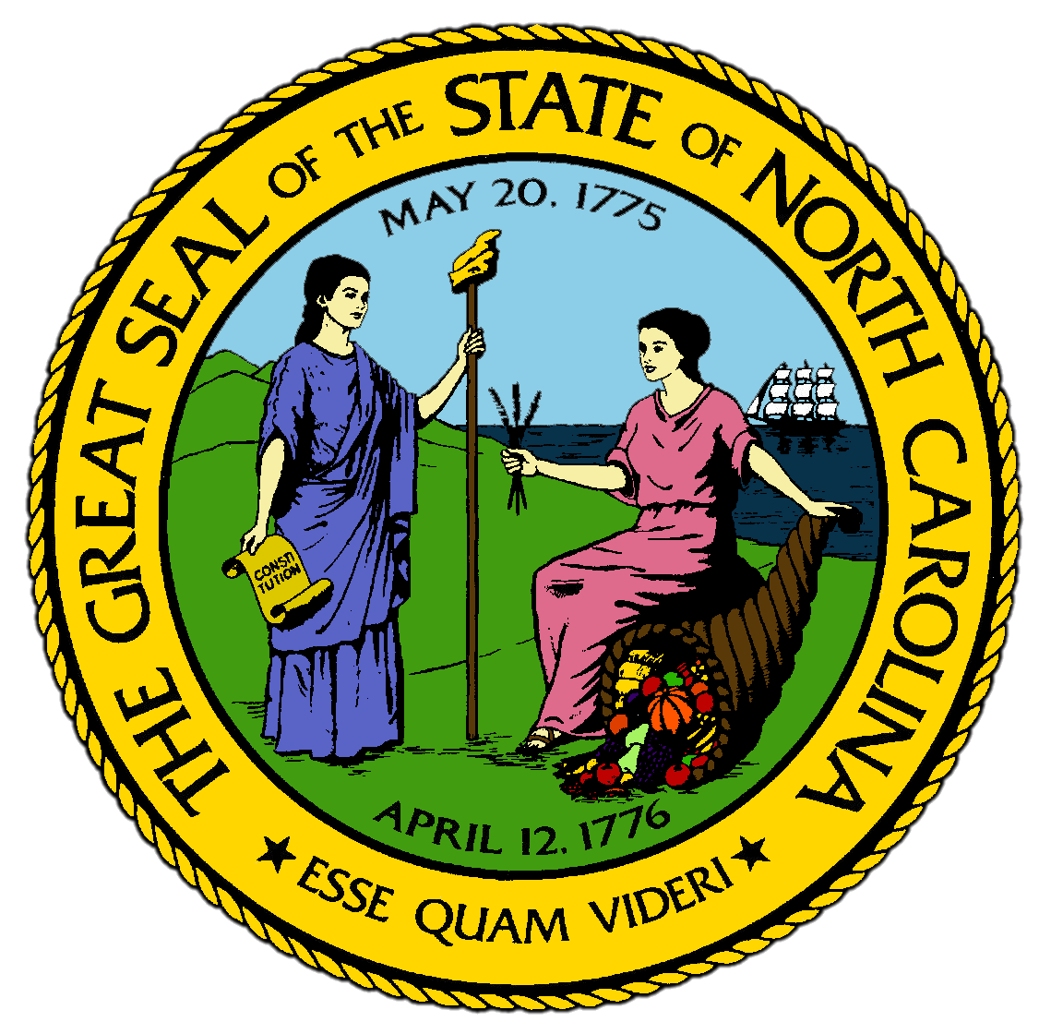
Chapter 4:
The Natives and the Newcomers
STUDY PRESENTATION
© 2017 Clairmont Press

Slide 2
Section 1: Cultures of the First People
Section 2: The Native People "Discovered"
Section 3: European Explorers Come and Go
Section 4: The Story of the Lost Colonists

Slide 3
Section 1: Cultures of the First People
Essential Question:
How did the advancements in tool making, hunting, and agriculture influence the development of different cultures during the prehistoric periods?

Slide 4
Section 1: Cultures of the First People
What terms do I need to know?
archaeologist
culture
atlatl
pemmican
ceremonial center

Slide 5
Introduction
The first people who settled in the area that would become North Carolina about 12,000 years ago were probably from Asia during the last Ice Age.
These first people were called “paleolithic” because they used stone tools, they were foragers in the Uwharrie Mountains and made spearheads from slate.
Their habits and patterns, which are the basis of a culture, are classified as the Archaic Period.

Slide 6
The Archaic Period
People formed foraging communities when the weather warmed around 9,000 years ago. Nuts and berries from forest increased and people became healthier while making more complex tools with flint and rock.
Foragers moved from place to place according to season:
They spent spring along coast and winter closer to the fall line.
The foragers developed an improved spear and used a launcher to improve throw.
An atlatl was carved stick used to fling spears forward with more force and speed, which drastically improved hunting.
Larger communities formed, built huts with hearths (permanent stone for fires), made clay pottery, planted seeds and crops for the first time, and improved their tools.
They ground meat, grease, and nuts together to make pemmican.

Slide 7
The Woodland Period
The life quality of natives increased again with the introduction of corn around 3,000 years ago.
It grew well in stream bottoms with its “sisters”, beans and squash.
People were able to stay in one place longer, and the village tradition became part of the culture of the natives.
The natives depended greatly on forest for food and shelter and hunting, so this period of history is referred to as the Woodland Period.

Slide 8
Mississippian Influence
The natives were influenced by the culture coming from the southwest with its principal towns located along the Mississippi River.
In turn, the Mississippians had been influenced by traders from Mexico.
Mississippians built ceremonial centers wherever they lived, allowing them to come together for worship, recreation, and fellowship.
They believed that the ceremonies helped grow better crops and helped them live in better harmony with the earth.
To create community among Mississippian settlers along the Pee Dee River, priests ordered a ceremonial center built, today called the Town Creek Indian Mound, where ceremonies were held and many community leaders were buried.
People came several times a year to celebrate; the most important was the Green Corn Ceremony when corn was ripe enough to eat.
Return to Main Menu

Slide 9
Section 2: The Native People “Discovered”
Essential Question:
How did contact with the Europeans affect Native American life and the culture of the Woodland people and other early NC tribes?

Slide 10
Section 2: The Native People “Discovered”
What terms do I need to know?
dialect
clan
matrilineal
Columbian Exchange
immunity

Slide 11
Introduction
Columbus’s voyages began a rapid increase in European exploration in the West.
Explorers found natives in “new world,” but for the natives, the Europeans were the strange ones.
Native culture was well organized in North Carolina by the 1500s.
Native groups had developed customs and values that lasted through the European contact, though many groups were renamed by Europeans.
There were probably at least 30 different groups living in Coastal Plain, Piedmont, and Mountains areas, some no larger than a few small villages, others with much larger populations.

Slide 12
Algonquin Tribes
The Algonquin Tribes were small groups living along the coast that all spoke versions of the Algonquin language.
This language was shared by tribes all along Atlantic Coast.
These groups depended heavily on fish they caught in the sea and in the sounds, as well as plants, including corn.

Slide 13
The Tuscarora
The Tuscarora dominated the Coastal Plain in the 1500s, with about 15 large villages each with 300-500 people.
“Tuscarora” means “hemp gatherers”.
They were known for using hemp to make rope and cords.
Kin to Iroquois nation of New York, they probably came south in 1400s.

Slide 14
The Catawba
There were tribes living west of the fall line that consisted of at least 12 different groups with many names, with the Catawba as the largest group in this area.
They were named by explorer Juan Pardo, from the words meaning “where the river divides”.
They called themselves “the people who lived on the river”.
They were distinguished by burnt-black pottery they made out of various clays in the area
Many groups moved around in Piedmont during the 1500s, but all spoke variations of the Sioux language and most groups were descendants of the Sioux tribes of Great Plains.

Slide 15
The Cherokee
Originally from the area around the Ohio River, bad relations with Iroquois forced them from their homes to settle in deep mountains during Woodland Period.
When the Europeans arrived, the Cherokee controlled a mountain region of about 40,000 square miles.
One of largest tribes in US, they numbered at more than 30,000 during the Woodland Period.
There were three principal groups of Cherokee, depending on their location: the Lower Cherokee, the Middle Cherokee (where the largest and most important villages were located), and the Upper Cherokee.
All three groups of Cherokee spoke different dialects of the Cherokee language.

Slide 16
Native American Habits and Beliefs
Tribes shared many habits and beliefs of the Woodland culture by the 1500s.
All tribes hunted, primarily for deer.
They all depended on the same forest products, such as grapes, berries, and nuts.
All tribes planted the “three sisters”, meaning corn, beans, and squash.

Slide 17
Village Life
Villages were the norm for all Native American groups by 1500s.
The most common shelter was huts made with tree branches and clay.
Each village had their own rules and customs, and many had protective fencing around them to keep out bears, wolves, and other attacking tribes.
Kinship ties were established through the women of the tribes.
All children belonged to mother’s clan, which is an extended family with common ancestor.
Matrilineal society: family line is traced through the mother
Work was divided between men and women.
The women planted and cared for crops, and the men hunted and cleared the ground.

Slide 18
Belief Systems
All natives respected nature and knew their survival depended on their interactions with the environment.
Their religion was often about nature, and they respected the spiritual qualities of all things.
The Native Americans repeated stories to gain understanding of nature, which often included monsters and beasts, similar to fairy tales.
The Cherokee believed that “Little People”, almost like knomes, lived under rocks and roots and could help them in times of trouble.

Slide 19
The Columbian Exchange
Native tribes were doing well in the 1500s when Europeans arrived, and their arrival brought drastic changes to all.
People, ideas, and goods from Europe were brought to the Americas, and through trade and warfare things from the Americas were brought to Europe.
This exchange of plants, animals, food, people, diseases, and ideas was called the Columbian Exchange.
Europeans also brought diseases that the Natives had never been exposed to so they had no immunity, or resistance.
Smallpox, measles, chicken pox, and influenza were the most deadly.
Disease and warfare seriously decreased native populations.
Within 100 years of the arrival of the Europeans, the population of Native Americans in the Carolinas was reduced by half.
Return to Main Menu

Slide 20
Section 3: European Explorers Come and Go
Essential Question:
What were the motivations of the European explorers in Americas and North Carolina, and how did their motives impact their interactions with the Native Americans?

Slide 21
Section 3: European Explorers Come and Go
What terms do I need to know?
expedition
charter

Slide 22
Introduction
Thirty years after Columbus’s discoveries, the first Europeans set foot on what became North Carolina at Cape Fear in 1524.
They were hoping to find precious metals and an all-water route through North America to Asia.

Slide 23
Giovanni da Verrazano and the French
Giovanni da Verrazano was an Italian explorer working for the King of France, looking for a water route to China and the riches of Asia.
When he arrived in the Carolinas, he and his explorers believed that the color of the beaches meant that gold had to be nearby.
He failed to find gold or a water route to China, but he believed that the water off Portsmouth Island went all the way to Asia and reported that information when he returned to Europe.

Slide 24
Hernando de Soto and the Spanish
Columbus helped establish a vast new world dominated by the Spanish.
By the 1520s, the Spanish had conquered the natives from Cuba to Mexico, discovered the Pacific Ocean, and found gold and silver mines in South America.
They continued looking for gold all the way to the Carolinas
In 1539, Hernando de Soto and his soldiers explored what would become the Southeastern United States, and by 1540, his expedition had reached the Carolinas.
De Soto never found the gold he sought, and he treated the natives he encountered very badly, demanding favors while stealing goods and animals at will.

Slide 25
Juan Pardo and More Spaniards
The second group of Spanish explorers stayed longer.
Juan Pardo left base camp in South Carolina in 1569 for the area explored by de Soto, bringing men and Catholic priests to convert the natives to Christian beliefs.
Pardo left behind small groups of soldiers along the way to establish camps for future exploration.
They were hoping to find gold in the mountains and use the camps as stopping points on the way back to the coast
Some Spaniards stayed in the camps for several years before giving up finding gold.

Slide 26
Walter Raleigh and the English
By the late 1500s, England wanted to gain new world riches.
Sir Humphrey Gilbert and Sir Walter Raleigh believed that they could find the route to China.
In 1578, they planned an expedition to find the Northwest Passage for England, and Queen Elizabeth I granted them a charter to explore the new world.
They had to turn back within the first year because of storms and Spanish attacks.
They planned a second expedition, but Sir Gilbert went without Raleigh and was lost at sea in 1583.
In 1584, Raleigh tried again and sent the first of several English expeditions to New World.
Return to Main Menu

Slide 27
Section 4: The Story of the Lost Colonists
Essential Question:
What were the results of the first English attempts to settle in North Carolina and what achievements were gained through the expeditions?

Slide 28
Section 4: The Story of the Lost Colonists
What terms do I need to know?
colony
Lost Colony

Slide 29
Introduction
The English landed in an inlet in the Outer Banks that the Indians called Roanoak on July 13, 1584.
They explored the coast for six weeks, making notes for a settlement, and returned to England with notebooks, samples of plants, and two native people.
Queen Elizabeth I named the area Virginia and Raleigh worked to set up a permanent English settlement on coastline.

Slide 30
The Lane Colony
In 1585, Raleigh sent another group to Roanoke.
Ralph Lane was sent to build fort for protection and settlement.
The scientist and artist included in the expedition made this expedition a very important scientific journey.
Lane built a base called Fort Raleigh in the Outer Banks, which was England’s first colony in what would become North Carolina.
They wasted a lot of time digging for gold without finding any, and the settlers fought among themselves and antagonized the local natives.
A lack of success and shortages of food led to violence.
The English murdered a local chief and many inhabitants of a nearby village.
After a year, the colonists decided to go back to England on the ships sent to restock their supplies.

Slide 31
The White Colony
Raleigh tried English settlement again, sending women and children along with soldiers to improve relations with the natives.
John White led 110 settlers towards the Chesapeake Bay but they never made it past Roanoke.
The White Colony still struggled with shortages; White returned to England to get supplies and didn’t return for 3 years.
In 1590 White returned to Roanoke and found no one.
The settlers had promised that if they moved they would carve destination in a tree so White could find them.
White found a tree with “CRO” carved in it and a post with “CROATOAN” referring to a native village on Hatteras Island.
White wanted to go to Croatoan, but damage to his ships forced him to return to England.
No Englishman ever saw the Roanoke colony again.

Slide 32
The Fate of the Lost Colony
The missing Roanoke colony became known as the Lost Colony, and their exact fate is unknown.
There was no evidence of violence, so the colonists likely went to Croatoa and lived with the natives there.
A hundred years later, natives of Cape Hatteras spoke of ancestors who could “talk from a book” and white settlers in later years noticed natives who had blue eyes, built houses, and had English names.
These natives at one time called themselves Croatoans and claimed the Lost Colony as their ancestors.
The disaster at Roanoke kept the English from North Carolina for more than fifty years.
They didn’t return to the Outer Banks area until after the Jamestown settlement was established and successful.
Return to Main Menu

Slide 33
Image Credits
Title Slide: Public Doman, Wikimedia Commons; Contents slide: Reginald Lankford, Clairmont Press; End Slide: Reginald Lankford, Clairmont Press;
Shown here: Kitty Hawk Bay, NC
Return to Main Menu

