Slide 1
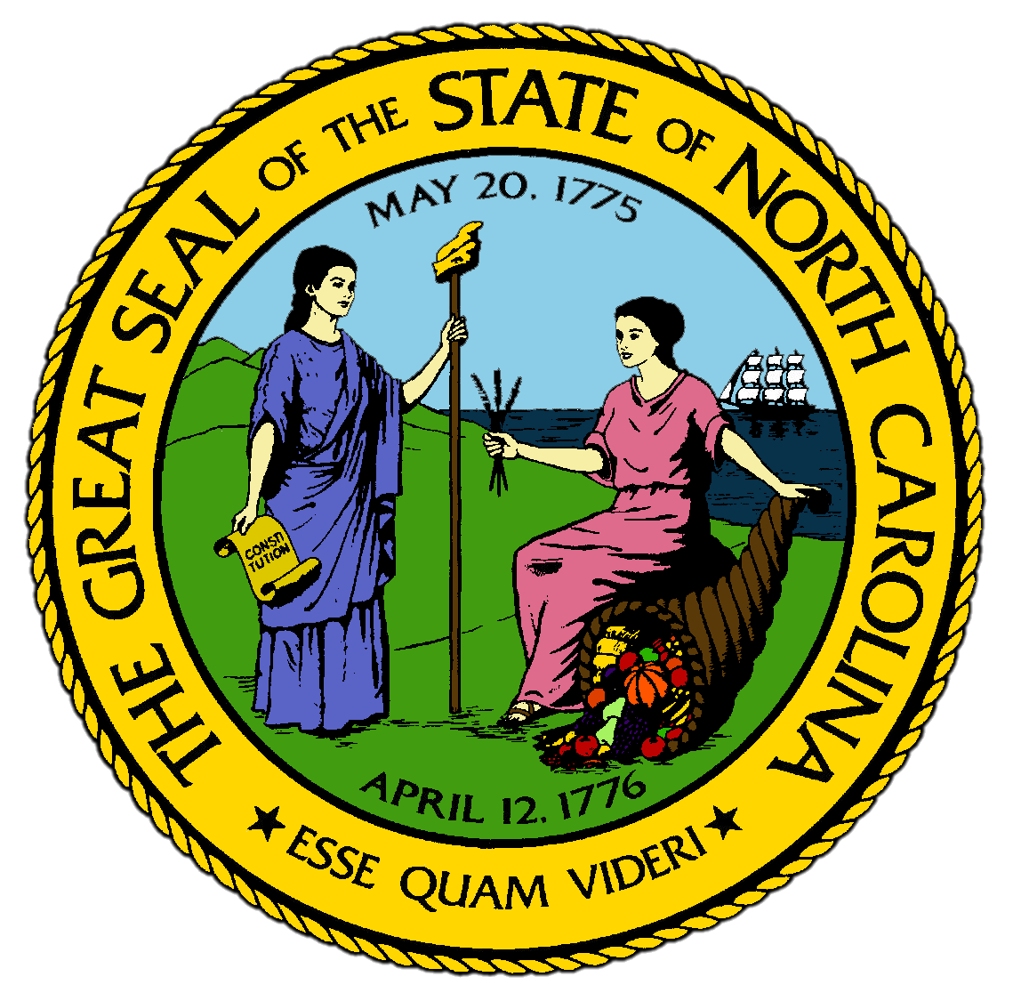
Chapter 1:
The Land Where We Live
STUDY PRESENTATION
© 2017 Clairmont Press

Slide 2
Section 1: The Tidewater Region
Section 2: The Coastal Plain Region
Section 3: The Piedmont Region
Section 4: The Mountains Region
Section 5: North Carolina’s Weather and Climate

Slide 3
Section 1: The Tidewater Region
Essential Question:
What are the main features and rivers of the Tidewater region and how have the barrier islands influenced this region?

Slide 4
Section 1: The Tidewater Region
What terms do I need to know?
sound
barrier island
inlet
Gulf Stream
wetland
estuary
pocosin
savanna

Slide 5
Introduction
The Tidewater is a narrow strip of land extending along the Atlantic Ocean.
The Tidewater includes land on North Carolina’s mainland and the Outer Banks.
This region is heavily influenced by the movement of the ocean’s tides.
The tides alter the currents in streams and sounds (inland bodies of mixed fresh and salt water found throughout the Tidewater).

Slide 6
Barrier Islands
The islands along the coast of North Carolina form most of the beach of the Tidewater and have influenced life from the first explorations to the present.
Only a few islands sit alone, most are part of a long chain of sand spits called barrier islands, the most famous of which are the Outer Banks.
Barrier islands are long ridges of sand spread across the ocean floor, with the tops showing above the water.
In low places of sand, inlets allow seawater to come in and out with the tides.
Very eastern tip of state, Cape Hatteras, sticks out into ocean for miles. The current running by it is the Gulf Stream, a major influence on the world’s weather.
The only true break in the barrier islands is Cape Fear, where the river flows directly into the ocean. All other rivers in the eastern half of the state flow into the sounds behind the islands.

Slide 7
The Sounds
North Carolina has five major sounds:
Currituck Sound, Albemarle Sound, Pamlico Sound, Core Sound, and Bogue Sound.
All are fed fresh water from rivers coming from the Coastal Plain region.
The earliest towns in North Carolina were along these rivers and served as trading centers where goods could be moved along the river to the ocean.
Sedimentation (the depositing of clay, silt, or gravel) has kept the sounds from being deep enough for large ships.
A large portion of the land of the Tidewater Region is wetland for much of the year, meaning the soil is soaked or flooded.
Along shore of the Tidewater are salt marshes where shellfish live and breed.
Estuaries: places where fresh water and salt water meet

Slide 8
Swamps and Lakes
The most common type of wetland other than estuaries is the pocosin.
Pocosin is an American Indian term for “swamp on a hill” made of peat that fills with water.
Pocosins are distinguished by their vegetation, often having a mix of laurel, bay, and scrub oak trees.
The Tidewater Region also contains savannas, where tall grass mixes with different types of pines.
Parts of the Green Swamp, which is the most extensive wetland in southern Tidewater, become savannas in the drier parts of the year.
Most of the natural lakes in North Carolina are in the Tidewater Region, with Lake Mattamuskeet as the largest.
The Tidewater Region is one of the least populated areas of the entire state.
Return to Main Menu

Slide 9
Section 2: The Coastal Plain Region
Essential Question:
What are the features of the Coastal Plain region and what types of traditional communities exist in the region?

Slide 10
Section 2: The Coastal Plain Region
What terms do I need to know?
crossroads hamlets
tobacco towns
Carolina bays

Slide 11
Introduction
The Coastal Plain has some of the richest soil in North Carolina and is about a third of the area of the state.
It is a part of the Atlantic Coastal Plain, which extends from New York to Florida.
Coastal Plain has two main characteristics: its flatness and its soil.
This makes it the chief farming region in the state.
Most rivers flow into the sounds of the Tidewater region.
Large areas of land cleared for farming, making the area extremely rural.
Residents of the Coastal Plain have traditionally lived in one of two types of communities: rural crossroads and small tobacco towns.

Slide 12
Crossroads Hamlets
Crossroads hamlets are found throughout the Coastal Plain region.
They often have a store, school, or church that provides goods and services to the nearby farmers who don’t have money or time to go to town frequently.
They are generally named for local residents.
In more recent times, they have become locations for convenience stores.

Slide 13
Tobacco Towns
Tobacco towns have been part of the Coastal Plain since it was first settled.
These towns grew in the 20th century when popularity of smoking increased.
The towns had many tobacco warehouses.
Everyone scheduled their business around the tobacco harvest.
Traditional tobacco barns were tall, thin squares of logs or planks, and were once seen everywhere along the Coastal Plain.
Tobacco was flue-cured, drying it for the market and making it mild enough to smoke.
Fewer and fewer Coastal Plain residents grow tobacco in modern times.

Slide 14
Longleaf Pine Forests and Carolina Bays
Before tobacco fields, longleaf pine was the most common sight in the Coastal Plain.
Because of its historical significance, the Longleaf Pine is North Carolina’s state tree.
In the southern Coastal Plain, there are hundreds of elongated depressions in the ground called Carolina bays.
No one knows for sure why they exist or how they were created; some are filled with water and others are similar to pocosins, being wet or dry in different parts of the year.

Slide 15
The Sandhills
Located northwest of the Carolina bays, the Sandhills are concentrations of rolling sand ridges left over from an ancient change in the shoreline of the Atlantic Ocean.
They have the poorest soil in the state, because the sand allows the topsoil nutrients to drain away.
In the 20th century, two uses were found for the Sandhills: golf courses like Pinehurst, and Fort Bragg, originally designed to be a training ground for artillery.

Slide 16
People of the Coastal Plain
Area has long attracted people of different ethnic backgrounds with its dark soil and other resources.
The most distinctive people of the Coastal Plain are the Lumbee of Robeson County, forming the largest population of Native Americans in the state.
Return to Main Menu

Slide 17
Section 3: The Piedmont Region
Essential Question:
What are the features of the Piedmont Region, specifically the significance of the fall line?

Slide 18
Section 3: The Piedmont Region
What terms do I need to know?
fall line
headwaters
sectionalism
mill village
NASCAR
monadnock

Slide 19
Introduction
North Carolina’s Piedmont region is easily recognized by its red clay.
A problem in the region has been erosion and poor soil conservation, since rain and wind have washed away the valuable topsoil.
To control the erosion, state officials planted millions of kudzu plants in the 1930s hoping to save the soil.
The kudzu nearly took over the state, usually growing several inches on a single hot, humid day.

Slide 20
The Fall Line
The red clay of the Piedmont erodes easily because the land is filled with hills and hollows.
Most of the Piedmont, which means “foot of the mountains”, is actually a plateau, located north of the Coastal Plain and south of the Blue Ridge Mountains.
The “line" that divides the Coastal Plain and the Piedmont, where rivers flowing out of the Piedmont go down their last hill and become flatter and smoother, is called the fall line.
Two principal rivers of the Piedmont are the Yadkin-Pee Dee and the Catawba, neither of which run to the fall line.
The main reason that sectionalism, or intense concern for local interests and customs, developed in North Carolina was the lack of connection between the rivers of the Piedmont and the Coastal Plain.
More than half of the Piedmont is covered in forests.

Slide 21
Farms and Factories
Farming is as much a tradition in the Piedmont as the Coastal Plain, but farming is more of a struggle in the Piedmont.
Farmers depended on livestock to make a living.
As farms declined, the construction of factories increased and people made their living processing and manufacturing materials.
Textiles, tobacco, and furniture were considered the main industries in the state during the 20th century.
Many factory workers lived on the edges of town in clusters of housing called mill villages.
The company owned the houses, provided stores and schools, and influenced lives of workers inside and outside the factory.
All three industries were declining in 1990s due to foreign competition.

Slide 22
Banking, Racing, and Medicine
Many cities of the Piedmont struggled to find other economic outlets.
Over the last two decades, Charlotte has become a world leader in banking as well as a center for stock car racing.
NASCAR (National Association of Stock Car Automobile Racing) has its Hall of Fame in Charlotte.
Community leaders attempted to turn around the decline in industrial jobs with the growth of medical services and medical schools like Wake Forest University and Duke University.

Slide 23
The Uwharries
The most distinctive natural feature of the Piedmont is the monadnock.
A monadnock is a geological condition where a point of land stands out because all of the land around it has been eroded away.
Most famous is Pilot Mountain north of Winston-Salem.
The Uwharrie Mountains are a group of monadnocks that have shaped North Carolina nearly as much as the barrier islands
They resemble miniature mountains from a distance, elevations rarely reach more than 2,000 ft.
These were not as thickly settled as the rest of the Piedmont due to their slopes and slate concentration in the soil.
Return to Main Menu

Slide 24
Section 4: The Mountains Region
Essential Question:
What features and characteristics of the Mountains region have impacted the growth of tourism and tree farming in the region?

Slide 25
Section 4: The Mountains Region
What terms do I need to know?
elevation
bald
cove

Slide 26
Introduction
The Mountains region begins at the Blue Ridge, which forms the eastern boundary of the Appalachian Mountains.
The eastern Continental Divide runs along the Blue Ridge, as does the Blue Ridge Parkway.

Slide 27
The Blue Ridge
The name comes from the mist evaporating off the mountains which often seems to look blue.
It runs from New Jersey into the Deep South.
It is really just one long landform with peaks of various heights and gaps.
Many places west of the Blue Ridge were more isolated than the barrier islands, which encouraged unique cultural developments.
Traveling over the Blue Ridge was hard and expensive before the construction of railroads in the late 1800s.

Slide 28
The Appalachians
The Appalachian mountains run from New York to Alabama, with the highest peaks located in North Carolina.
The highest elevation, or height above sea level, is Mt. Mitchell at 6,684 ft.
The Appalachians contain more than a dozen different mountain ranges in North Carolina.
The Great Smokey Mountains are most notable.
More varieties of plants are found in the Smokey Mountains than almost anywhere else on Earth.
The Great Smokey Mountains National Park is the most visited national park in the United States.
Some of the Smokey Mountains have balds, places that are usually above 6,000 feet where few trees ever grow, but many flowers and shrubs grow.

Slide 29
Mountain Streams and Rocks
The mountain rivers run north and west.
The New River starts just west of the Blue Ridge and flows straight north.
Tributaries of the Tennessee River flow all the way to the Mississippi River.
Cherokee built most of their villages along the Tennessee River tributaries.
There are more than 100 lakes in the Mountains region, but nearly all are man-made.
There are many natural wonders in the Mountains region:
Blowing Rock, Chimney Rock, Grandfather Mountain, and the Nantahala River Gorge.

Slide 30
The Mountain Economy
This region was never as populated or developed as the other regions of the state.
The first settlers lived in coves, or valleys where streams had cut out areas of land large enough for farming.
It was very difficult to get from one cove to the next or get goods out of the mountains.
Families raised livestock and sold plants with medicinal properties to make money.
Recently, tourism has become the largest part of the Mountain economy.
Retirement and vacation homes have become more common throughout the region.
The most distinctive recent economic development is the Christmas Tree industry, mainly in Ashe County and other surrounding counties.
Return to Main Menu

Slide 31
Section 5: North Carolina’s Weather and Climate
Essential Question:
What are the differences in weather and climate and what kinds of precipitation and temperatures are common in North Carolina?

Slide 32
Section 5: North Carolina’s Weather and Climate
What terms do I need to know?
weather
climate
westerlies
humidity
precipitation
tornado
hurricane

Slide 33
“It’s Not the Heat; It’s the Humidity”
North Carolina’s temperatures run close to the same throughout the state.
This is caused by westerlies, winds that bring warmer air in the winter and cooler air in the summer.
The Sandhills have more extreme, hot days than any other area of the state.
The highest Mountain peaks have the lowest temperatures, being the most likely to have temperatures below zero degrees.
It doesn’t feel very temperate most days due to humidity, a measure of the amount of moisture in the air, which is often more than 50% in most areas of the state.

Slide 34
Different Storms in Different Places
The rate of precipitation, which is rain, sleet, snow, or hail, varies greatly throughout the regions of North Carolina.
The highest levels of rain occur in the southwest mountains, where westerlies bring storms from the Great Plains.
This causes the Piedmont to be the driest area of the state.
Mountains get the bulk of the snow.
The whole state experiences thunderstorms in the summer, with large storm fronts bringing hail from the west.
Tornadoes, funnel-shaped storms with winds that can reach more than 200 mph, come with storm fronts and are most frequent in the Sandhills region.

Slide 35
The Path of Hurricanes
Hurricanes are tropical storms that bring high winds and heavy rains, most often from the Atlantic Ocean.
Hurricanes cause great damage to North Carolina in three major ways:
Wind and rain create a storm surge, or a huge tide, that wipes out sand, plants, and anything else on the beach.
The swirling winds can do great amounts of damage.
Hurricanes usually slow and weaken over land, causing them to drop huge amounts of water and causing widespread flooding.
Most hurricanes develop during hurricane season starting in June, peaking in September, and ending at the end of November.
Return to Main Menu

Slide 36
Image Credits
Title Slide: Public Doman, Wikimedia Commons; Contents slide: Reginald Lankford, Clairmont Press; End Slide: Reginald Lankford, Clairmont Press;
Shown here: Kitty Hawk Bay, NC
Return to Main Menu

