Slide 1
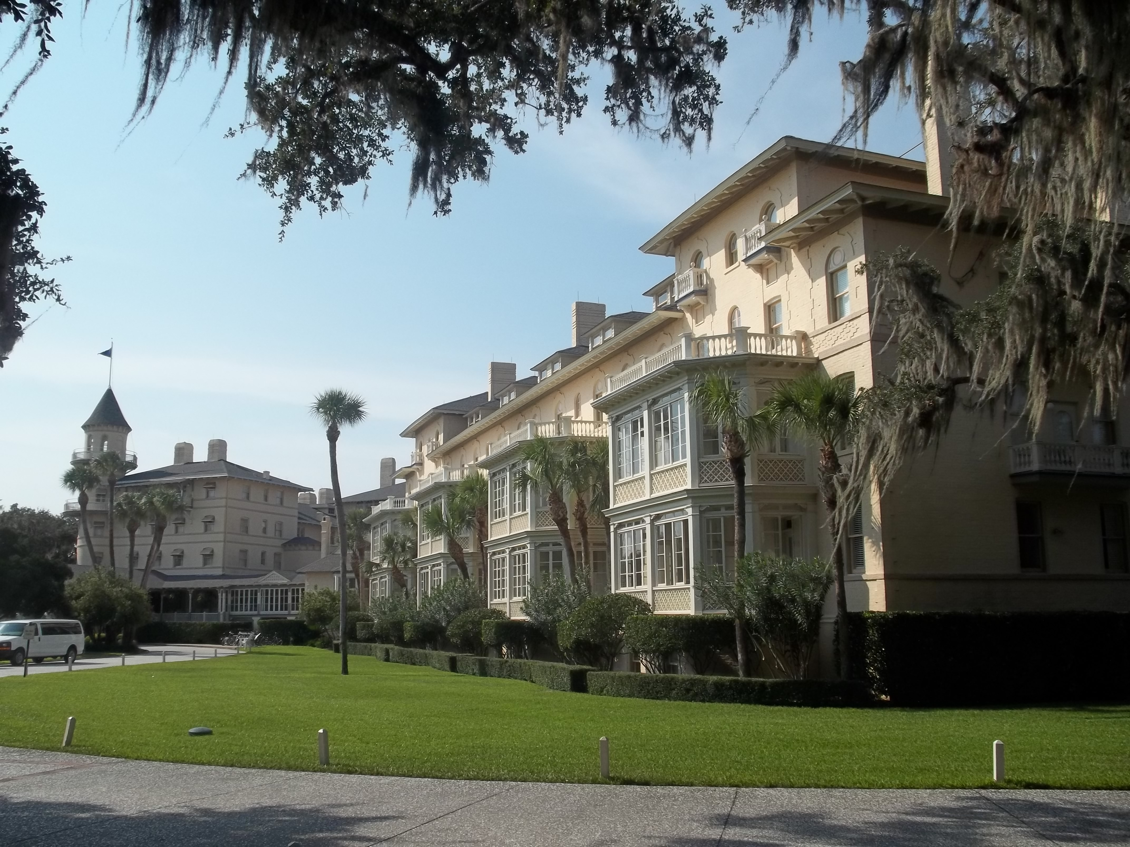

Chapter 9: Colonial Georgia STUDY PRESENTATION
© 2025 Clairmont Press

Slide 2
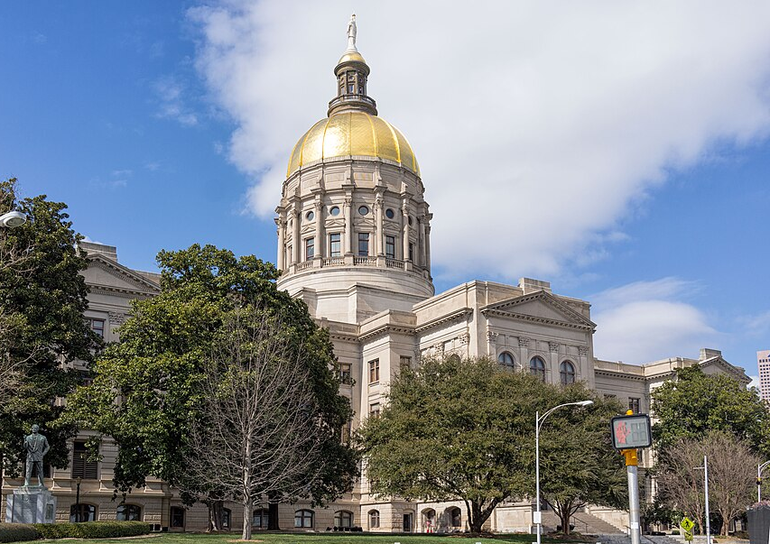
Section 1: Georgia’s Founding

Slide 3
SECTION 1: GEORGIA’S FOUNDING
Essential Question:
What were the reasons for the founding of Georgia?

Slide 4
SECTION 1: GEORGIA’S FOUNDING
What terms do I need to know?:
philanthropy
charter
trustee colony
buffer
mercantilism
slavery
militia

Slide 5
GEORGIA’S FOUNDING
By the early 1700s, Great Britain had twelve colonies in North America – all located along the East Coast:
Carolina had two settlement areas:
The north, settled by small farmers from Virginia
The south, settled by planters from Barbados, with plantations surrounding Charles Town
By 1729, Carolina and Charles Town became royal colonies under control of the king.
By the late 1720s, no one had settled the part of South Carolina south of the Savannah River, which was the dividing line between the Carolinians and the Indian nations.

Slide 6
THE CHARTER OF 1732 AND THE TRUSTEE PERIOD
James Oglethorpe and his associates asked King George II for a land grant to found the colony: philanthropy, defense, and economics.
Philanthropy is when people give their time, money, or resources to help others without expecting something back.
Oglethorpe and his fellow trustees received the Charter of 1732, which stated the trustees could not profit from their position.
A charter was a document that granted territory to trustees and set up rules under which the trust would work.
Because the colony of Georgia was governed by trustees, it was considered a trustee colony.

Slide 7
Philanthropy
The Georgia colony was established to attracted both deserving poor English people and persecuted Protestant Europeans.
Trustees would pay for the passage of some colonists.
Males who became charity colonists would receive 50 acres of land to farm along with tools and other supplies for a year.
However, no one from a debtor’s prison was chosen to be an original colonist.

Slide 8
Defense
Georgia was established to be a buffer (protection) between southern Carolina and the Spanish in Florida.
Georgia colonists existing in the region between would make it harder for Spain to attack southern Carolina and disrupt their rice production.

Slide 9
Economics
Trustees believed the new colony could also grow plants England couldn’t, which would reduce import costs of those goods.
This was part of the government’s economic policy of mercantilism (favorable balance of trade).
Colonies were expected to help their home countries by supplying raw materials as well as serving as a market for manufactured goods.

Slide 10
AUTHORITY OF THE TRUSTEES
The Charter of 1732 granted the trustees the land between the Savannah and Altamaha Rivers and westward to the Pacific Ocean.
Trustees would control the colony till 1752, and they could raise money, grant land to settlers, make rules and regulations, establish courts, and maintain a military defense until that time.
Trustees banned slavery (owning people as property) and the sale and use of “spirits”.
Land ownership was limited to ensure families owned and farmed the land rather than large plantations.

Slide 11
SAVANNAH, THE FIRST SETTLEMENT
Oglethorpe (the only trustee who came to the colony) led the first settlers:
1732 – ship Anne set sail from England with chosen settlers (voyage took 57 days)
settlers welcomed by Carolinians who donated food, provisions, slaves, etc., to help work
site chosen for first settlement – a high bluff known as Yamacraw (good defense against enemies)
Tomochichi (leader of Yamacraw people and good friend to Oglethorpe) was valuable in ensuring early success of the colony.

Slide 12
SAVANNAH, THE FIRST SETTLEMENT, Pt. 2
John and Mary Musgrove, local trading post owners who spoke English and Creek, acted as interpreters between Oglethorpe and Tomochichi.
Mary became the main interpreter after John’s death in 1735.
Oglethorpe brought the settlers to the future site of Savannah in February 1733, where they set up tents and began planning the town.
Oglethorpe supervised the town’s construction and led the people as the only trustee in Georgia.

Slide 13
JAMES OGLETHORPE, TOMOCHICHI, AND MARY MUSGROVE
Tomochichi gave Oglethorpe permission to settle on Yamacraw land and acted as a diplomat between the British settlers and the Creek.
Oglethorpe promised to protect Tomochichi’s people from their mutual enemies and gained access to trade opportunities for his community.
Mary Musgrove helped build alliances and communicate needs effectively between each group, and she personally gained influence and trade opportunities.

Slide 14
DEFENDING GEORGIA
Oglethorpe had concerns about the colony’s defense and convinced the British government to pay for building forts at the northern and southern ends of the colony.
Oglethorpe built more forts and roads along the coast and was promoted to the rank of general, putting him in command of local British troops and militias (citizen soldiers).
When war broke out between Britain and Spain in 1739, Oglethorpe fought Spanish forces in Florida but eventually was forced to retreat despite initial success.

Slide 15
DEFENDING GEORGIA, Pt. 2
Spain invaded St. Simons, Georgia, in 1742, but Oglethorpe pushed them back and convinced them British reinforcements were coming, so they retreated.
Oglethorpe returned to England in 1743 after thanking Mary Musgrove for her work and never returned, but he did live long enough to see Georgia become part of the US.

Slide 16
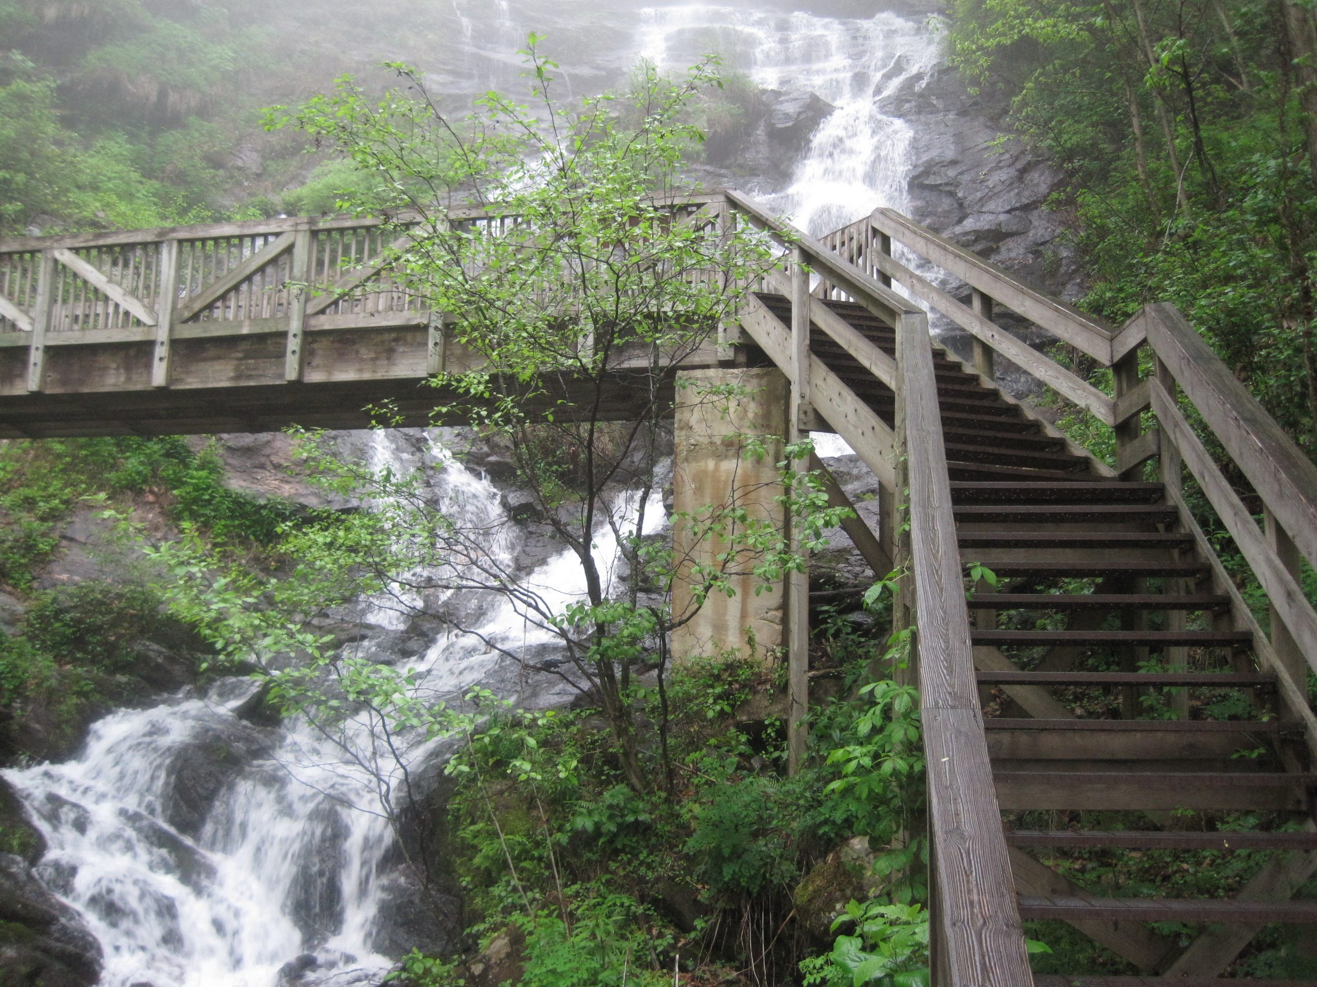
Image Credits: all Wikimedia Commons. Maps: ©2025 Clairmont Press.
Return to Main Menu

