Slide 1
SMART SKILLS
Map 2: Regions of West Virginia
© 2019 Clairmont Press

Slide 2
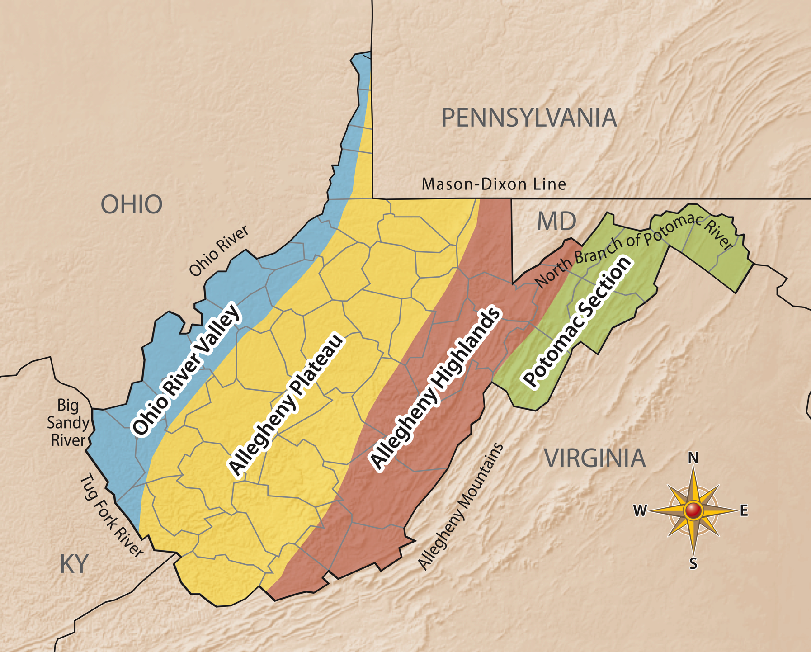
Question 1:
How many geographic regions are there in West Virginia? Name them.
Notes:
Four; Ohio River Valley, Allegheny Plateau, Allegheny Highlands, Potomac Section

Slide 3
Question 2:
Which region is the largest? The smallest? Which region do you live in?
Notes:
Allegheny Plateau Region; Potomac Section Region; answers may vary.

Slide 4
Question 3:
Which regions share a border with Kentucky?
Notes:
Ohio River Valley and Allegheny Plateau Regions

Slide 5
Question 4:
What primary directions do each of the following rivers flow: Ohio River, Big Sandy River, Tug Fork River, Potomac River.
Notes:
Ohio: Southwest Big Sandy: North
Tug Fork: Northwest
Potomac River: East

Slide 6
Question 5:
Using other maps of the United States, look for the source and mouth of one major rivers in the state. If there are multiple sources, list them.
Notes:
Sample answers: Big Sandy River: Sources are Tug Fork and Levisa Fork Rivers, mouth is the Ohio River. Tug Fork River: Source is Big Stone Ridge, mouth is Big Sandy River.
Ohio River: Sources are Allegheny River and Monongahela River, mouth is the Mississippi River.
Monongahela River: Sources are Tygart Valley and West Fork Rivers, mouth is the Ohio River.
Tygart River: Source is Allegheny Mountains, mouth is Monongahela River.
Potomac River: Source is Fairfax Stone, mouth is Chesapeake Bay
New River: Sources are South Fork and North Fork New Rivers, mouth is the Kanawha River
Kanawha River: Sources are New and Gauley Rivers, mouth is Ohio River
Elk River: Sources are Old Field and Big Spring Forks, mouth is Kanawha River

Slide 7
Image Credits
Title Slide: General “Stonewall” Jackson, by Snoopywv, Uploaded 20 June 2009, Wikimedia Commons;
End Slide: Glade Creek Grist Mill, by Gabor Eszes, Uploaded 29 April 2006, Wikimedia Commons
Glade Creek Grist Mill
Return to Main Menu

