Slide 1
Chapter 10:
Canada
STUDY PRESENTATION
© 2017 Clairmont Press

Slide 2
Section 1: The Geography of Canada
Section 2: A Brief History of Canada
Section 3: Language and Religion in Canada
Section 4: Government of Canada
Section 5: Economy of Canada
Section 6: US-Canada Relations

Slide 3
Section 1: Geography of Canada
Essential Question:
How have Canadians worked to solve their pollution problems?

Slide 4
Section 1: Geography of Canada
What terms do I need to know?
humid continental climate
growing season
acid rain
phosphorus
algal bloom
slag
clear-cutting

Slide 5
Location and Size of Canada
Canada is the largest country in the western hemisphere and second largest in the world.
Canada shares a border with the United States and is surrounded by the Atlantic, Arctic, and Pacific Oceans.
Canada has about 36 million people according to a 2017 estimate.
This is small compared to its land size, given that the United States has roughly 9 times as many people.
Because of its size, Canada has developed many ways to trade, like water trade routes, highways, railroads, airports, and seaports.

Slide 6
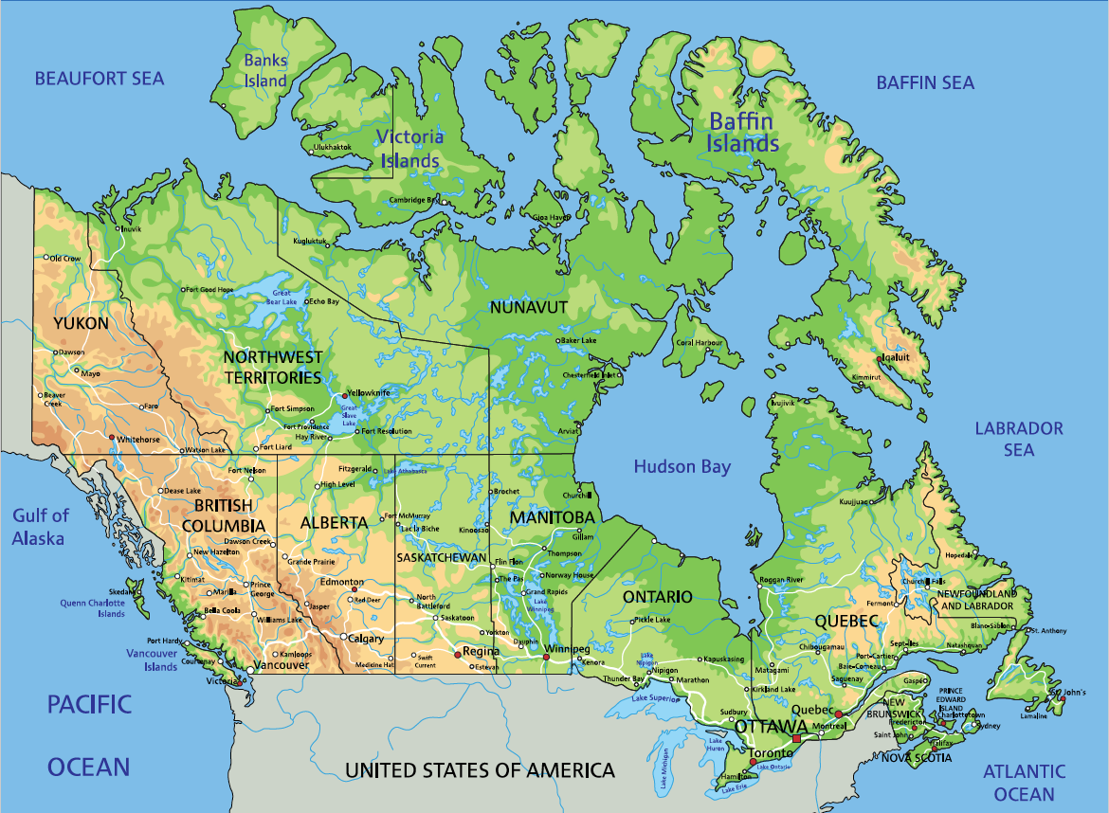
Location and Size of Canada

Slide 7
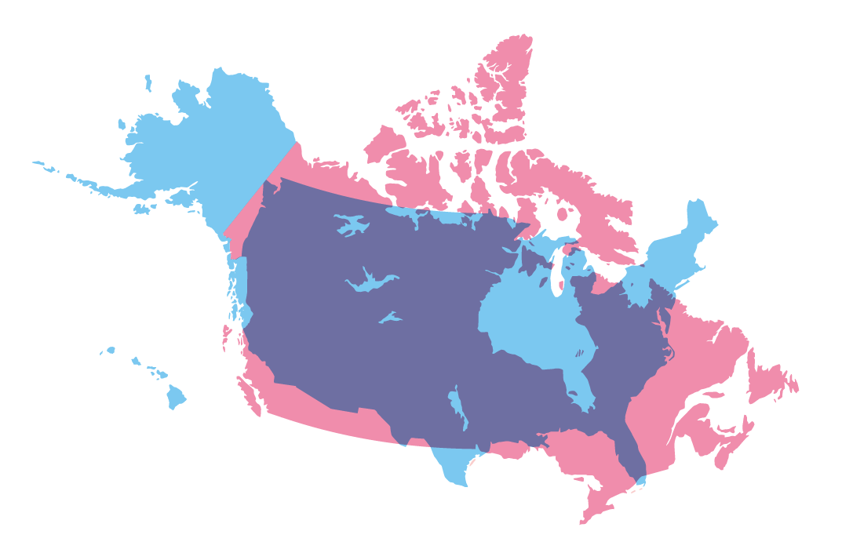
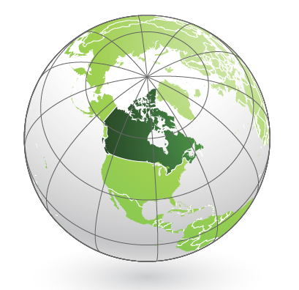
Location and Size of the Canada

Slide 8
Physical Features of Canada
Canada has many rivers, with a very important one being the St. Lawrence River.
Canada also has many lakes, with the Great Lakes forming a portion of the border with the United States.
As the largest group of freshwater lakes in the world, the Great Lakes are a very important water source, trade route, and recreational area.
The Canadian Shield covers a large portion of eastern and central Canada, with thin rocky soil and rough, rolling landscapes.
The Rocky Mountains are in the west, stretching from British Columbia to Mexico.
These mountains are important to the United States and Canada for both minerals and tourism.

Slide 9
Climate of Canada
Much of the north is covered in snow for a majority of the year.
This tends to limit where people settle.
The southeastern part of the country has a humid continental climate, which means it has warm to hot summers and cold winters.
The southern and central parts of Canada have a long growing season (period between the last frost of spring and first frost in fall) thanks to its moderate climate.
The Pacific Coast has a temperate climate due to the ocean regulating temperatures.
Northern regions are much colder, with temperatures even in the short summertime at possibly below freezing.

Slide 10
Nunavut
This region became an official territory of Canada in 1999.
Located in northeastern Canada, it was formed to give the native Inuit more governmental control of their lives.
The environment and climate are harsh, and the region can only be reached by boat or plane.
Only about 33,330 people live here.
Archaeologists have discovered evidence supporting Inuit contact with Vikings as far back as 1000 AD, with the region’s history going back over 4,000 years.
Today, the people here follow the traditions of their ancestors, focusing on collectiveness and mutual reliance.

Slide 11
Natural Resources of Canada
Canada has many valuable resources, including iron ore, nickel, zinc, copper, gold, silver, and diamonds.
The numerous rivers and lakes are great sources of fish, fresh water, and hydroelectric power.
Fertile soil allows farmers to grow more than what the country needs and to export crops for profit.
Forests and their wildlife, coal, oil, and natural gas make up the rest of the major resources.
Because of the distribution of these resources, Canadians may live close to the goods they intend to harvest, whether it be mineral, crop, fish, or anything else.

Slide 12
Environmental Issues in Canada
The abundance of energy resources, while great for the economy and standard of living, has led to environmental problems.
Factories, coal-burning power plants, and automobiles produce many pollutants that, when combined with water molecules in the air, can create acid rain (clouds or rain droplets that are acidic).
While it does not burn through skin, acid rain can kill plants, damage trees, pollute water sources and kill the fish in them, and dissolve the stone in statues.
While Canada has been working on its pollution problem, it needs the US to reduce its pollution, too, since winds tend to take acid rain from the US north into Canada.

Slide 13
Environmental Issues in Canada (cont.)
Water in the Great Lakes was well known for its pollution in the 70s, with fish unsafe to eat or no fish alive at all.
Factories around the Lakes were using the water as a cheap dumping ground.
In 1972, the United States and Canada signed their first agreement to work on phosphorus pollution reduction.
Phosphorus is a chemical found in fertilizers, pesticides, toothpaste, detergents, and explosives.
In large quantities, phosphorus can cause a rapid increase in algae, called algae bloom, which can result in the eventual death of plant and animal life in the area.
Canada and the United States signed the Great Lakes Water Quality Agreement in 1972 and updated it in 2012 with the goal of restoring the lakes’ environments and preventing further damage.

Slide 14
Natural Resources of the Canadian Shield
Beneath the thin, rocky soil are the most valuable resources in Canada, with mines harvesting gold, silver, copper, zinc, lead, iron ore, uranium, and nickel.
Land around mines can be damaged or ruined due to blasting and digging with heavy machinery.
Slag, or leftover rock from smelting, is often dumped in any convenient location with little regard to the environment.
Mining can also create pollutants, like sulfur dioxide getting into the air or chemicals from the mines getting into bodies of water and poisoning the environment.

Slide 15
The Timber Industry in Canada
Timber is an important natural resource to the economy of Canada.
The timber is used to make lumber, plywood, and wood pulp for paper products.
Forests also provide a habitat for plants and animals, as well as provide oxygen and filter out air pollutants.
Clear-cutting is when a company cuts all the trees in a given area, which can cause reduced water quality, erosion, and loss of habitats for wildlife.
Environmental groups are working to convince companies to leave more trees up and cut more small groups rather than acres at a time.
Return to Main Menu

Slide 16
Section 2: A Brief History of Canada
Essential Question:
Why does Quebec desire independence from Canada?

Slide 17
Section 2: A Brief History of Canada
What terms do I need to know?
indigenous
dominion
separatists
bilingual

Slide 18
How Canada Became an Independent Nation
Canada was originally inhabited by indigenous (native) peoples for thousands of years, who Europeans mistakenly called Indians.
The Native Americans had developed their own cultures, languages, and methods of survival.
With the introduction of European settlers came foreign diseases, advanced weaponry, and greater numbers that quickly pushed back the natives.
First colonized by the French, it would eventually become part of the Kingdom of Great Britain in 1763 from France’s defeat in the French and Indian War.
By the mid-1860’s, colonists in Canada wanted to unite and rule themselves similarly to the United States.

Slide 19
How Canada Became an Independent Nation (cont.)
The British Parliament created the British North America Act of 1867, which put together New Brunswick, Nova Scotia, Ontario, and Quebec, created a constitution, and named the new country ‘The Dominion of Canada’.
A dominion is a self-governing nation separate from the United Kingdom that recognizes the British monarch as chief of state.
It could have its own prime minister and parliament, but it could not make treaties and it had to be a part of the British military.
This system worked for quite a while until World War I, when the United Kingdom pulled many Canadians for combat and their death count was quite high.
Canadians worked for full independence, and in 1931, the British Parliament granted the country its independence.

Slide 20
Canada’s Indigenous People
Canada’s native people developed various cultures, mostly due to location and resources available to them.
One can see these differences in comparing two peoples:
Northwest Coast Indians:
They inhabited land along the Pacific Coast and nearby islands.
While the ocean influenced much of their life, the nearby forests provided many of their resources.
Because of their abundant resources, these natives had more time to be more creative.
Inuit:
Sometimes called Eskimo, their location in the Arctic and sub-Arctic regions limited their resources.
Instead of trees or plants, they largely depended on ocean fish and mammals.
They would also use boats, dogsleds, and igloos to move and survive.

Slide 21
Quebec’s Independence Movement
The legacy of France still lives in Quebec, with 81% of people in Quebec speaking French as a first language.
Quebec and the rest of Canada have had a successful, cooperative relationship, and many Canadians want Quebec to stay with them.
However, some in Quebec, called separatists, want the province to be a separate country.
They believe Quebec will lose its French culture if it stays with the rest of Canada.
People have voted twice before on this issue, both times deciding to remain.
The government of Canada has passed laws to encourage Quebec to stay, including making Canada bilingual, with both English and French as official languages.
Still, Quebec stresses its distinct society, with French as its only official language and the rare use of English as well as other cultural elements.
Return to Main Menu

Slide 22
Section 3: Language and Religion in Canada
Essential Question:
What effect did colonization have on language and religion?

Slide 23
Language and Religion in Canada
The colonizing French and English brought their languages and religions from home and settled rapidly, forcing indigenous people out or destroying them in the process.
Most people in Quebec were Roman Catholic because of the French influence, while most of the rest of Canada was non-Catholic Christian.
This language and religious barrier between Quebec and the rest of Canada has been a source of tension in the past.
During British rule, English-speakers spread coast to coast, with 60% of Canadians having English as their first language today.
Today’s numbers reflect statistics of the past, with the main religions and languages spoken today still those brought from European settlers.

Slide 24
Section 4: Government of Canada
Essential Question:
What is the effect of having the British monarch as head of state?

Slide 25
Section 4: Government of Canada
What terms do I need to know?
constitutional monarchy
parliamentary democracy
federal government

Slide 26
Type of Government
Canada’s government is a constitutional monarchy.
The United Kingdom’s king or queen acts as head of state and a symbolic leader of the country with little real power.
Canada’s constitution organizes the government, explains citizens’ rights, and limits the monarch’s power.
Canada has a parliamentary democracy in which its citizens elect members of parliament, who them elect the prime minister as head of government.
The prime minister is in charge of the military, enforces laws, and keeps the country running day to day.
Both members of parliament and the prime minister can call for re-votes of each other’s positions if they feel the country needs it.
Canada also has a federal government, where power is divided between the central government and the provinces, similar to the United States.

Slide 27
Citizen Freedoms
Canadian citizens have many freedoms.
Citizens 18 and older may choose to vote.
National, provincial, and local elections are held on a regular basis, and smooth transitions between leaders means the country can operate smoothly and efficiently.
Citizens may also speak out freely against their leaders and their decisions.
Trade, travel, and property are all rights protected by laws, too.

Slide 28
The Royal Canadian Mounted Police (RCMP)
The Royal Canadian Mounted Police, or Mounties, are both the federal and provincial police force for Canada.
They were created in 1873 with only 300 men patrolling 300,000 miles of wilderness.
Their first job was to drive out American traders who were causing problems with the natives.
Mounties also helped the ill-prepared gold miners in the Yukon Gold Rush at the end of the 19th century.
After World War I, they became a federal force, and over the decades, they added marine and air divisions, along with dog and crime units.
To be a Mountie, one must endure 6 months of training focused on criminal law, driving, shooting, fitness, and police tactics.
Return to Main Menu

Slide 29
Section 5: Economy of Canada
Essential question:
What is the importance of the good relationship between Canada and the United States?

Slide 30
Section 5: Economy of Canada
What terms do I need to know?
financial sector
North American Free Trade Agreement (NAFTA)
tariff
specialization
quota
embargo
trade surplus
Gross Domestic Product (GDP)
literacy
entrepreneur

Slide 31
The Economic System
Canada has one of the strongest market economies in the world.
It has a very competitive financial sector (businesses like banks, insurance companies, and real estate).
The government negotiates free trade agreements, and the provinces and territories have a great deal of economic freedoms.
Consumers and producers constantly work out production deals with one another to maintain a healthier economy.

Slide 32
North American Free Trade Agreement
In 1994, the Mexican, Canadian, and American governments signed the North American Free Trade Agreement (NAFTA), which took away all tariffs on goods traded between the three.
This allows member nations to specialize on goods for which they have an abundance, which is called specialization.
NAFTA also created laws protecting artists from having their work copied.
The agreement was there would be no tariffs, quotas (limits on goods traded), or embargos (stopping trade altogether) to hinder trade.

Slide 33
Trade
Located on the Arctic, Pacific, and Atlantic Oceans gives Canada a unique advantage, allowing trade between Europe and Asia.
Canada’s river systems help move goods throughout the country, too.
Canada exports its oil and natural gas, fish, agricultural products, and timber.
Canada is the United States’ largest foreign supplier of energy, including oil, natural gas, and electric power.
Canada has a trade surplus with the United States, meaning it exports more than it imports.

Slide 34
Currency Exchange
The currency is the Canadian dollar ($).
Canadians often refer to the $1 coin as a loonie because of the bird on it.
Due to currency value differences, countries need to exchange their currency when trading with Canada, which may lead to exchange fees.

Slide 35
Gross Domestic Product and Economic Growth
The Gross Domestic Product (GDP) of a country is the total value of all the final goods and services produced in that country in a year.
Canadians have a relatively high standard of living compared to many other countries because of the many valuable resources Canada exports.
Another reason for a high standard of living is because of the relatively low population of the country.

Slide 36
How the Literacy Rate Affects the Standard of Living
Canada has a very high literacy (ability to read and write) rate.
Having a high literacy rate can mean a greater chance for the people of a country to succeed in life.
High literacy rates mean higher-paying jobs, wealthier citizens, and better quality of life overall.
The standard of living measures how well off a country is.

Slide 37
Entrepreneurship
Canada is a world leader in entrepreneurs, people that have creative innovative ideas about goods and services.
Canada offers many opportunities for businesses with plenty of resources, a highly-educated workforce, and good amount of wealth.
Laws in Canada are also favorable for business, with very few restrictions.
Return to Main Menu

Slide 38
Section 6: US-Canada Relations
Essential question:
What are ways the United States and Canada can work together militarily?

Slide 39
Section 6: US-Canada Relations
What terms do I need to know?
bilateral
Permanent Joint Board on Defense
North American Treaty Organization (NATO)
North American Aerospace Defense Command (NORAD)

Slide 40
A Close Relationship
The United States and Canada’s bilateral relationship is one of the closest and most extensive in the world.
From national security and law enforcement to environmental protection and free trade, the two countries work together on multiple levels.
The Permanent Joint Board of Defense is one example of military cooperation between two countries.
They also share North American Treaty Organization (NATO) mutual security commitments and the defense network of the North American Aerospace Defense Command (NORAD).
Through these agreements, if Canada is attacked, the United States will come to its aid and vise versa.

Slide 41
Bilateral Economic Relations
The United States and Canada share the world’s largest trading relationship, supporting millions of jobs in each country.
Canada and the United States also have one of the world’s largest investment relationships, with each being major investors in each country’s economies.
Trade disagreements between the countries can be settled by working with groups like the World Trade Organization (WTO).
An example of this is when the United States began their “Buy America” rule after the recession in 2009, Canada was up in arms and threatened to add high tariffs to their goods.
Return to Main Menu

Slide 42
Image Credits: 42 by Trick17, https://commons.wikimedia.org/w/index.php?curid=46685780, all others Wikimedia Commons. Maps ©2017 Clairmont Press.

