Slide 1
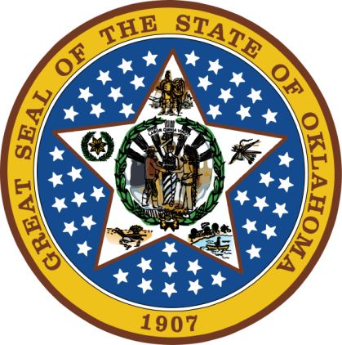
OKLAHOMA:
Our History Our Home
Chapter 18:
Celebrate Oklahoma!
STUDY PRESENTATION
© 2020 Clairmont Press

Slide 2
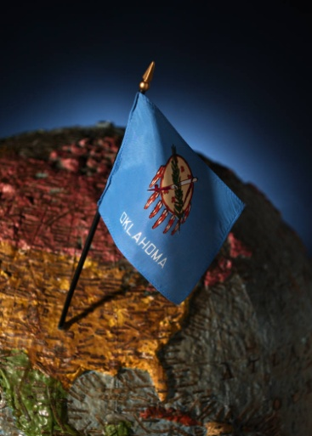
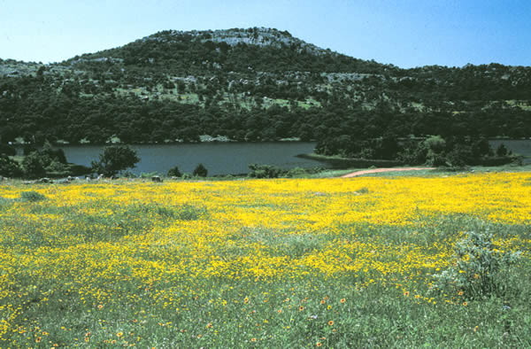
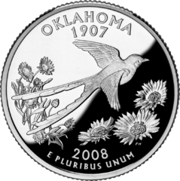
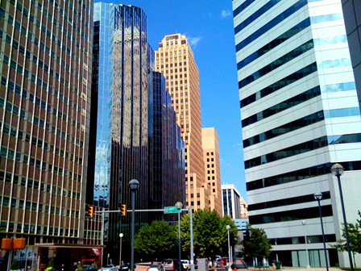
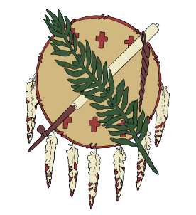
Section 1: Kaleidoscope of Events
Section 2: Museums and Historic Sites
Section 3: Ethnic Groups

Slide 3
Section 1: Kaleidoscope of Events
Essential Question:
What do Oklahoman’s celebrations and events reveal about its culture?

Slide 4
Section 1: Kaleidoscope of Events
What terms do I need to know?
culture
diversity
rodeo
powwow

Slide 5
Introduction
Culture is the way of life of a group of people.
Native Americans were joined by European Americans, African Americans, people from Asia, the Middle East, and Latin America to form a unique blend of cultures in Oklahoma.
There are diverse ideas, customs, skills, arts, foods, and beliefs in the state.
Will Rogers represents one part of Oklahoma’s culture.

Slide 6
Rodeos & Music
Rodeos are held in virtually every part of the state.
They evolved from informal contests held by American cowboys and include roping, horse braking, riding, herding, and branding.
Music is common to cultures worldwide. In Oklahoma’s festivals, one will find bluegrass, western swing, jazz, folk, country, pop, and others plus fiddlers and square dancers.
Various festivals are held each year.

Slide 7
Native American Heritage
Celebrations are held by Native Americans throughout the year and are known as powwows. Famous powwows include:
Gourd Clan Powwow
Tinker Inter-Tribal Powwow
Other events include:
The Choctaw Storytelling Festival
American Indian Exposition
Red Earth Native American Cultural Festival
Celebration of the Muscogee Creek Nation
The “Trail of Tears Drama”

Slide 8
Battle Sites
Oklahoma was the site of several Civil War battles.
Reenactments of life in those times can be seen at the Battle of Honey Springs every three years marking the Union Army victory July 17, 1863.

Slide 9
The Frontier Era
There are many places to enjoy and learn about the pre-1840s life of mountain men, trappers, and craftsmen in Oklahoma.
Tombstone Tales is an historical portrayal of those buried at Fort Reno Post Cemetery.
Blacksmithing demos can be found at Pawnee Bill Ranch.

Slide 10
Harvest Celebrations
When a ripened crop is gathered from the field, farmers like to celebrate!
Oklahoma’s agriculture heritage is celebrated around the state. Some festivals include AgriFest, the Oldies Club Tractor & Vehicle Show, the Great Plains Antique Tractor Show, the National John Deer Two-Cylinder Show, and the Billings Wheat Country Festival.
Community fairs are popular, too.

Slide 11
Trails and Rails
You can learn about the history of travel by rail and trail in Oklahoma in several places.
The Chisholm, Great Western, and Santa Fe Trails are celebrated with museums and festivals.
Railroads are celebrated at the Santa Fe Depot and with Railroad Day in Muskogee.
Many towns celebrate Route 66 which stretched across the U.S.
Aircraft are featured at the Will Rogers Fly-In and Oklahoma Museum of Flying.

Slide 12
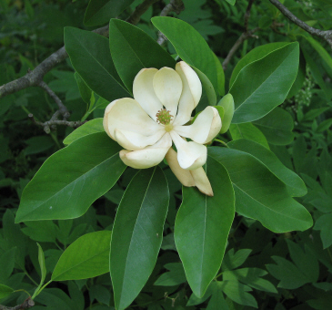
Flora and Fauna
There are special yearly events to observe the abundance of state wildlife. Among them are the following:
Bat watches: Boiling Springs State Park, Freedom, & Jet
Annual “Fangtastic” Rattlesnake Hunt
Rose Rock Festival at Noble
Azalea Festival
Iris Festival
Dogwood Days Festival
Tulips A Bloom Festival
The Magnolia Festival
The Canna Festival
The Birding and Crystal Festival
Sand Fest
Sand Drag Racing at Little Sahara State Park
Magnolias are celebrated at Durant’s Magnolia Festival.

Slide 13
Other Celebrations
Many colorful cultures are spotlighted in festivals throughout the state.
Germanfests feature schnitzel sandwiches, bratwurst, sauerkraut, and apple strudel.
There is the Scottish Games and Gathering in Tulsa, with Celtic crafts, pipe and drum competitions.
Also there is the Irish Arts Oklahoma Feis, Italian Festival, Cimarron Territory Celebration, and Cherokee Strip Celebration.
Return to Main Menu

Slide 14
Section 2: Museums and Historic Sites
Essential Question:
How do Oklahomans commemorate their famous people and the frontier era?

Slide 15
Prehistory
The Sam Noble Oklahoma Museum of Natural History depicts Oklahoma some 300 million years ago.
There are also Caddo and Choctaw artifacts.
The Spiro Mounds Archaeological State Park (LeFlore County) and Kenton Mercantile or Cimarron Heritage Center (Boise City) have much on the prehistory of the region.
The Mabee-Gerrer Museum of Art is one of the oldest museums in the state.

Slide 16
Native American
Native American sites include:
Cherokee Heritage Center
Tsa-La-Gi Ancient Village
Indian City U.S.A.
Five Civilized Tribes Museum
Ataloa Lodge Museum
Seminole Nation Museum
Bigheart Museum
American Indian Cultural Center

Slide 17
Frontier Era
The frontier era was a time of multi-ethnic history and heritage and an important era of commercial history.
Learn about life in a frontier fort during the mid-1800s at the Fort Towson Historic Site.
The Doaksville Site is the former Choctaw Nation capital.
Also of interest is Fort Gibson and the Fort Sill Museum.

Slide 18
Traveling
It can be fun to follow an historic trail or road. Several Chisholm Trail museums exhibit this important route.
The Oklahoma Territorial Museum documents the land rush of the late 1800s.
Railroad museums are at Hominy, Checotah, and other former station sites.

Slide 19
African Americans
African Americans searched for new beginnings in Oklahoma.
More all-black communities were in OK than anywhere in the country.
Boley was one of 27 all black towns. Its historic district was founded as a camp for black railroad workers.
The Farmers & Merchants Bank (now closed) was the site of an attempted robbery by gangster Pretty Boy Floyd.

Slide 20
Famous Oklahomans
Several Oklahomans have gained national fame and are honored in the state. Following are a few of those special locations.
Will Rogers Memorial
Gene Autry Oklahoma Museum
Tom Mix Museum
Henry & Shirley Bellmon Library
Governor Seay Mansion
T.B. Ferguson House of Watonga
The Peter Conser House
Sequoyah’s Cabin
Jim Thorpe House at Yale
The White Hair Memorial
Augusta Metcalfe Museum

Slide 21
Urban Regions
Oklahoma’s large cities have monuments to our state’s culture.
Tulsa:
Philbrook Museum of Art
The Gilcrease Museum
Collection of American Indian and western art
The Oklahoma Jazz Hall of Fame
The Geoscience Center Oklahoma City Museums
Oklahoma City:
National Cowboy and Western Heritage Museum
The Harn Homestead
The Omniplex Arts and Science Museum
The Red Earth Indian Center
International Photography Hall of Fame and Museum
The State Capitol
The Oklahoma City Museum of Art
The Firefighters Museum
The Oklahoma City National Memorial and Museum

Slide 22
Other Museums
Other museums in the state include:
“The Little Smithsonian”: the Woolaroc Museum and Wildlife Preserve
Nellie Johnstone #1(replica of state’s 1st commercial oil well)
Main Street Oil Well
Pitcher’s Mining Field Museum
Coal County Historical and Mining Museum
Hajek Motorsports Museum: vintage dragsters
High Car Museum of Ponca City
Darryl Starbird’s National Rod & Custom Car Hall of Fame
Mickey Mantle Exhibit in Grove
Oklahoma Sports Museum
The National Softball Hall of Fame Museum
Return to Main Menu

Slide 23
Section 3: Ethnic Groups
Essential Question:
How have various ethnic groups affected the development and lifestyle of Oklahoma?

Slide 24
Section 3: Ethnic Groups
What terms do I need to know?
ethnic groups

Slide 25
Native Americans
The name Oklahoma is derived from two Choctaw words:
okla – red
humma – people
Combined means “red people”
Oklahoma is home to the headquarters of thirty-nine different tribes and nations.
Descendants of the original 67 Native American tribes still reside in Oklahoma.
Oklahoma has the second largest American Indian population in the US (behind California).
The earliest tribes were the Wichita, Comanche, Plains Apache, and Quapaw.
New tribes were added through forced relocation of hundreds of American Indians.
Most retained their basic values.
Festivals, museums, and cultural centers retain Indian heritage for younger generations.

Slide 26
African Americans
African-Americans arrived with early explorers.
Others came as slaves to Indian plantation owners.
Some black troops saw action during the United States Civil War and were later known as the “buffalo soldiers.”
An estimated 7,000 blacks came to Indian Territory after the Civil War on a promise of a “black paradise.”
They came as settlers, farmers, workers, cowboys, and gunfighters.
They built 27 all-black towns in Oklahoma; some towns no longer exist.

Slide 27
British and Irish
Europeans were in America before white settlement in Oklahoma.
Intermarriage between Europeans and Indians followed (including English, Scottish, Welsh, & Irish).
Most came as settlers, traders, and trappers
After the Civil War, Scottish cattlemen leased Indian grassland.
Irish laborers helped build railroads or worked coal mines.
British and Irish settlers helped establish a coal industry in southeastern Oklahoma.
By 1900, over 4,000 English, Irish, Scottish, and Welsh were in the state.
The British and Irish settlers settled in rural areas but moved over time to urban areas.

Slide 28
Italians
Italians first came to work in coal mines in 1875; some farmed in the Fort Cobb area.
Large group of Italians immigrated to the U.S. in the early 1900s.
By 1910, over 2,500 lived in Oklahoma (85 % in coal-mining towns in southeastern Oklahoma).
Others established grocery and dry goods stores, blacksmith shops, and restaurants.
Pete Prichard established “Pete’s Place.”

Slide 29
Germans and Germans from Russia
The largest number of foreign-born immigrants in Oklahoma was German in language and culture. Most were German but some were Swiss or Austrian.
One in eight Oklahomans claim German ancestry (more than any other ethnicity).
Cheap land appealed to many Germans already in United States.
Land runs, lotteries, and allotments attracted thousands of Germans, including Germans from Russia.
Most were farmers and were largely responsible for bringing wheat to the new land.
Other Germans were shoe cobblers, cabinetmakers, butchers, bakers, watchmakers, and blacksmiths.
They were known for their work ethic.

Slide 30
Czechoslovakians
Czech families were successful at farming which was a family affair.
Czechoslovakians immigrated to America to preserve their culture which was being threatened in their home country.
Polka music and good food continue to be a part of Czech culture.

Slide 31
Hispanics
Hispanics now rank as one of the fastest-growing groups in Oklahoma. Early Indian raids brought some Mexicans as captives in the 1800s.
Poor conditions in Mexico caused many Hispanics to emigrate after statehood for better opportunities.
Early Hispanics worked as laborers in coal mines, railroads, and on farms and ranches.
Hispanic family ties retain strong generational bonds.
Spanish is still spoken in some households with English as the main or only language in others.
Traditional Mexican food is a part of many religious celebrations and colorful fiestas for special days.

Slide 32
Asians and Pacific Islanders
Chinese immigrants came in the late 1800s and others in Oklahoma by the time of statehood.
After the Vietnam War departure of Vietnamese from their country (sponsored by groups across the United States) brought many to Oklahoma.
Oklahoma City has a growing Asian District with businesses and shops.

Slide 33
Image Credits
Slide 1: Daniel Mayer on Wikimedia Commons; Slide 2: Public Domain; Image Credits Slide: Thomas Jones on Wikimedia Commons
Return to Main Menu

