Slide 1
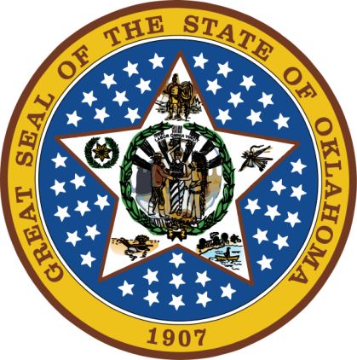
OKLAHOMA:
Our History Our Home
Chapter 14:
The Roaring Twenties and
the Great Depression
STUDY PRESENTATION
© 2020 Clairmont Press

Slide 2
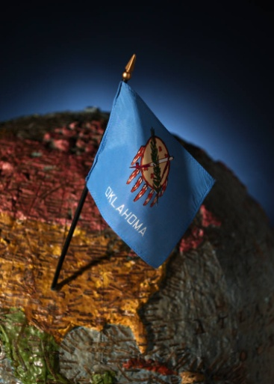
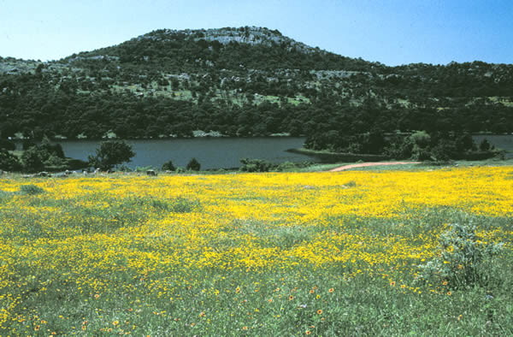
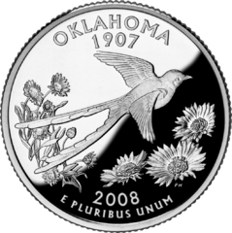
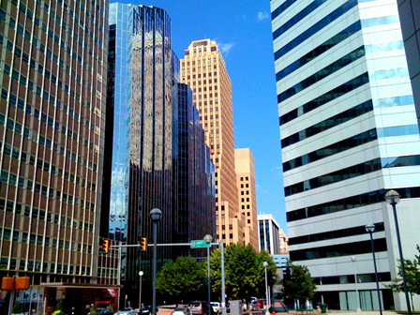
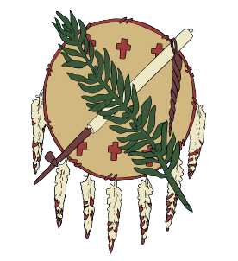
Section 1: The Roaring Twenties
Section 2: The Great Depression

Slide 3
Section 1: The Roaring Twenties
Essential Question:
How did Oklahoma’s society change during the 1920s?

Slide 4
Section 1: The Roaring Twenties
What terms do I need to know?
inflation
martial law
Ku Klux Klan
petrochemicals
barnstormer
partisan
indict

Slide 5
The Roaring Twenties
Year | Population | % urban
1910 | 1,657,155 | 19
1920 | 2,028,283 | 27
1930 | 2,396,040 | 34

Slide 6
Social Unrest
After WWI, demand for manufactured goods, minerals and agricultural products declined.
Soldiers came home and needed jobs.
High demand for goods caused prices to increase.
Workers demanded more money; some organized into unions who called for strikes.
Eastern Oklahoma was put under martial law in November 1919 due to miners’ strikes.
A “red scare,” or fear of communism, occurred after the war.
The Ku Klux Klan reorganized (1915) and wanted to ensure supremacy of white, native-born Protestants.
An estimated 100,000 members were in Oklahoma in 1920.
The KKK would terrorize people with beatings, warnings, whippings, lynching, and burning crosses.

Slide 7
The Tulsa Race Riot
Greenwood was a prosperous African American city near Tulsa.
May 30, 1921: One of the worst race riots in America was in Tulsa.
Whites (many with guns) gathered in town demanding punishment for a young black man who was accused of assaulting a young white girl.
Tensions grew during the evening and white crowds began to harass and chase blacks.
The National Guard was called in. Panicked black citizens sought escape from the city.
White mobs began burning homes and businesses in Greenwood and kept firefighters away at gunpoint.
Twenty-six blacks and thirteen whites were killed, hundreds were injured, and 35 square blocks of Greenwood were burned.

Slide 8
Growth of the Oil Industry
After the war, oil prices fell.
A glut of oil caused further price drops until producers cut production.
1931: Fields in Texas and the Oklahoma panhandle and southwest Kansas were connected by pipeline to Chicago.
Derricks surrounded Oklahoma City which had one of country’s richest oil fields.
The petrochemical industry began in 1926 creating formaldehyde and alcohols; later it made solvents, photographic chemicals, medicines and refrigerants.

Slide 9
Other Industries
Coal production peaked in 1920 at 5 million tons.
Most industries grew during this time, but overproduction on farms caused prices to fall.
Machinery was not a part of most farms until the 1940s.

Slide 10
Aviation Takes Off
Early runways were flat fields or grasslands.
Fort Sill had army airfield before the war.
Some WWI pilots did stunt shows and gave rides for a fee (barnstormers).
1930: 70,000 people through the Tulsa airport.
Curtiss-Southwest Airplane Company, Spartan School of Aeronautics, and Braniff started during this time.
Wiley Post, famous aviator, flew solo around the world in 7 days.

Slide 11
“Motoring”
The moving assembly line helped reduce the cost of automobiles.
Sales rose quickly; by 1929 there were 23,000,000 cars.
Congress wanted a highway to connect Virginia to California.
Cyrus Avery worked to get this road routed through Tulsa and Oklahoma City. It was known as Route 66 (U.S. 66) “The Main Street of America.”

Slide 12
Life Was Good
Many fashion fads (raccoon coats and flappers), motion pictures (silent and talkies), jazz music, and increased use of home appliances showed that life was good for many.
Most towns had vaudeville and movie theaters.
The invention of radio changed lives by connecting people to information and entertainment even in rural areas.
“Fibber McGee and Molly” was a famous radio show.
Will Rogers was famous for wild west shows and witty radio and newspaper comedy.

Slide 13
Politics
Mary Alice Robertson was the first woman elected to the U.S. House of Representatives.
Democrats won a majority of seats in the state legislature and John C. Walton was elected governor in 1922.
Walton was impeached and charged with 22 counts, convicted of 11, and removed from office after only 10 months.
Walton provided free textbooks to students; the state prohibited teaching evolution.
1925: Tennessee’s similar law was challenged in the famous Scopes Trial in which a teacher was charged with teaching Darwin’s theory of evolution.
Return to Main Menu

Slide 14
Section 2: The Great Depression
Essential Question
How did the Great Depression affect lives in Oklahoma?

Slide 15
Section 2: The Great Depression
What terms do I need to know?
Great Depression
credit
stock market
New Deal
collective bargaining
shelterbelt

Slide 16
Trouble Brews
Factors contributing to the Great Depression:
consumers rushed to purchase the latest household items; spending on credit increased
international trade decreased because of tariffs (taxes on imports)
growth of stock market increased wealth of many; stocks were purchased with the expectation that they could be sold at a higher price
October 1929: stockholders began to lose confidence in their purchases; many began to sell at any price; this caused stock market prices to tumble, eventually creating a panic
Tuesday, October 29, 1929: “Black Tuesday” – panic selling caused many Americans to lose all their money, many were so far in debt, they would never be able to recover
Due to lack of money, purchasing slowed – factories had to slow or stop production because there were no buyers for their goods
People withdrew savings from banks, but some banks had no money to give due failed loans – 5,000 banks closed by 1933

Slide 17
Oklahoma’s Plight
Low and falling prices for oil and farm crops hurt the economy of Oklahoma.
Cotton cost more to grow than it could be sold for.
Unemployment was at an all-time high.

Slide 18
“Alfalfa Bill”
1930: William “Alfalfa Bill” Murray (D) was elected governor.
Emergency food and free seed were provided by the state.
The Oklahoma Tax Commission worked to reduce state debt.
The National Guard was called out to close oil wells until prices rose by controlled production.

Slide 19
The New Deal
1932: Franklin D. Roosevelt was elected president. He worked to create jobs and improve the economy; laws passed were called a “New Deal” for America.
Example New Deal Projects:
CCC (Civilian Conservation Corps): camps where young men could get a job constructing buildings, trails, parks, bridges, and planting trees
PWA (Public Works Administration): built roads, buildings and other public works
FERA (Federal Emergency Relief Administration): federal money for state and local assistance for citizens
FDIC (Federal Deposit Insurance Corporation): insured people’s money deposited in banks
AAA (Agricultural Adjustment Act): worked to help farmers
REA (Rural Electrification Administration): brought electric power to rural homes and farms
SEC (Securities and Exchange Commission): regulated stocks and the stock market to avoid another crash
FHA (Federal Housing Administration): helped to provide low-income housing
The Indian Reorganization Act restored common tribal land and tribal self-government rights.

Slide 20
The Second New Deal
By 1935, labor unions were stronger with collective bargaining laws.
The Social Security Act provided for retirement and old-age benefits.
WPA (Works Progress Administration): largest program of the New Deal with many construction projects along with public art and writing.

Slide 21
The Dust Bowl
In the early 1930s, drought occurred in southeastern U.S. The worst areas were Western Kansas, southeast Oklahoma and the panhandle.
Native grasses had been removed to make way for plowing for farms.
Strong winds blew away topsoil in great dust storms.
April 14, 1935: “Black Sunday” – Dark clouds of dust covered much of the state.
1936-1940: Over 309,000 people left the state.
John Steinbeck’s Grapes of Wrath was written about conditions in the state.
Woody Guthrie wrote many songs and poems about life in the region.

Slide 22
Life Goes On
1934: E.W. Marland was elected governor. He started the Highway Patrol.
1938: Leon Phillips was elected governor. He worked to get the state out of debt and mobilized for WWII.
Will Rogers and Wiley Post were killed in an air crash in Alaska.
Shelterbelts were built to block winds and efforts were made to conserve soils.
The Denison and Grand River Dams were constructed.
Crime increased with poverty. Pretty Boy Floyd, Bonnie and Clyde, and Ma Barker, were famous outlaws.
Jazz grew in popularity. The Count Basie Orchestra was among those with Oklahoma roots.
Weather problems continued: drought, floods, very cold weather and violent tornadoes.

Slide 23
Image Credits
Slide 1: Daniel Mayer on Wikimedia Commons; Slide 2: Public Domain; Image Credits Slide: Thomas Jones on Wikimedia Commons
Return to Main Menu

