Slide 1
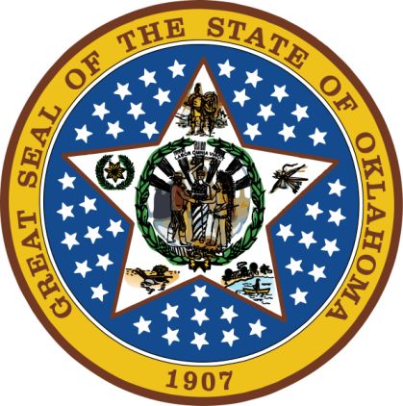
OKLAHOMA:
Our History Our Home
Chapter 12:
Creating the 46th State
STUDY PRESENTATION
© 2020 Clairmont Press

Slide 2
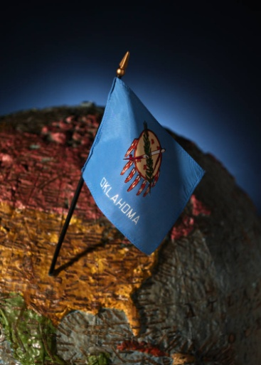
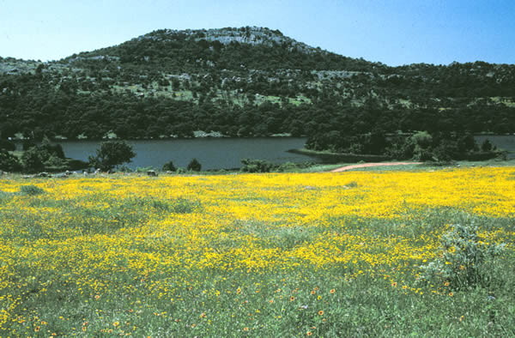
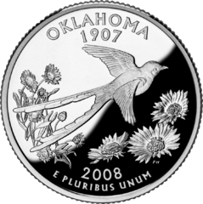
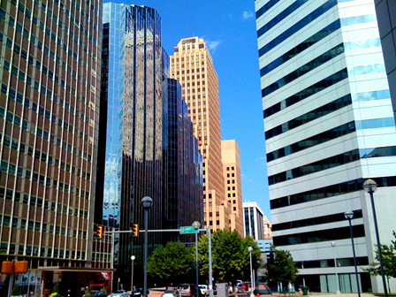
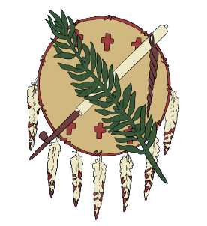
Section 1: Growth in the Territories
Section 2: Statehood

Slide 3
Section 1: Growth in the Territories
Essential Question:
What types of growth were experienced in Oklahoma Territory at the turn of the century?

Slide 4
Section 1: Growth in the Territories
What terms do I need to know?
interurban
boll weevil
subscription school

Slide 5
Railroad Power
Railroads helped to speed the movement of settlers to Oklahoma.
By the late 1800s, it was a leading industry in the U.S.

Slide 6
Railroad Power: Importance of Railroads
Coal, asphalt, and timber were exported, but people and their belongings were imported to OK.
Railroads in a town were good for its economy and could mean a town would boom (El Reno) or go bust (Reno City).
Government town planners and railroad town planners sometimes planned for settlements in different places; results could be frustrating for citizens who could not get the rail service they wanted.

Slide 7
Railroad Power: Growing Towns
Oklahoma City was crossed by four railroads by 1897.
The freight yards at Bricktown were a center of local exports (cattle, cotton, horses, wheat, corn, etc.).
Inbound trains were filled with hardware, machines, and farm equipment.
Shawnee was another big rail center and served as repair center for the Rock Island Railroad. A grand depot was built here for the Santa Fe Railroad.
Tulsa paid $12,000 to get The Katy to stop there.
Interurbans were short train routes within a town (trolleys) started in Oklahoma City (1902).
Click for 1894 Railroad Map

Slide 8
Agriculture
Farmers’ success depended on rainfall.
Sorghum was planted often by the first settlers and was good for livestock feed and sorghum molasses (sweetener).
Cotton, oats, maize and broomcorn could grow in drier climates.
Cotton grew well, but required labor to keep down weeds, to pull bolls, and to bag and haul the cotton to gin (to remove seeds from inside the cotton boll).
The boll weevil was an insect that damaged many farmers’ cotton crops until a method was found to kill it.
Russian immigrants brought wheat seeds that grew well in territories; invention of machinery for wheat farming improved production
A boll weevil attacks a cotton boll.

Slide 9
Education
Schools were important for education and as a center of community life.
Subscription schools cost parents $1-2/month per student.
The 1890 Organic Act established schools that were free.
J.H. Lawhead was the first territorial superintendent.
In 1897, mixed race schools were declared unlawful.
Black students rarely had the chance to go to school after 8th grade.

Slide 10
Mining
Salt, coal, lead and zinc mining were important industries.
The “Tri-State” or “Joplin” region was rich in lead.
1913: large lead deposits found in Picher.
1926: Ottawa County was the world’s largest supplier of lead and zinc.
Gypsum was found in Blaine County.
The 1904 St. Louis World’s Fair was a chance to demonstrate the quality and usefulness of gypsum.
An 1890s gold rush was brief. Geologists determined that the ore quality was not good.
Return to Main Menu

Slide 11
Section 2: Statehood
Essential Question:
What factors led to the statehood of Oklahoma?

Slide 12
Section 2: Statehood
What terms do I need to know?
Enabling Act
progressive movement
referendum
governor
bicameral
amendment
initiative
suffrage
prohibition
Jim Crow laws
charter

Slide 13
Introduction
The call for statehood was persistent in Oklahoma Territory.
The population grew with each land opening.
Leaders of the Five Tribes opposed joining Indian Territory and Oklahoma Territory.
Tribal leaders saw that statehood was inevitable, however, but thought it better for Indian Territory to be separate from Oklahoma.
 | Indian Territory | Oklahoma Territory
1890 | 61,000 | 197,000
1900 | 400,000 | 300,000
1907 | 722,441 | 691,736

Slide 14
The State of Sequoyah
In 1905, the Five Tribes called for a constitutional convention to create a state of Sequoyah.
Creek leader Pleasant Porter presided and William Wirt Hastings chaired a committee to draft the constitution.
It had a bill of rights, three branches of government and a system of checks and balances similar to the U.S. government model.
Delegates approved the constitution and sent it to Congress. The issue was tabled in favor of discussion of unification.

Slide 15
The Enabling Act
The Enabling Act, or Hamilton Statehood Bill (1906), provided for joining the twin territories.
It required the people to organize a government similar to other states.
The constitution had to forbid liquor in Indian Territory and the Osage Nation; establish religious freedom; prohibit polygamy; guarantee all races the right to vote; establish free public schools.
Guthrie was to remain the capital until 1913.
112 delegates met on November 6, 1906 to debate the matter, but there were no women or blacks.
77 counties were organized.

Slide 16
Writing the Constitution
The Progressive Movement was popular at the time. Supporters believed that government could best solve the problems in society.
They wanted to break up and/or regulate large businesses such as railroads.
They supported an income tax and a greater amount of say in government by the people.

Slide 17
Writing the Constitution: State Government
Three branches of government were set up with a system of checks and balances.
Most state officials were elected by the people, including the governor, and there was a two house (bicameral) legislature.
The plan was for a legislature to have more power than the governor who could serve for only one four-year term.
Citizens could propose a law or constitutional amendment (an initiative).

Slide 18
Writing the Constitution: Labor Rights & Education
A Labor and Arbitration Committee wrote laws to shorten the workday to eight hours in mines and public works projects.
Convict labor was prohibited.
Children under 15 could not be employed in hazardous work.
Boys had to be 16 to work in mines.
The constitution called for free public schools not affiliated with a religious group.
Children 8-16 years old were required to attend school.

Slide 19
Writing the Constitution: Suffrage
Statehood was discussed at the same time that the Women’s Suffrage Movement was active.
Southern Democrats did not want women to have the right to vote because they thought it would encourage more black voters.
Paupers, felons, women, and the mentally incapable were not allowed to vote.

Slide 20
Writing the Constitution: Prohibition
Alcohol was legal in Oklahoma Territory but not in Indian Territory.
Many disagreed with the laws on both sides.
The Women’s Christian Temperance Movement (WCTM) was a powerful force at the time. It worked to outlaw alcohol use.
Carrie Nation led a prohibition campaign in Kansas and Oklahoma; she tore down saloons, broke mirrors, and smashed liquor bottles.
Many European immigrants wanted to keep alcohol legal since its use was a part of their culture.
A Constitutional Convention decided to leave the issue to a vote by the people.

Slide 21
Writing the Constitution: Rights for Blacks
African Americans wanted to escape Jim Crow laws (these limited rights of blacks).
Some delegates at the convention wanted to add Jim Crow provisions on segregation to the constitution.
The matter was tabled until statehood.

Slide 22
Writing the Constitution: Business Issues
All corporations had to be chartered by the state.
They could not influence political campaigns or own stock in competing firms.
Records were subject to state inspection.
Large businesses were to be regulated by an elected corporation commission.

Slide 23
Writing the Constitution: Ratification
A very long constitution was completed after several months. It was considered very “progressive” but was later criticized for being inflexible.
It was accepted by popular vote on September 17, 1907.
Charles N. Haskell (Democrat) was elected governor.
The prohibition amendment passed.
Five congressional representatives were elected, but senators could not be elected until statehood and the meeting of the legislature.

Slide 24
Statehood Proclaimed
November 16, 1907: President Theodore Roosevelt signed the statehood proclamation.
Great celebrations began in Guthrie and Haskell was sworn in as governor.
A symbolic marriage of “Mr. Oklahoma Territory” to “Miss Indian Territory” was held for the 46th state.
Its population was 1,414,177.
Many Indians felt betrayed and that the new state wiped out their identity.

Slide 25
Image Credits
Slide 1: Daniel Mayer on Wikimedia Commons; Slide 2: Public Domain; Image Credits Slide: Thomas Jones on Wikimedia Commons; all others public domain
Return to Main Menu

