Slide 1
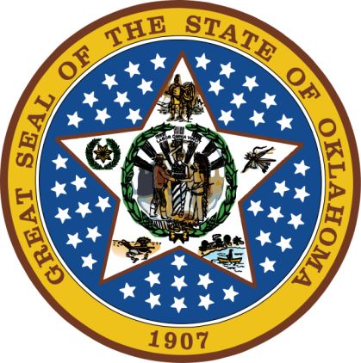
OKLAHOMA:
Our History Our Home
Chapter 11:
Boomers, Sooners, and Oklahoma Territory
STUDY PRESENTATION
© 2020 Clairmont Press

Slide 2
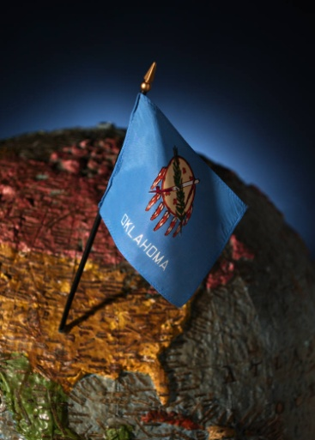
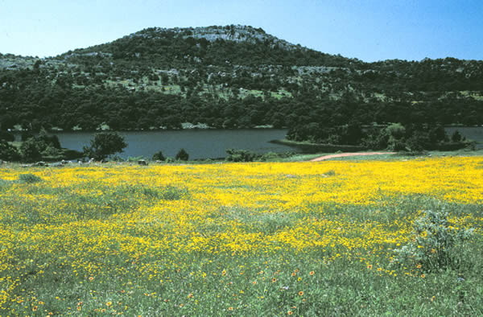
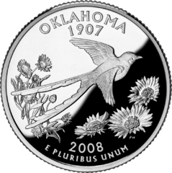
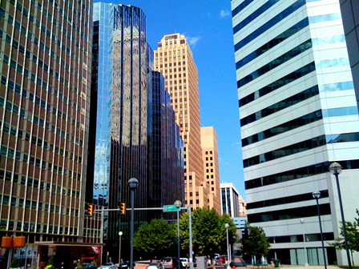
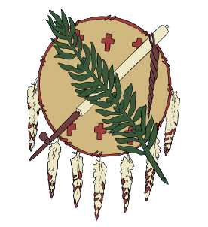
Section 1: Dissolving a Way of Life
Section 2: Oklahoma Territory

Slide 3
Section 1: Dissolving a Way of Life
Essential Question:
How did the federal government work to break up the Indian nations in the late 1800s?

Slide 4
Section 1: Dissolving a Way of Life
What terms do I need to know?
Dawes Severalty Act
Curtis Act
boomer
rider
squatter
sooner

Slide 5
The Dawes Act
Friends of the Indians was a group led by Alice Fletcher. They believed the Indians would be best served by dividing lands into homesteads as in the white society.
1887: The Dawes Severalty Act extended U.S. law to the territory and dissolved some tribal ownership of the lands.
1893: All tribal ownership was dissolved for all tribes.

Slide 6
Boomers
Pressure increased to allow settlement of the 2 million acres of “unassigned lands.”
Some Indians believed this might be good for the local economy.
“Boomer” was a term used to describe those who were part of the land boom.
David L. Payne led a group of settlers to the Unassigned Lands, but was driven off by federal troops. He returned several times until his death in 1884.
William L. Couch’s group of 400 settlers refused orders to leave, but were surrounded and not allowed to get supplies. They gave up and went back to Kansas.

Slide 7
Boomers: Indian Response
By law, non-Indians were forbidden to be in the Territory.
Tribes sent delegates to Washington to ask for help and remind politicians of the law; they helped marshals watch for illegal activity.
Judge Parker ruled in 1881 that the Indians did have an interest in the Unassigned Lands.

Slide 8
Boomers: The Springer Amendment
1889: The Indian Appropriation Act authorized payment to tribes in exchange for dropping claims on the Unassigned Lands.
The Homestead Act allowed settlers into the region at noon on April 22, 1889 to claim a homestead.
“Sooners” were those who crossed the line early and staked a claim on choice land in the territory.

Slide 9
The First Land Opening
Word spread quickly of the opportunity for good land.
Rich, poor, black, white, young, old gathered in Kansas, Texas, and Arkansas days ahead of the entry date.

Slide 10
The First Land Opening: The Run for the Unassigned Lands
Hundreds of people, wagons, buggies, and animals of all sorts made their way across rivers into the Territory.
50,000 – 100,000 people entered and claimed the two million acres within a few hours.

Slide 11
The First Land Opening: Claiming Land
Homesteaders had to find the surveyor’s stone with the land description, then report to the filing office and pay a filing fee.
They obtained title to the land after living and farming there for five years.
Fists, guns, and courts were used to settle disputes about ownership.

Slide 12
The First Land Opening: New Towns
The Seminole Townsite and Improvement Company came in early and mapped out locations for new towns.
Oklahoma City had 12,000 people on its first day.
Many towns were started and local governments established quickly.
Blacksmiths and barbers served as dentists; lawyers and merchants set up shop quickly.
Food and water ran low in Guthrie due to the huge number of settlers.
1890: African American Edward McCabe established the town of Langston. Thousands of blacks were a part of the land run; 50 all-black communities were formed.

Slide 13
Homesteading
Settlers might use their wagon as the first home.
If trees were scarce, dugouts or “soddies” served as a home.
Barns were often built first.
Sod houses were insulated and safe from fires; rain caused a wet, muddy mess.
If a farm was successful, a small wood house would be built.
Most farms would add cellars (food storage and tornado protection), windmills (for pumping water), and cisterns (to collect rainwater).
Return to Main Menu

Slide 14
Section 2: Oklahoma Territory
Essential Question:
How did establishment of Oklahoma Territory affect Indians and settlers?

Slide 15
Section 2: Oklahoma Territory
What terms do I need to know?
Organic Act
township
normal school

Slide 16
The Organic Act
May 2, 1890: Oklahoma Territory was defined as west of the land of the Five Tribes, including No Man’s Land.
President Harrison was to appoint a governor, secretary, and three supreme court judges.
Citizens would elect a 13-member council and 26-member house of representatives.
Seven counties set up with citizens to vote on county names.
Until they could create their own laws, they used the laws of Nebraska.

Slide 17
Oklahoma Territory and Indian Territory

Slide 18
The Organic Act: Greer County
Lands claimed by Texas were ruled by the Supreme Court as part of Oklahoma Territory.
Greer County was later divided into four counties (Beckham, Jackson, Greer, and Harmon).
Homesteaders were allowed to keep their land.
The Choctaw tribe was compensated for the loss.

Slide 19
The Organic Act: No Man’s Land
Oklahoma Panhandle had uncertain ownership.
Boundaries of other areas went around it; some thought it part of the Cherokee Outlet.
It was also known as the Public Land Strip and Neutral Strip of Indian Territory.
Though some had already settled there (and wanted to have their own “Cimarron Territory”), officially, settlement was allowed in 1890.
Called Beaver County until statehood, then became Beaver, Texas, and Cimarron counties.

Slide 20
The Organic Act: First Territorial Government
George W. Steele (Indiana) was named governor and Robert Martin named secretary.
Steele arrived May 23, 1890 and traveled the territory and set a date for territorial elections for the legislature.
His first act was to provide for care and custody of prisoners in Lansing, Kansas.
Public schools were quickly established with funds from the Organic Act.
Two sections of each township were reserved to fund schools. A township had 36 1-square mile “sections”; each section had 640 acres.
A university was established at Norman, an agricultural and mechanical school at Stillwater, and a normal school for teacher training at Edmond.
The capital was at Guthrie.

Slide 21
The Cherokee (Jerome) Commission
The Cherokee, or Jerome Commission, was led by David Jerome for the federal government.
President Harrison wanted Indians to give up their “surplus” lands since there was huge demand by whites for homesteads.
By 1893, 15 million additional acres became available through more than 11 agreements.

Slide 22
More Land Openings
Reservations were dissolved and 20,000 people participated on the run for the Sac and Fox, and Potawatomi, Iowa, and Shawnee lands.
25,000 people ran on the Arapaho and Cheyenne lands; however, some of this land was so rugged that settlers did not stay.
Opening of the Cherokee Outlet, Tonkawa, and Pawnee lands brought 100,000 settlers.
The last run in 1895 was for Kickapoo lands.

Slide 23
Territorial Governors
Governor Steele resigned and went home to Indiana in 1891.
Robert Martin, secretary of the territory, was acting governor into 1892.
Abraham Seay was the second governor followed by William Renfrow (1893-1897).
1897: The Northwestern Normal School in Alva opened and the Colored Agricultural and Normal University opened in Langston.
Cassius M. Barnes was governor from 1897-1901; he opened the University Preparatory School in Tonkawa and Southwestern Normal School in Weatherford.
William Jenkins was governor May – November 1901.
Thompson B. Ferguson and Frank Frantz were the last territorial governors.

Slide 24
Land Openings

Slide 25
The Last Land Distributions
A land lottery used for later distributions.
165,000 homesteaders registered at land offices.
300 registration cards were drawn per day; winners could pick their claim in county or town plans.
Land was divided in Ponca, Otoe-Missouri, Kaw, and Osage tribes to the members. There was no surplus land.
The Osage retained mineral rights on their lands.
Big Pasture land was sold by auction and money set aside for the Kiowa, Comanche, and Apache.

Slide 26
Image Credits
Slide 1: Daniel Mayer on Wikimedia Commons; Slide 2: Public Domain; Image Credits Slide: Thomas Jones on Wikimedia Commons
Return to Main Menu

