Slide 1
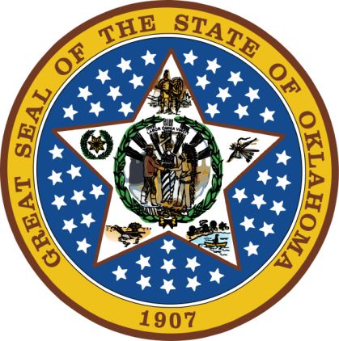
OKLAHOMA:
Our History Our Home
Chapter 8:
The Civil War in the Indian Territory
STUDY PRESENTATION
© 2020 Clairmont Press

Slide 2
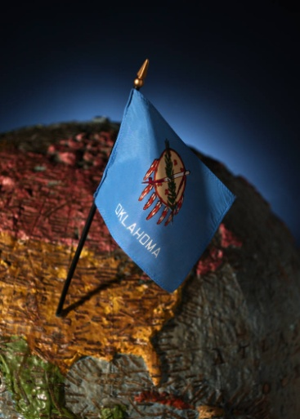
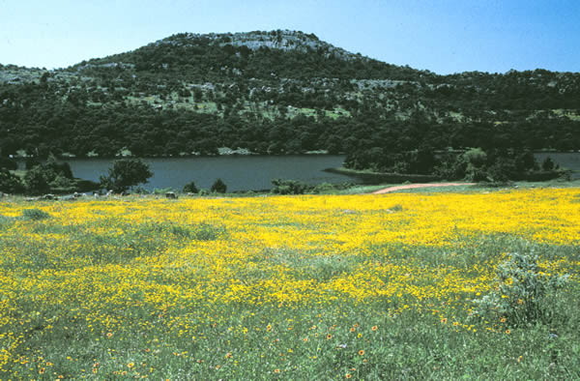
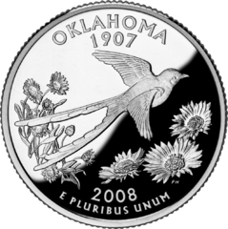
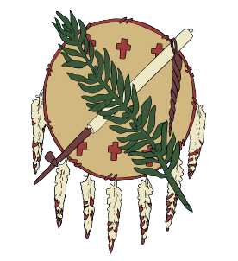
Section 1: Divided Loyalties
Section 2: Indian Territory Joins the Confederacy

Slide 3
Section 1: Divided Loyalties
Essential Question:
What differences between the North and South led to the Civil War?

Slide 4
Section 1: Divided Loyalties
What terms do I need to know?
tariff
states’ rights
free state
slave state
secede
Compromise of 1850
abolitionist
Underground Railroad
popular sovereignty
Confederate States of America

Slide 5
Divided Loyalties
Northern States | Southern States
larger population – more urban | smaller population – more rural
more representatives in Congress | fewer representatives in Congress
immigrants source of cheap labor for factories | slaves source of cheap labor for large farms
industry important to economy | agriculture important to economy
federal government viewed as more important than state government | state government viewed as more important than federal government
tariffs were viewed by most as good source of income for federal government | because they imported more goods from Europe and sold crops to Europe, many felt tariffs were unfair to the South

Slide 6
Increasing Tensions
Wealthy southern farmers felt that their cotton-based economy required slave labor. In 1819, there were 11 free states and 11 slave states.
As new states entered Union, Congress tried to keep an equal balance of slave and free.
The Compromise of 1850 attempted to settle the argument of admitting new states and required all Americans to help recover fugitive (escaped) slaves.
Abolitionists continued to help slaves escape the South via the Underground Railroad.
Some escaped slaves hid in the North, others in Canada.
The 1854 Kansas-Nebraska Act formed two new territories; citizens were allowed to vote on whether to have slavery.
Fighting broke out in Kansas between people for and against slavery (“Bloody Kansas”).
The border of Kansas was set at this time; the panhandle of OK was created when the Cherokee did not want Kansas’ border to reach Texas.
1857: Dred Scott – Supreme Court ruled blacks were not citizens and said Congress could not stop slavery in the territories.

Slide 7
Missouri Compromise Line

Slide 8
The Election of 1860
Southern states began the process to secede after Lincoln’s election. South Carolina was first on December 20, 1860.
Confederate States of America formed by South Carolina, Mississippi, Florida, Alabama, Georgia, Louisiana, and Texas in February 1861.
Jefferson Davis was elected president of Confederacy.
War broke out in April 1861 at Charleston, SC (Fort Sumter).
Arkansas, Tennessee, North Carolina and Virginia joined the Confederacy.

Slide 9
Confederate States of America

Slide 10
Section 2: Indian Territory Joins the Confederacy
Essential Question:
How did the Civil War affect people in Indian Territory?

Slide 11
Section 2: Indian Territory Joins the Confederacy
What terms do I need to know?
neutral
guardianship
guerrilla

Slide 12
Introduction
Confederate officials were aware of rich resources in the Indian Territory.
Indian Territory was a buffer between North and South.
The Civil War quickly spread to Indian Territory.

Slide 13
Taking Sides
Tribes were divided on which side to take or whether to stay neutral.
Without the U.S. Army, the Indians had to accept Confederates in the territory.
Albert Pike: Confederate Commissioner of Indian Affairs – urged Cherokee Chief John Ross to join the Confederacy, but he refused.
Pike was able to sign a treaty with the Creek, Choctaw, Chickasaw, Seneca, Caddo, Wichita, Osage, and Shawnee.
August 1861: Cherokee people pressured Ross to sign the treaty.
Fighting regiments of Indians were quickly formed, including the Cherokee Mounted Rifles.

Slide 14
Confederate Outposts
The first Confederate outpost in Indian Territory was Fort Davis near Muskogee, OK.
March 1852: Fort Davis abandoned and Fort McCulloch was established on the Blue River near Kenefic, OK.
Fort McCulloch was located along the military road between Forts Smith, Gibson, and Washita and supply towns in Texas.

Slide 15
War on Indian Land
Civil War brought out differences in the Indians’ views.
Many wanted to be neutral or were pro-Union.
Upper Creeks (led by Opothleyahola) came to Indian Territory after the Lower Creeks (led by McIntosh) and wanted to stay with Union.
They were known as the Loyal Creek.

Slide 16
War on Indian Land: The Loyal Creek Fight for Survival
Nov. 1861: Confederate Col. Cooper attacked Loyal Creek at Round Mountain. There was no clear winner, but Creeks lost supplies along the way.
Creeks were on the move to Union-controlled Kansas.
Dec. 1861: Creeks defeated in battle and survivors fled to Kansas through a blizzard.
The defeat set the Creeks back for many years.

Slide 17
Civil War Battles in Indian Territory

Slide 18
War on Indian Land: Pea Ridge
Confederates won most of the first battles of the war.
Battle of Pea Ridge (NW Arkansas)
 | Confederacy | Union
Number of troops | 16,000 troops + 800 Cherokee | 10,000 troops
Leaders | Major Gen. Earl Van Dorn, Ben McCulloch, Albert Pike | Brig. Gen. Samuel Curtis
Casualties | 4,600 dead | 1,400 dead
Outcomes | LOST McCulloch killed, Pike abandoned Fort Davis | WON Union leaders saw opportunity to re-take Indian Territory

Slide 19
War on Indian Land: The Indian Expedition
June 1862: Additional troops brought in, including loyal Indians led by Col. William Weer to take back Indian Territory.
July 1862: Defeated Confederate troops and took over Fort Gibson and Tahlequah (Cherokee capital).
Cherokee chief John Ross and family were taken to Philadelphia for safety until war ended.
Oct. 1862: Several battles resulted in Confederates being driven from Fort Wayne.

Slide 20
War on Indian Land: Black Troops
Aug. 1862: The first unit of African-American soldiers, First Kansas Colored Infantry, was created.
1864: 11th Regiment, U.S. Colored Troops – 265 men deployed in Indian Territory to guard supplies.
They were attacked by 300-400 Confederate troops, but held their ground.

Slide 21
War on Indian Land: The Battle at Cabin Creek
Union Col. William Phillips left in command of Union Indian troops in Indian Territory.
He encouraged the Cherokee to return to their lands.
The Cowskin Prairie Council chose John Ross as chief, abolished slavery, and declared Stand Watie and his followers outlaws.
At the Battle of Cabin Creek, Stand Watie and his men attacked a Union supply train. Union infantry of whites, blacks and Indians held off the attackers.

Slide 22
The War on Indian Land: The Battle of Honey Springs
The Battle of Honey Springs was the largest and bloodiest battle in Indian Territory on July 17, 1863.
There was a surprise attack by the Union to head off future attacks by Confederates.
The Union had a mix of white, black and Indian troops.
A result was the Union controlled all of Indian Territory north of Arkansas River.

Slide 23
The War on Indian Land: The Battle at Perryville
The Battle of Perryville was a follow up to the Battle of Honey Springs on August 26, 1863.
Union leader Blunt found Confederates at one of their supply depots at Perryville on the Texas Road.
Blunt took some supplies abandoned by the Confederates then burned the town.

Slide 24
The War on Indian Land: Guerrilla Warfare
Sept. 1863 – Summer 1865: guerilla warfare occurred in Indian Territory.
Col. William Quantrill led Confederate raiders.
They stole cattle and horses and burned homes and villages and any military targets and captured the Union supply steamboat J. R. Williams.
Sept. 1864: 300 supply wagons captured worth $1,500,000.
Confederate Indian troops saw little action toward the end of the war.

Slide 25
The War on Indian Land: Indian Refugees
Thousands of Indians were displaced by the war.
Pro-Confederate Cherokee fled south across the Arkansas River.
Loyal Creek went to Kansas.
14,000 refugees gathered along the Red River Valley.

Slide 26
The War Ends
April 9, 1865: The War ended at Appomattox Court House, VA. Confederate Gen. Robert E. Lee surrendered to Union Gen. Ulysses S. Grant.
The last Confederate commander to surrender was General Stand Waite (Cherokee) at Doaksville, June 23, 1865.
Indian leaders met to present plan of peace to the United States at Camp Napoleon.
Indian Territory was devastated. Many were dead or maimed, farms and homes were destroyed, and money was gone.

Slide 27
Image Credits
Slide 1: Daniel Mayer on Wikimedia Commons; Slide 2: Public Domain; Image Credits Slide: Thomas Jones on Wikimedia Commons
Return to Main Menu

