Slide 1
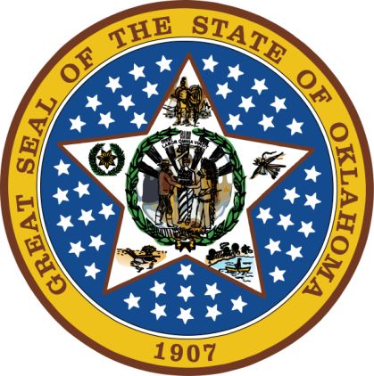
OKLAHOMA:
Our History Our Home
Chapter 7:
Opening the West
STUDY PRESENTATION
© 2020 Clairmont Press

Slide 2
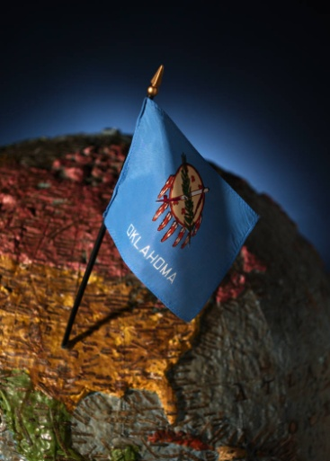
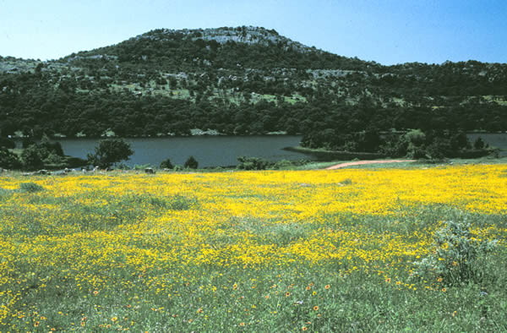
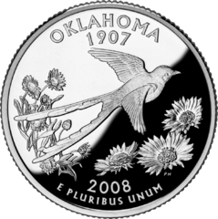
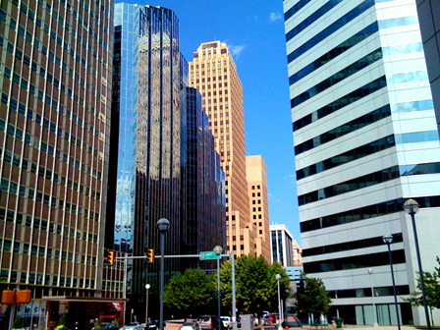
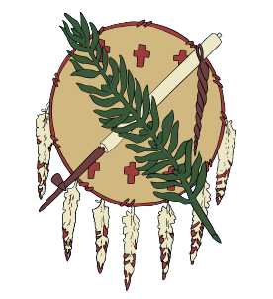
Section 1: Westward Movement
Section 2: Crossing the Territory

Slide 3
Section 1: Westward Movement
Essential Question:
What factors led Americans and immigrants to move and settle in the West?

Slide 4
Section 1: Westward Movement
What terms do I need to know?
immigrant
buffer zone
annex

Slide 5
Manifest Destiny
Manifest Destiny was the belief that Americans should expand their land and spread their beliefs and ideals.
Births and immigration caused the population to rise.
Cheap land and opportunity for wealth led some to move west.
Westward movement of whites caused the federal government to continue to relocate native peoples to the “Great American Desert” (present day Oklahoma).
Louisiana had been a buffer zone between Euro-Americans and the Spanish, but settlers came into the region.
American settlers demanded protection from the federal government in Oregon (claimed by Great Britain), Texas and California (claimed by Spain).
President James K. Polk worked out treaty over Oregon and annexed Texas. The Mexican-American War (1846-1848) secured much of the southwest for the U.S. and the Gadsden Purchase (1853) set the final border between U.S. and Mexico.

Slide 6
U.S. Territorial Expansion

Slide 7
Impressions of Indian Territory
Indian Territory (later Oklahoma) was viewed as poor land for settlement (Capt. Benjamin Booneville).
Dr. Josiah Gregg (1839) and Lts. James Albert and William Peck (1845) were famous explorers of the region.

Slide 8
Section 2: Crossing the Territory
Essential Question:
What were the best methods of travel for settlers moving West?

Slide 9
Section 2: Crossing the Territory
What terms do I need to know?
station
caravan
transcontinental railroad
contract

Slide 10
Trailblazing
Many trails began as animal paths.
Old Indian trails were also used.
Spanish priests, traders, and trappers followed the old Spanish trail – Natchitoches, Louisiana, up the Red River to Tillman County, and on to Santa Fe, New Mexico.

Slide 11
Early Trails

Slide 12
Trailblazing: The Santa Fe Trail
1848: Gold was discovered in California and began a gold rush.
Trails to the west were rugged and dangerous, but took half the time of ship travel (6 months vs. 1 year).
The Santa Fe trail began in Independence, MO.
The Cimarron Route went through the Oklahoma Panhandle. It was shorter but drier than the Rocky Mountain Route.
1821: William Becknell led the first wagon train on the trail.
1825: George Sibley surveyed the trail.
1870s: Railroads became the best choice for travelers going west.

Slide 13
Trailblazing: Texas Road
Osage Trace went from St. Louis, MO to Santa Fe through Oklahoma and Texas.
It became known as the Texas Road.
Stations along the road provided relief for stage coaches and other travelers.

Slide 14
Trailblazing: The California Road
1849: Capt. Randolph Marcy led a caravan of gold seekers from Fort Smith, AK across Oklahoma toward Santa Fe, NM (over 800 miles).
The trail became known as the California Road.
Travel was 4-15 miles/day, depending on the terrain and weather.
Rock Mary named for Mary Conway, one of the travelers in the group.

Slide 15
Trailblazing: Other California Trails
1849: Capt. L. Evans led a caravan from Fayetteville, AK.
It traveled the new Cherokee Trail through the Cherokee nation.
Another trail followed the California Trail to Coal Creek, then turned SW to El Paso, TX.

Slide 16
Traveling the Trails
The Oregon Trail was more northerly; an estimated 75,000 travelers went west on northern trails in 1850.
Trails through Indian territory, more southerly, handled about 25,000 in the same year.
The Prairie Traveler by Capt. Marcy recommended routes, supplies, wagons, and animals need for a successful migration.
Weapons were needed for hunting and protection.
1851: Marcy establishes Fort Arbuckle (near Davis) to protect immigrants and keep peace with Indians.

Slide 17
Railroad Survey
The Transcontinental Railroad spanned the continent from the Atlantic to Pacific Oceans.
The Kansas-Nebraska Act (1854) divided and organized the territory north of Oklahoma.
Settlers entered these areas and plans for the railroad were begun.
Surveys were made to determine the best route, supervised by Secretary of War Jefferson Davis.
Surveys along the 35th parallel provide much information about life in the area in the 1850s.
This route was not chosen, in the end, due to the Civil War and the push for a more northerly route.

Slide 18
Butterfield Overland Mail
Stagecoaches were used in the 1850s-1870s to haul mail and travelers.
The telegraph did not stretch across the continent at first.
The Butterfield Stage was a famous company with a route across Oklahoma, entering at Ft. Smith, AK, and traveling to the Red River via Boggy Depot and Colbert’s Ferry.
Stations located along the way had fresh horses and refreshed travelers.
Choctaw and Chickasaw nations had deals with the company to maintain roads and stations for a fee.
The Choctaw had a toll system to cover expenses of the business in their territory.
The first stage in 1858 with available trains took 4 days to go from St. Louis, MO to Sherman, TX or to San Francisco in 25 days.
1860: The Pony Express increased the speed of mail travel.
The Civil War delayed expansion of the Pony Express and stage coach route development.

Slide 19
Image Credits
Slide 1: Daniel Mayer on Wikimedia Commons; Slide 2: Public Domain; Image Credits Slide: Thomas Jones on Wikimedia Commons; all others public domain
Return to Main Menu

