Slide 1
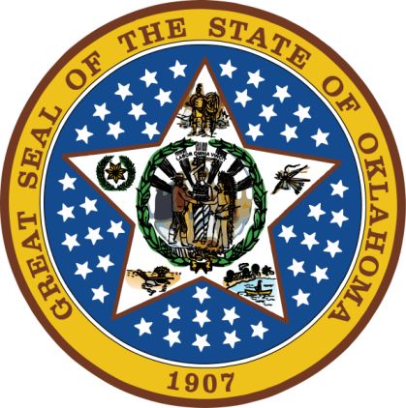
OKLAHOMA:
Our History Our Home
Chapter 3:
European Quest for New Land
STUDY PRESENTATION
© 2020 Clairmont Press

Slide 2
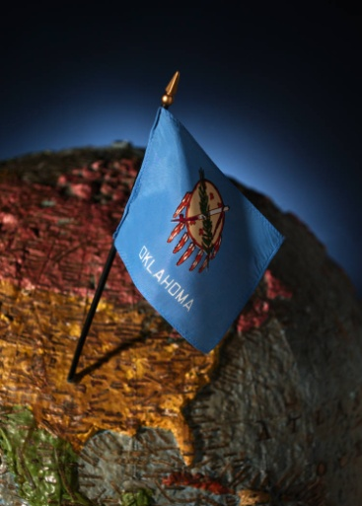
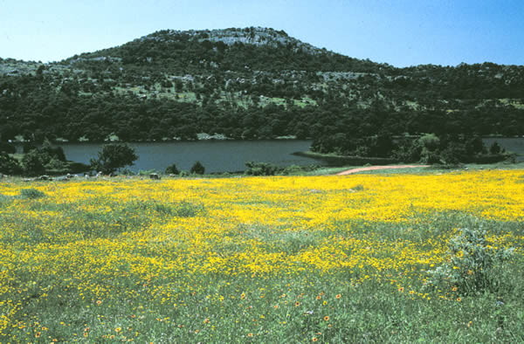
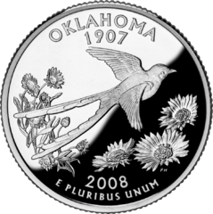
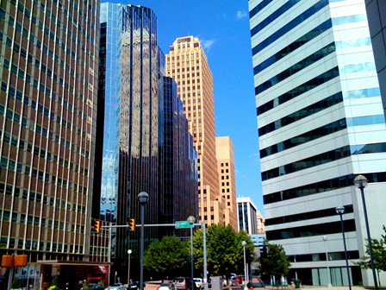
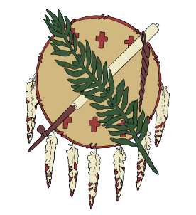
Section 1: Early European Explorers
Section 2: European-Indian Contact

Slide 3
Section 1: Early European Explorers
Essential Question:
What factors encouraged Europeans to explore in the New World?

Slide 4
Section 1: Early European Explorers
What terms do I need to know?
middleman
expedition
cartographer
Northwest Passage
isthmus
conquistador
skirmish
missionary
colony
alliance

Slide 5
Introduction
Scandinavian Vikings were possibly the first Europeans in the Americas.
Vikings may have traveled to Heavener, Oklahoma.
Vikings didn’t continue exploration in New World.
Carvings on the “Heavener Runestone” cause some to believe the Vikings once explored the lands of Oklahoma.
Click for map of Norway.

Slide 6
The Search for New Trade Routes
1400s: European countries looked for new trade routes to the Orient.
Treasured Oriental silk, perfumes, drugs, gold, jewels, dyes, teas, and spices (pepper, cinnamon, nutmeg, and cloves) were sought.
In searching for a shorter route to the Far East they instead landed on the South and North American continents.

Slide 7
The Search for New Trade Routes: Christopher Columbus
Christopher Columbus was an Italian sea captain who believed the best route to the Far East lay to the west.
He estimated the distance from Portugal to Japan as less than 3,000 miles (it’s closer to 7,000 miles!)
On August 3, 1492 he set sail (headed west) from Spain on the Niña, the Pinta, and the Santa Maria.
On October 12, 1492, he landed on an island near San Salvador.
He made four voyages to the New World but did not discover the East Indies.
A replica of Columbus’s Santa Maria
Click for map.

Slide 8
The Search for New Trade Routes: Other Early Explorers
In 1497, John Cabot landed in Newfoundland; he was the first European given credit for reaching the North American mainland.
Vasco da Gama discovered a sea route to India around Africa.
Magellan was responsible for the first expedition to circle the globe.

Slide 9
Early European Explorers

Slide 10
Spain in the New World
Ponce de Leon (1513) landed in what is now Florida.
Balboa crossed the Isthmus of Panama to reach the Pacific Ocean.
Cortés (1519) landed in present-day Mexico and in 1521 conquered Aztecs.
Nárvaez (1527) made an unsuccessful expedition to the Cape of Florida which led to his death; one of his colleagues, Cabeza de Vaca, survived, and wrote of his travels in the southwest, encouraging more exploration.

Slide 11
Spain in the New World: Francisco Vásquez de Coronado
“Seven Cities of Cibola” was a false report of houses of gold and turquoise.
Coronado led an expedition (1000 men, 1500 horses & mules, and numbers of cattle & sheep) to find the Seven Cities.
His exploration was a financial disaster yet a large territory was claimed for Spain.
Coronado and troops followed a route through Oklahoma Panhandle on their return.

Slide 12
Spain in the New World: Juan de Padilla
An ordained priest with Coronado expedition, Padilla did missionary work among the Wichita.
He and his group were warmly received at Quivira.
Padilla eventually was ambushed and killed by Kaw Indians.
Padilla’s companions, in sorrow, vowed to carry a wooden cross across Oklahoma to the Gulf Coast (do Campo route).

Slide 13
Spain in the New World: Hernando de Soto
Hernando de Soto led a 1539 expedition of 700 men, over 200 horses, dogs, and equipment.
He explored Florida and other areas in the Southeast.
1542: de Soto wintered on the Arkansas River (died same year).
He added to Spain’s land claims north of Mexico and unintentionally brought diseases to Indians.
Hernado de Soto’s exploration route

Slide 14
Spain in the New World: Juan de Oñate
In 1595, Juan de Oñate was give the job of settling New Mexico, mainly to spread Catholicism.
1598: he established San Juan de los Cabelleros (first Spanish settlement in Nuevo Mexico).
1601: more legends of gold brought Oñate to Oklahoma.
He helped open the door to the multitude of changes to come.

Slide 15
France in the New World
The French explorers were looking for furs and trade.
They bartered for food, furs, and more.
In the area of Canada, they founded Quebec.
The French usually did not try to conquer Indians, but treated Indians with respect.
They looked for a fabled route through the continent, a northwest passage which would provide water transport to the Pacific.
1673: Jolliet and Marquette took an expedition down Mississippi River.

Slide 16
France in the New World: La Salle
La Salle desired to set up trading posts down the Mississippi River.
He claimed land drained by the Mississippi River for King Louis XIV of France, naming it Louisiana.
He was murdered by frightened and frustrated colonists.
His claim led to the first French colony and the eventual exploration of Oklahoma.

Slide 17
France in the New World: La Harpe
Jean Baptiste Bernard de la Harpe established a trading post along the Red River (1719).
He explored much of eastern Oklahoma.
La Harpe was impressed with the Indian nations and their lifestyle as well as the land.
He established trading partners with the Indians and the beginning of French trade in the region.

Slide 18
France in the New World: Other French Explorers
France placed importance on Oklahoma.
By the mid-1700s, French explorers such as Pierre-Antoine, Paul Mallet, and Andre Fabre de la Bruyere were in the region.
Early French influence is evident in names of rivers, geographical features, and communities in eastern Oklahoma and surnames found in Oklahoma families (e.g. Sans Bois, Chouteau, etc.).

Slide 19
England in the New World
John Cabot (1497) provided England’s claim to North America.
In 1588, the Spanish Armada’s defeat by England further ensured English dominance of New World.
Unsuccessful attempts to find the fabled Northwest Passage continued.
By end of 1600s, twelve English colonies were started along the Atlantic Coast.
Indian life was greatly disrupted by Europeans.

Slide 20
Section 2: European-Indian Contact
Essential Question:
What were the effects on Indians of contact with Europeans?

Slide 21
Section 2: European-Indian Contact
What terms do I need to know?
economy
calumet
immunity

Slide 22
Introduction
Many Native Americans were involved in trade networks.
Some tribes very skilled at trading when the Spanish and French arrived.
Food, clothes, and shelter were primarily for their own use.
Trade among Indians was traditional.
Demand for fur and hides, desired by Europeans, changed the Indians’ economy.

Slide 23
Horse Sense
Horses had an immediate and significant impact on Indian life.
They were called “magic dogs” and “wonder dogs.”
Their power updated the Indians and allowed more permanent villages.
Their endurance extended the range of Indian life and adventure.
Other animals adopted by Indians included pigs, chickens, sheep, and goats.

Slide 24
Plants
New world food included maize (corn), beans, potatoes, squash, pumpkins, cacao, tomatoes, bell peppers, peanuts, passion fruit, sunflowers, and almost 50 varieties of berries.
Indians, for thousands of years, grew, chewed, and smoked tobacco; it became a major export to Europe.
Coffee, wheat, rice, melons, and onions were among the food plants brought to the New World by Europeans.

Slide 25
Disease
Europeans brought diseases to Indians for which the Indians were unprepared.
In Mexico, as many as 9 million out of 10 million may have died from diseases and/or battle.
Smallpox was deadliest to all Indians.
Immunity came too late to rebuild Indian populations before being conquered.

Slide 26
Image Credits
Slide 1: Daniel Mayer on Wikimedia Commons; Slide 2: Public Domain; Image Credits Slide: Thomas Jones on Wikimedia Commons; all other public domain
Return to Main Menu

