Slide 1
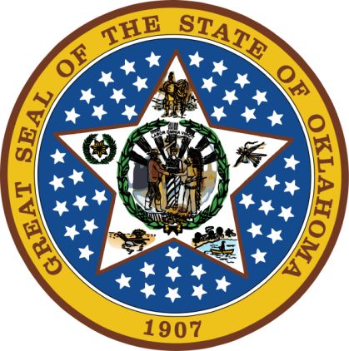
OKLAHOMA:
Our History Our Home
Chapter 2:
Early Cultures in Our Land
STUDY PRESENTATION
© 2020 Clairmont Press

Slide 2
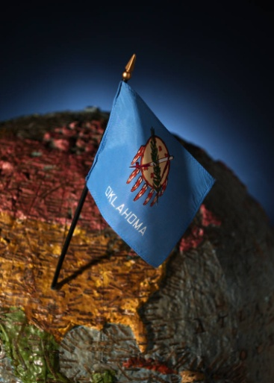
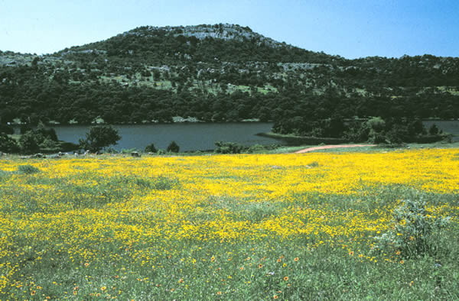
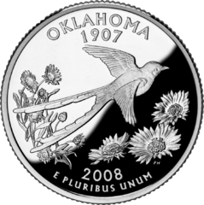
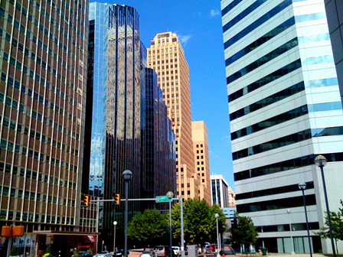
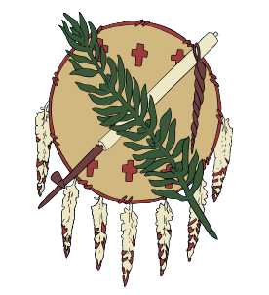
Section 1: The Earliest People
Section 2: Historic Native American Cultures

Slide 3
Section 1: The Earliest People
Essential Question:
What were the characteristics of Oklahoma’s earliest people?

Slide 4
Section 1: The Earliest People
What terms do I need to know?
prehistoric people
archaeologist
artifact
petroglyph
fossil
anthropologist
nomadic
atlatl
protohistoric

Slide 5
Searching for Clues
Artifacts include items such as pottery, tools, bone, jewelry, and paintings that were made or used by people.
Archaeological digs are excavations of a site where people lived or worked long ago.
Archaeologists study and document any fragment of an artifact discovered.
Pieced together, artifacts help tell more about past peoples.
Fossils are traces or remains of living things like animals, birds, and people.
The most common fossils are teeth, bones, or shells.
Carbon dating is used to obtain age estimates on organic (once-living) matter.
DNA studies, fluorine dating, and dendrochronology are other methods of determining the age of an artifact.
Fossil pollen can give clues to types of plants from the past.

Slide 6
Prehistoric Cultures
The earliest people to live in America came from Asia.
Around 10,000 B.C., the Bering Strait was a “land bridge” from Asia to North America.
Over 16,000 prehistoric and early American Indian sites are found in Oklahoma.
Click to see modern-day map.

Slide 7
Paleo Indians
1961: scientists discover evidence of Paleo Indian hunters in Oklahoma.
Thousands of years ago, six-foot tall bison, camels, horses, and sloths the size of elephants lived in the area that is Oklahoma.
Columbian mammoth bones were found at the Cooperton site in Kiowa County.
Soil deposits date to about 30,000 years ago at Burnham site.

Slide 8
Paleo Indians: Clovis People
The Clovis people, named after the New Mexico site where first artifacts were reported, were known for their spears (spear point usually 3-4 inches long)
There is an important Clovis site near Stecker in Caddo County.
The Clovis people first hunted mammoths and then switched to bison as the mammoth population declined.
Click for information on Jake Bluff.

Slide 9
Paleo Indians: Folsom People
The Folsom people sites include the Cooper Bonebed and the Waugh site as evidenced by various spear points and a painted bison skull.
The Dalton people lived some 9,000-10,000 years ago. They were skilled in making clothing, containers, tools, and covers for shelters from the animals they killed.

Slide 10
Archaic Culture Foragers
As climate changed, the people adapted and their culture changed.
They become hunters and harvesters and made flour and stored it in baskets.
Pieces of bone and antler became spear points, needles, awls, punches, and atlatl hooks.
They ate a variety of wild animals and knew how to start a fire with a wood drill.

Slide 11
Woodland Culture
About 2,000 years ago, Woodland culture emerged.
People planted, cultivated, and harvested food (e.g. squash, corn, beans, sunflowers).
The first farms were in the Grand River area, the Ouachita Mountains, the Cimarron River area, and along the Canadian and Washita Rivers.
Bow and arrow were developed about this time and made hunting easier.
Because farming meant growing crops, people moved less and villages began to develop.

Slide 12
Plains Village Farmers
These groups lived in Oklahoma from about 1,200 to 500 years ago.
They grew corn, beans, squash, gourds, sunflowers, and tobacco.
They hunted bison and deer along with nuts and wild berries.
Villages of about 100 people were built near waterways.
Houses were rectangular, made of wood posts, sticks, and cane covered with clay. There was a fireplace and roof covered with grass.

Slide 13
The Mound Builders
Along with Plains Villages, there were Spiro Mound Builders, or Caddo people.
They built the Spiro Mounds, now a part of the Spiro Mounds State Archaeological Park.
The people lived in small farming villages.
Spiro men and women painted themselves with colorful paints.
They were fine craftsmen and worked with stone, shell, and copper.
The Spiro were ruled by a chief who had control over the people’s resources.

Slide 14
Early Plains Indians
About 500 years ago, climate change caused the people to move to a more nomadic way of life.
They hunted buffalo, deer, antelope, rabbit, or whatever was available.
They foraged for wild plant foods and lived in grass houses covered with buffalo hide.
These hunters may be ancestors of Wichita people.

Slide 15
Section 2: Historic Native American Cultures
Essential Question:
What elements of culture were exhibited by the Indians during first contact with Europeans?

Slide 16
Section 2: Historic Native American Cultures
What terms do I need to know?
viceroy
barter
totem
shaman
polygamy

Slide 17
Introduction
Christopher Columbus began to explore in the New World in 1492.
Antonio de Mendoza was approved for an expedition to find golden cities in 1540.
Franciso Vasquez wandered the Central Plains looking for any sign of civilization.
Christopher Columbus Takes Possession of the New Country, a 19th-century view by L. Prang & Co.

Slide 18
First Encounters
1493: Coronado’s expedition was the first recorded contact between Indians and the Spanish.
Famous explorers Hernando de Soto, Louis Joliet and Father Jacques Marquette, and Bernard de La Harpe made contacts here, as well.
1542: Spanish monks found the Kaw people.

Slide 19
Indian Culture
Native Americans belonged to different tribes and spoke different languages.
They believed in many gods and spirits, an afterlife, and cleansing themselves to purify their spirits.
Life was sacred to all Plains tribes.
Prayer was to the Great Spirit, Mother Earth, and totems.
The shaman (medicine man) used herbs and prayer to heal sick, interpreted dreams and signs, passed down history and beliefs through spoken word.
Members of a tribe worked together for the good of the group, parents and older members were shown respect, and honest was valued. Children were rarely punished.

Slide 20
Indian Culture: The Family
Marriages were permitted between related tribes and a man could have more than one wife.
Men were warriors and hunters. They held important leadership roles such as chief.
Women kept the shelter (such as a tipi) and kept the family clothed and fed.
Boys and girls were taught their roles and needed skills at early ages.

Slide 21
Indian Culture: Food
Women prepared the food.
Meats were eaten raw, roasted, boiled, or dried.
Wild animals were a main food source (bear, squirrel, turkey, duck, turtles, fish, etc.).
Other foods were wild honey and other natural foods such as corn, pumpkins, squash, etc.

Slide 22
Indian Culture: Plants
Native Americans used many wildflowers and plants for natural healing.
About 170 plants used by Indians have been found to have modern use in medicine (e.g. digitalis comes from foxglove, aspirin from willow bark, mint for nausea).
The people used the resources that they found and learned to live in the lands we call Oklahoma.

Slide 23
Image Credits
Slide 1: Daniel Mayer on Wikimedia Commons; Slide 2: Public Domain; Slide 17: Library of Congress, Prints and Photographic Division; Image Credits Slide: Thomas Jones on Wikimedia Commons
Return to Main Menu

