Slide 1
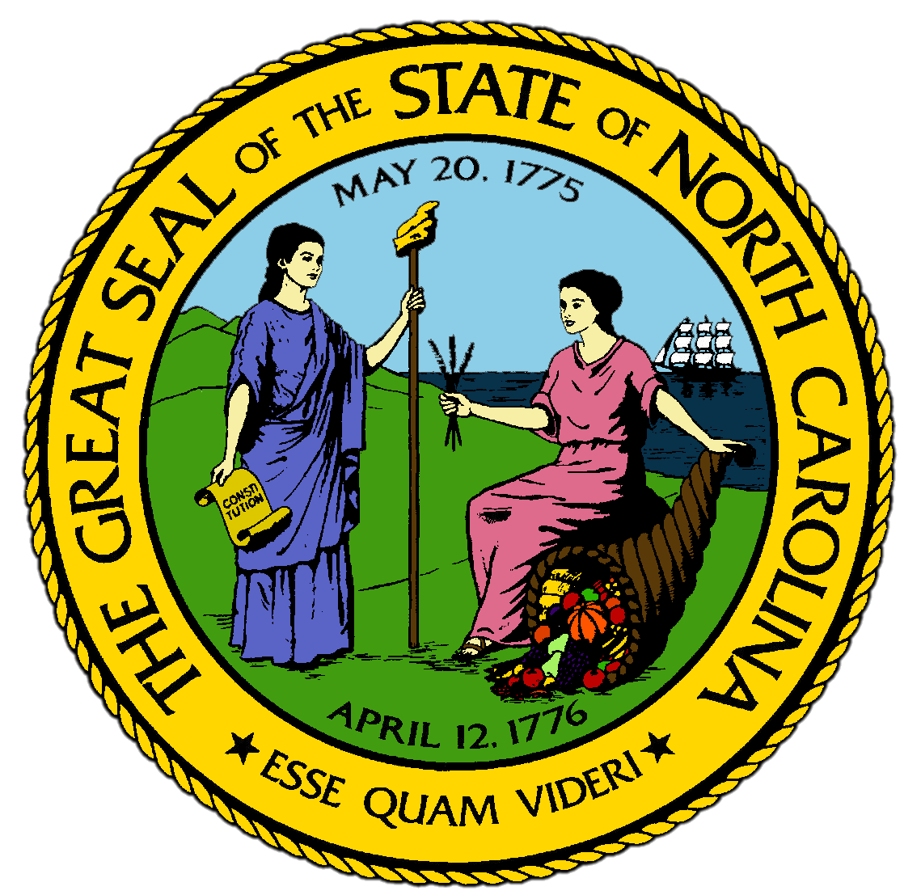
Chapter 15:
A New Century for North Carolina
STUDY PRESENTATION
© 2017 Clairmont Press

Slide 2
Section 1: The Impact of Global Change
Section 2: Living Local in a Global Economy
Section 3: North Carolina and the Great Recession

Slide 3
Section 1: The Impact of Global Change
Essential Question:
How did global change impact North Carolina’s economy at the beginning of the 21st century?

Slide 4
Section 1: The Impact of Global Change
What terms do I need to know?
millennium
North American Free Trade Agreement (NAFTA)
biotechnology

Slide 5
Introduction
The 21st century brought new people, widespread development, job losses, and new technology to the state.
Traditional industries of the state had to adapt to new conditions or die out.
Many jobs moved overseas, and many new jobs became available.
State landmarks were altered by new technology.
The Cape Hatteras lighthouse was moved inland as erosion shortened the space between it and the sea.

Slide 6
Downward Movement of the Big Three Industries
Though North Carolina remained the largest textile employer in the nation, textile mills began to close quickly over the following years.
The main problem was global competition.
American tobacco companies agreed to finance a “buyout” of tobacco allotments, and thousands agreed to stop growing tobacco for a living by 2007.
Though far fewer Americans smoke, cigarette factories still operated in the state.
Many furniture factories closed in the early 21st century, but some remained by customizing their products for certain markets.

Slide 7
North Carolina’s Move to High-Tech Jobs
Employment remained high despite the loss of traditional manufacturing jobs because of the development of new types of work, like banking.
Charlotte became a world financial leader as the headquarters of both Wachovia and Bank of America.
Telecommunication companies concentrated many of their operations in North Carolina.
The state became a leader in biotechnology, the use of living organisms to make or modify products.
NASCAR grew even more high tech and was increasingly concentrated in North Carolina.

Slide 8
Newcomers to the State
Thousands of people from outside the U.S. moved to North Carolina in the 21st century.
North Carolina had the fastest rate of growth of immigrants from Mexico, Central America, and the Dominican Republic in the nation.
Latinos came to the state for economic opportunities, and increasingly created new jobs themselves as more immigrants moved to the state.
All immigrants in North Carolina brought elements of their home cultures with them.
Many retired Americans from other states also moved to the state for lower real estate prices.

Slide 9
“The Most Military Friendly State”
After the terrorist attacks on September 11, 2001, North Carolina played a significant role in the “war on terror”.
The state’s military bases were central to the American mission during Operation Iraqi Freedom as well.
Thousands of soldiers from the state’s military bases served overseas during this period.
In 2010, soldiers from Fort Bragg were sent to Haiti to help victims of a devastating earthquake.
The war on terror helped create jobs in North Carolina after 2003 on and off the military bases.
Return to Main Menu

Slide 10
Section 2: Living Local in a Global Economy
Essential Question:
In what ways have North Carolina communities changed to meet the changing needs of the new century?

Slide 11
Section 2: Living Local in a Global Economy
What terms do I need to know?
organic farming
ecosystem

Slide 12
Introduction
North Carolinians in the early 21st century were concerned with their identity as a state and what their state would be like as it went through global changes.
For many residents of the state, old habits and new tastes could be combined.

Slide 13
Farming Innovations
State residents adapted old traditions to find a niche, or a specialized market, in the global marketplace
North Carolina continued to be the 2nd-largest producer of Christmas trees in the U.S.
Wineries opened along the Yadkin River by 2013.
The Maple Hill Farm bottled its own milk for local markets and its ice cream shop became known as one of the best in the country.
State farmers turned to organic farming, using no industrial fertilizers or pesticides and selling their produce at local farmers’ markets.

Slide 14
Industrial Adaptations
Traditional industry was also adapting.
Winston-Salem plant began to produce “wearable electronics,” specialized clothing for extreme conditions.
Some turned old cotton mills into apartments as the population of the state increased.
International companies continued to innovate with new technologies.
Established North Carolina firms like Food Lion opened new stores under the name Bloom, selling ready-made packaged foods.

Slide 15
Community Revitalization
Communities took advantage of global possibilities to strengthen their assets.
New housing built in downtowns helped revive the cores of major cities in the early 2000s.
The Main Street program helped smaller towns to attract business and cultural destinations like museums.
As older towns lost businesses, people turned them into entertainment destinations, and newer communities worked to adapt new ways with traditional ideas.
Communities attempted to stem the tide of uncontrolled development like urban sprawl.
Coastal residents formed “Down East Tomorrow” to preserve the coastal ecosystem from development.
Return to Main Menu

Slide 16
Section 3: North Carolina and the Great Recession
Essential Question:
What impact did the Great Recession have on North Carolina’s economy and political views?

Slide 17
Section 3: North Carolina and the Great Recession
What terms do I need to know?
subprime loan
underemployment
Tea Party movement
Moral Monday movement
exurbs

Slide 18
Introduction
The Great Recession was an economic slowdown from 2008-2011 that rivaled the Great Depression.
It was primarily caused by the overextension of credit given by banks as mortgages, often in subprime loans, meaning it was unlikely the loans would be paid back.
There were two main similarities of the Great Recession and the Great Depression:
Leading up the collapse, money was lent unwisely.
The immediate effect both times was fear that the banking system could not continue without harming consumers and citizens.

Slide 19
The Local Impact of a National Slump
During the worst years, the state’s Gross Domestic Product was half what it was during the 1990s.
North Carolina was 6th in the nation for number of jobs lost.
Underemployment, which is when people are employed less than full-time or in jobs that don’t match their training or meet their needs, was higher in 2015 than in 2011.
North Carolina’s rise to a world banking center made it a likely victim of the recession.
In 2008, Wells Fargo bought Wachovia and restored operations.
The state government struggled to make ends meet with a huge shortfall in tax money.
In 2011, the state started the North Carolina Virtual Public School where classes were taken online and expanded Pre-K programs.

Slide 20
New Debates
For most of the 20th century, North Carolina was proud of their balance of liberal aspirations and conservative approaches.
Between 2008-2013, the state tilted in a conservative direction, caused by loss of economic security during the Great Recession and the Tea Party movement, which called for a reduced role of government at all levels.
Republicans argued that the Democrats hadn’t managed the state’s money and other resources during the Great Recession.
They cut taxes on all citizens and most companies, cut government programs in many areas, and took steps to oppose changes in social values that accompanied globalization, technology, and immigration.
Residents who disagreed joined the Moral Monday movement and walked the hallways of the state legislature building to call attention to their grievances.
Pattern of division changed:
Republican leaders lived in the exurbs, which were outlying areas around cities, while Democrats tended to live in the revitalized cores of the cities.
Return to Main Menu

Slide 21
Image Credits
Title Slide: Public Doman, Wikimedia Commons; Contents slide: Reginald Lankford, Clairmont Press; End Slide: Reginald Lankford, Clairmont Press;
Shown here: Kitty Hawk Bay, NC
Return to Main Menu

