Slide 1
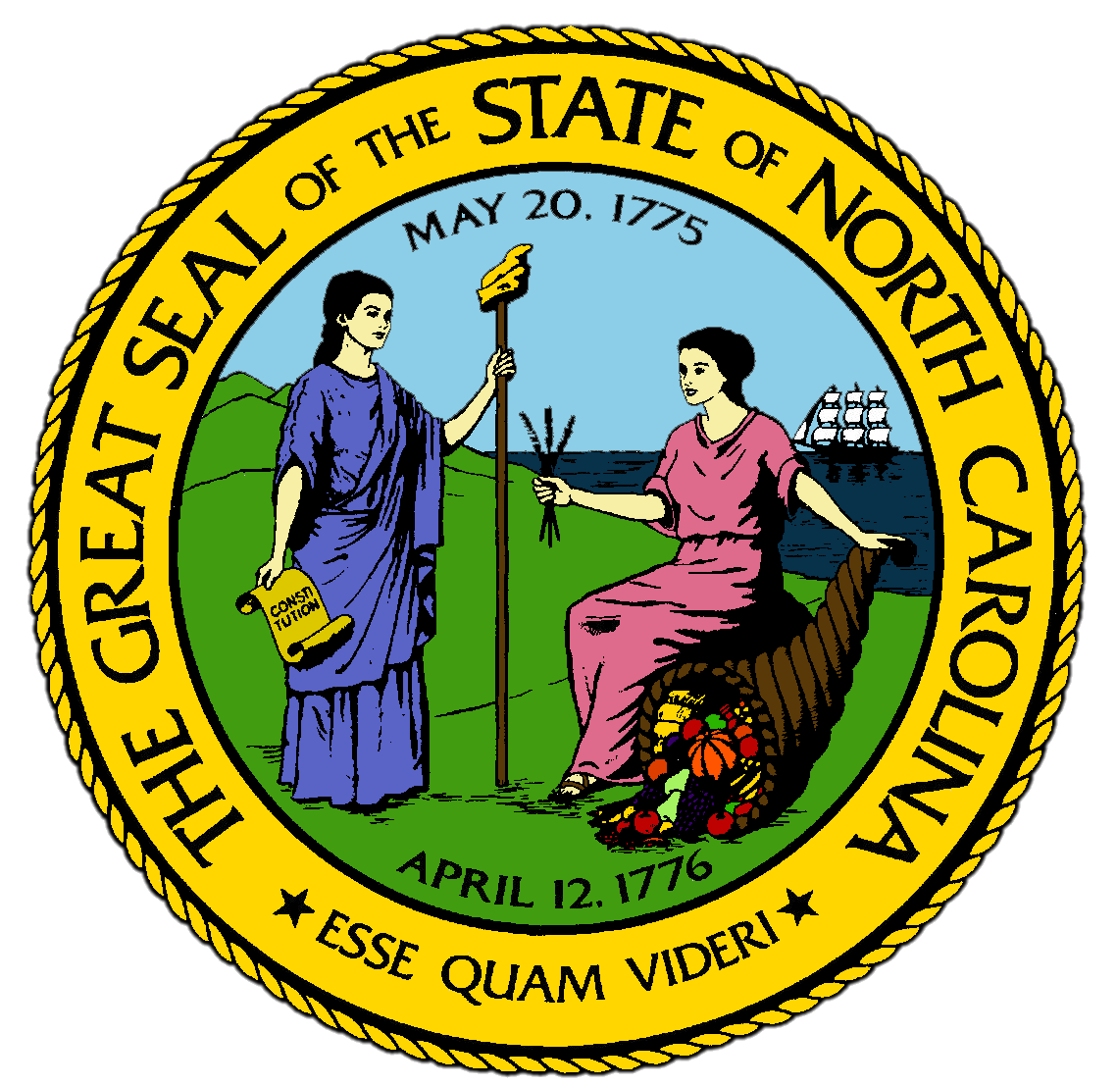
Chapter 12:
The Great Depression and the Big War
STUDY PRESENTATION
© 2017 Clairmont Press

Slide 2
Section 1: North Carolina Roars through the Twenties
Section 2: The Great Depression Levels North Carolina
Section 3: The New Deal Plows through North Carolina
Section 4: North Carolina Again Helps Win the World War

Slide 3
Section 1: North Carolina Roars through the Twenties
Essential Question:
How did increases in manufacturing efficiency positively and negatively impact residents of North Carolina?

Slide 4
Section 1: North Carolina Roars through the Twenties
What terms do I need to know?
assembly line
moonshine
evolution
stretch-out

Slide 5
Introduction
After the First World War, North Carolinians were richer than ever before, though some were poorer than ever as well.
North Carolinians were closer to the average American in lifestyle than ever before, and life moved very quickly.

Slide 6
The Automobile Becomes Affordable
By 1912, cars were used on a daily basis by people in towns, but after WWI, they became important in the countryside.
Henry Ford’s company perfected an assembly line that lowered the cost of his basic car, the Model T.
Assembly lines move products through machines, equipment, and workers which each perform one task until the product is complete.
After WWI, one in ten families in the state had cars, and even more families had them in cities.
The availability of cars led to growth of all businesses, even illegal ones.
People in the mountains continued to make moonshine, a type of alcohol, and cars made delivery of the moonshine easier and quicker.

Slide 7
The Good Roads State
State leaders built a network of roads to connect the industrial towns in the Piedmont with the raw materials grown in the Coastal Plain.
The state went into debt to create these roads just as it had when building the railroads years before.
Governor Morrison created a highway network from the coast into the mountains.
By the end of the 1920s, North Carolina had the best highways in the South.

Slide 8
A State on the Move
In the 5 years after WWI, more than 100,000 people moved to towns and cities.
One third went to Charlotte or Winston-Salem.
Winston-Salem was the largest city in the state, and produced more consumer goods than large cities like Atlanta or Los Angeles.
With highways providing links to the world, North Carolina’s manufacturers became known all over the world.
In 1922, North Carolina established its first radio station.
Tobacco companies were sponsors and had advertising slogans during all radio shows, which allowed tobacco profits to skyrocket during the period.

Slide 9
The Paradoxes of Progress
Very little was changing in the rural parts of the state despite the progress elsewhere.
Most farmers were still sharecroppers, and many were extremely poor.
There were paradoxes throughout the state:
There was support for high schools, but many did not want schools to teach the theory of evolution.
The state produced the most electricity in the nation, but most farmers didn’t have access to it.
Electricity made cotton mills more productive, but the competition drove profits and wages down.
Workers had to tend more machines, called a stretch-out, as they had to reach to tend to the machines.
The Loray Mill Strike was a response to conditions and wages in the mills, involving violence, arrests, and murders.
Return to Main Menu

Slide 10
Section 2: The Great Depression Levels North Carolina
Essential Question:
What impact did the Great Depression have on North Carolina?

Slide 11
Section 2: The Great Depression Levels North Carolina
What terms do I need to know?
secret ballot
depression
stock market
relief
Live at Home Program

Slide 12
Introduction
O. Max Gardner became governor in 1929 with a goal of making the state more progressive for all citizens.
He pushed for the secret ballot, so voters did not have to cast votes publicly and risk repercussions.
To avoid violence during a labor strike, he met with both the protestors and the owners to settle the dispute.
He also attempted to save tax money by reducing government offices.
He created one state highway department.
He was so successful in reorganizing the government that his allies controlled the state and the Democratic party through World War II.
Gardner dealt with the Great Depression as governor, attempting to help the state through the downturn in economic activity worldwide.

Slide 13
The Causes of the Great Depression
One cause of the Great Depression was the stock market crash in 1929.
Stock markets are where stock of corporations are bought and sold.
Americans made a lot of money during WWI selling arms and supplies to Europe, and factories grew quickly.
By the late 1920s, factories had too many products and too few customers.
Farmers grew as much as they could and produced more than the market needed.
Because wages declined, people bought less and businesses closed.
Banks were forced to close when many people withdrew their money before the banks ran out of money.

Slide 14
The Live at Home Program
The people who suffered first were those in the mill villages and sharecroppers.
Workers without jobs turned to the county governments for help or relief.
Governor Gardner tried to keep banks open, continued to spend on highways to put men to work, and urged farm families to participate in the Live at Home Program.
The program gave them seeds bought by local governments to grow more food so they wouldn’t have to buy as much.
The state increased taxes on manufacturing profits rather than a sales tax, which would hurt the poor.
Return to Main Menu

Slide 15
Section 3: The New Deal Plows through North Carolina
Essential Question:
What impacts did New Deal relief and recovery programs have on North Carolina?

Slide 16
Section 3: The New Deal Plows through North Carolina
What terms do I need to know?
New Deal
Civilian Conservation Corps (CCC)
tobacco allotment
parity
tobacco price support
minimum wage
collective bargaining
Social Security Act

Slide 17
Introduction
Franklin D. Roosevelt became president in 1933 and started to fight the Great Depression with his New Deal:
First, he closed all banks until their accounts were checked. They could reopen if their accounts were sound.
Second, he used federal money for relief in every state.
Third, Congress regulated how much factories and farms could produce.
The New Deal aimed to put money in people’s hands so they could spend it and revive the economy.

Slide 18
Relief with Temporary Jobs
In the short term, people were given money to pay debts and living expenses.
In the long term, the state was improved by the structures built and work done during relief programs.
The Public Works Administration hired thousands of Mountains residents to clear, grade, and pave the Blue Ridge Parkway, and the Tennessee Valley Authority built hydroelectric dams on all streams into the Tennessee River.
Thousands enlisted in the Civilian Conservation Corps (CCC), where they lived in camps, were fed, and given money to send home as they worked on stopping the effects of erosion and developing the Great Smoky Mountains National Park.

Slide 19
Recovery Attempts
The New Deal attacked overproduction in the fields and factories.
In 1933, the Federal government developed two programs to handle this problem:
The Agricultural Adjustment Administration (AAA) for farms.
The National Recovery Administration (NRA) for factories.

Slide 20
The AAA Down East
The AAA ordered farmers to destroy a third of their crops in 1933 so that they would make more money by growing less, and it worked.
Tobacco farmers particularly made more money as people continued to smoke.
The Supreme Court outlawed the AAA because Congress had gone too far in managing the marketplace, but North Carolinians welcomed a new version in 1938.
AAA payments were made to landowners, so sharecroppers did not always see an increase in income.

Slide 21
Tobacco Price Supports
The farm program became a part of life on the Coastal Plain for tobacco farmers.
Each farmer had a tobacco allotment, a specific amount of land to grow the crop.
In return, the federal government made sure each farmer received enough cash to live on, called parity.
Tobacco price supports allowed farmers to store crops that they wouldn’t make any profit from and gave them a loan to be paid back when the crop was sold.
It allowed farm families to stay on the land and not move to towns where jobs were scarce.
It also tied voters in the east to the Democratic Party that developed the plan.
It provided merchants, bankers, and warehouse owners guaranteed business.

Slide 22
The National Recovery Administration and Labor
This had its biggest impact on the industrial cities in the Piedmont.
It required each business to create a list of rules and procedures.
It also allowed manufacturers to regulate themselves by cutting production
This quickly stabilized the state’s textile industry and eliminated child labor.
This also limited the work week to 40 hours and provided a minimum wage that benefitted owners and workers.

Slide 23
The General Strike of 1934
Northern labor unions tried again to organize the textile workers and use the union for collective bargaining with the mill owners.
The General Strike spread through the South and was the most aggressive strike in state history.
The reaction of workers was mixed.
Some sided with strikers and some fought with them to continue to work.
The National Guard was called out in some towns.
Many workers blamed their problems on the union when they weren’t rehired.

Slide 24
Reform Efforts of the New Deal
The relief and recovery efforts of the New Deal were meant to be temporary.
The Social Security Act gave many workers their first retirement pension.
Federal law strengthening labor unions was less successful in North Carolina.
Many farm owners resented the attempts to buy worn-out land and sell it to sharecroppers, so very few families escaped sharecropping.
The New Deal changed life for everyone in the state in some way.
Return to Main Menu

Slide 25
Section 4: North Carolina Again Helps Win the World War
Essential question:
What were North Carolina’s contributions to the war effort of World War II, and what impact did they have on the state?

Slide 26
Section 4: North Carolina Again Helps Win the World War
What terms do I need to know?
rationing

Slide 27
Introduction
In 1940, life in North Carolina was more stable.
Tax money was more wisely spent as the Great Depression lifted.
State residents were more in tune with international events, especially those that threatened their industrial way of life.

Slide 28
Going to War, Again
World War II continued the issues of World War I.
Japan played a large role, wanting more influence over Asian countries and their resources.
President Roosevelt was determined to have U.S. in a more decisive role in the outcome of WWII.
Congress actions at the start of the war impacted North Carolina directly.
They started a military draft.
They also extended the income tax to most Americans to cover increased federal spending, which was the first time most North Carolinians had to pay income taxes.

Slide 29
North Carolina’s Mobilization
WWII began in Europe in 1939 when Germany invaded Poland.
The U.S. remained neutral.
Japan invaded French Indochina, which includes Vietnam, Laos, and Cambodia, in 1941.
Japan attacked Pearl Harbor, Hawaii on December 7, 1941.
In retaliation, the United State declared war on Japan, and Germany and Italy declared war on the U.S.
More than 300,000 North Carolinians served in the armed forces during WWII, and more than 7,000 were killed during their service.
German submarines ambushed ships off Cape Hatteras.
North Carolina became an important military training center during the war.
State produced many materials used in fighting the war, particularly textiles and cigarettes.

Slide 30
Women and the War
WWII took women out of the home and put them in the middle of the war effort.
They harvested cotton, worked in factories, and joined the Women’s Army Corps or British Royal Air Force.
Those who didn’t leave home took in boarders, often recent immigrants, or contributed in other ways.

Slide 31
Minorities and the War
Blacks from North Carolina served in the same ways as whites during the war, though some counties still sent them off in segregated buses.
Men who weren’t drafted worked in shipyards and women moved into towns to work in local factories.
The constant changes and movement of people during the war changed normal behavior in North Carolina.

Slide 32
Sacrifices on the Home Front
Thousands left the state to work in cities like Norfolk and Baltimore.
The state’s factories operated at full capacity for the first time in ten years.
The federal government imposed strict regulations on goods to make use of all resources .
Most groceries were controlled by rationing, meaning each family could only buy a certain amount of an item each month.
Gasoline purchases were strictly limited.
Families were encouraged to plant “victory gardens” to raise their own food.
In 1944, polio struck hundreds of children in western North Carolina, increasing the struggles of the war.

Slide 33
The Celebration at the End
The war ended in 1945 when the Germans surrendered in May and the Japanese surrendered in August.
Residents celebrated wherever they were, and streets clogged with traffic in every city and town in the state.
There were changes for North Carolina and the nation at the end of WWII.
The war had changed the role of women and helped attack prejudice and discrimination.
Return to Main Menu

Slide 34
Image Credits
Title Slide: Public Doman, Wikimedia Commons; Contents slide: Reginald Lankford, Clairmont Press; End Slide: Reginald Lankford, Clairmont Press;
Shown here: Kitty Hawk Bay, NC
Return to Main Menu

