Slide 1
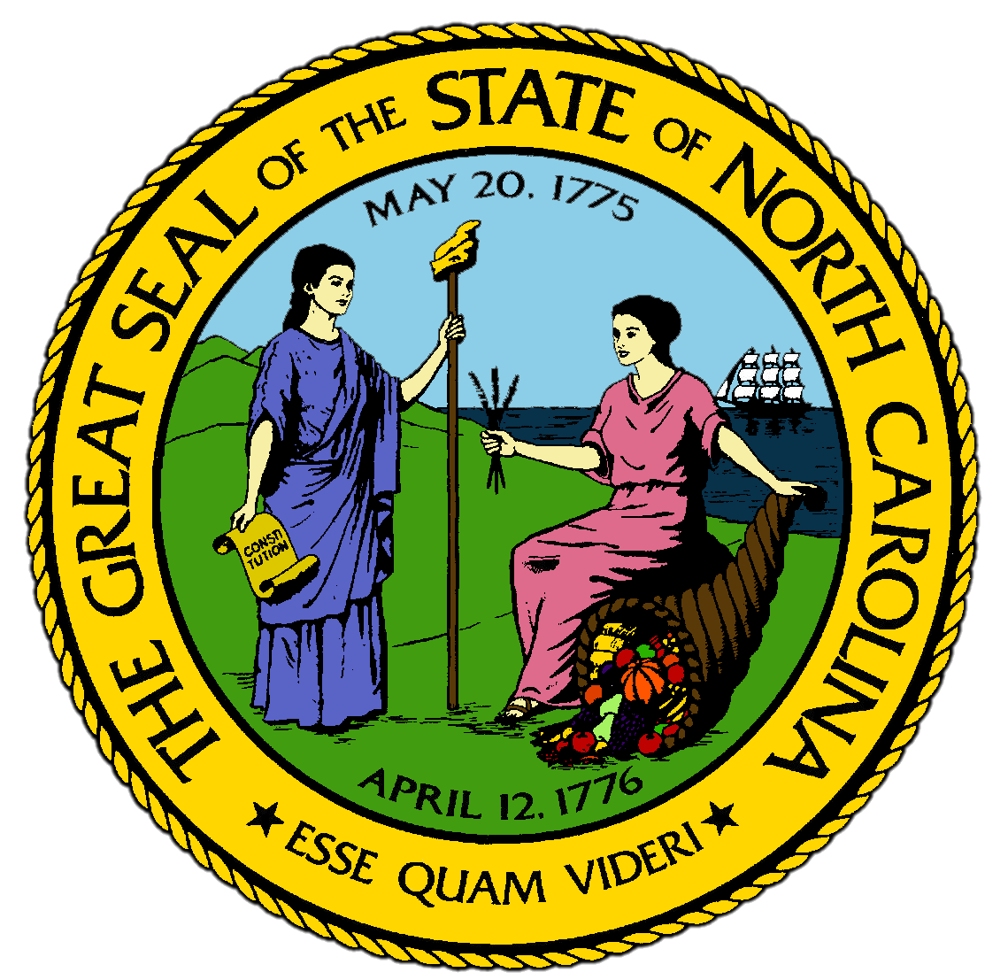
Chapter 9:
Civil War and Reconstruction
STUDY PRESENTATION
© 2017 Clairmont Press

Slide 2
Section 1: Sectionalism and Secession
Section 2: Sticking with the Confederacy
Section 3: Conflicts on the Home Front
Section 4: Reconstruction in the State
Section 5: African Americans during Reconstruction

Slide 3
Section 1: Sectionalism and Secession
Essential Question:
How did North Carolina initially feel about secession, and what issues led to their eventual secession from the United States?

Slide 4
Section 1: Sectionalism and Secession
What terms do I need to know?
North Carolina Manumission Society
North Carolina Colonization Society
secession
Confederate States of America
Unionist

Slide 5
Introduction
The increasing prosperity of the 1850s aggravated the divisions about slavery in North Carolina.
Western areas grew less cotton, so those areas had less of a need for slaves.
Large increases in cotton production led eastern areas to strongly defend slavery.

Slide 6
North Carolinians and Abolition
After the War of 1812, Americans argued if slavery should be continued.
North Carolina was notable for having more citizens speaking against slavery than any other southern state.
In 1816, Quakers in the Uwharries formed the North Carolina Manumission Society to raise money to buy slaves and free them.
Quakers also joined the North Carolina Colonization Society, which raised money to pay for passage back to Africa for free blacks who wished to move.
After 1830, most North Carolinians strongly supported slavery, as they began to profit from sales of cotton along with the rest of the South.

Slide 7
North Carolinians and the Mexican War
In the 1830s-1840s, Americans were settling the West to start new lives on new lands.
President James K. Polk was from North Carolina and supported Manifest Destiny; he annexed Texas to the United States and wanted to acquire other western territories.
These actions led to war with Mexico in 1846.
The Whigs of North Carolina lost control of the state after 1850 because many thought that they had been against the war with Mexico.
Some wanted to join with the South in a new nation, but they didn’t send delegates to a convention on secession
Congress passed the Compromise of 1850, which avoided war and southern secession temporarily.

Slide 8
The 1860 Election
North Carolina was divided about slavery, but it would not side with the Northern U.S.
In 1860, the new Republican party nominated Abraham Lincoln for president, but there were no Republicans in North Carolina to vote for him.
Lincoln’s outspoken opposition to the growth of slavery ultimately led to the secession of South Carolina and 6 other southern states from the Union.
In 1861, they formed the Confederate States of America.

Slide 9
The Failure of Unionism
North Carolina hesitated to join the Confederacy.
Unionists, who were leaders that wanted to stay in the Union, were more influential in North Carolina than other southern states.
In 1861, voters voted to not hold a convention on secession from the Union.
Unionists were only conditionally supporting the Union.
They did not want any military action against the other southern states.
North Carolina held its secession convention and voted unanimously to secede after the Confederates fired on Fort Sumter in South Carolina and Lincoln called for volunteers to put down the rebellion.
Return to Main Menu

Slide 10
Section 2: Sticking with the Confederacy
Essential Question:
What was the impact of North Carolina’s participation in the Civil War?

Slide 11
Section 2: Sticking with the Confederacy
What terms do I need to know?
naval blockade
blockade runner

Slide 12
Introduction
North Carolinians acquired the nickname of Tar Heels during the American Civil War.
North Carolinians provided one-sixth of the Confederate soldiers, even though the state had only one-ninth of the South’s population, and they suffered nearly one-fourth of all Confederate casualties.
Soldiers also frequently got sick, wounded, captured, or deserted the army.
The state was no more of a military leader during the war than it was a political force during America’s early history.

Slide 13
Fighting on the Virginia Front
Much of the early fighting of the war took place in Virginia.
North Carolinians fought in almost every major battle in Virginia.
The Tar Heels stayed with the Confederacy until the end, and when the Confederate army surrendered in 1865, one-fourth of those surrendering were North Carolinians.
They also committed one of the biggest mistakes of the war, accidentally wounding General Thomas “Stonewall” Jackson, who later died from his wounds.

Slide 14
Defending the North Carolina Coastline
There was considerable fighting along the coast of North Carolina during the war.
In 1861, the Union began to capture Confederate forts on the Outer Banks, and by 1862, they controlled the sounds.
The North had maintained a naval blockade since the start of the war, where a fleet of ships patrolled all southern ports.
Only the port at Wilmington remained open, since the North was kept away from Cape Fear because of the sandbars and shallow waters.
Blockade runners, or low-lying steamships painted gray to match the water, were able to slip in and out of Cape Fear waters past the blockade.
Additionally, more than a dozen battles were fought in the Tidewater to cut off the railroad that supplied the Confederacy.

Slide 15
The End of the War
In 1865, invaders closed in on North Carolina from all sides.
In January, the Union took Fort Fisher, closing Wilmington’s port.
After burning Columbia, South Carolina, Union General William T. Sherman headed to cut off the lifeline of the Confederacy—the railroad depot at Goldsboro— and took possession of central North Carolina.
On April 9, 1865, General Lee surrendered at the Appomattox Court House in Virginia.
By the end of April 1865, most North Carolina soldiers were on their way home.
Return to Main Menu

Slide 16
Section 3: Conflicts on the Home Front
Essential Question:
How did the American Civil War affect those who remained at home?

Slide 17
Section 3: Conflicts on the Home Front
What terms do I need to know?
conscript
price gouging
buffalo
outlier
Home Guard
Peace Movement

Slide 18
Introduction
The Civil War bred conflict within the state just like the American Revolution.
Nearly 20,000 North Carolinians were conscripted, meaning they were forced to join the Confederate army.
With so many men gone, people began to take advantage of soldier’s families.
Price gouging, or charging a higher price than is “fair”, was constant during the war as the money in North Carolina lost value.

Slide 19
Women in the War
The cost of war was particularly heavy for families.
The state required a “tax-in-kind” from every family, or a portion of all the produce grown on the family farm.
With the men gone, this meant that the wife had the burden of her work along with all the planting, harvesting, and feeding the rest of the family alone.
By 1863, many soldiers' wives had to receive financial help from their communities.
Women worked hard during the war to preserve their families and protect their children.

Slide 20
Deserters and Fugitives
Disorder spread across the state by 1863.
In the Tidewater, groups of buffaloes, or men who were said to “go about in gangs like buffaloes”, hid in the swamps to avoid fighting for the Confederacy, while some went to fight for the North.
Slaves left their plantations and fled to the Union lines.
In the Uwharries, where most opposed secession, groups called outliers, since they were “lying out in the woods”, avoided fighting for the Confederacy.
Outliers often fought with the Home Guard, who were older men charged with defending their neighborhoods during the war.
Fighting amongst North Carolinians was most vicious in the mountains.

Slide 21
The Peace Movement
As the Confederacy struggled, some North Carolinians thought that secession had been a bad idea.
William W. Holden, a newspaper editor, had favored secession until he saw the suffering of North Carolina.
Holden began to urge the state to seek a separate peace with the North after the battle of Gettysburg, which became the Peace Movement.
Opposing Holden was Governor Zebulon B. Vance, who strongly opposed the Peace Movement, arguing that it was simply submission to the North.
In 1864, Vance and Holden were candidates for Governor, but fewer than half of the eligible men actually voted, and Vance remained governor.
Return to Main Menu

Slide 22
Section 4: Reconstruction in the State
Essential Question:
What changes were made by North Carolina after the war during the period of Republican control, and what were the differences between their reforms and those of the Conservatives?

Slide 23
Section 4: Reconstruction in the State
What terms do I need to know?
Reconstruction
freedmen
Black Codes
carpetbagger
universal manhood suffrage
segregate
Ku Klux Klan
martial law
Kirk-Holden War
impeach

Slide 24
Introduction
When the Civil War ended, President Andrew Johnson made Holden temporary governor of the state as part of the Reconstruction plan.
Reconstruction referred to the steps taken to restore the southern states to the Union and rebuild the South.
Holden worked diligently to reorganize and reform the state against great opposition from the leaders who favored the Confederacy.
Holden’s reforms were eventually compromised by violence and intimidation.

Slide 25
Black Codes
In 1865, Jonathan Worth became governor and the North Carolina legislature ratified the Thirteenth Amendment, drafted a new state constitution, and passed laws defining the social status of freedmen, or freed slaves.
These Black Codes allowed marriage, education, and property ownership, but denied rights to move freely, own firearms, serve on juries, or work without an annual contract.
The federal government moved to stop the southern states from implementing these laws by reinstating a military occupation in the South.
North Carolina would not be readmitted to the Union until it passed a constitution that recognized freedmen as citizens.
Holden organized the Republican Party to do what Congress required.

Slide 26
The State Constitution of 1868
Delegates came to Raleigh in 1868 to write a new constitution.
They included former slaves, whites with no previous political experience, and carpetbaggers, who were men from northern states that came south to gain power and fortune.
They established universal manhood suffrage, meaning all men over 21 could vote regardless of color or status.
The delegates greatly increased the number of public offices chosen by the people .
They also required that the state provide more services to its people, including public education for all children.
The new constitution did allow segregation, or separation by race, in schools.

Slide 27
Radical Republicans in Control
The new legislature ratified the Fourteenth Amendment to the U.S. Constitution and North Carolina was readmitted to the Union in 1868.
The Republicans held a majority but faced great opposition from former supporters of the Confederacy who called themselves Conservatives.
Conservatives faulted carpetbaggers for misleading the former freedmen into making bad decisions for the state and claimed that Holden and his allies were too radical.

Slide 28
White Conservatives Regain Control
The Conservatives worked hard to regain control, exposing every wrongdoing of the radicals and highlighting mistakes made by freedmen legislators.
In 1869, the Ku Klux Klan became an active arm of Conservative resistance, with as many as 40,000 members in North Carolina.
The Klan started in Tennessee right after the war as a social organization for Confederate veterans, but it became a secret, racist organization that spread across the South.
They harassed and intimidated North Carolinian Republicans in 25 counties and were accused of at least 15 murders.

Slide 29
The Kirk-Holden War
Governor Holden declared martial law, which is where military forces are used to keep order, to keep the Klan from taking over key places of the state.
State militia was sent under the control of Colonel George Kirk.
Suspected Klan members were arrested and held without charge or trial, and Conservatives were angered that Holden made so many arrests with so little evidence.
Conservatives called this the Kirk-Holden War.
In the 1870 election, 15 previously Republican counties voted Conservative.
The Klan had been active in 10 of those counties.
The Klan continued to cause mayhem until a federal act outlawing it generally ended its activities after 1872.

Slide 30
Redemption in North Carolina
The Conservative legislature got rid of Governor Holden by impeaching him in 1871.
Charges were brought against him for his wrongdoing while in office, specifically for those he arrested without charging.
The Conservatives ruled that the Klan didn’t exist, so it couldn’t be discussed.
The Conservatives worked to “redeem” the state by undoing as many reforms as possible.
They amended the state Constitution to change the state government, giving the legislature more control over the freedmen of the state and require schools to be segregated.
Conservatives had begun to call themselves Democrats and argued that they were saving the state from the trouble caused by the radicals.
Return to Main Menu

Slide 31
Section 5: African Americans during Reconstruction
Essential Question:
How did the freedmen’s lives change during Reconstruction?

Slide 32
Section 5: African Americans during Reconstruction
What terms do I need to know?
Freedmen’s Bureau
sharecropping

Slide 33
Introduction
The Black Codes created new restrictions and made it hard for freedmen to find work.
Since the Black Codes were a form of slavery, freedmen actively fought to gain their rights.
They established the North Carolina Equal Rights League, and they later formed an education association to build schools and worked with the Freedmen’s Bureau to operate them.
The Freedmen’s Bureau was a federal organization to provide food, clothing, shelter, and education for the former slaves.
The African Methodist Episcopal (A.M.E.) Church was organized in the state and there were more than 50 ministers by 1869.
African Americans often formed their organizations and institutions in the face of great opposition.

Slide 34
African Americans as Republicans
To gain better rights, black leaders became active in the Republican Party as it was established in 1867.
Eastern counties with majorities of blacks always sent black representatives to Raleigh during Reconstruction, where they continually tried to advance the interests of blacks struggling to get over slavery.
Despite the terrorism of the Klan, black justices of the peace held courts until the convention of 1875 gave the legislature the power to replace them with whites.
Blacks continued to be elected to the legislature even after the Conservatives took power.

Slide 35
The Rise of Sharecropping
Most freedmen did not have time to participate in public life after making a living to provide for their families.
Many former slaves moved to towns to work in stores or worked as hired hands for white farmers.
Many black men tried to rent land and farm on their own, but cash was scarce, so the landowner and the renter often split the proceeds from selling the crop raised on the rented land, known as sharecropping.
If the rent took all the profits, the sharecropper got nothing, and most sharecroppers had to borrow money to buy seeds and other supplies.
Many black families did little more than get by, and in some counties in the east, black sharecroppers were the majority of the farmers by the 1870s.
Return to Main Menu

Slide 36
Image Credits
Title Slide: Public Doman, Wikimedia Commons; Contents slide: Reginald Lankford, Clairmont Press; End Slide: Reginald Lankford, Clairmont Press;
Shown here: Kitty Hawk Bay, NC
Return to Main Menu

