Slide 1
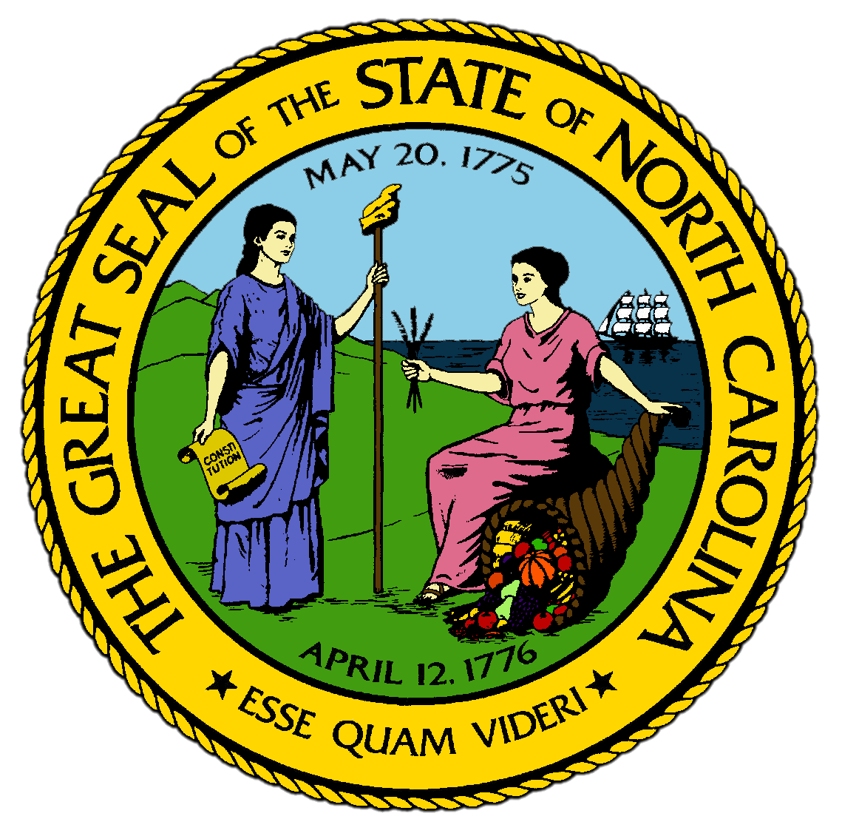
Chapter 8:
A Growing United States Grows Less United
STUDY PRESENTATION
© 2017 Clairmont Press

Slide 2
Section 1: Growth of the Western Lands
Section 2: Slavery Binds and Divides

Slide 3
Section 1: Growth of the Western Lands
Essential Question:
How did the expansion of the United States impact and increase conflicts throughout the country?

Slide 4
Section 1: Growth of the Western Lands
What terms do I need to know?
impressment
embargo
Indian Removal Act
manifest destiny
Gadsden Purchase

Slide 5
Introduction
The United States was still a young country compared to England, France, and Spain.
The United States was also relatively undeveloped, with only a small army and half a dozen ships.
However, the U.S. had large amounts of land.

Slide 6
The Louisiana Purchase
Americans were moving west for fresh soil and access to the port of New Orleans, which was still owned by Spain.
Spain closed the port several times, frustrating and angering the western settlers.
Spain had signed a deal to return New Orleans to the French, so James Monroe went to Paris to attempt to buy it for the U.S.
Napoleon was willing to sell all of Louisiana to fund his military expansion.
The United States paid $15 million for 828,000 square miles of land.
The Constitution did not grant power to buy the land, but President Jefferson believed that it was in the nation’s best interest, as the purchase nearly doubled the size of the United States.

Slide 7
The War of 1812
The British were kidnapping American sailors to increase their own navy, which was called impressment.
The British also ordered American merchants to not trade certain goods in Europe and forbade them from trading in certain ports in Europe.
President Jefferson issued an embargo, or a government order that limits trade in some way, not allowing American ships to trade with any foreign country.
The United States declared war on Great Britain in 1812, and the war lasted nearly 3 years.
The Battle of New Orleans went badly for the British, as General Andrew Jackson held them off with only 13 casualties, compared to the 2,600 of the British.
A treaty was signed in Belgium in December 1814, before the Battle of New Orleans, but news traveled very slowly.

Slide 8
Removal of the Native People
As settlers crossed the Appalachian Mountains, skirmishes, or brief battles, broke out between the settlers and the Native Americans.
In the Northwest Territory, Tecumseh tried to unite smaller tribes to increase military strength, but he was defeated in November 1811 by William Henry Harrison at the Battle of Tippecanoe, pushing the Indians farther west.
Indians who wanted to fight were called Red Sticks, but they were eventually defeated by Andrew Jackson in 1814.
He forced the Indians to sign a treaty giving most of their land to the U.S. government.
In 1830, Congress passed the Indian Removal Act, calling for all Native Americans to be moved to the western territories .
Between the Indian Removal Act of 1830 and the Trail of Tears, more than 100,000 Native Americans were displaced from 200 million acres of land that had been theirs for hundreds of years.

Slide 9
The Lone Star Republic
Manifest destiny referred to the belief of some Americans that the U.S. had been chosen to control all the land between the Atlantic and Pacific Oceans.
Thousands of white settlers moved to Texas, a territory of Spain until 1821 when Mexico won its independence.
The new Mexican constitution took away privileges of the Texians and made immigration to Texas illegal, infuriating the Texians, who declared their independence.
Santa Anna took control of capital in San Antonio, but it took days to capture the Alamo, where 190 Texians made a stand.
The Texians defeated Santa Anna at the Battle of San Jacinto in 1836 and gained Texas’s independence from Mexico, forming a new country, the Republic of Texas, or the Lone Star Republic.

Slide 10
The Mexican-American War
Mexico cut all ties with the U.S. after the annexation of Texas.
Mexico invaded Texas and fought the American army, which captured Mexico City in 1847, forcing Mexico to surrender.
The United States gained 500,000 square miles of territory from their treaty with Mexico, agreeing to pay $18.25 million.
This territory included modern day California, Nevada, Utah, Arizona, most of New Mexico, and parts of Wyoming and Colorado.
In 1853, through the Gadsden Purchase, the U.S. bought the southern part of New Mexico for $10 million.

Slide 11
Oregon and California
The British and Americans set a boundary with the Oregon Treaty of 1846 that split the Oregon Territory, giving the northern half to the British in Canada and the southern half to the U.S.
The borders of the U.S. now extended from the Atlantic to Pacific, manifest destiny had been achieved, and thousands headed west into new territories.
In 1848, gold was discovered in California, and a national stampede west began and mining camps sprung up overnight as 80,000 people rushed to California.
Return to Main Menu

Slide 12
Section 2: Slavery Binds and Divides
Essential Question:
How were the changing attitudes about slavery in the United States reflected in the compromises made about slavery?

Slide 13
Section 2: Slavery Binds and Divides
What terms do I need to know?
abolition
Underground Railroad
Missouri Compromise
protective tariff
nullification
secede
free soil
Compromise of 1850
Kansas-Nebraska Act

Slide 14
Introduction
An increasing number of Americans saw slavery as incompatible with the values of a democratic society.
Differences in thinking created feelings of sectionalism, and as the country expanded westward, the question of slavery had to be answered.
Negotiation and compromise were achieved for a period of time, but wouldn’t last.

Slide 15
The Cotton Gin and the Expansion of Slavery
Slavery was common in the South where large fields of crops were grown, requiring significant amounts of labor.
Before 1790, producing cotton on a large scale wasn’t possible, but the invention of the cotton gin, which removed the seeds from ripe cotton, transformed cotton production in the South.
Now, much of the interior land in the South could grow cotton as a cash crop, and slaves could provide the required labor in the fields.
Textile factories in Britain were becoming more efficient as well, creating the need for more cotton.
By the 1860s, cotton made up 50% of the exports from the U.S. and most of the world’s cotton was grown in the southern U.S.

Slide 16
Growing Differences on the Question of Slavery
Many people in northern states were opposed to slavery.
There was growing support for abolition, which was the movement to do away with slavery, leading to newspapers like The Liberator and the American Anti-Slavery Society.
Some abolitionists helped slaves escape to the North through the Underground Railroad, a system of routes and safe houses across the South.
Southern slave owners felt threatened by the anti-slavery movement, believing they needed slavery for their economic system to continue.
The North had begun to industrialize more than the South, leading to growth of towns and cities, and more people working in factories.
These sectional differences led to differences in laws people in these regions were willing to support.

Slide 17
The Missouri Compromise
Southerners wanted to make sure Congress couldn’t abolish slavery.
Keeping an even balance of slave states and free states would ensure this.
Louisiana became a state in 1812 and allowed slavery, and Missouri later requested statehood in 1819, planning to also allow slavery.
By 1819, there were 11 slave states and 11 free states, meaning Missouri would break the balance.
Senator Henry Clay offered a compromise: Missouri could join as a slave state, and Maine would be divided from Massachusetts as a free state.
Both sides accepted the Missouri Compromise in 1820, but it showed that the country was divided on the issue of slavery and expansion.

Slide 18
The Nullification Crisis
In 1816, the U.S. issued the first protective tariff, adding a tax to manufactured goods imported from other countries.
Vice President John C. Calhoun argued that a state had the right to void a law that it thought unconstitutional, an idea that became known as nullification and became part of the states’ rights argument.
A law could be nullified only in a special state convention called for that purpose, not by the state legislature.
If the state was still opposed, he argued that the state had the right to secede, or withdraw, from the United States.
South Carolina nullified the tariff in 1832 and threatened to secede if troops were used against them.
In 1833, Henry Clay offered another compromise: the tariff would be lowered to about 20% over 10 years.
The stance for states' rights had a deeper issue than the tariffs, however: the question of slavery.

Slide 19
The Slavery Problem Worsens
The antislavery movement in the North continued to grow stronger in the 1840s.
Northerners began to believe that the government had the right to keep slavery from spreading into new territories, an idea known as free soil.
The Democratic Party redefined the democratic ideal of popular sovereignty to allow people in new territories to decide issues for themselves, including whether or not to allow slavery.

Slide 20
The Compromise of 1850
In 1849, California ratified a state constitution and requested statehood as a free state.
Southerners opposed it, as California would change the balance of power between free and slave states in the Senate.
The two major political parties, which were the Democrats and the Whigs, were torn along sectional lines.
Congress passed five laws known as the Compromise of 1850, hoping to settle things and keep the country from breaking up.
Northerners resisted the Fugitive Slave Law, and leaders in the South resented the North’s attacks on slavery.

Slide 21
The Kansas-Nebraska Act
The Missouri Compromise allowed slavery in the Louisiana Purchase territory south of Missouri’s southern border.
In 1854, legislationwas passed to create two new territories, Kansas and Nebraska, out of the northern area of the Louisiana Purchase, called The Kansas-Nebraska Act.
It included a clause that the Compromise of 1850 allowed popular sovereignty in the territories.
This act killed the Whig Party, since northern Whigs didn’t want to be in the same party as southern Whigs, so northern Whigs joined free soilers to create the Republican Party.
They believed that the government had the power to limit slavery to the areas where it already existed
Differences between the North and South became violent in Kansas, with two separate governments and continuous conflict.

Slide 22
The Dred Scott Case
The U.S. Supreme Court tried to end the arguments about slavery through their decision in the case of Dred Scott and his family.
Dred Scott had been a slave his entire life and traveled with his owner to free states and territories, where his daughter was born.
In 1846, Scott sued for his and his family’s freedom because they were living in a territory that didn’t allow slavery.
The Supreme Court ruled that blacks were not citizens and therefore did not have the right to sue.
The Court also ruled that Congress never had the right to forbid slavery in the territories.

Slide 23
John Brown’s Raid at Harpers Ferry
John Brown was a northerner from Kansas who decided that the slaves needed to liberate themselves.
He decided to raid the U.S. government’s arsenal, which is an arms storehouse, at Harpers Ferry, Virginia, now located in West Virginia.
He sought to take guns and ammunition, arm the slaves, and start a slave revolt.
His men were captured or killed, and Brown was convicted of murder, treason, and rebellion.
Some antislavery northerners saw Brown as a martyr, or a person killed for their beliefs.
White southerners were alarmed, since their greatest fear was a slave revolt.
There was no one event that created the sectionalism of the Antebellum U.S., and eventually negotiation and compromise failed.
Sectionalism propelled the country into its bloodiest war.
Return to Main Menu

Slide 24
Image Credits
Title Slide: Public Doman, Wikimedia Commons; Contents slide: Reginald Lankford, Clairmont Press; End Slide: Reginald Lankford, Clairmont Press;
Shown here: Kitty Hawk Bay, NC
Return to Main Menu

