Slide 1
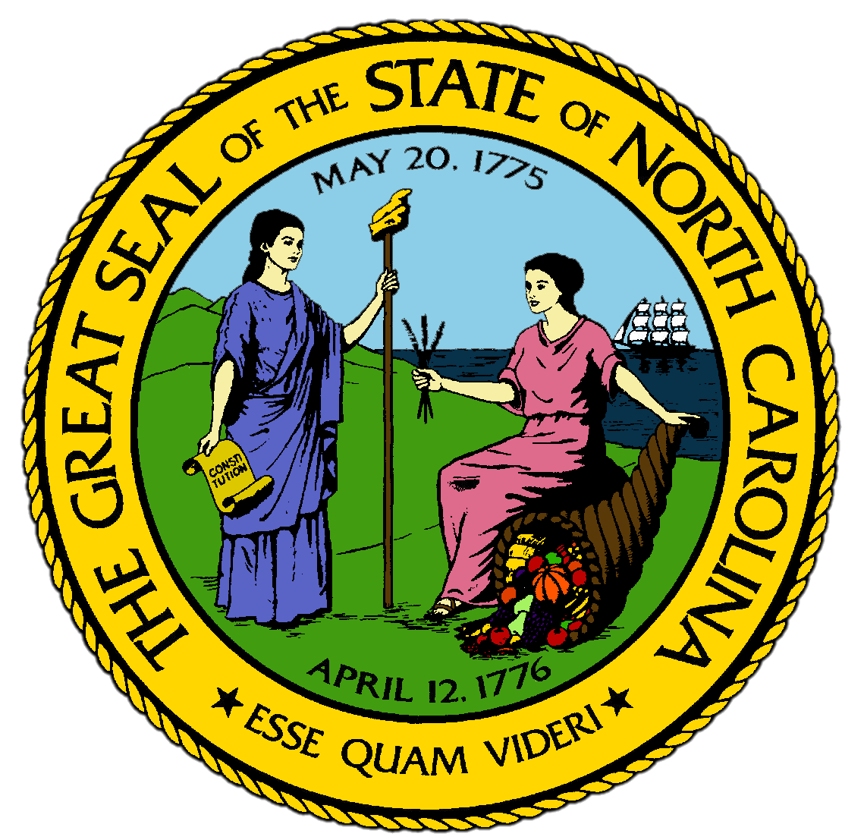
Chapter 3:
Governing Our Nation and State
STUDY PRESENTATION
© 2017 Clairmont Press

Slide 2
Section 1: Achieving Democratic Ideals
Section 2: Federal Government
Section 3: North Carolina Government
Section 4: The Responsibilities of Citizenship

Slide 3
Section 1: Achieving Democratic Ideals
Essential Question:
What were the ideals of democracy and fairness that guided the Founding Fathers to move from a monarchy to a republic?

Slide 4
Section 1: Achieving Democratic Ideals
What terms do I need to know?
consensus
Founding Fathers
democracy
popular sovereignty
Declaration of Independence
monarchy
republic
United States Constitution
amendment
Bill of Rights

Slide 5
Introduction
Decisions are often made by consensus, which means a general agreement, or voting.
The issue of fairness was important to the Founding Fathers, the original leaders who planned how the government of the United States would be organized.
The ways the colonies were governed seemed unfair to many people, leading to the desire to create a new form of government and gain independence.

Slide 6
Democratic Ideals
Ideal: a vision of what a perfect government would look like
Citizens of the United States have worked hard for many years to make these ideals of good government reality.
The term democracy means control of a group or country by its members.
The ideal of popular sovereignty, or rule by the people through their votes, is center of what makes our country great.
The first three democratic ideals were described by the Declaration of Independence:
Life: everyone has the right to live and government must protect citizens
Liberty: everyone is free to act, behave, and think as they wish without government interfering as long as the liberties of others are not harmed
Pursuit of Happiness: everyone should be able to pursue happiness as long as it doesn’t abuse the rights of others

Slide 7
From Monarchy to Republicanism
In Europe, where most colonists came from, countries were ruled by a monarchy, or to be ruled by a king or queen.
In a monarchy, the leader is in place for life and selected based on ancestry.
Colonists were ruled by England’s king and Parliament, who would send new laws by ship across the Atlantic to the colonies, taking months.
Colonists felt ignored by their ruler.
In the colonies, the idea spread of an ideal republic: a country in which citizens ruled by voting for leaders.
A system of checks and balances spread political power across branches of government.
Citizen elections allowed the choice of a candidate based on merit.
Frequent elections insured that the people had a voice and leaders were held accountable.
A weak executive branch would keep the leader from holding absolute power and prevent corruption.

Slide 8
Basic Principles of Government
American government is separated into legislative, executive, and judicial branches, and powers are divided into federal, state, and local levels.
The United States Constitution, or the document that set up our nation’s current framework for government, is the supreme law of the land.
All laws at every level must be consistent with the Constitution.
In the U.S. the people are sovereign and are the source of power and authority, meaning elected officials govern by the consent of the governed.
The Founding Fathers set up a system of checks and balances to limit power of the government through the three branches and various levels of government.
American people elect public officials at all levels of government for specific terms of office.

Slide 9
The Protections of the Bill of Rights
When the Constitution was completed in 1787, some delegates argued that it was not specific in the rights it granted to citizens.
In 1791, the first ten amendments, or additions or changes to a constitution, were adopted and are now known as the Bill of Rights.
Return to Main Menu

Slide 10
Section 2: Federal Government
Essential Question:
How are the federal branch, judicial branch, and legislative branch structured and how does the Constitution adapt to the changes in the structure of the government through time?

Slide 11
Section 2: Federal Government
What terms do I need to know?
elastic clause
bicameral
enumerated powers
implied powers
ratify
Electoral College
judicial review

Slide 12
Introduction
The first three articles of the Constitution establish the legislative, executive, and judicial branches of government.
To meet future changes and demands, they included an “elastic clause” empowering Congress to make laws necessary for the government of the United States.

Slide 13
Legislative Branch
Article I created a bicameral (two-house) legislature of the U.S. Senate (Upper House) and House of Representatives (Lower House).
Every state has 2 members in the Senate who serve 6 year terms and are elected by popular vote. The Vice President is the presiding office of the Senate.
Each member must be at least 30 years old, a citizen of the U.S. for at least 9 years, and a resident of the state he or she represents.
Each state’s membership in the House is based on its population and serve 2 year terms
Each member must be at least 25 years old, a citizen of the U.S. for at least 7 years, and a resident of the state he or she represents.
The Constitution grants certain powers to Congress.
Enumerated powers are specifically given to Congress in the Constitution, while implied powers are those given to Congress in the elastic clause.
The House of Representatives has the power to impeach those in office, and the Senate confirms presidential appointments to the Supreme Court and ratifies, or approves, treaties.

Slide 14
Executive Branch
The Constitution established the office of President and a process for electing the President that did not rely on the popular vote.
Each state has a number of electors equal to their number of members in Congress, creating the Electoral College which chooses the President and Vice President.
The Executive branch is given power to carry out the laws made by Congress and includes the President, Vice President, and 15 cabinet members.
The Vice President becomes President if the President dies while in office, resigns, or is impeached.

Slide 15
Judicial Branch
The Judicial branch has the power to interpret the Constitution and laws passed by Congress.
The Supreme Court includes a chief justice and 8 associate justices, who serve lifetime appointments.
Supreme Court has original jurisdiction (authority to hear a case for the first time) and appellate jurisdiction (authority to review a case already tried by a lower court).
Most significant power is judicial review, which is the authority to determine the constitutionality of laws passed by Congress and state legislatures and any actions taken by the executive branch.
Below the Supreme Court is the U.S. Court of Appeals, which reviews cases heard in lower courts.
Below the Court of Appeals are U.S. District Courts, the only federal courts with juries and witnesses during trials.
Special Courts include the U.S. Tax Court, Court of Military Appeals, Court of International Trade, and the U.S. Claims Court.
Return to Main Menu

Slide 16
Section 3: North Carolina Government
Essential Question:
How are the three branches of government structured in North Carolina’s state government?

Slide 17
Section 3: North Carolina Government
What terms do I need to know?
General Assembly
bill
constituent
veto
Council of State
felony
tax
county seat
sheriff
county commission
municipality
city council

Slide 18
Introduction
Several thousand North Carolinians hold public offices, both elected and appointed, throughout the state.
In the last several years, the leadership of the state has become more multiethnic and multicultural, with more variety of backgrounds among the state’s public servants than ever in our history.
This is the result of living up to democratic ideals.

Slide 19
The Structure of State Government
Like the national government, North Carolina’s state government has 3 branches.
The legislative branch is the lawmaking branch of the state.
The entire membership of the General Assembly is elected every 2 years and includes 50 senators and 120 representatives.
They vote on bills, or proposed laws, that address the needs of their constituents (the people of the legislator’s district).
The executive branch enforces the laws of the state, with governor as head of the branch with veto power, which is the ability to deny passage of legislation.
It also makes sure budget is followed by state government and is in charge of various state departments.
The judicial branch is headed by the chief justice of the state Supreme Court and oversees courts of the state.
District Courts (handle traffic violations and civil disputes), Superior Courts (cases sent by District courts and more serious crimes), Court of Appeals (handles appeals of cases previously tried), and the Supreme Court of the state decides if laws were properly executed in specific cases.

Slide 20
Funding State Government
State government acquires money to function in several ways.
The state’s budget is a detailed plan for acquiring and spending money for the year.
The governor prepares the budget and presents it to the legislature.
Taxes, or money paid by citizens to the government to support government and the services they provide, supply much of the state’s revenue.
States also receive revenue from various fees charged for certain kinds of government-issued items, like driver’s licenses.

Slide 21
County Government
This is the primary local government division.
Each county’s courthouse and government are in a municipality called the county seat.
Each county has a sheriff as chief law enforcement agent.
Sheriff’s deputies keep order and help administer the court system and county jail.
Each county is responsible for its schools and has a school board.
The county commission is the key body for county government.
Commissioners are elected by the people and are responsible for overseeing school budgets, monitoring law enforcement, and administering recreational facilities.

Slide 22
Municipal Government
There are more than 500 municipalities, or cities with their own government, in North Carolina.
These are usually governed by a city council, headed by a mayor.
Municipalities are responsible for many public services, including police and fire protection, streets and sidewalks, street lights, water and sewer facilities, and parks.
Return to Main Menu

Slide 23
Section 4: The Responsibilities of Citizenship
Essential Question:
What are the responsibilities of citizens of North Carolina and the U.S., and why are those responsibilities important in the governing of the state?

Slide 24
Section 4: The Responsibilities of Citizenship
What terms do I need to know?
juror
political action committee (PAC)
lobbyist

Slide 25
Introduction
All American citizens have rights and responsibilities of citizenship.
Good citizens obey laws, serve on juries, pay taxes, stay informed, get involved, and vote.
Success of our democratic ideals is dependent on citizens being good participants in government.

Slide 26
Voting
One of the most important ways to demonstrate citizenship is voting.
At 18 years old, you have the opportunity to register to vote.
In North Carolina, voters must be residents of the county for a least the last 30 days and must register to vote for the first time at least 25 days before the next election.

Slide 27
Obeying Laws
Laws are rules enacted by federal, state, and local governments to provide order and keep the peace in society.
Without laws, there would be chaos and anarchy, also known as mob rule.
Violations of the law can lead to imprisonment and the loss of many rights and privileges.

Slide 28
Serving on Juries
Another major responsibility of citizenship is to serve on a jury when called.
Jurors, who are citizens selected for jury duty, are randomly selected from a list of registered voters.
A trial jury has 12 jurors who determine guilt or innocence of the defendant, which is the person being tried.
In criminal cases, the vote must be unanimous to return a verdict.
In civil cases, 9 of the 12 must agree on a verdict.
A grand jury consists of 18 citizens who determine if there is enough evidence against an accused person to issue an indictment, a formal charge.

Slide 29
Staying Informed
Informed citizens are necessary for the success of a democratic society.
Staying informed allows citizens to make intelligent decisions when voting and not be swayed by campaign rhetoric.
Political action committees (PACs) try to keep the public informed and influence legislators to favor the group’s position.
Some special interest groups employ lobbyists, or persons who are paid to represent an interest group and present the views of their organization to lawmakers.
Citizens also have the opportunity to join a political party and register as a party member to vote for that party’s nominees in a primary election.

Slide 30
Citizen Volunteers
Citizen volunteers are citizens who lend their expertise to boards, commissions, and other advisory groups.
Some examples are the State Medical Board and the State Board of Education.
Other citizens volunteer their spare time to do many different things.

Slide 31
Getting Involved
Citizens in a democratic society have an obligation to participate in public affairs.
Citizens can help candidates run for public office, run for office themselves, participate in community service activities, serve in the military, debate public issues, or volunteer their time to civic groups.
Return to Main Menu

Slide 32
Image Credits
Title Slide: Public Doman, Wikimedia Commons; Contents slide: Reginald Lankford, Clairmont Press; End Slide: Reginald Lankford, Clairmont Press;
Shown here: Kitty Hawk Bay, NC
Return to Main Menu

