Slide 1
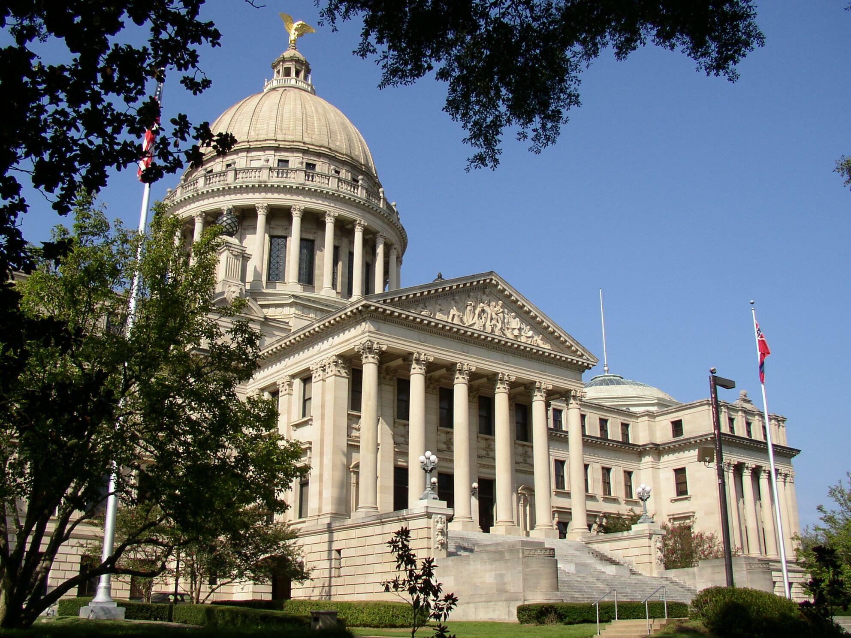
A Place Called Mississippi
Chapter 12: Mississippi in the Global Village
STUDY PRESENTATION
© 2020 Clairmont Press

Slide 2
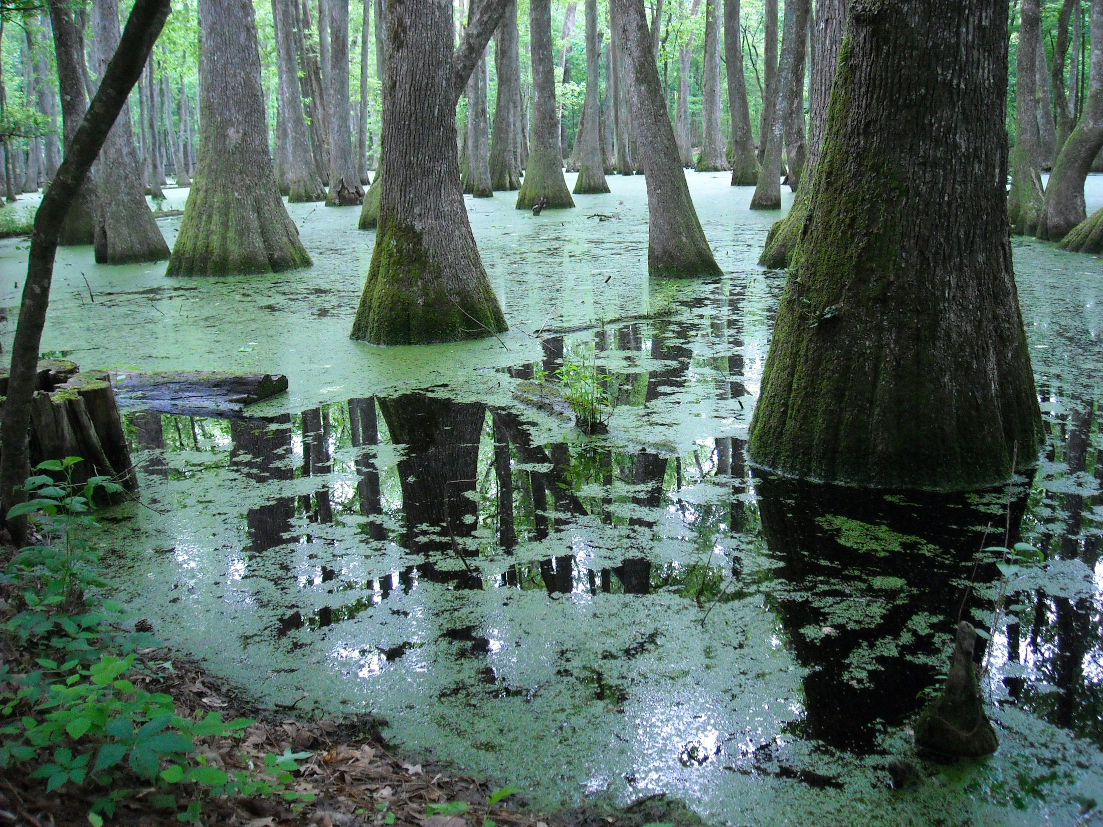
Section 1: The People of Mississippi
Section 2: Urbanization
Section 3: Mississippi’s Changing Economy

Slide 3
Section 1: The People of Mississippi
Essential Question: What types of people live in Mississippi?

Slide 4
Section 1: The People of Mississippi
What terms do I need to know?
  ethnic
  Latino
  gaming

Slide 5
Section 1: The People of Mississippi
Mississippi is ranked 31st out of the 50 states for population with almost 3 million residents.

Slide 6
Population Distribution
Mississippi’s population is not evenly distributed.
Hinds County has the largest population.
The least populated county is Issaquena with 1,406 people.
The two most populated areas are Jackson and the Gulf Coast.
Mississippi’s population increased greatly after it became a state.

Slide 7
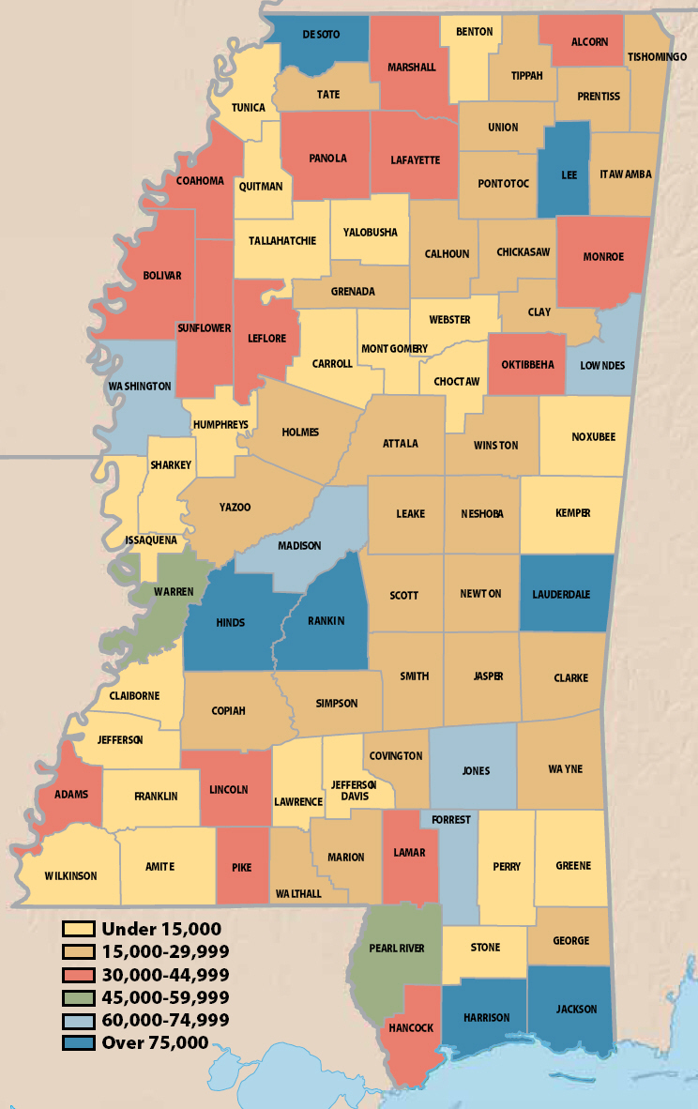
Mississippi Population

Slide 8
Ethnic Diversity
Mississippi has diversified greatly since World War II.
Many ethnic groups (people with a common racial, national, linguistic or cultural heritage) are a part of the state.
Mississippi now has Hispanics, Latinos, blacks, whites, Native Americans, and Asian Americans.

Slide 9
Ethnic Diversity: Native Americans
During the 1830s, almost 13,000 Choctaw Indians migrated to Oklahoma.
A Choctaw Reservation was established in 1944.
The Mississippi Band of Choctaw Indians have successfully blended the new with the old.
95% can speak their native language, while 90% can also speak, read, and write in English.
Choctaw children attend public and tribal schools to learn about their history and culture.
The gaming (gambling, games of chance) industry has brought in a lot of wealth for the Choctaw.
Recently, the tribe made history by electing the first woman chief (or miko) of their tribe.

Slide 10
Ethnic Diversity: A Nation of Immigrants
Immigrants have come to America for generations.
The United States Citizenship and Immigration Services helps immigrants who want to be American citizens.
In the past 10 years, over 7 million people have become citizens of the United States.

Slide 11
Ethnic Diversity: European Americans
While most European Americans don’t celebrate their cultural heritage, there are still a few small festivals that do, such as Oktoberfest (Germans) and the Scottish Highland Festival.
There are small groups that have retained their cultural identity, however, such as the Slovenians on the Gulf Coast and the Lebanese in Vicksburg.

Slide 12
Ethnic Diversity: African Americans
After Mississippi became a state, African Americans accounted for 43.4% of the population.
By 1840, the African American population was at 51.9%, making it the majority.
By 1860, the African American population was 55.2%.

Slide 13
Ethnic Diversity: Asian Americans
Mississippi’s Chinese population immigrated here in the 1870s.
Many of them opened grocery stores.
The Chinese have retained their traditions.
Many still live in the Delta.
The first Vietnamese came to the Gulf in the 1980s.
Many of them worked in the seafood industry.
There are several other smaller populations also, such as the Indians, Filipinos, Japanese, and Koreans.

Slide 14
Ethnic Diversity: Hispanic or Latino Americans
The number of Hispanic and Latino people has increased drastically.
The state’s Latino population could number as high as 100,000.

Slide 15
Languages and Religions
Most citizens of Mississippi speak English.
Only 6% of families speak only another language.
Religion is important to 85% of the people living in Mississippi- that’s the highest percentage in the nation.
Baptists, Methodists, Catholics, and Presbyterians account for 90% of the religious population.
There is a growing number of mosques and Hindu temples.

Slide 16
Section 2: Urbanization
Essential Question: How has urbanization changed the lives of Mississippians?

Slide 17
Section 2: Urbanization
What terms do I need to know?
  municipality
  city
  town
  village
  census designated place
  suburbs

Slide 18
Section 2: Urbanization
World War II ended the Great Depression and caused an economic boom for the state and the nation.
The large number of newly available jobs in industry attracted thousands to the cities and towns.
Urbanization altered the state’s social customs.
Black servicemen who returned from war were not willing to accept life as second-class citizens.

Slide 19
Municipalities
A municipality is a political subdivision within the state.
Municipalities are called cities if they have more than 2,000 residents.
Those with between 300 and 2,000 citizens are called towns.
A village is a municipality with 100-300 inhabitants.

Slide 20
Growth of Towns and Cities
In 1698, the first capital of Mississippi, Natchez, began with only 1,511 residents.
By 1870, the state’s population had increased to 872,922 people.
Vicksburg was the most populated city from 1870 to 1910.
In 1910, Meridian became the most heavily populated.
Since 1930, Jackson has been the largest city.
In 1970, many people began moving to the suburbs.

Slide 21
Section 3: Mississippi’s Changing Economy
Essential Question: How have changes in the economy affected the lives of Mississippians?

Slide 22
Section 3: Mississippi’s Changing Economy
What terms do I need to know?
  poverty level
  economy
  primary sector
  biofuels
  secondary sector
  export
  durable goods
  nondurable goods
  tertiary sector
  quaternary sector
  quinary sector
  renewable resources
  nonrenewable resources
  recyclable resources

Slide 23
Section 3: Mississippi’s Changing Economy
Mississippi’s economy is one of the poorest in the nation.
In 2009, the state had a poverty rate of 21.9%, the highest in the country.
The Delta and the area along the Mississippi River are the most highly concentrated areas of people living below the poverty level.
Since Hurricane Katrina and the BP oil spill, the number of people below the poverty level has increased significantly.
Economic activities are divided into three sectors: the primary, secondary, and tertiary.

Slide 24
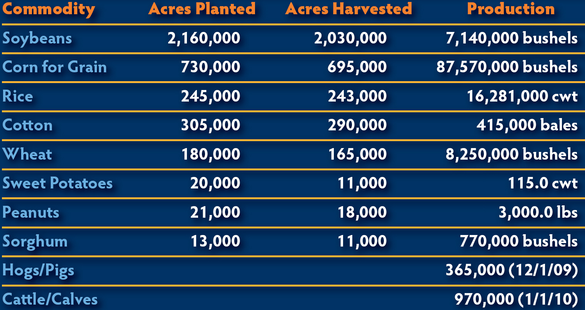
Mississippi Commodities

Slide 25
The Primary Sector: Agriculture
29% of Mississippi’s workforce is in some way involved with agriculture, making it the dominant industry in the state.
Even with $6.3 million in agriculture business, the number of farms has decreased since World War II.
The highest concentration of farms is in the Delta.
Soybeans are the most valuable crop that comes from Mississippi. They are followed by corn, rice, and cotton.
Poultry and eggs make the most income for farmers.
Cal-Maine Foods, Inc., located in Jackson produces the most shell eggs in the United States.
Catfish farming is also a popular new business. Mississippi is first in the nation for catfish production.

Slide 26
The Primary Sector: Forestry and Biofuels
Timber is one of the state’s most important resources. In 2009, the estimated value of forest products was $817 million.
Biofuels (fuels from plants) are the up-and-coming energy source.
There is a possibility that Mississippi could become the first place where woodchips are converted into a crude oil substitute.

Slide 27
The Primary Sector: Mining
In 1939, oil was discovered in Mississippi and the state has been an important producer of oil ever since.
The state also has good supplies of gravel, clay and lignite.

Slide 28
Manufacturing and Construction:
The Secondary Sector
The secondary sector includes manufactured goods and construction.
Most factories in Mississippi produce goods that can be used longer than three years.
Mississippi also has several high-tech companies such as the Stennis Space Center and Howard Industries.
The most famous manufacturing plant in Mississippi is the Viking Range Company.
Many other big companies such as Nissan have plants in Mississippi.

Slide 29
The Service Industry: The Tertiary through Quinary Sectors
The third sector provides services to the other sectors.
This sector includes the third, fourth, and fifth industries.

Slide 30
The Service Industry: Tertiary Sector
This sector involves transportation, communication and utility services.
There are only a few airports in Mississippi that offer commercial airline services.
19 different railroad companies criss-cross the state.
22 cities publish daily newspapers.

Slide 31
The Service Industry: Quaternary Sector
This sector includes insurance, trade, legal services, retailing, and many other services.
There is also an important service that involves computerized information.

Slide 32
The Service Industry: Quinary Sector
The fifth sector includes education, government and healthcare services.
Gaming and tourism are also included in this sector.

Slide 33
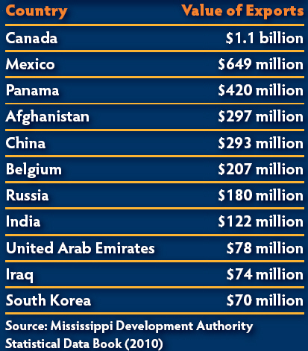
Mississippi in the Global Economy
Governor Bill Waller introduced foreign trade missions in the 1970s. After he left office, his mission continued.
19 countries own 112 manufacturing plants in Mississippi.

Slide 34
Environmental Resources
A resource is anything that can be consumed or used by people.
Renewable resources are resources that can naturally renew themselves like plants and animals.
Coal, oil, and gas are non-renewable resources that cannot be replaced once they are used.
Plastic, aluminum, and paper products are recyclable resources.

Slide 35
Environmental Resources: Protecting the Environment
Consumers must be aware of the effect they have on the environment.
We must remember to manage our resources carefully because pollution and waste management is a concern for everyone on Earth.
Fortunately, things are becoming more environmentally friendly, but more can still be done to preserve our resources.

Slide 36
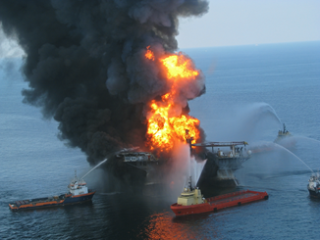
Environmental Resources:
The BP Oil Spill
On April 20, 2010, BP experienced an explosion on one of its oil rigs in the Gulf of Mexico.
For five months, oil leaked out, killing wildlife and the tourism and fishing industries.
The damage went from Florida to Texas and is probably the most expensive environmental disaster in history.
BP spent $20 billion to help the reconstruction of the Gulf Coast.
In September 2012, the Department of the Interior released new regulations that would reduce the likelihood of another oil spill.

Slide 37
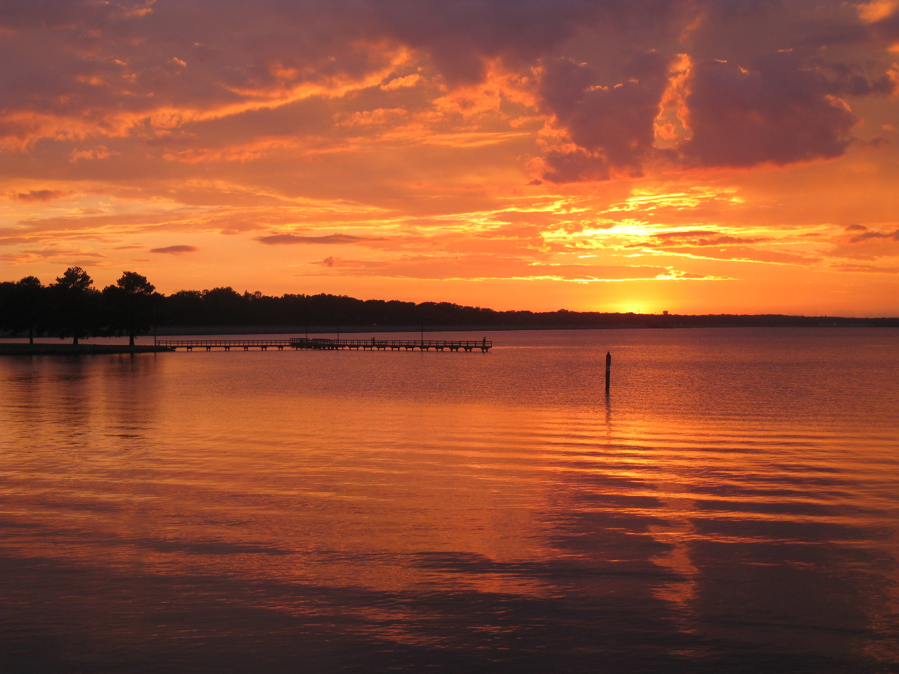
Image Credits
Slide 1: allstarecho on Wikimedia Commons; Slide 2: Public Domain Wikimedia Commons; Image Credits slide: Thomas R. Machnitzki on Wikimedia Commons; all others Clairmont Press or public domain
Return to Main Menu

