Slide 1
LOUISIANA:
Our History,
Our Home
Chapter 4:
Louisiana’s Government
STUDY PRESENTATION
© 2015 Clairmont Press

Slide 2
Section 1: From Colony to Democracy
Section 2: Structure of State Government
Section 3: Local Governments
Section 4: Citizens and Government

Slide 3
Section 1: From Colony to Democracy
Essential Question:
Which factors influenced the development of Louisiana’s government?

Slide 4
Section 1: From Colony to Democracy
What terms do I need to know?
government
Napoleonic Code
common law
federalism
Bill of Rights

Slide 5
Introduction
Government is the way a community is organized. It is the government’s job to make and carry out laws.
There are different types of governments.
During the colonial era, Louisiana was a monarchy, which means that it was ruled by a king.
After 1803, it slowly became a democratic government, which means that the power of the government rests with the citizens.

Slide 6
The History of Louisiana Government
The Napoleonic Code was a set of civil laws made by Napoleon for France, which influenced Louisiana’s first civil code.
Civil laws set the ground rules for how individuals interact with each other.
In 1803, the British system of common law was introduced to Louisiana and influenced criminal laws.
When Louisiana became a democracy, the idea of citizens running the government was new.

Slide 7
Foundations of Government
The constitution of a government explains a government’s purpose, organizations, and powers.
A constitution is the most important statement of a government.
Each level of government has its own powers and responsibilities given by the U.S. Constitution and the Louisiana Constitution.
The U.S. Constitution and the Louisiana Constitution must work in harmony together.

Slide 8
The United States Constitution
The U.S. Constitution explains which powers belong to both the federal and state governments.
Federalism, which is the separation of federal and state powers, is important for the government.
The Bill of Rights are the first ten amendments of the U.S. Constitution. The tenth amendment discusses the reserved powers doctrine.
Click to view the Constitution of the United States

Slide 9
The State Constitution
Louisiana has had ten constitutions.
The present Louisiana Constitution (1974) follows the U.S. Constitution more closely than any of our earlier state constitutions.
Like the U.S. Constitution, it contains a Bill of Rights that guarantees citizens self-determination, equal treatment under the law, and freedom from discrimination.
Louisiana’s present constitution is more like a general framework for government than earlier versions.
Click to view the first Louisiana state constitution (1812)

Slide 10
Section 2: Structure of State Government
Essential Question:
How is power divided between the three branches of government in Louisiana?

Slide 11
Section 2: Structure of State Government
What terms do I need to know?
checks and balances
special session
reapportionment
conference committee
felony
misdemeanor
appeal
jury
grand jury
severance tax
taxes
gaming

Slide 12
Introduction
Louisiana’s Constitution divides the government into three branches.
By dividing powers among these branches, checks and balances are made.
Examples of these powers would be the veto, canceling a veto, and the judicial review.
Louisiana State Capitol Building

Slide 13
Louisiana’s Three Branches of Government
Louisiana Constitution
Executive Branch
Legislative Branch
Judicial Branch
Governor, Lt. Governor, Secretary of State, Attorney General, and more
Senators & Representatives
Louisiana Supreme Court and lower courts

Slide 14
Executive Branch
This branch enforces laws passed by the legislature.
The governor is the head of this branch.
Six other officials are elected by statewide elections, like the lieutenant governor and the secretary of state.
Each position has its own requirements and responsibilities.
Louisiana’s Executive Branch of Government

Slide 15
Governor
To become governor of Louisiana, candidates must meet several criteria, including being at least 25 years old, a U.S. citizen, and a resident of Louisiana for at least 5 years.
The governor is elected to a four-year term and can serve two back-to-back terms.
One of the governor’s most important duties is to prepare the state budget and submit it to the legislature.
The governor can also call upon special sessions of legislature when extreme problems occur.
Office of the Governor

Slide 16
Lieutenant Governor
The lieutenant governor of Louisiana is similar to the vice president of the United States.
The lieutenant governor can act temporarily as governor if needed.
Other duties of the lieutenant governor include overseeing many state functions, like the Department of Culture, Recreation, and Tourism.

Slide 17
Attorney General
The attorney general is the state’s head legal official and runs the state’s Department of Justice.
The attorney general’s office provides legal advice and representation to the state’s departments, agencies, boards, and commissions, and to statewide elected officials.
The attorney general also defends Louisiana laws if they are challenged in the federal courts.

Slide 18
Secretary of State
The secretary of state is the chief election officer for Louisiana, and leads the Department of State.
The department administers the election laws passed by the legislature.
The secretary of state is the keeper of the Great Seal of the State of Louisiana. The seal is used to give official approval to state documents.

Slide 19
Treasurer
The state treasurer is the head of the Department of Treasury.
The Department of the Treasury is in charge of the state’s money and keeps records of the state’s income and expenses.
The state treasurer is required to prepare and present a yearly financial report to the governor and the legislature one month before each regular session of the legislature begins.

Slide 20
Other Elected Officials
Louisiana voters elect two additional members of the executive branch: the commissioner of agriculture and the commissioner of insurance.
The members of two other boards are elected: the Public Service Commission and the state’s Board of Elementary and Secondary Education (BESE).

Slide 21
Legislative Branch
Like the U.S. Congress, Louisiana’s legislature is divided into two parts, which is known as bicameral.
Having two chambers creates a balance of power between the chambers.
Louisiana’s Legislative Branch of Government

Slide 22
Legislative Membership
The Louisiana legislature has 144 members: 39 senators and 105 representatives.
Each member of the legislature is elected from a geographic district based on population.
A U.S. Census, the official count of each state’s population, occurs every ten years and is used to review district populations.
If population numbers have changed, revising district boundaries might occur. This is called reapportionment.
Click to see legislative maps

Slide 23
State Legislators
Like the governor, legislators must meet certain criteria, including being at least 18 years old and a resident of their district for at least one year.
Legislators are elected for 4 year terms.
In 1995, voters in Louisiana approved a term limit of three back-to-back terms for legislators.

Slide 24
Legislative Sessions
The legislature meets every year.
In odd-numbered years, the legislature meets for 45 days during a 60 day period. Tax bills can only be passed in odd-numbered years.
In even-numbered years, the legislature meets for 60 days over an 85 day period.
Members of each chamber elect officers to preside over the sessions.
The House of Representatives elects a speaker of the House.
In the state Senate, the elected leader is called the president of the Senate.

Slide 25
Making Laws
Of the 2,500 bills introduced in each session of the legislature, only about one-third become laws.
Legislative committees study and debate proposed laws.
Once a bill is introduced it has to be approved by the chambers and the governor before becoming laws.
If different bill forms are liked in different chambers, a conference committee will work out the differences.

Slide 26
Judicial Branch
This branch interprets and applies the constitution and laws of the state.
It also protects the rights of citizens.
Louisiana’s Judicial Branch of Government

Slide 27
Civil and Criminal Law
The laws of Louisiana are divided into 2 categories: civil law and criminal law.
Civil laws deal with how people interact with each other.
Criminal laws protect society from wrongdoings. Serious crimes, like murder and armed robbery, are called felonies. Less serious crimes, like speeding, are called misdemeanors.
There are many important jobs in this branch, such as sheriffs, police, city marshals, and district attorneys.

Slide 28
Louisiana’s Court System
Louisiana’s court system has 3 levels: 43 District Courts, 5 Courts of Appeal, and the Louisiana Supreme Court.
District Courts are the main trial courts of the state, listening to both civil and criminal cases.
The next step in the justice system would be to appeal, or to take to a higher court, a ruling in the Court of Appeals.
If a case escalates enough, it may be taken to the Louisiana Supreme Court.

Slide 29
Juries
A person accused of a crime has the right to be tried before a jury of peers (persons of equal standing in society).
A jury is a group of citizens who hear evidence on a legal case and make a decision based on the evidence.
Citizens may also be called to serve on a grand jury. A grand jury is made up of twelve citizens who serve for six months.

Slide 30
Funding State Government
Governments must have money to function.
All governments get their money (called revenue) in a variety of ways.
Knowing how much money is needed starts with a detailed plan.

Slide 31
The State Budget
A budget is needed to plan how to acquire and spend money.
This budget is put together by the governor.
The Louisiana Constitution requires a balanced budget, which means that the state cannot spend more money than it takes in.

Slide 32
Taxes
Much of a state’s revenue comes from taxes, which are amounts paid by citizens to their governments to support the government and its services.
In Louisiana, the sales tax is the largest single source of revenue.
Louisiana also collects severance tax, which is an amount charged for severing (removing) natural resources.
Other types of taxes include property tax and income tax.

Slide 33
Other Sources of Revenue
Louisiana receives revenue from a variety of fees charged for certain kinds of government-issued items like drivers’ licenses or business licenses.
Oil and gas royalties (share of the profit) are another source of income.
The federal government is also an important source of state revenue.
Gaming, the name for legal gambling, is another large revenue source.

Slide 34
Section 3: Local Governments
Essential Question:
How does the parish system of local government work?

Slide 35
Section 3: Local Governments
What terms do I need to know?
parish
police jury
home rule
municipality

Slide 36
Introduction
Citizens are most likely to interact with government at the local level.
In Louisiana, the units of local government are parishes, municipalities, and special districts.

Slide 37
Parish Government
The parish is the primary local government division.
Louisiana is divided into 64 parishes.
Louisiana is the only state in the nation that has parishes and parish seats rather than counties or county seats.
Parish government is a legacy from Spanish colonial rule, when government divisions were based on districts created by the Catholic Church.
Ouachita Parish Courthouse

Slide 38
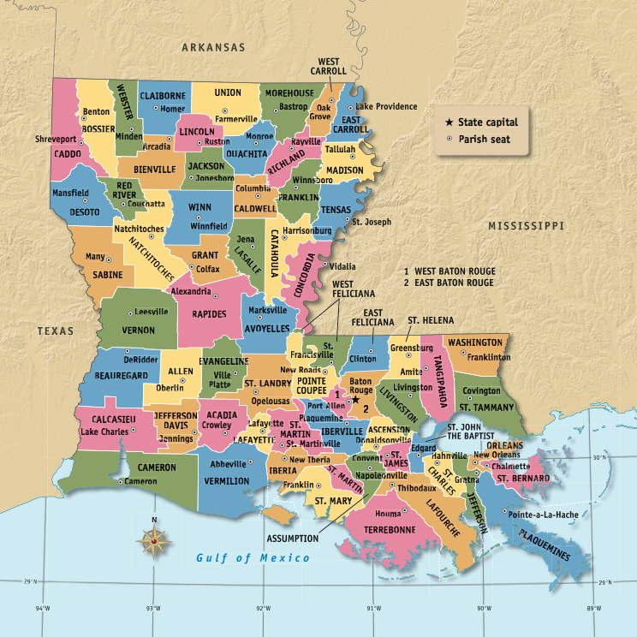
Louisiana Parish Map

Slide 39
Police Juries
Police juries pass local laws for their parishes as well as build and maintain roads and public buildings.
Police juries can have between 3 and 15 elected members.
Sometimes police juries create special districts to perform specific services, like school, fire protection, levee, and water districts.
The sheriff is elected to be the chief law enforcement officer and tax collector in the parish.

Slide 40
Other Types of Parish Government
The Louisiana Constitution of 1974 gave more authority to local governments.
The power given to political subdivisions to govern their own affairs is known as home rule.
Parishes with a home rule charter are allowed to organize in a form other than the police jury. These other forms of government include having an elected parish council and a parish president, or an elected parish council that is empowered to select a parish administrator (manager).

Slide 41
Municipalities
Municipalities are the cities, towns, and villages of different sizes, each being ranked by population.
People who live in rural areas outside a city or town have no municipal government.
A municipality elects a mayor and a council or a group of commissioners.

Slide 42
School Boards
Most local school systems share boundaries with their parish.
School board members are elected from a district based on population in the parish and serve a 4 year term.
School boards are special forms of government not linked with the parish government, but they are more closely regulated by the state.
Each board chooses a superintendent to oversee operations of the school system.

Slide 43
Section 4: Citizens and Government
Essential Question:
What are the different ways citizens can participate in the Louisiana government?

Slide 44
Section 4: Citizens and Government
What terms do I need to know?
open primary system
political party
lobby
propaganda

Slide 45
Introduction
In a democratic government, the main focus is the citizens, their rights, and their responsibilities.
While a citizen may have many rights, they also have many responsibilities.
Citizens are also responsible for their actions and must respect the rights of others.
Rights of citizens include: freedom of speech, freedom of religion, and the right to vote.

Slide 46
Voting and Elections
There are several requirements to meet before a citizen can be a registered voter.
Statewide elections in Louisiana are held in 2 stages.
The first stage is an open primary system, when all of the candidates, no matter what political party they represent, compete in the first (or primary) election.
After the primary election, the two candidates with the most votes move on to a runoff election, where the one with the most votes wins.

Slide 47
Political Parties
Political parties are organizations who share ideas on how the government should work and have joined together.
There are two major parties around today: the Democratic Party and the Republican Party.
Historically, people in Louisiana have often voted on the basis of local issues or identities rather than on the basis of party affiliation.

Slide 48
Campaigns
Many candidates organize campaigns to gain attention from voters, from television commercials to Internet ads.
Running political campaigns has become very expensive because buying time for advertisements on television is quite costly.
Fund-raising is an important part of the modern campaign process.

Slide 49
Lobbying and Organizing
Every citizen has the ability to attempt to influence legislators about issues, which is called lobbying.
People who disagree on an issue sometimes accuse their opponents of creating propaganda.
Propaganda is information spread widely in order to promote or discourage a particular proposal or political point of view.
Organization of many people has become more efficient through social media.

Slide 50
Image Credits
Slide 1: Chris Miceli on Wikimedia Commons, Public Domain; Slide 2: Ken Thomas (alligator); Jillian.E (Chicot State Park); City of Monroe, LA; Albert Herring (Mardi Gras), Lael Butler (pelican); Jesper Rautell Balle (cajun meal); Susan Adams (Chemin-a-Haut State Park) on Wikimedia Commons; Slide 12: Reginald Lankford, Clairmont Press; Image Credits Slide: Edd Prince on Wikimedia Commons; maps copyright Clairmont Press; all others public domain
Shown here: Fontainebleau State Park
Return to Main Menu

